Slide 1
AEC

Slide 2
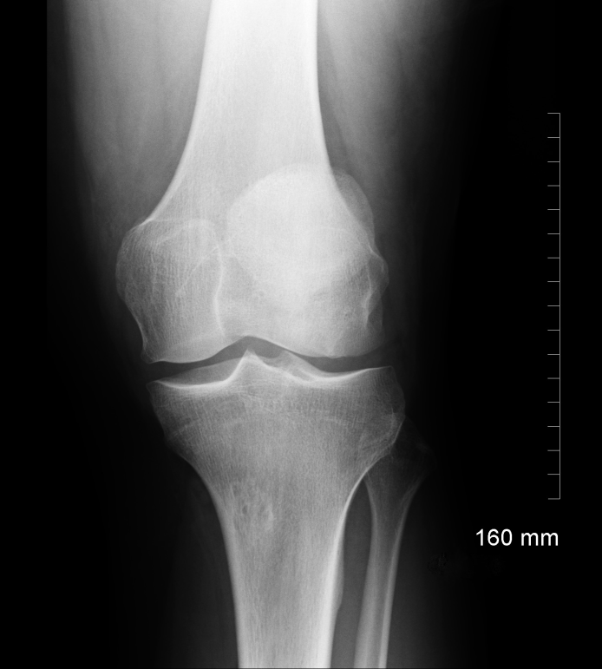
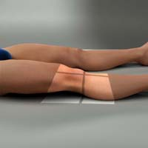
Digital System AEC 80 kVp
8 mAs
EI 800

Slide 3
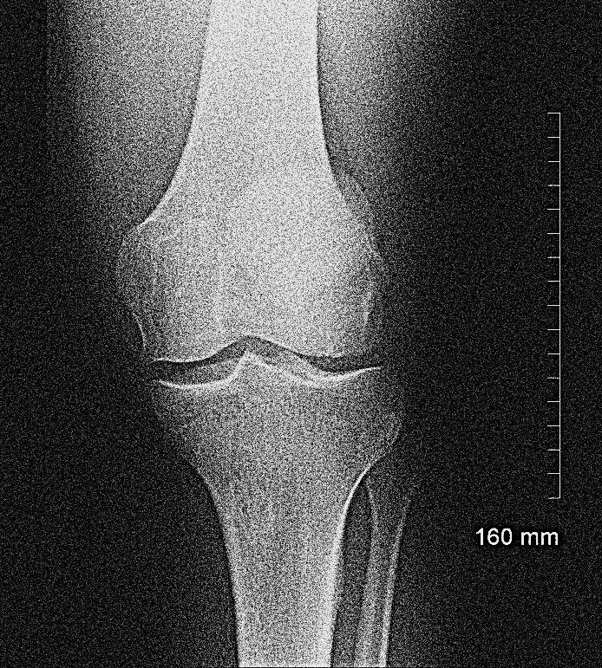
Digital System AEC 80 kVp
1 mAs
EI 100

Slide 4
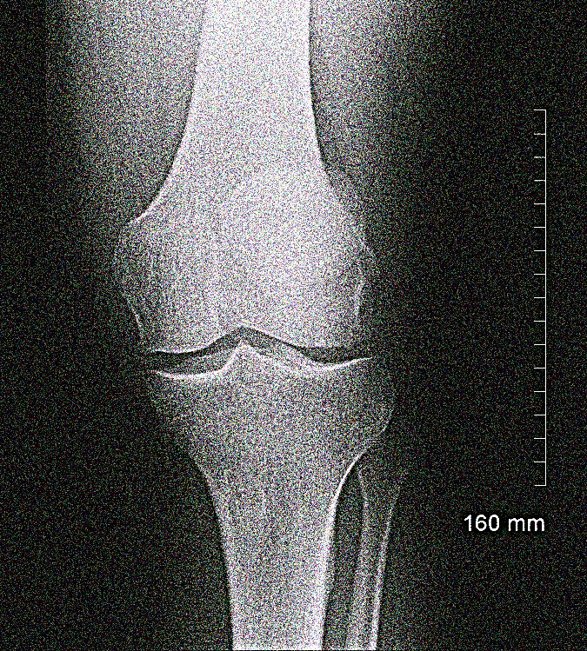
Digital System AEC
1 mAs
EI 100

Slide 5
Digital System AEC
1 mAs
EI 100

Slide 6
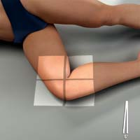
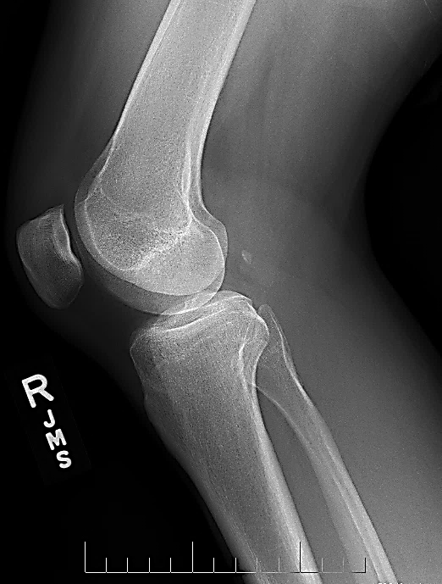
Digital System AEC 80 kVp
8 mAs
EI 800

Slide 7
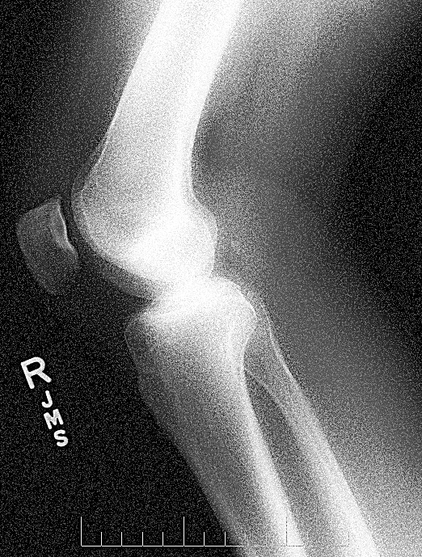
Digital System AEC 80 kVp
1 mAs
EI 100

Slide 8
Digital System AEC 80 kVp
-2
4 mAs
EI 400

Slide 9
Digital System AEC 80 kVp
-3
2 mAs
EI 200

Slide 10
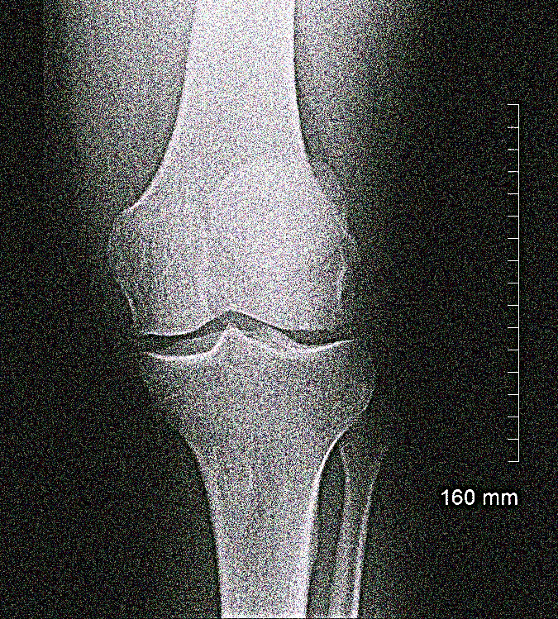
Digital System AEC 80 kVp
-5
1 mAs
EI 100

Slide 11
Digital System AEC 80 kVp
+2
10 mAs
EI 1000

Slide 12
Digital System AEC 80 kVp
+3
16 mAs
EI 1600

Slide 13
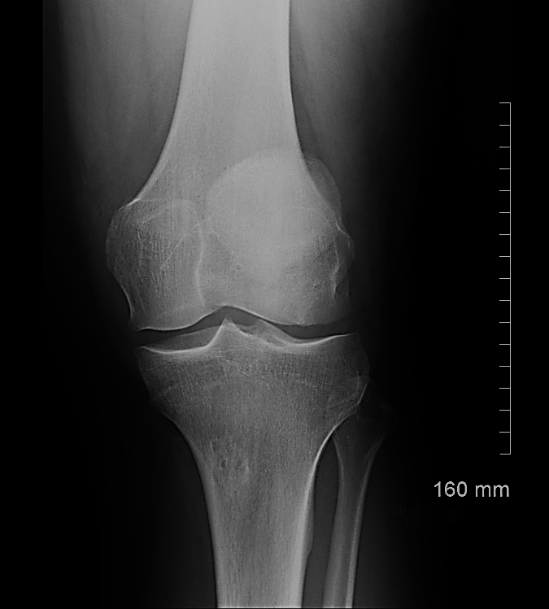
Digital System AEC 80 kVp
+5
20 mAs
EI 2000

Slide 14
Digital System AEC 80 kVp
L
32 mAs
EI 3200

Slide 15
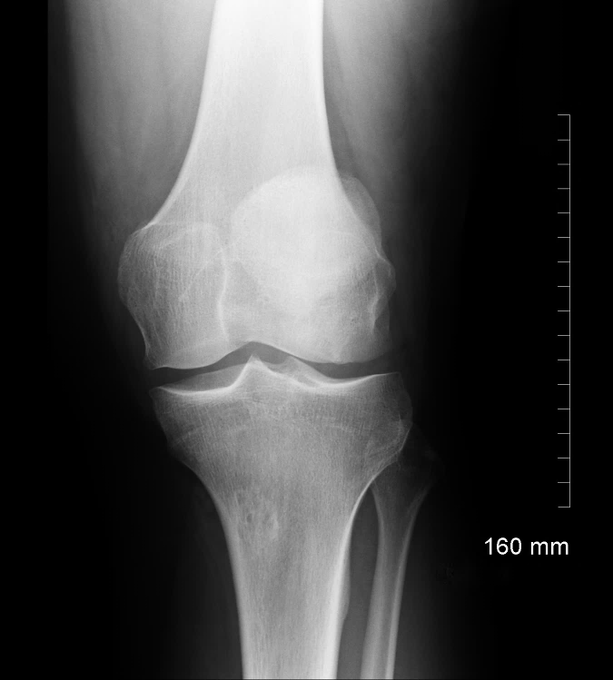
Digital System AEC 80 kVp
M
8 mAs
Lgm 2.27

Slide 16
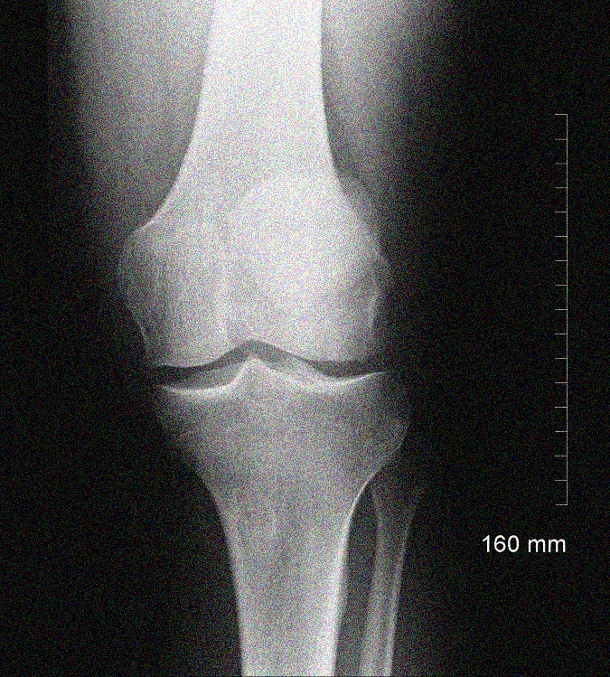
Digital System AEC 80 kVp
H
2 mAs
EI 200

Slide 17
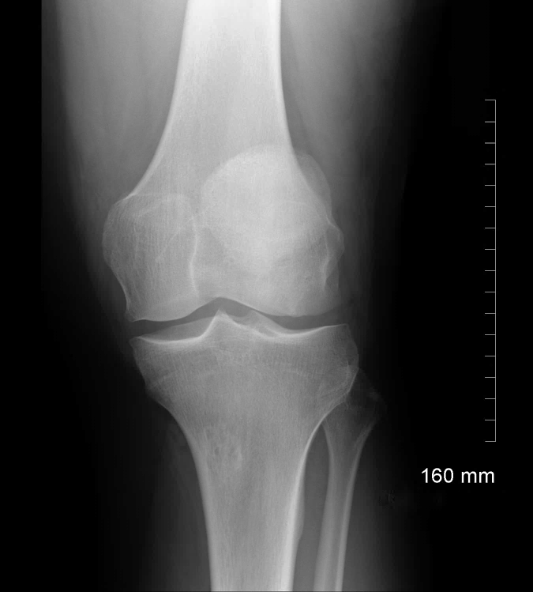
Digital System AEC 80 kVp
4 mAs
EI 800
kVp increased to 95

Slide 18
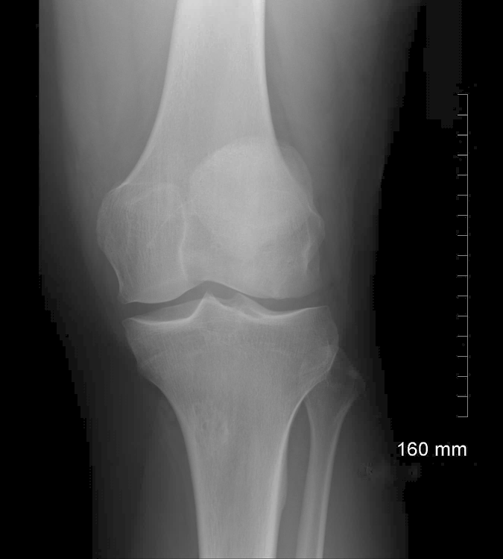
Digital System AEC 80 kVp
2 mAs
EI 800
kVp increased to 115

Slide 19
Digital System AEC 80 kVp
16 mAs
EI 800
kVp decreased to 65

Slide 20
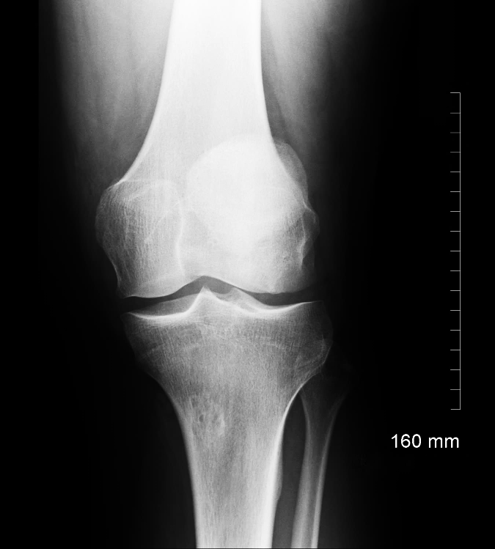
Digital System AEC 80 kVp
32 mAs
EI 800
kVp decreased to 55

Slide 21
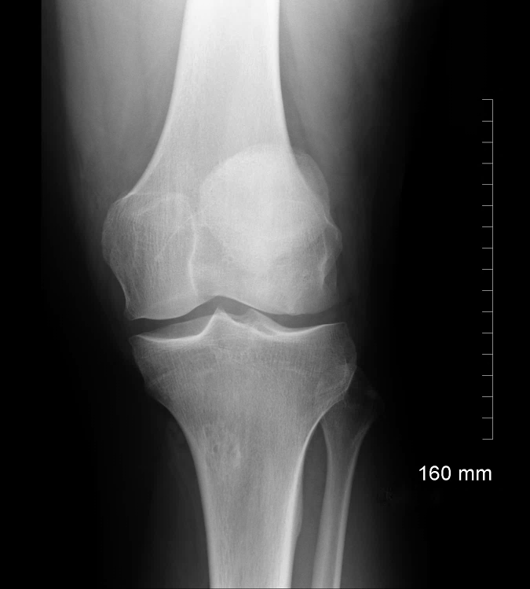
Digital System AEC 80 kVp
2 mAs
EI 800
SID decreased to 50 cm (20”)

Slide 22
Digital System AEC 80 kVp
32 mAs
EI 800
SID increased to 200 cm (80”)

Slide 23
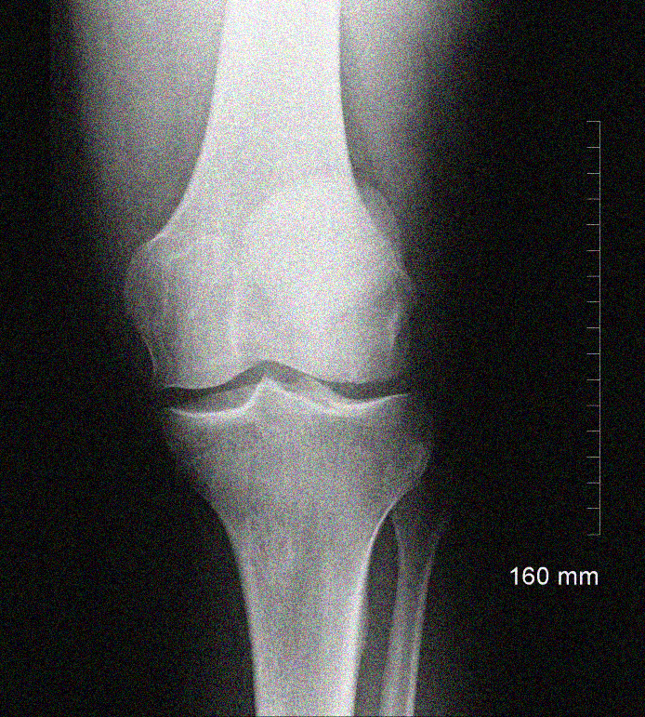
Digital System AEC 80 kVp
2 mAs
EI 200
CR off centered 8” laterally

Slide 24
Digital System AEC 80 kVp
7 mAs
EI 700
CR off centered 8” longitudinally

Slide 25
Digital System AEC 80 kVp
8 mAs
EI 800
Cephalic angulation 20⁰

Slide 26
Digital System AEC 80 kVp
8 mAs
EI 800
Caudal angulation 20⁰

Slide 27
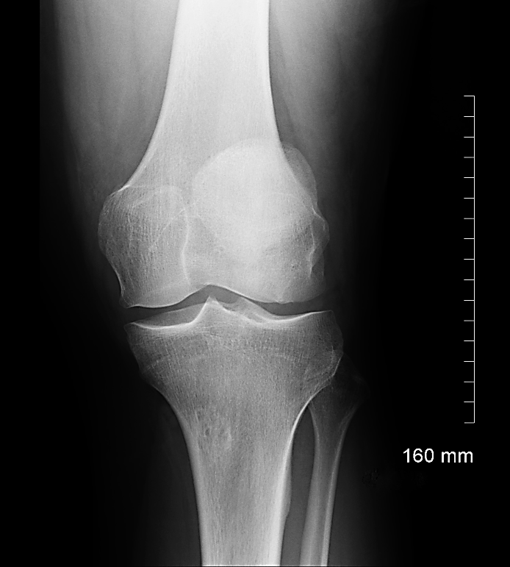
Digital System AEC 80 kVp
16 mAs
EI 1600
Vertical bucky selected
Backup 16 mAs

Slide 28
Digital System AEC 80 kVp
8 mAs
EI 800
Backup time 40 mAs
(TABLE BUCKY)

Slide 29
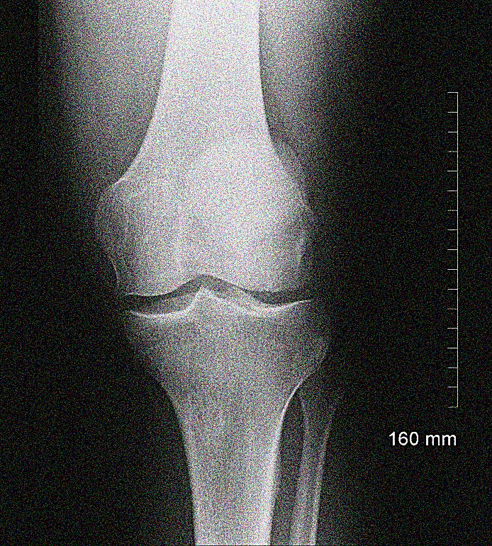
Digital System AEC 80 kVp
4 mAs
EI 400
Backup time 4 mAs
AEC OVER!

Slide 30
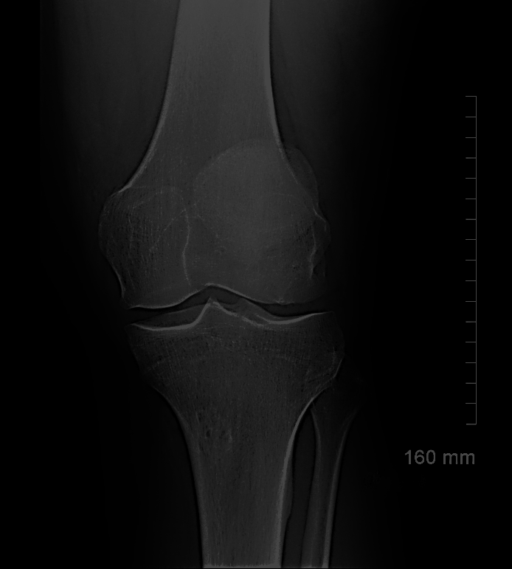
Digital System AEC 80 kVp
200 mAs
EI 4000
Vertical bucky selected
Buckup time 200 mAs

