Slide 1
PACS Fundamentals

Slide 2
The picture archiving and communication system (PACS) is becoming more commonplace in today's hospitals because hospital administrators have come to see the necessity of having such a system to serve physicians and patients even though it is expensive. The initial capital cost is great, but the benefit of having the system far outweighs the cost.

Slide 3
The PACS is an electronic version of the radiologist reading room and the file room. The first PACSs were used in the early 1980s and generally served a single modality. Large research institutions housed early systems because most were developed by the scientists who worked at those institutions. As vendors became more involved, they developed proprietary systems that were very specific to their modalities. Finally, as physicians and hospitals became interested, it was determined that there must be standardization.

Slide 4
Digital imaging and communications in medicine (DICOM) is a universally accepted standard for exchanging medical images among the modality, viewing stations, and the archive. First completed in 1985, this standard laid the groundwork for the future development of integrated PACSs. Now each modality and PACS communicates via DICOM, and DICOM continues to be refined every year.

Slide 5
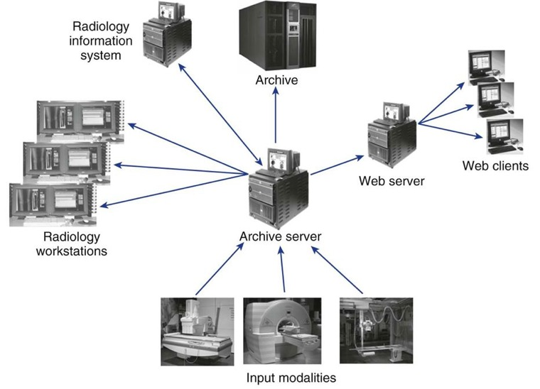

Slide 6
PACS three fundamental parts:
image acquisition
display workstations
archive servers

Slide 7
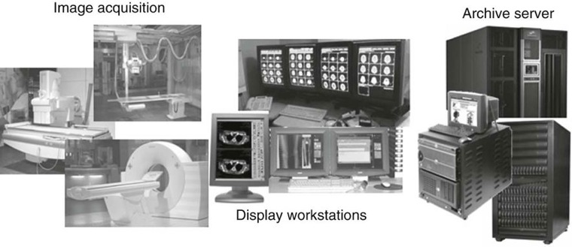

Slide 8
Image Acquisition
In modern radiology departments, most images are acquired in a digital format, meaning that the images are inherently digital and can be transferred via a computer network. Ultrasound, computed tomography (CT), magnetic resonance imaging (MRI), and nuclear medicine have been digital for many years and have been taking advantage of PACS far longer than general radiography has.

Slide 9
Display Workstations
A display workstation is any computer that a health care worker uses to view a digital image It is the most interactive part of a PACS, and these workstations are used inside and outside of radiology. The display station receives images from the archive or from the various radiology modalities and presents them for viewing. The display workstation has PACS application software that allows the user to perform minor image-manipulation techniques to optimize the image being viewed. Some display stations have advanced software to perform more complex image-manipulation techniques.

Slide 10
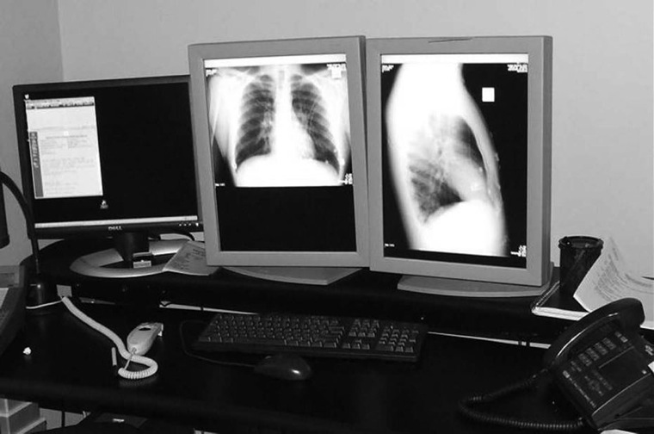

Slide 11
Archive Servers
An archive server is the file room of the PACS. It is composed of a database server or image manager, short-term and long-term storage, and a computer that controls the PACS workflow, known as a workflow manager. The archive is the central part of the PACS and houses all of the historic data along with the current data being generated. In many institutions the archive serves as the central hub that receives all images before they are released to the radiologists for interpretation.

Slide 12
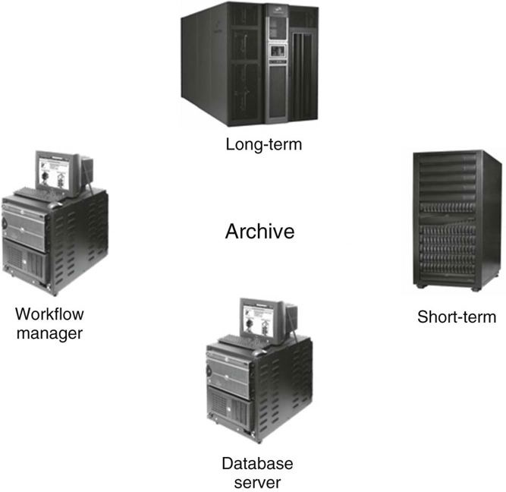

Slide 13
Workflow
Workflow is a term that can be used in any industry or in any organization. It simply means how a process is done, step by step. In radiology, the term workflow has always been used to describe how an examination is completed, from order entry to transcribed report. The workflow in each radiology department is different because there are many variables.

Slide 14
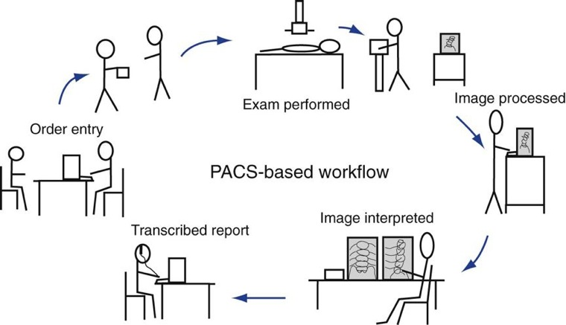

Slide 15
The first step in any radiology department workflow is the entry of the order. The order may be a paper prescription from the ordering doctor, or the order may have been placed in the computer system by any hospital staff member. Either way, an order is placed in the radiology information system (RIS), and a requisition is generated. A requisition generally contains the following information:
•Patient's name
•Patient's hospital identification (ID) number
•Date of birth
•Ordering physician's name
•Examination ordered
•Reason for examination
•Chief complaint

Slide 16
The order is input into the RIS, and the RIS sends a message to the PACS to find all historic images and put them on the short-term archive. This eliminates waiting for the file room to retrieve a film jacket from the off-site storage location.
The technologist prepares the room, retrieves the patient, and performs the patient history. The history is recorded on the paper requisition or input electronically into the patient's computerized medical record.
The technologist performs the examination, and depending on the type of image acquisition device, the images are processed and repeated as necessary and sent to the appropriate PACS device. The patient images have been tagged with information from the RIS so that historic image reports are available at the PACS when the new images are sent. If the patient's physician does not have access to the electronic images, a compact disk (CD) or digital versatile disk (DVD) can be made that contains the images in digital format.

Slide 17
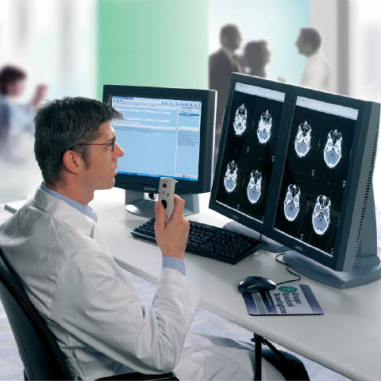
The requisition is either taken to the radiologist, or the radiologist may pull the images from an electronic worklist. The radiologist also pulls up historic images and reports and compares the previous images with the current images.
The radiologist dictates a report and has it transcribed, or voice recognition software may be used. If the radiologist uses voice recognition software, he or she can review the report right after dictation, make corrections, and sign the report, making it final.

Slide 18
System Architecture
System architecture can be defined as the hardware and software infrastructure of a computer system. In a PACS, the system architecture normally consists of acquisition devices, storage, display workstations, and an image management system.

Slide 19
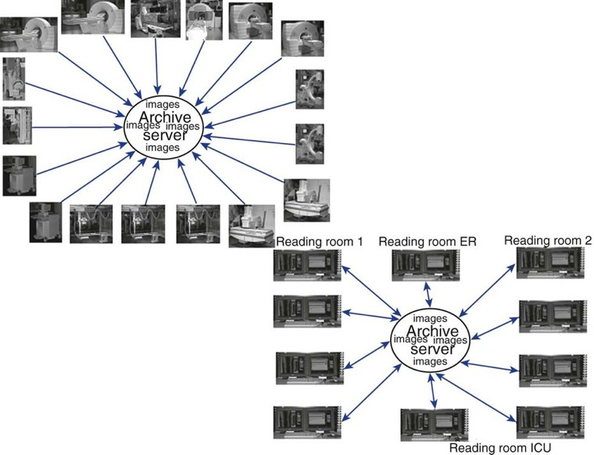
In a client/server-based system, images are sent directly to the archive server after acquisition and are centrally located. The display workstation functions as a client of the archive server and accesses images based on a centralized worklist that is generated at the archive server. The health care worker at the display workstation chooses a name from the central list, and the archive server sends the image data to the display station. After the “client” is finished, the image data are flushed from its memory. Most systems allow basic image manipulation at the display workstation or “client,” and the changes are saved on the archive server.

Slide 20
In a distributed or stand-alone system, the acquisition modalities send the images to a designated reading station and possibly to review stations, depending on where the order originated (i.e., the intensive care unit or the emergency room). In some systems, the images are sent from the modality to the archive server, and the archive server distributes the images to the designated workstation.
The workstations can query and retrieve images from the archive. All images are then stored locally and subsequently sent to the archive server after they have been read. These images remain on the local hard drive of the workstation until they are deleted either by a user or at a predetermined time set by system rules.

Slide 21
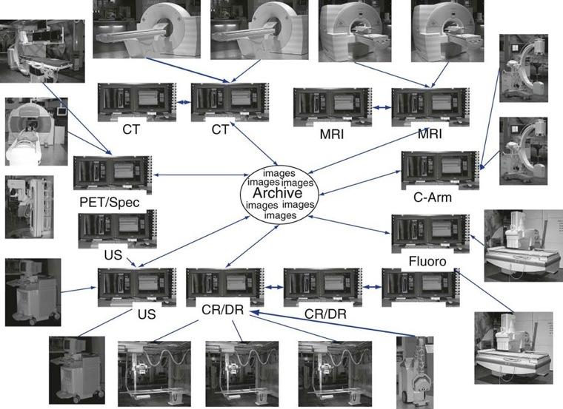

Slide 22
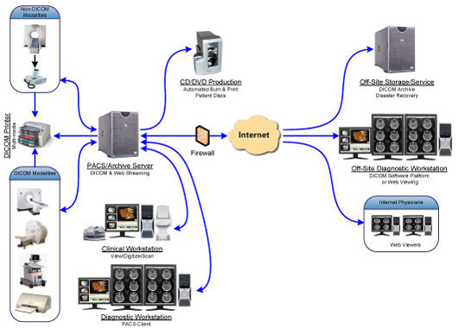
A web-based system is very similar to a client/server system in how data flow. The significant difference is that both the images and the application software for the client display are held centrally. This means that when someone wants to view images from a web-based application, he or she simply searches for the pertinent images and the web browser will display the images that are held in the web server. This does not require special software to be downloaded to the computer.

Slide 23
The display workstation is the most interactive part of a PACS, consisting of a monitor and a computer with a mouse and keyboard. In addition, each system has hardware and software that fits the users' requirements.
Common screen resolutions that are found on today's monitors are:
1280 × 1024 (1K)
1600 × 1200 (2K)
2048 × 1536 (3K)
2048 × 2560 (5K)

Slide 24
Most cross-sectional imaging is read on a 1K square monitor.
Most digital projection images are read on at least a 2K portrait monitor.
Mammography requires a 5K or 5-megapixel resolution to provide the viewing capacity needed

Slide 25
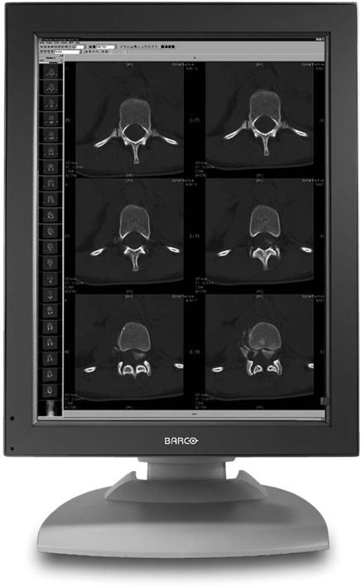
1 K

Slide 26
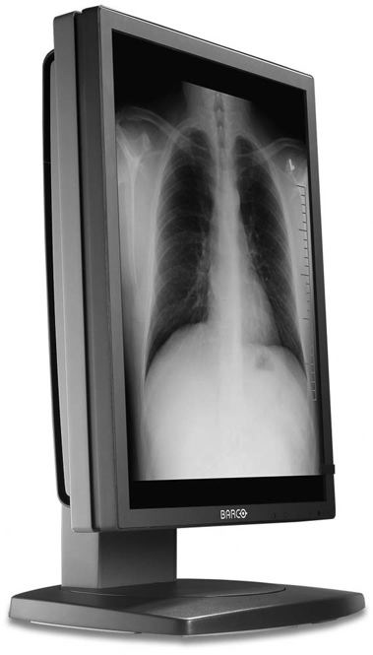
2K

Slide 27
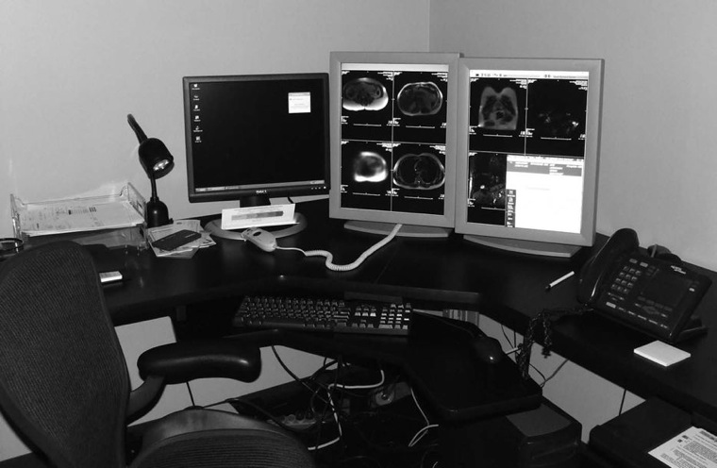
The radiologist reading station is used by a radiologist when making a primary diagnosis. The reading station has the highest quality hardware, including the best monitor.

Slide 28
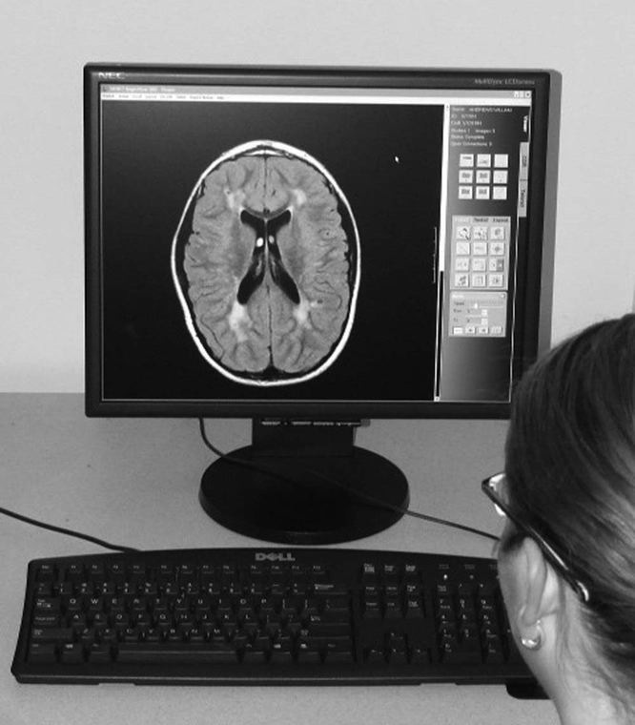
The physician review workstation is a step-down model of the radiologist reading station. Many vendors use the same level of software but may eliminate some of the more advanced functions. One of the most important features on a physician review station is the ability to view current and previous reports along with the images. This can be accomplished with the integration of RIS functions with the PACS software

Slide 29
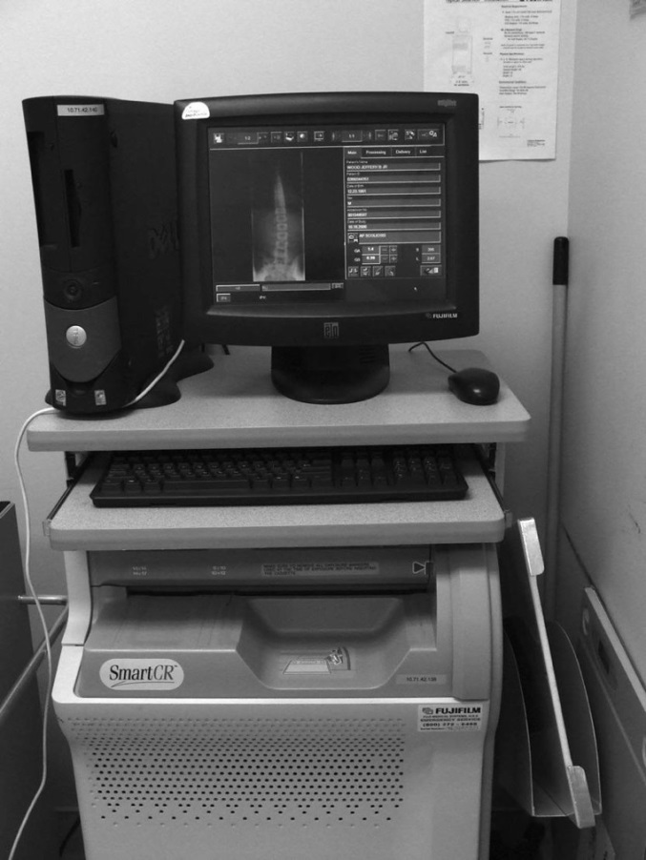
The technologist quality control (QC) station is used to review images after acquisition but before sending them to the radiologist. The QC station may be used to improve or adjust image quality characteristics, or it may be used to verify patient demographic information. Many QC stations are placed between the computed radiography (CR) and digital radiography (DR) acquisition modalities as a pass-through to ensure that the images have met the departmental quality standard. The technologist QC station generally has a 1K monitor. When manipulating images, the technologist must be careful not to change the appearance too much from the original acquired image. The technologist should consult frequently with the radiologist to ensure that the images being sent are of the required quality.

Slide 30
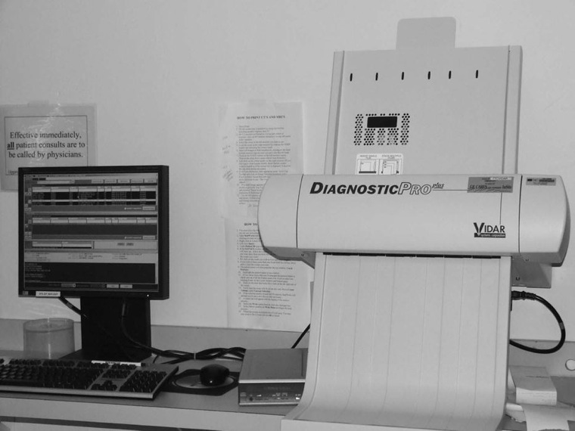
The file room workstation may be used to look up examinations for a physician or to print copies of images for the patient to take to an outside physician. Many hospitals are moving away from printing films to save the cost of the film and are instead moving toward burning CDs with the patient's images.

Slide 31
PACS workstations functions can be broken down into four categories:
navigation functions
image manipulation and enhancement functions
image management functions
advanced workstation functions.

Slide 32
Navigation functions are used to move through images, series, studies, and patients. The worklist is used to navigate through patients. Most worklists are customizable for the user. One doctor may want to see only unread CT studies, and another may want to see all neurologic studies done that day regardless of the modality.

Slide 33
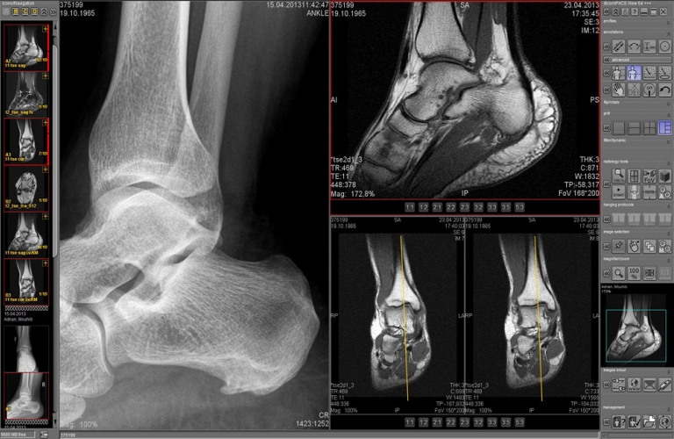
Once a patient has been selected from the worklist, the images load into the display software. In most PACSs, each user has the ability to set up custom hanging protocols. A hanging protocol is how a set of images will be displayed on the monitor

Slide 34
Image Manipulation and Enhancement Functions:
Window width/window level
Annotations
Flip and rotate
Pan, zoom, and magnify
Measurements

Slide 35
Image Management Functions
Most PACSs allow the user to modify patient demographics at the technologist QC station, the reading station, and the file room station. It is imperative that the patient demographics are correct. If wrong information is archived on an image, the image will be difficult to retrieve and may never be found again. Make changes only when the information is absolutely known to be wrong. To minimize errors, many hospitals allow only certain people the access to change demographics.
Another image management function is the query/retrieve function used to retrieve studies from the archive. The query function allows the user to query a study on multiple fields such as the patient's name or ID, date of service, or modality. Some systems also allow a query based on a diagnosis code or comment field.

Slide 36
Many vendors have provided a CD-burning option that allows users to save studies to a CD for outside use. The feature may be available only in the file room to control the CDs that are sent out. Health Insurance Portability and Accountability Act (HIPAA) compliance must also be maintained.
Another common feature is the ability to copy and paste images into a document. This is frequently used with the web-based systems when creating presentations for conferences. The patient information must be removed from the image before it is placed into a presentation.
Some hospitals have retained the ability to print films for outside use. This is also usually done only in the file room so that control can be maintained over the printed films for HIPAA purposes and cost reasons. Some hospitals have also connected workstations to paper printers for quick consults and medical records.

Slide 37
Advanced functions are usually placed on specialty workstations for the radiologist, but some are found on the technologist QC station to further enhance the images.
MPR
3D
Stitching

Slide 38
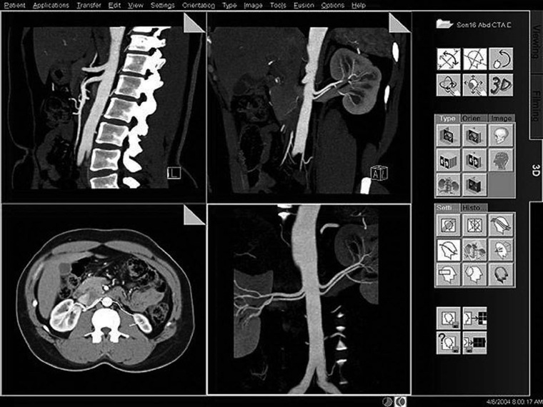
MPR

Slide 39
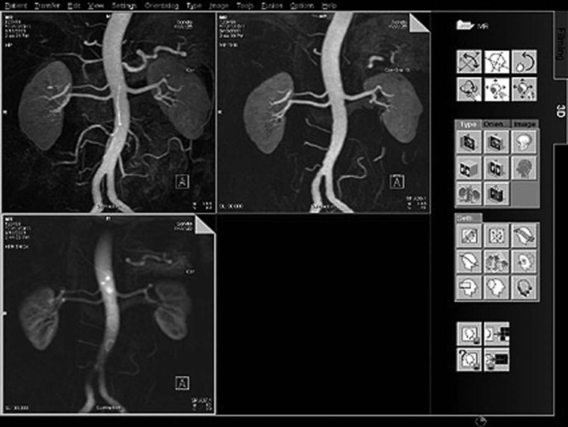
3D MIP

Slide 40
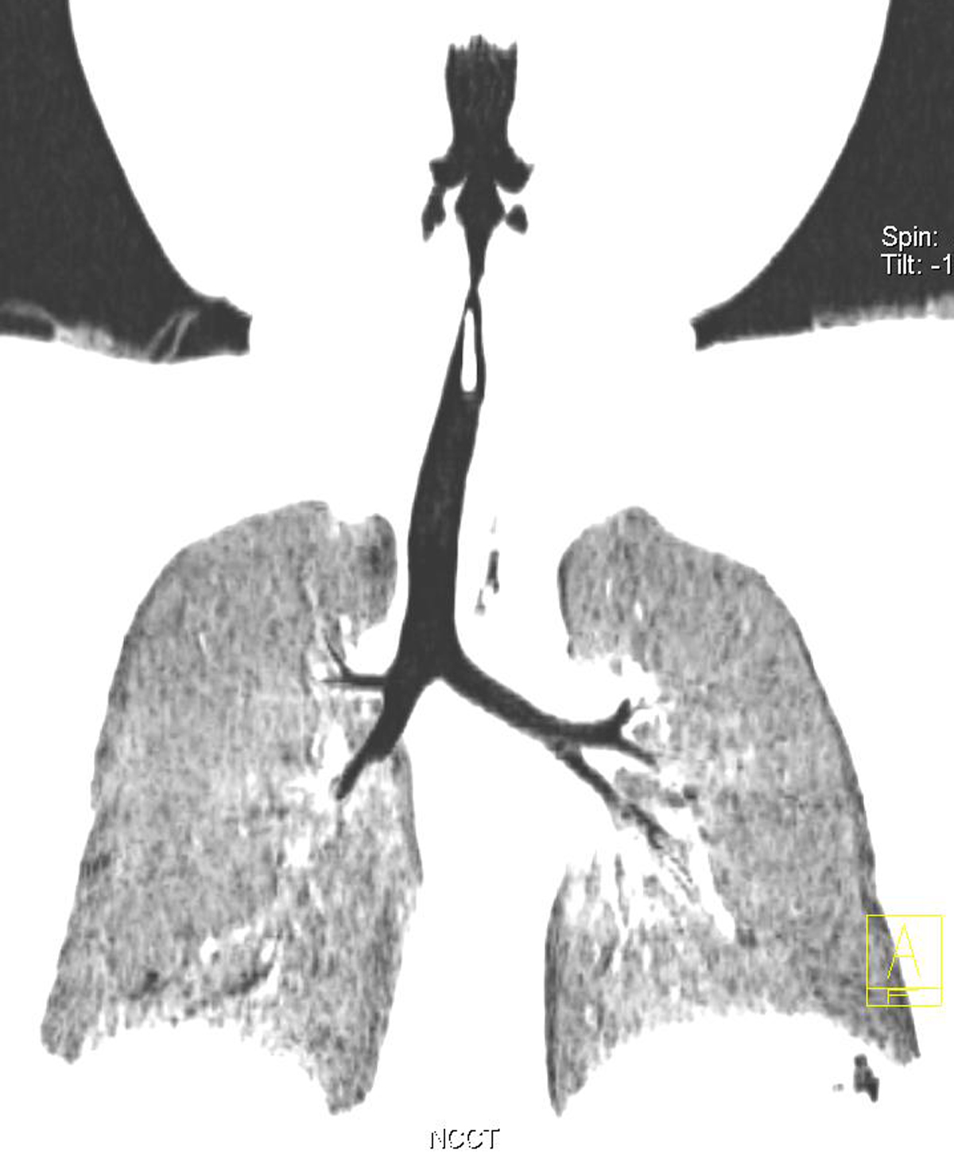
3D minIP

Slide 41
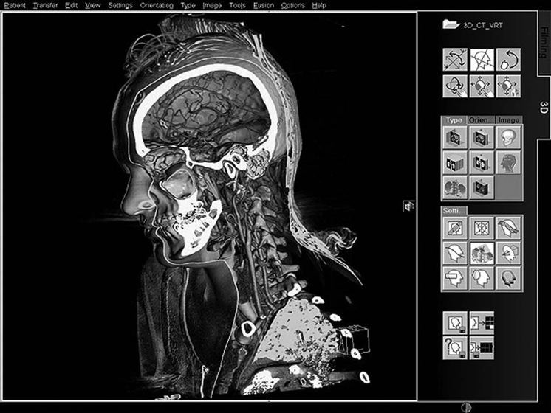
3D VR

Slide 42
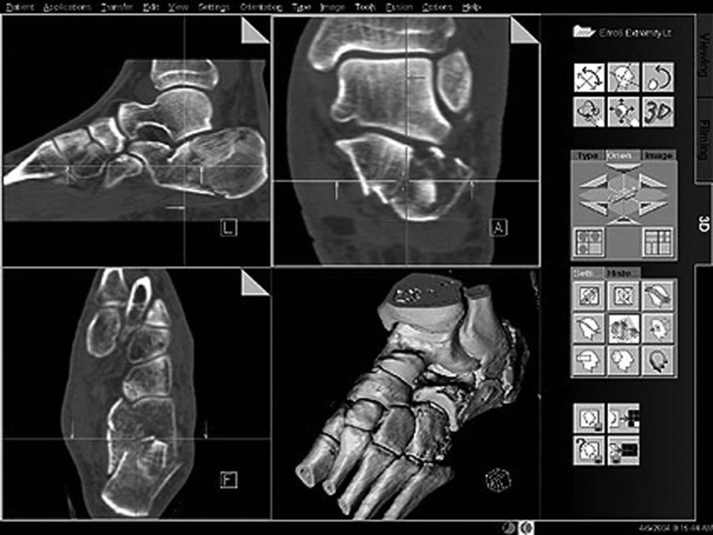
3D SSD

Slide 43
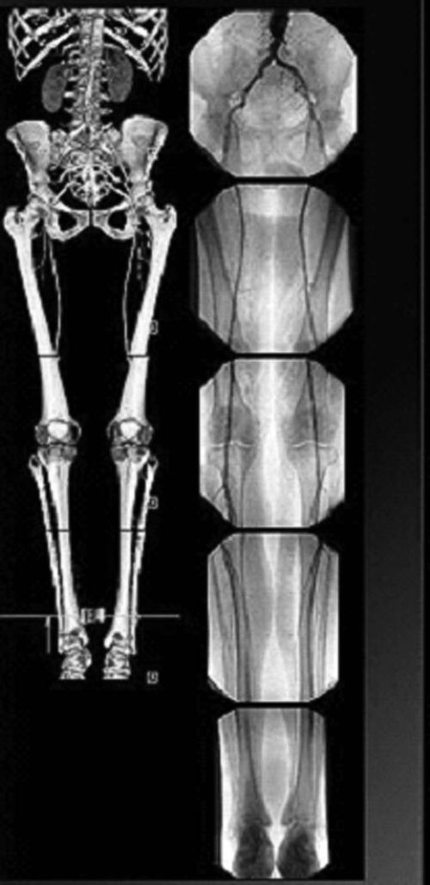
Stitching

