Slide 1
Brain

Slide 2
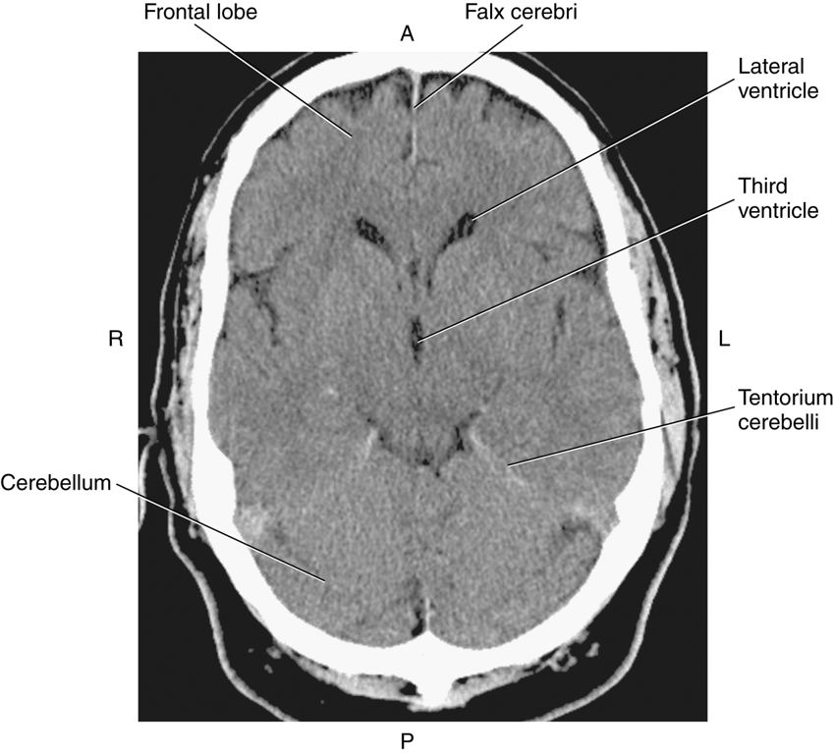
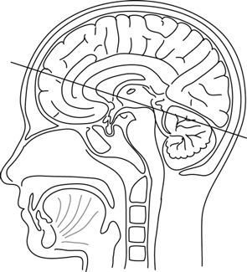
The brain is a delicate organ that is surrounded and protected by three membranes called the meninges. The outermost membrane, the dura mater (tough mother), is the strongest. Folds of dura mater help to separate the structures of the brain and provide additional cushioning and support. The dural folds include the falx cerebri, tentorium cerebelli, and the falx cerebelli. The falx cerebri separates the cerebral hemispheres, whereas the tentorium cerebelli, which spreads out like a tent, forms a partition between the cerebrum and cerebellum. The falx cerebelli separates the two cerebellar hemispheres.

Slide 3
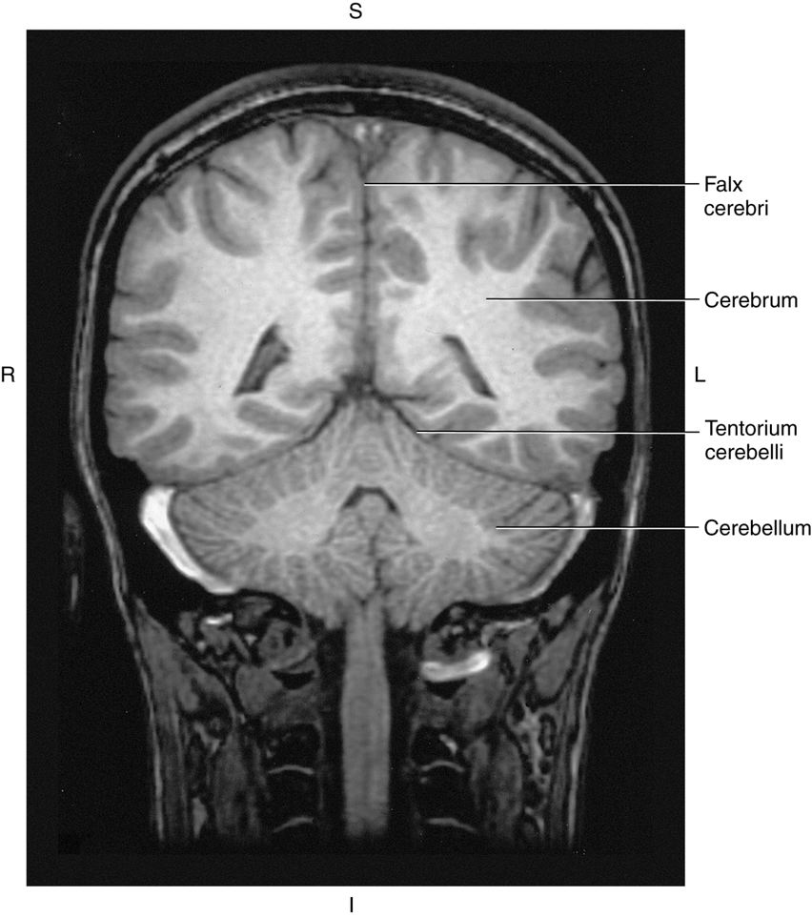
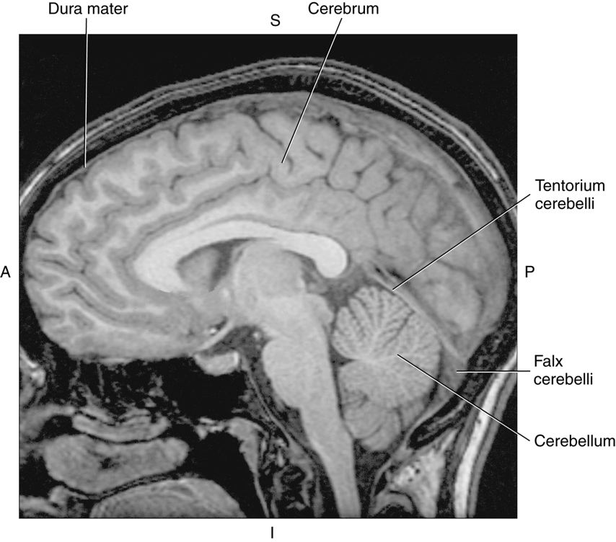

Slide 4
The ventricular system provides a pathway for the circulation of the cerebral spinal fluid (CSF) throughout the CNS. A major portion of the ventricular system is composed of four fluid-filled cavities (ventricles) located deep within the brain.
The two most superior cavities are the right and left lateral ventricles. These ventricles lie within each cerebral hemisphere and are separated at the midline by a thin membrane known as the septum pellucidum.
The lateral ventricles consist of a central portion called the body and three extensions: the frontal (anterior), occipital (posterior), and temporal (inferior) horns

Slide 5
The lateral ventricles communicate inferiorly with the third ventricle via the paired interventricular foramen (foramen of Monro).
The third ventricle communicates with the fourth ventricle via a long, narrow passageway termed the cerebral aqueduct (aqueduct of Sylvius).
CSF exits the ventricular system through foramina in the fourth ventricle to communicate with the subarachnoid space within the basal cisterns. The major exit route is the median aperture (foramen of Magendie), located on the posterior wall of the fourth ventricle

Slide 6
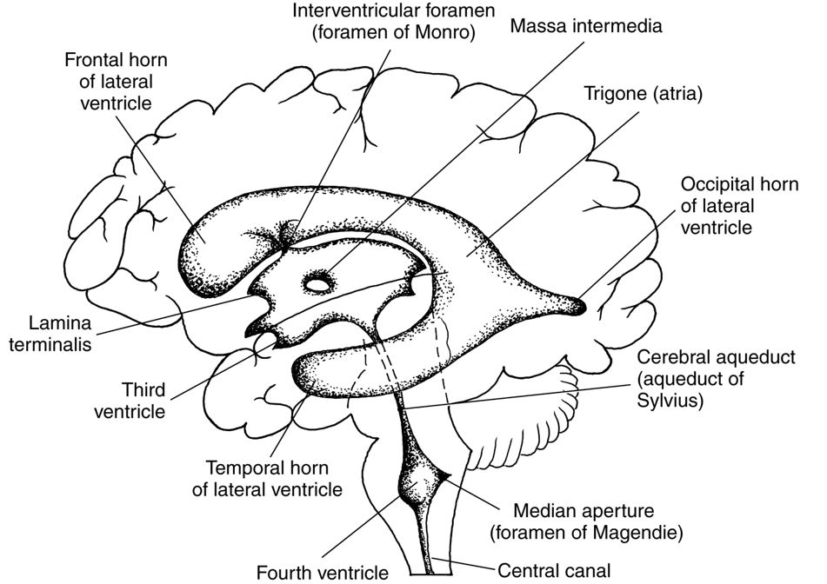

Slide 7
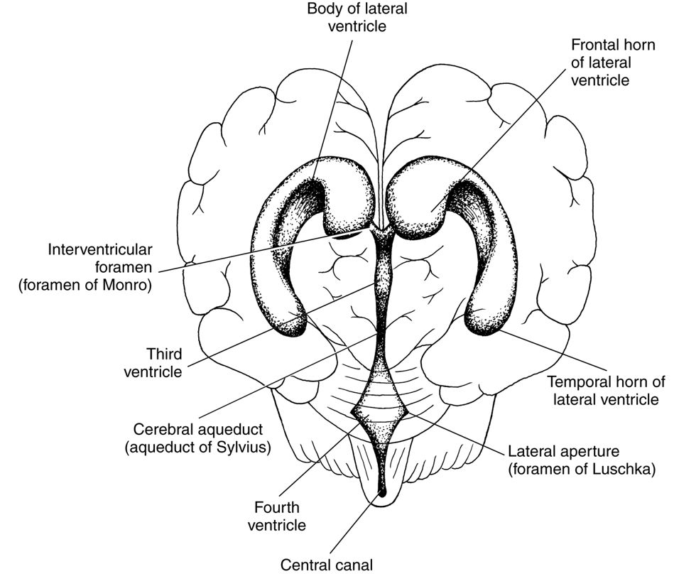
There are two lateral apertures, termed the foramen of Luschka, which communicate with the cerebellopontine angle cistern. From the fourth ventricle, CSF continues into the spinal cord via the central cana

Slide 8
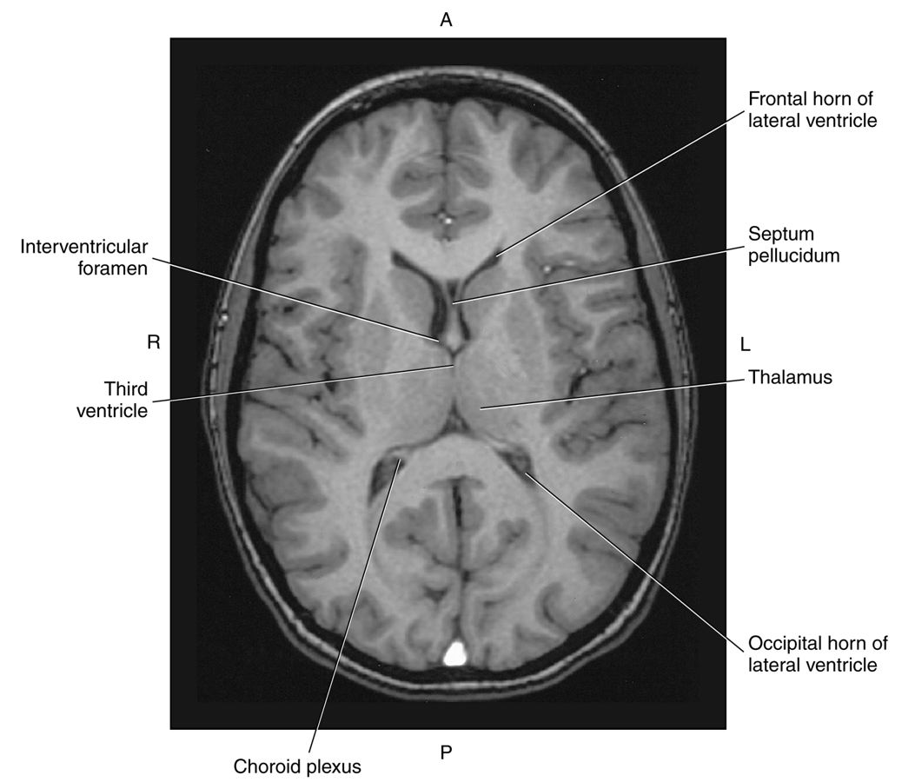
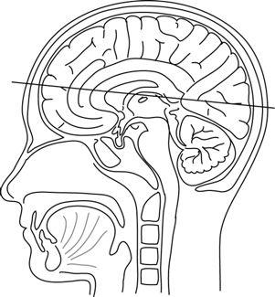
The septum pellucidum is frequently used as a landmark to determine if the midline of the brain has shifted as a result of trauma or pressure.

Slide 9
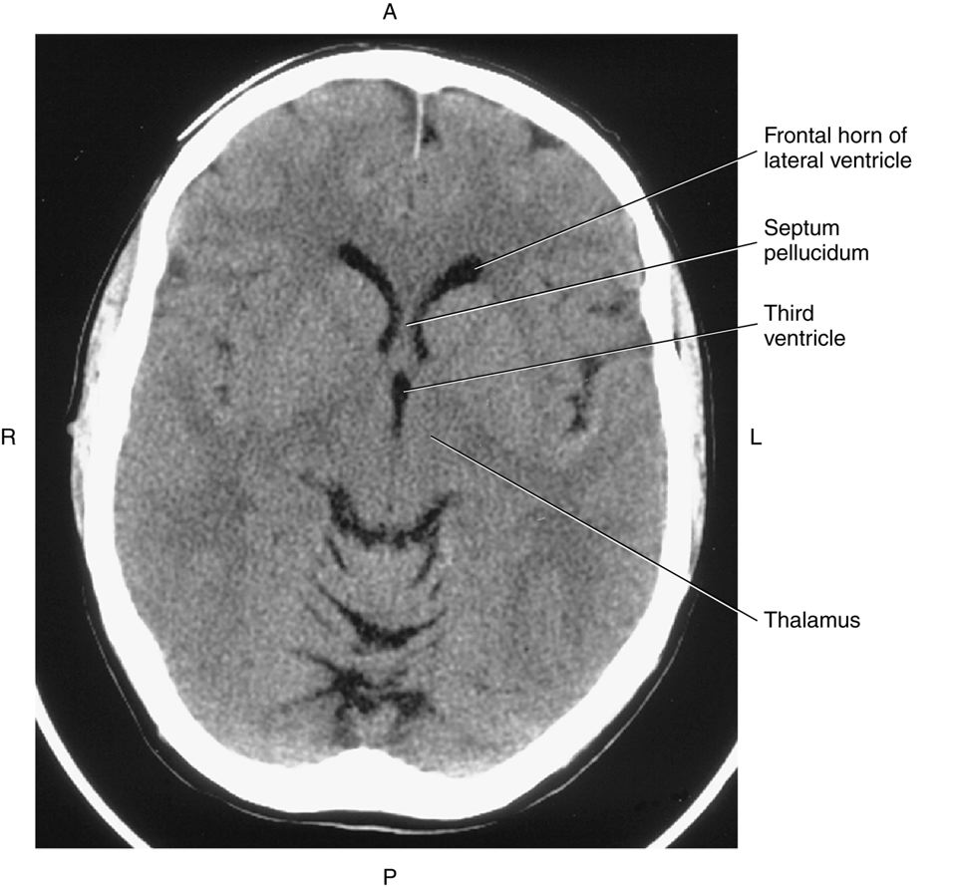
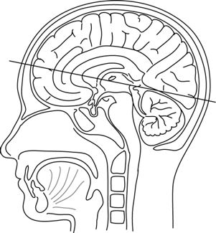

Slide 10
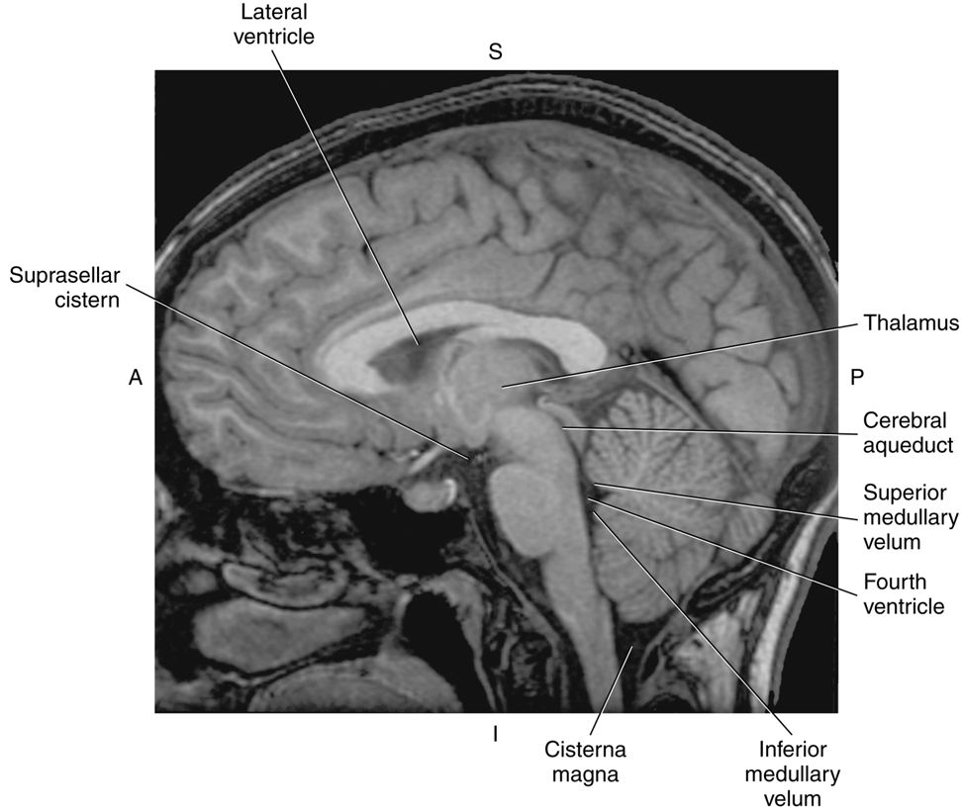
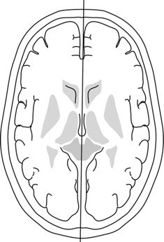

Slide 11
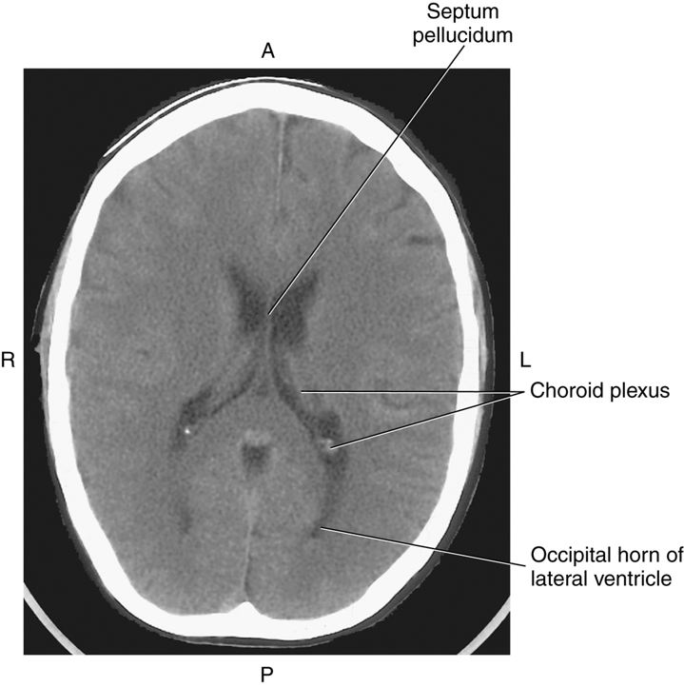
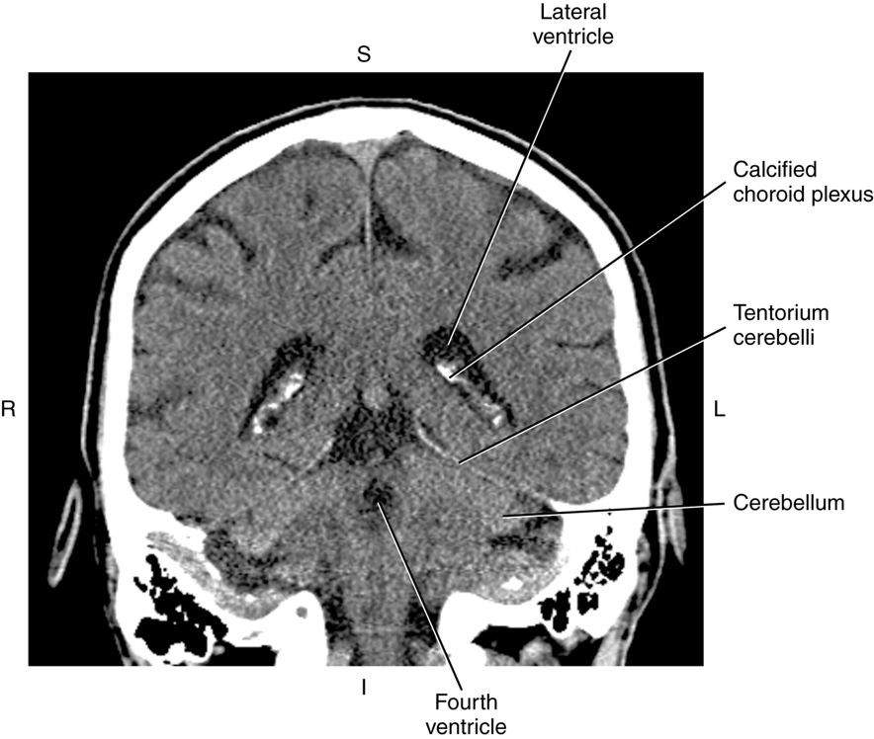
Located within the ventricular system is a network of blood vessels and nerve cells termed the choroid plexus, which produces CSF. The choroid plexus lines the floor of the lateral ventricles, roof of the third ventricle, and the fourth ventricle.
Frequently, the choroid plexus is partially calcified, making it more noticeable on computed tomography (CT) images

Slide 12
The cerebrum is the largest portion of the brain and is divided into left and right cerebral hemispheres. Each hemisphere contains neural tissue arranged in numerous folds called gyri. The gyri are separated by shallow grooves called sulci and by deeper grooves called fissures. The main sulcus that can be identified on CT and MR images of the brain is the central sulcus, which divides the precentral gyrus of the frontal lobe and postcentral gyrus of the parietal lobe.
The two main fissures of the cerebrum are the longitudinal fissure and the lateral (Sylvian fissure)

Slide 13
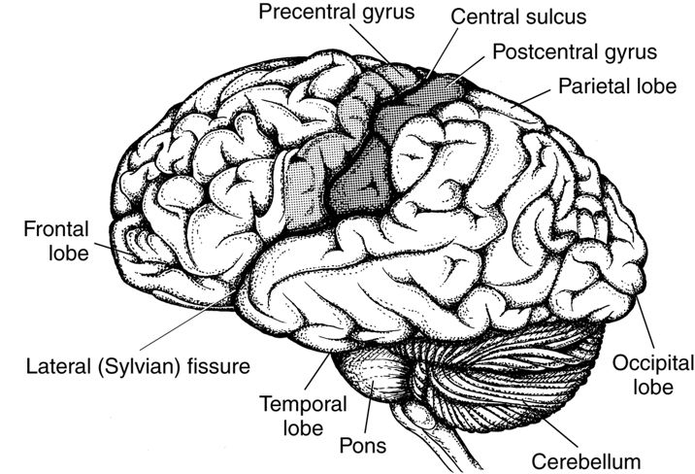

Slide 14
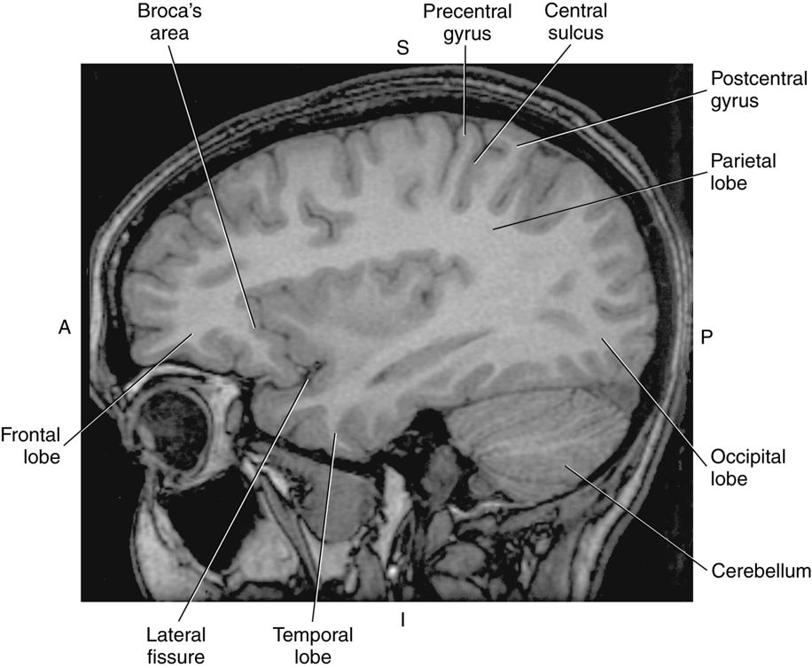

Slide 15
The cerebrum as a whole has many critically important functions, including thought, judgment, memory, and discrimination. The cerebrum consists of gray matter (neuron cell bodies) and white matter(myelinated axons).
The cortex not only receives sensory input but also sends instructions to the muscles and glands for control of body movement and activity. Deep in the cortex is the white matter, which contains fibers that create pathways for the transmission of nerve impulses to and from the cortex.
The largest and densest bundle of white matter fibers within the cerebrum is the corpus callosum. This midline structure forms the roof of the lateral ventricles and connects the right and left cerebral hemispheres. The four parts of the corpus callosum, from anteroinferior to posterior, are the rostrum, genu, body, and splenium

Slide 16
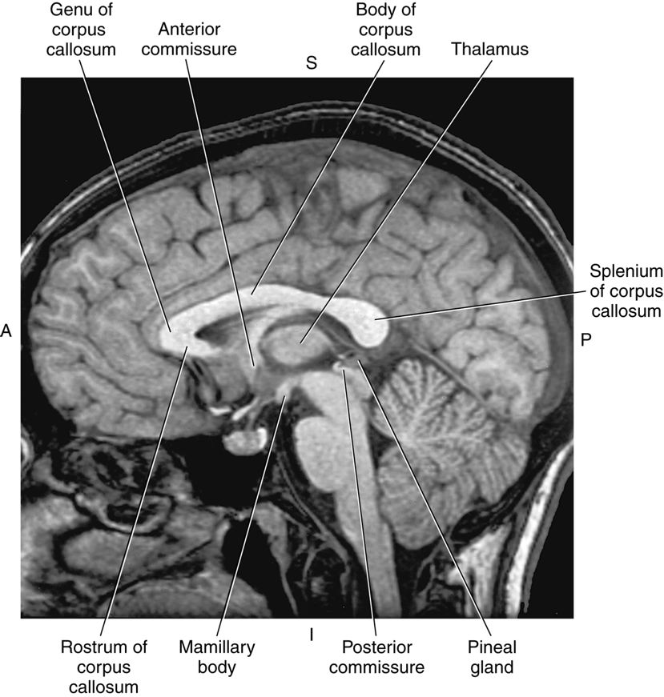
The thalamus is a structure in the middle of the brain. It is located between the cerebral cortex and the midbrain. It works to correlate several important processes, including consciousness, sleep, and sensory interpretation.

Slide 17
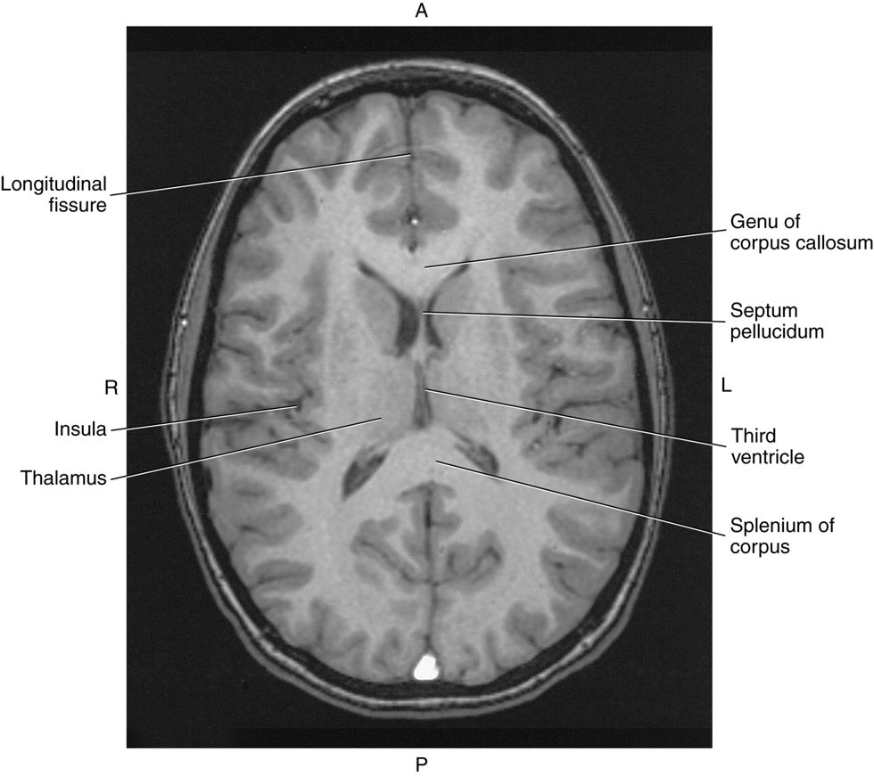

Slide 18
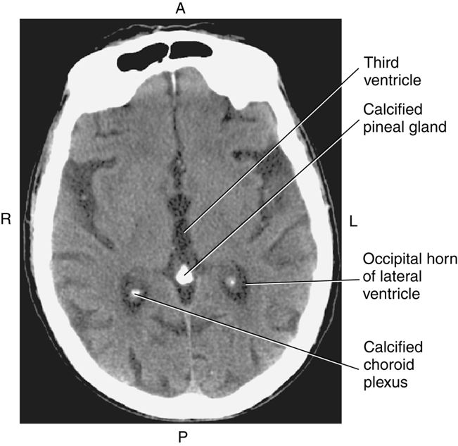

Slide 19
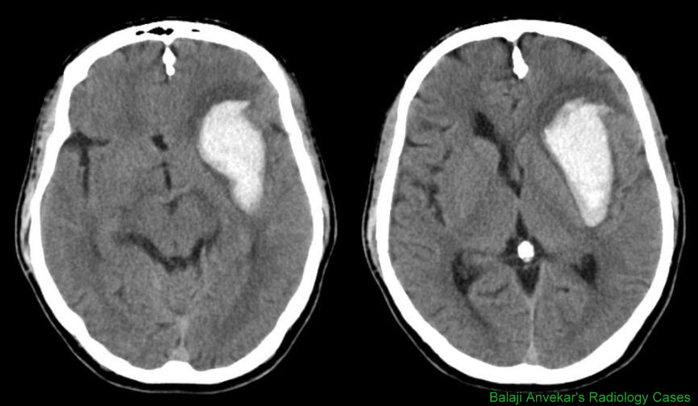

Slide 20
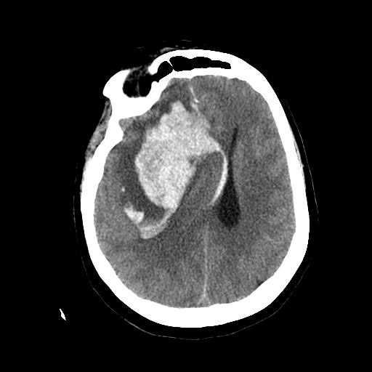

Slide 21
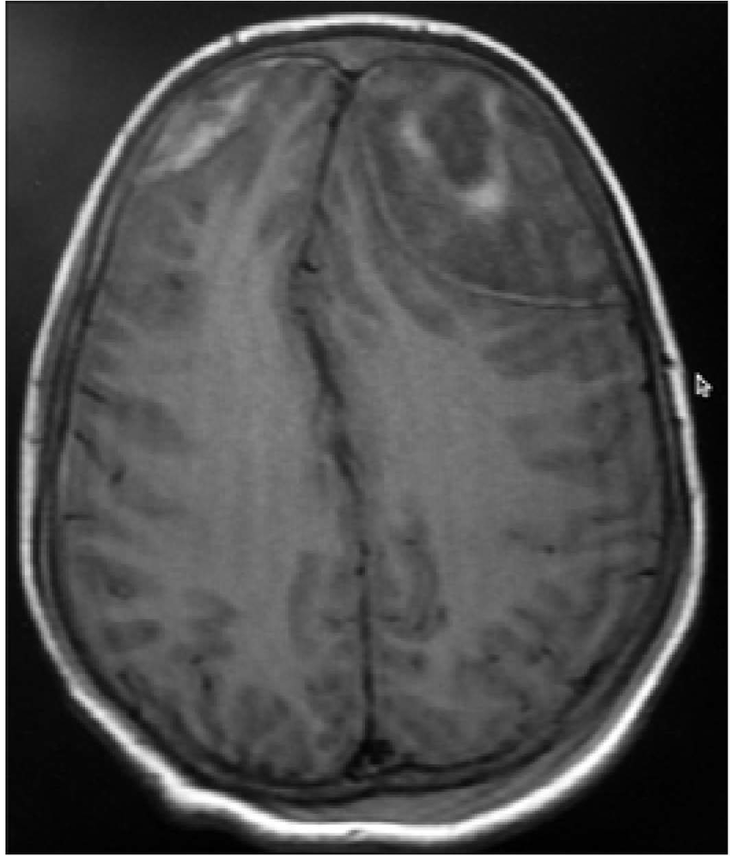

Slide 22
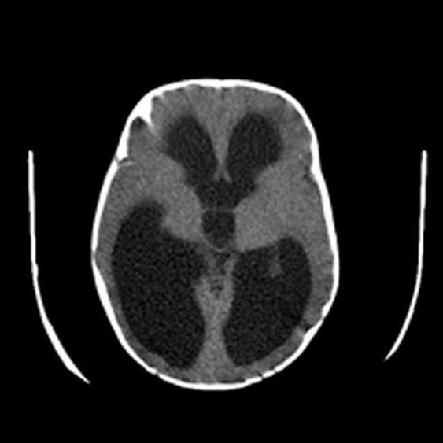
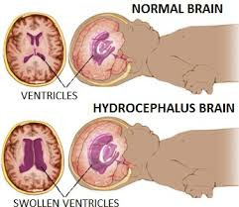
The term hydrocephalus is derived from the Greek words "hydro" meaning water and "cephalus" meaning head. As the name implies, it is a condition in which the primary characteristic is excessive accumulation of fluid in the brain. Although hydrocephalus was once known as "water on the brain," the "water" is actually cerebrospinal fluid (CSF) — a clear fluid that surrounds the brain and spinal cord. The excessive accumulation of CSF results in an abnormal widening of spaces in the brain called ventricles. This widening creates potentially harmful pressure on the tissues of the brain.

Slide 23
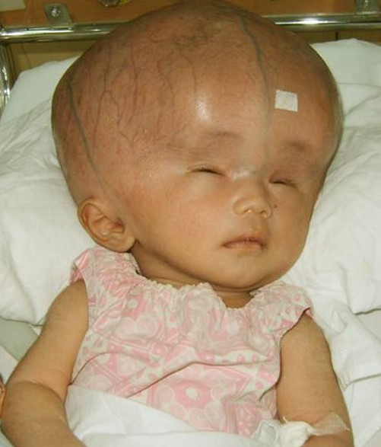

Slide 24
