Slide 1
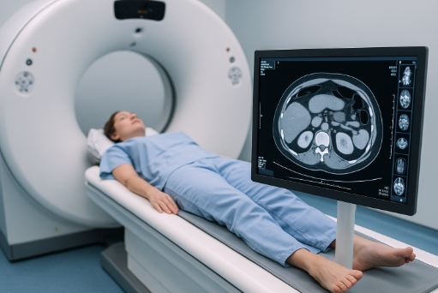
Generating Image in CT

Slide 2
Image Generation in CT
Computed Tomography (CT) transforms raw X-ray data into cross-sectional images.
The process involves four major stages:
Planning
Acquisition
reconstruction, and display.
Each step requires careful parameter selection to balance image quality and patient safety.

Slide 3
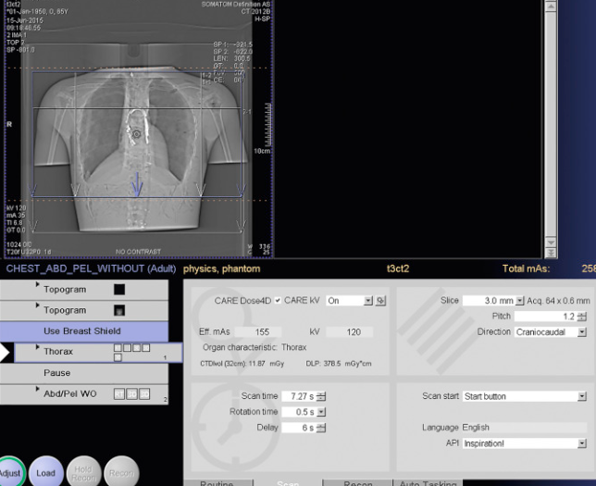
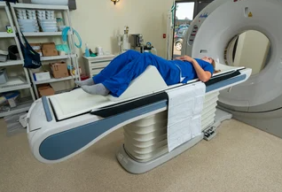
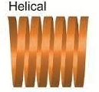
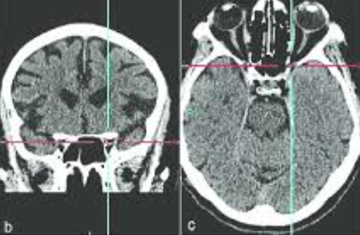
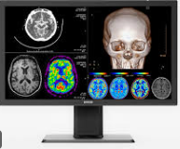
CT exams follow a systematic sequence:
Protocol selection (deciding what and how to scan).
Patient positioning (accurate centering prevents artifacts).
Scanning (data acquisition, either axial or spiral).
Reconstruction (mathematical processing of attenuation data into Hounsfield Units).
Display (DFOV, window/level adjustments).

Slide 4
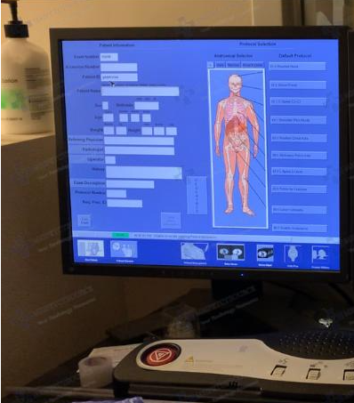
Protocol & Technique
Protocol Selection
Protocols are tailored to anatomy (head, chest, abdomen, extremities) and patient group (adult vs pediatric).
Pediatric scans must always prioritize lowest dose (ALARA).
Special protocols exist for vascular studies (CTA) vs soft tissue imaging.

Slide 5
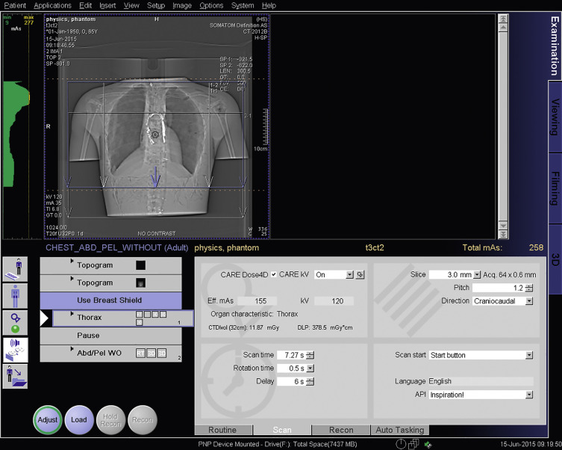
kVp: Controls photon energy, penetration,and quantity of radiation Higher kVp reduces contrast but decreases noise.
mA and Time (mAs): Control the total number of photons.
Time: Scan time (acquisition) or Tube rotation time
Directly proportional to dose and SNR.
Rotation Time: Shorter = less motion blur, but potentially more noise if mAs are low.
Scanning direction: cranio–caudal or caudo-cranial.

Slide 6
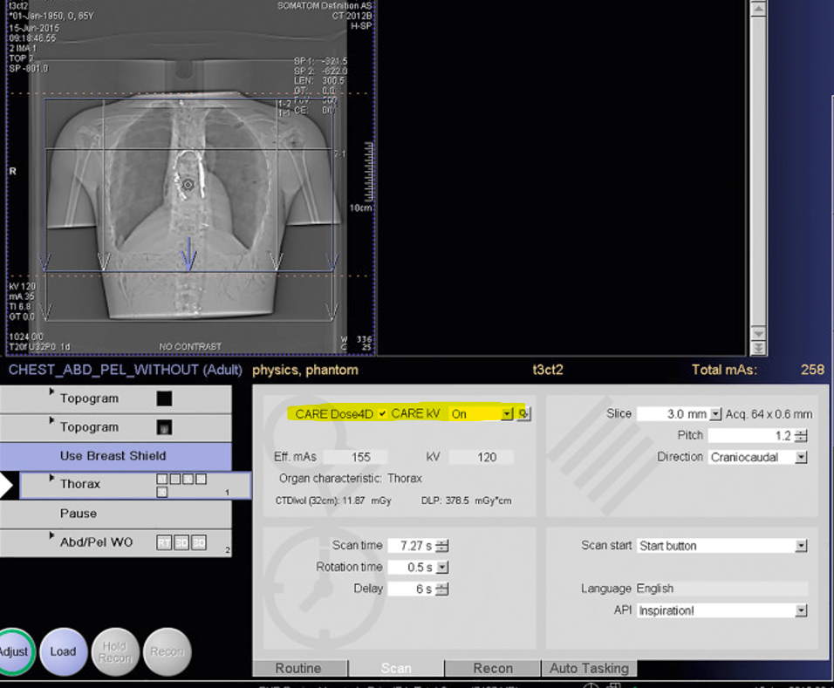
Care Dose 4D:
Purpose: To optimize radiation dose while maintaining consistent image quality.
How: The system automatically adjusts the tube current (mA) during the scan, based on patient size, shape, and attenuation.
How It Works
Topogram (Scout Image):
  The system analyzes the patient’s anatomy before the scan (from the scout view) to set baseline tube current.
Angular Modulation:
  As the tube rotates, the mA changes depending on how dense the body is at each angle (e.g., higher through shoulders, lower through lungs).
Longitudinal (z-axis) Modulation:
  Along the length of the patient, mA increases for denser areas (abdomen, pelvis) and decreases for less dense ones (chest).
Real-Time Adjustment (the “4D” part):
  It adapts throughout the entire scan in four dimensions:
    x-axis (left-right)
    y-axis (anterior-posterior)
    z-axis (head-to-toe)
    time (as the patient is scanned)

Slide 7
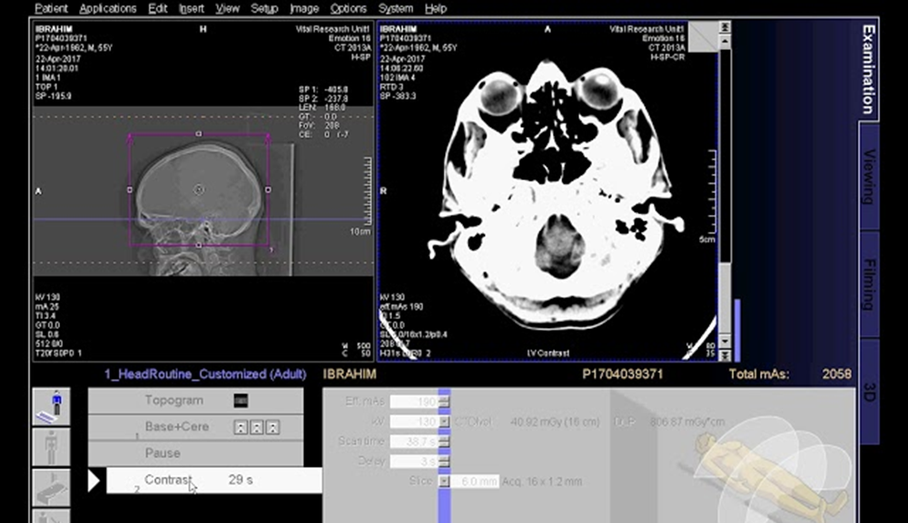
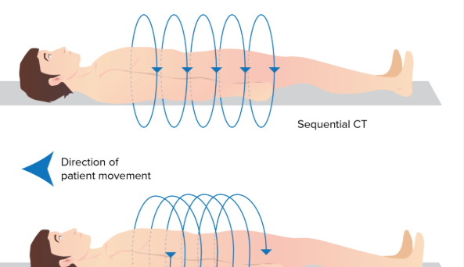
Scanning Modes
Axial (step-and-shoot): High precision, used in neuro. Table pauses → fewer motion artifacts.
Spiral (helical): Continuous rotation + table movement. Faster, isotropic voxels, better for 3D reformats.

Slide 8
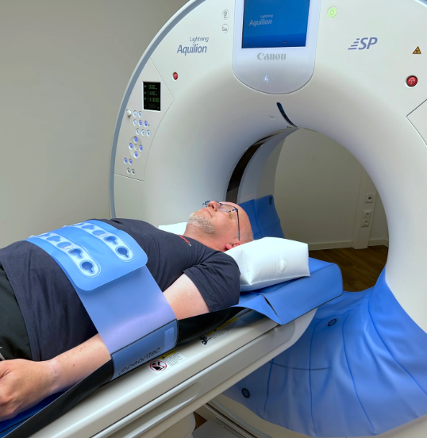
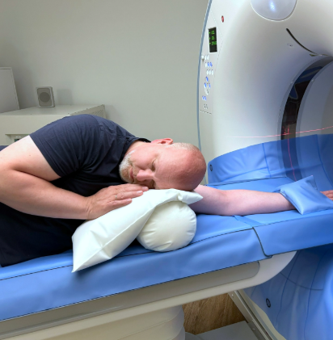
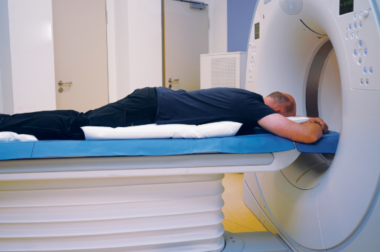
Patient Positioning
Correct centering ensures uniform dose modulation and minimizes artifacts. Off-centering can cause miscalculated mA (ATCM), increased noise, and inaccurate HU values. Supine, Prone, Lateral decubitus

Slide 9
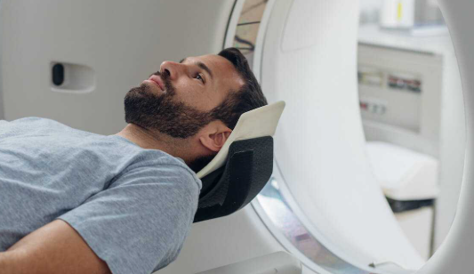
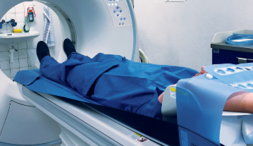
Patient Orientation
Options: head-first vs feet-first.
Must be properly documented in DICOM header for correct anatomical labeling.
Incorrect orientation may confuse the radiologist or cause reconstructions to invert anatomy.

Slide 10
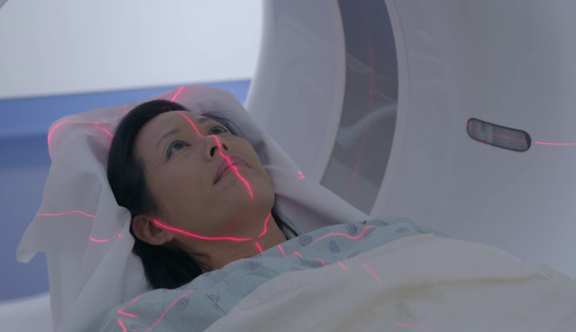
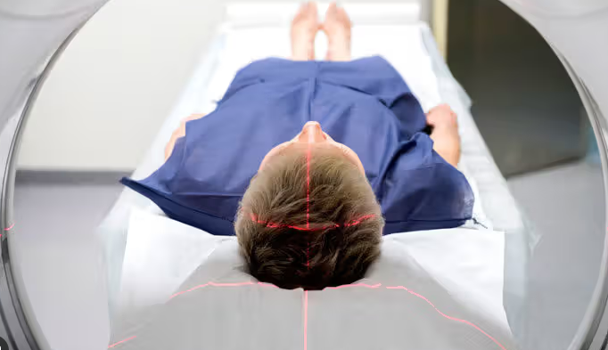
The body part being scanned must be positioned at the isocenter to ensure:
Accurate image geometry (no magnification or distortion).
Consistent image quality across the scan field.
Correct function of ATCM systems (like Care Dose 4D).

Slide 11
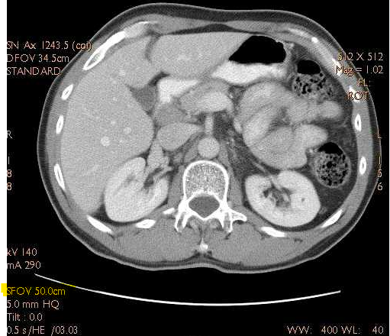
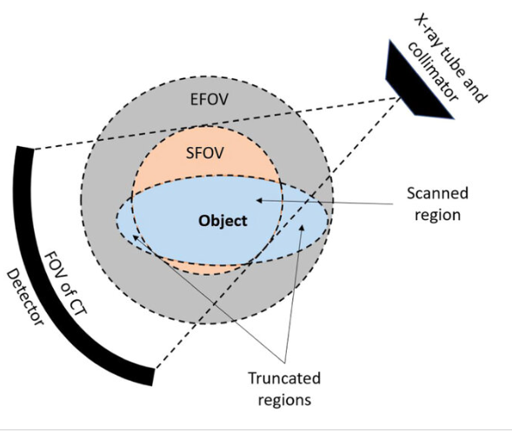
Scanning Field of View (SFOV)
Definition: The SFOV is determined by the scanner hardware — detector selection and calibration.
Purpose: It defines the maximum circular area from which the system acquires raw projection data.
Only anatomy inside the SFOV contributes to the reconstructed image. Anything outside is ignored, even if it appears in the display.

Slide 12
Importance of Correct SFOV Selection:
Image Quality: Choosing the appropriate SFOV ensures that detectors capture the entire region of interest with proper resolution.
Anatomy Coverage: A too-small SFOV can cut off or exclude important anatomy (e.g., shoulders, extremities).
Spatial Resolution: Using the smallest SFOV that fully covers the patient improves spatial resolution because smaller detector areas are sampled more finely.
Noise and Artifacts: Incorrect SFOV choice can increase image noise, introduce truncation artifacts, or degrade diagnostic value.
Reconstruction Limits: Once data is not acquired (outside SFOV), it cannot be recovered during reconstruction.

Slide 13
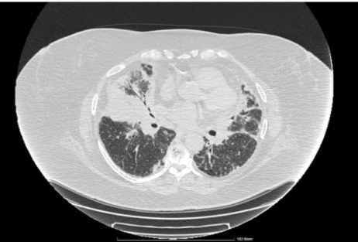
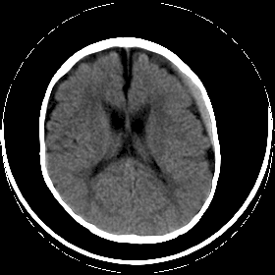
Practical Considerations
Match to Patient Size: Select SFOV large enough to include all relevant anatomy but not excessively large.
Consistency: Use standardized SFOV protocols (e.g., Head, Body Small, Body Large).
Centering: Proper patient isocenter positioning is critical; miscentering can result in anatomy falling outside the intended SFOV

Slide 14
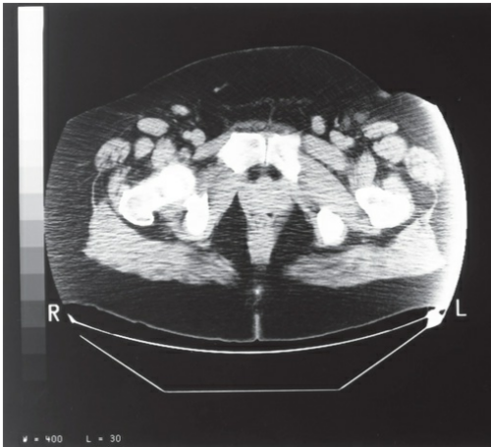
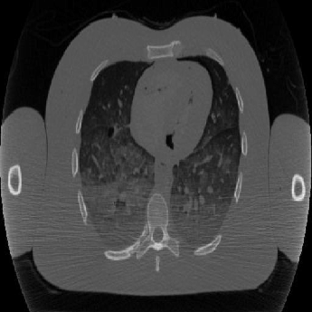
Out-of-Field Artifact
If anatomy extends beyond SFOV, no raw data collected. Appears as streaks, truncation, or missing anatomy.
Image: CT scan with truncation artifact.

Slide 15
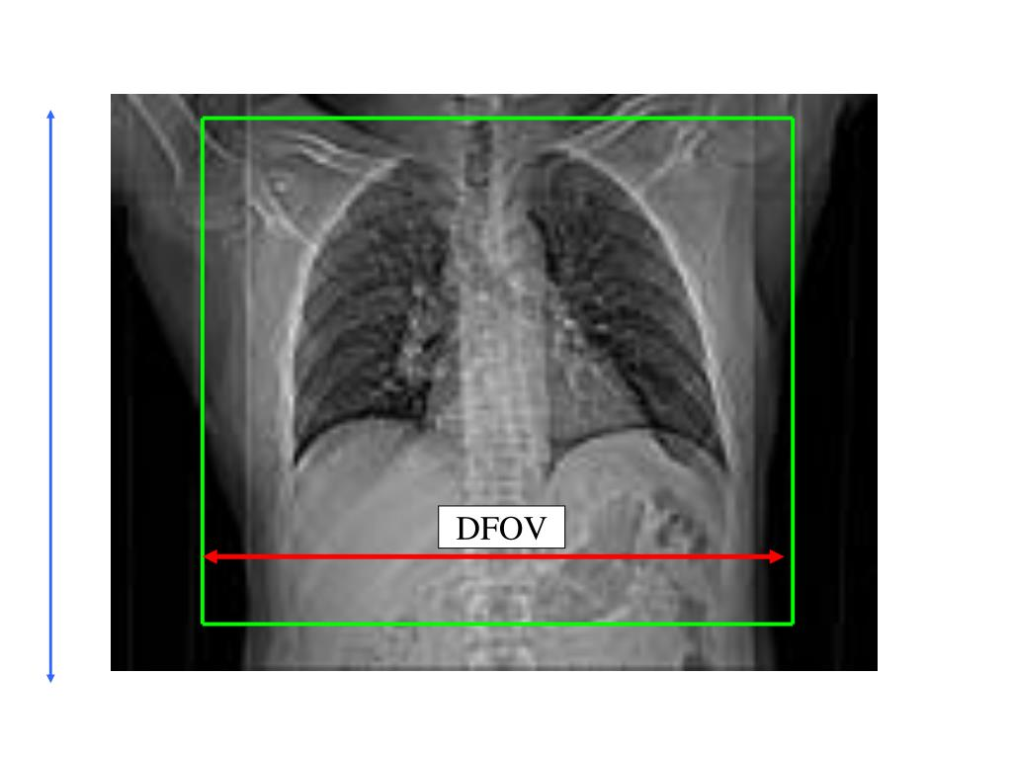
Display Field of View (DFOV)
Definition: The DFOV determines how much of the acquired raw data (from the SFOV) is displayed in the final reconstructed image.
Relationship to SFOV:
  DFOV can be equal to or smaller than the SFOV.
  DFOV can never be larger, since raw data outside the SFOV was never acquired.
Function: Acts like a “zoom window” on the acquired data — it controls what anatomy is displayed and at what scale

Slide 16
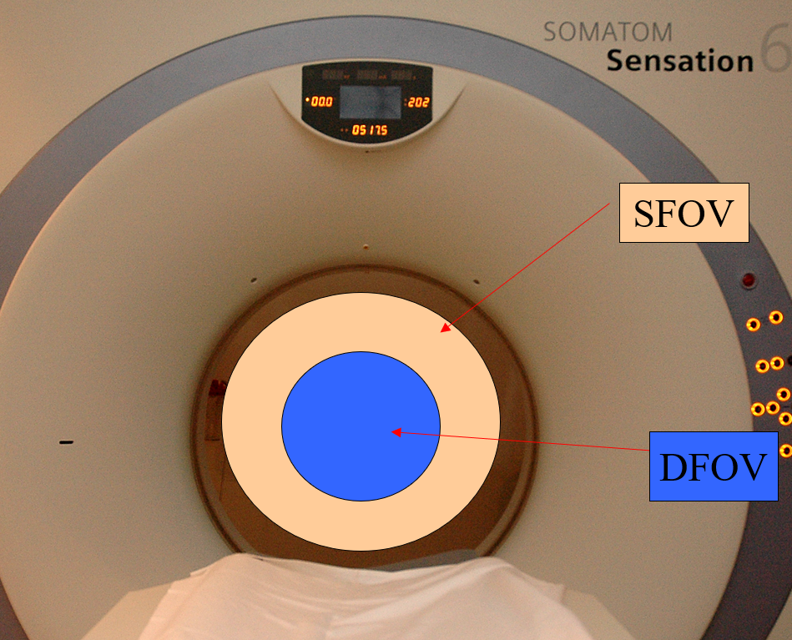
DFOV can be equal to or smaller than SFOV, never larger.

Slide 17
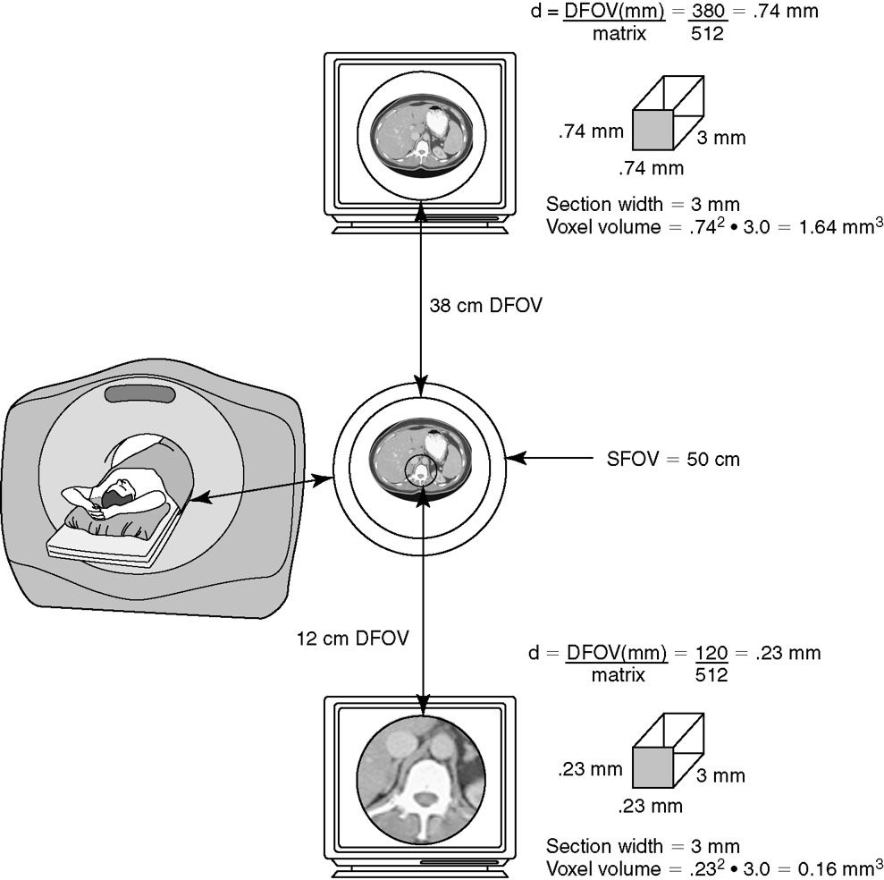
Effect on Image Quality
Smaller DFOV:
  Increases image magnification of the region of interest.
  Decreases pixel size (higher spatial resolution).
  Pixel size = DFOV ÷ Matrix
    Example: DFOV 25 cm ÷ 512 matrix ≈ 0.49 mm/pixel.
Larger DFOV:
  Shows more anatomy, but each pixel represents a larger area (lower resolution).
  Useful for overview images but may reduce diagnostic detail.

Slide 18
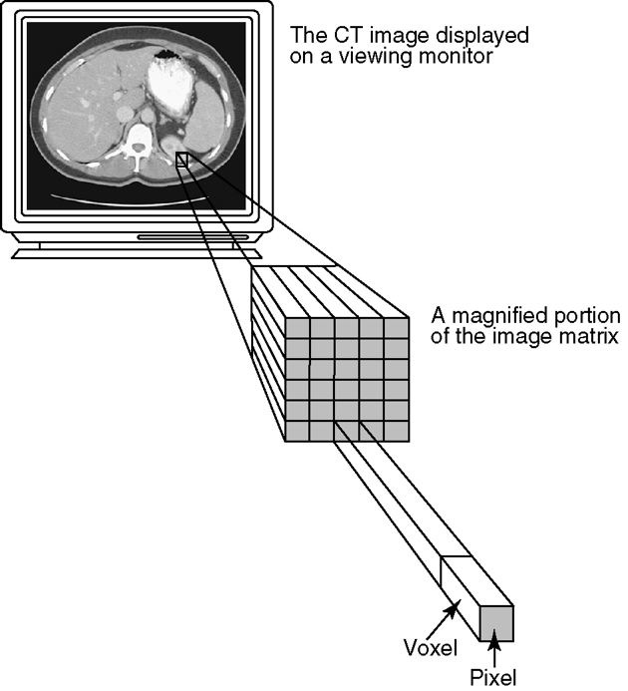
CT and Voxels
Voxel = 3D volume element (like a cube).
In CT, the patient is divided into many small voxels during image reconstruction.
Each voxel has a single value representing the average attenuation coefficient (how much X-rays were absorbed) for that tiny volume of tissue

Slide 19
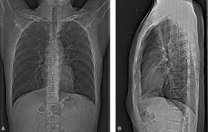
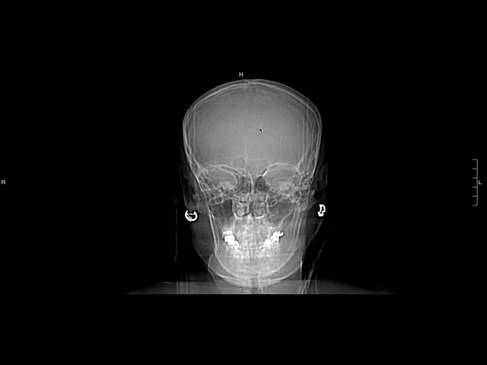
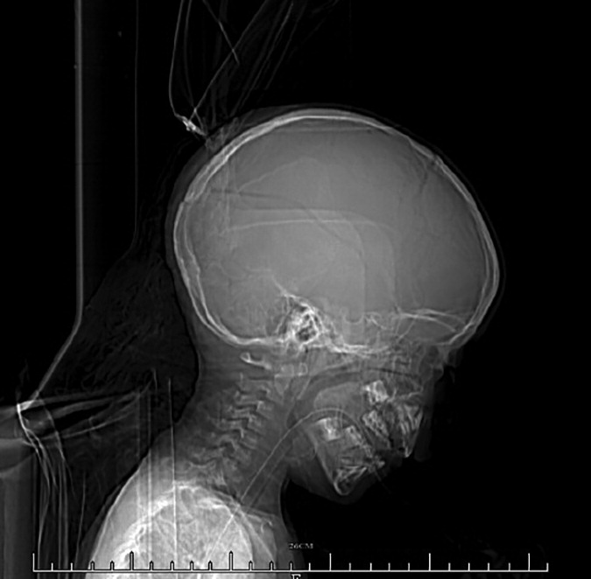
Scanning
2D projection, tube stationary. Used to plan start/stop positions, angle gantry, and avoid radiosensitive areas.
Errors in scout → misaligned slices.
During the scout acquisition, the tube is not rotating around the patient.
AP Scout
Lateral Scout
Lateral Scout
AP Scout

Slide 20
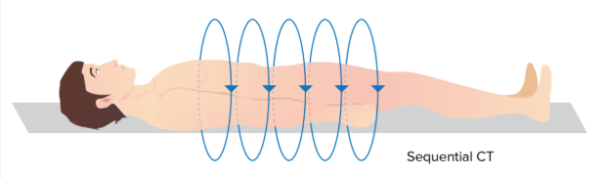
Axial (Sequential) CT Scans
Acquisition Method:
  Known as “step-and-shoot.”
  The table moves to a set position → X-ray tube rotates → acquires one slice.
  Table then moves again, repeats for the next slice.
Advantages:
  High contrast stability: Each slice is acquired at a fixed position, so tissue contrast is consistent.
  Lower risk of interpolation artifacts compared to helical mode (no interpolation between slices).
  Precise anatomical detail, especially useful when motion or fine bony detail is critical.
Disadvantages:
  Slower than helical scanning (table must stop for each slice).
  Potential for slice misregistration if the patient moves between acquisitions.
  Limited use for dynamic studies or large-volume scans

Slide 21
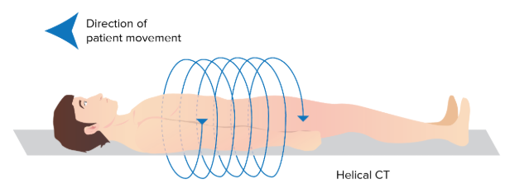
Spiral (Helical) CT Scans
Acquisition Method:
  X-ray tube rotates continuously around the patient while the table moves smoothly through the gantry.
  This creates a helical (spiral) path of data acquisition.
Advantages
Speed: Much faster than step-and-shoot; ideal for trauma, pediatrics, chest/abdomen/pelvis.
Continuous Coverage: No slice gaps, allowing imaging of long body regions in one breath-hold.
Less Motion Artifact: Faster scans reduce patient motion issues and respiratory misregistration.
Disadvantages
Requires interpolation between spiral paths → risk of helical interpolation artifacts (esp. at high pitch).
Slight trade-off in contrast stability compared to axial mode.

Slide 22
Acquisition Terminology
Ray
A single path of X-ray photons traveling through the patient to strike one detector element.
Each ray measures attenuation along its path.
View
A collection of rays acquired at one tube position during a single projection.
As the tube rotates, many views are collected at different angles around the patient.
Example: 1,000+ views per rotation.
Profile
The analog signal from a single view.
Represents the summed attenuation values from all rays in that projection before being digitized.
Once digitized, profiles become the raw data used for reconstruction.

Slide 23
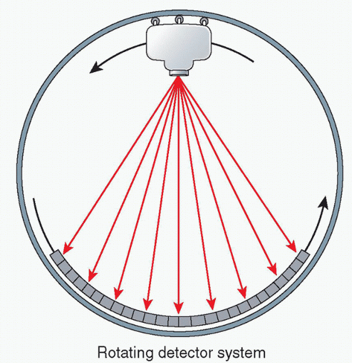
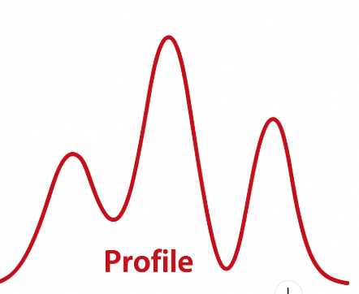
Ray
Analog Signal Profile
View

Slide 24
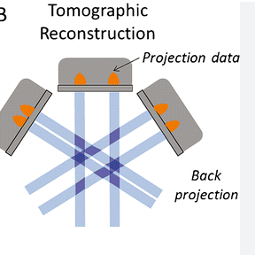
Reconstruction Basics
Raw data → mathematical backprojection → image matrix.
Modern scanners use filtered backprojection or iterative reconstruction.

Slide 25
Linear Attenuation Coefficient (µ) - Reconstruction
Definition:
  A physical property that describes how strongly a material (tissue) absorbs or weakens an X-ray beam as it passes through.
  Units: cm⁻¹ (per centimeter).
Mathematical Meaning:
  Expressed in the equation I = I₀ e^(−µx) (Lamber –Beer Law)
    I₀ = incident X-ray intensity
    I = transmitted X-ray intensity
    µ = linear attenuation coefficient
    x = thickness of material
  Higher µ → faster exponential decay → less X-ray passes through

Slide 26
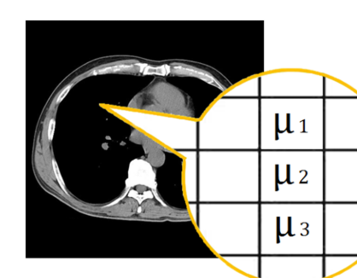
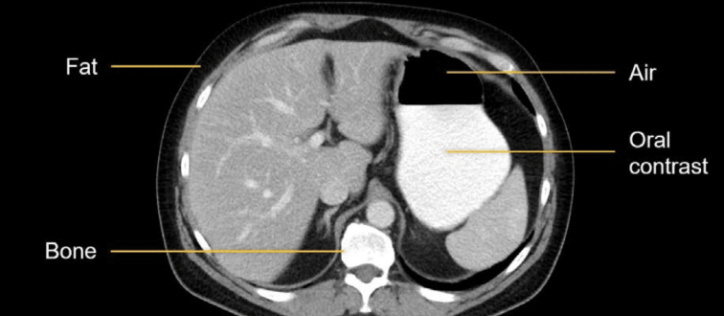
Tissue Examples (at diagnostic energies)
Bone: High µ (dense, high atomic number, absorbs more). Appears white on the CT image
Soft Tissue: Moderate µ. Appears grey on the CT image
Air: Very low µ (almost transparent to X-rays). Appears black on the CT image

Slide 27
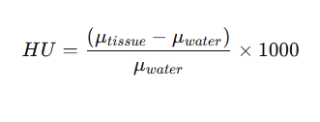
CT scanners measure tissue attenuation using the linear attenuation coefficient (µ), but because raw µ values vary with scanner settings and beam energy, they are standardized into Hounsfield Units (HU). Water is used as the reference point (set at 0 HU), and all other tissues are expressed relative to it: air, with almost no attenuation, is –1000 HU; fat is about –100 HU; soft tissue is +30 to +60 HU; and dense bone reaches +700 or more. This conversion provides a universal scale that ensures images are consistent and comparable across patients and scanners

Slide 28
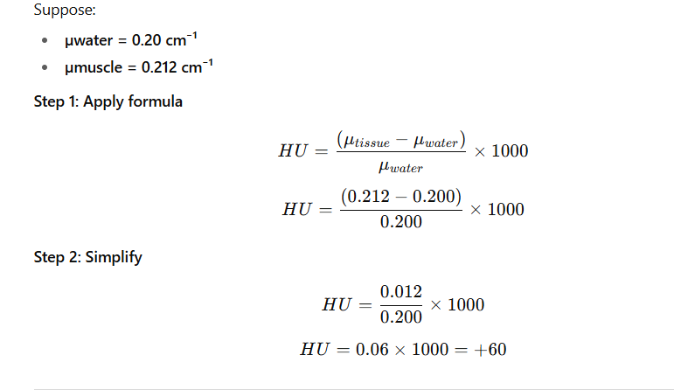
CT# of +60 is associated with muscle

Slide 29
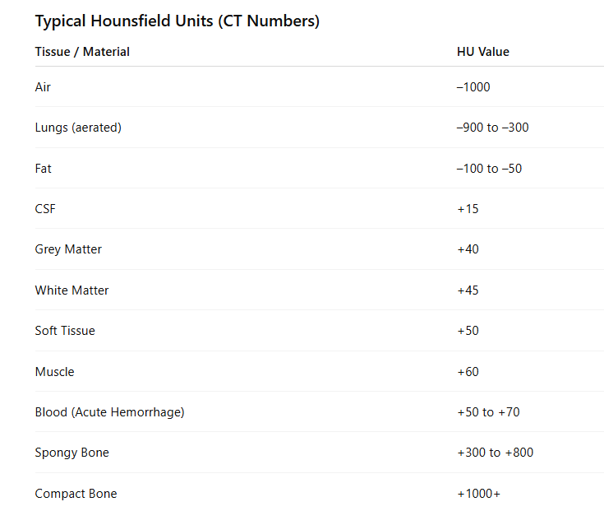

Slide 30
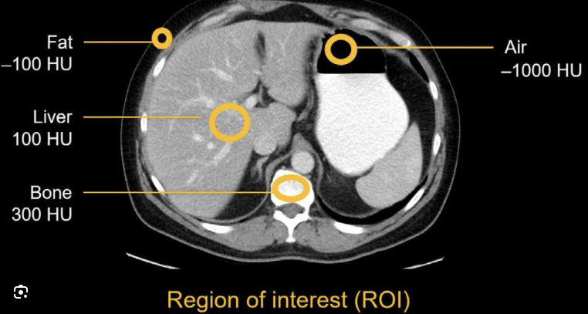
In CT imaging, ROI stands for Region of Interest.
An ROI is a selected area on the CT image (outlined by the technologist or radiologist) used for quantitative measurements.
The CT computer then calculates statistics (average HU, standard deviation, area, etc.) within that region.

Slide 31
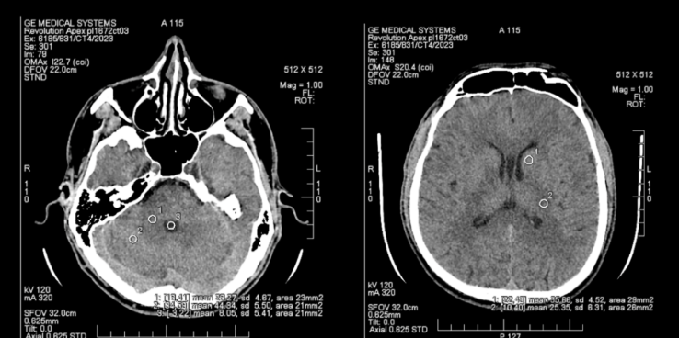

Slide 32
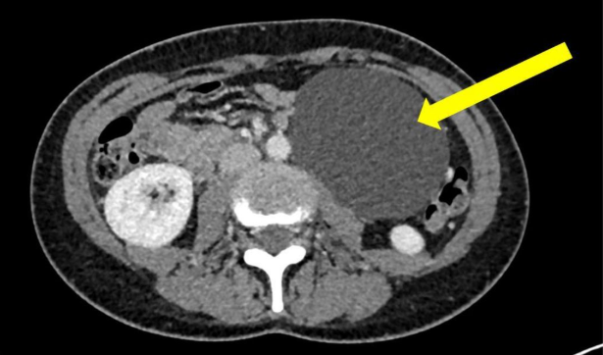
Clinical HU Applications
Cystic Lesions (Water Density)
CT cyst = ~0 HU. Appears homogeneous, water-like.
Helps distinguish cysts from solid tumors.
HU ~0

Slide 33
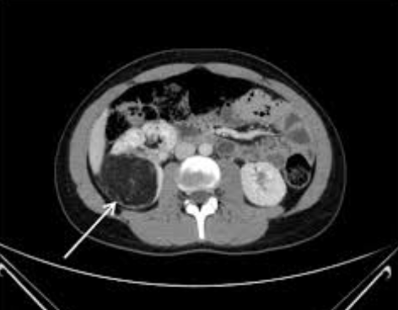
Angiomyolipoma is diagnosed on CT when the lesion contains regions with negative HU values (–10 to –100), representing macroscopic fat.
-20

Slide 34
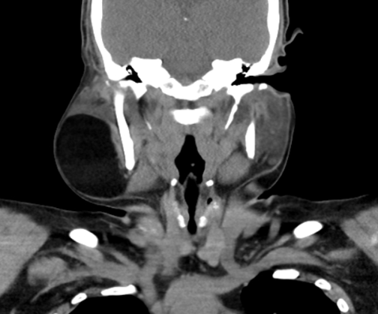
CT Appearance of Lipoma
Attenuation (CT Numbers):
  Lipoma = fat density, typically –50 to –100 HU.
  Homogeneous, well-defined low-density lesion.
-80

Slide 35
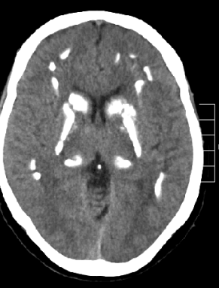
Brain Calcification and CT Numbers
Attenuation:
  Calcifications measure +100 to +400 HU (depending on density and thickness).
  Denser calcifications can approach +1000 HU, overlapping with bone.
+200

Slide 36
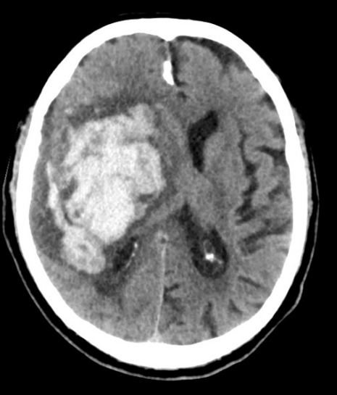
CT Numbers of Hemorrhage
Acute Hemorrhage (fresh blood):
  Typically +30 to +45 HU
  Appears hyperdense (bright) compared to brain parenchyma.
  Early recognition is key in trauma and stroke imaging.
+60

