Slide 1
Simplifying Exposure Index
DI Calculations

Slide 2
Learning Objectives
Conventional Radiography
Digital Imaging
Computed Radiography (CR)
Digital Radiography (DR)
Exposure Indices

Slide 3
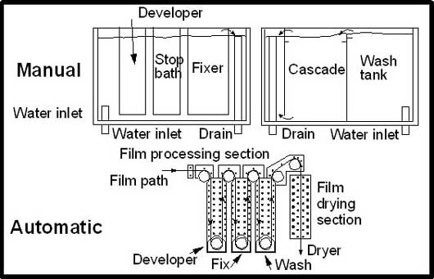
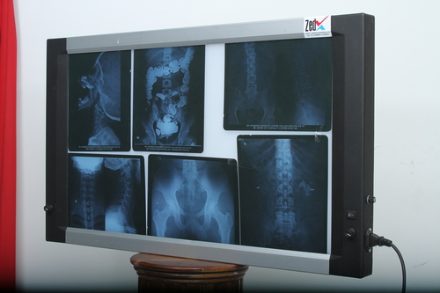
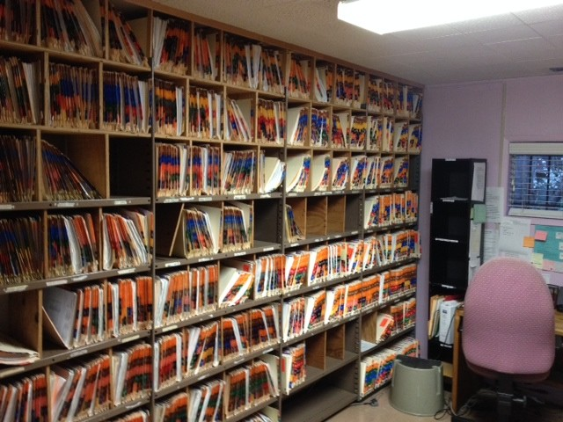
Conventional Radiography
X-ray beam enters and exits the patient to reach the photographic film
followed by chemical processing of the film
processed image to be viewed in a view box
stored as hard copy

Slide 4
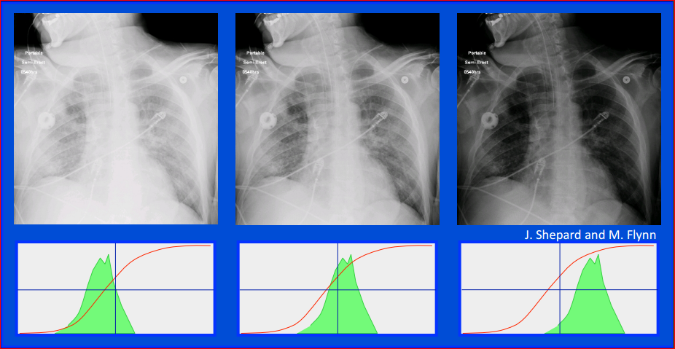
Traditional photographic film screen systems use overall film density as an exposure indicator – direct feedback to the technologists
Optimum exposed
Overexposed
Underexposed

Slide 5
Conventional Radiography - disadvantages
long processing time (approx. 11 minutes)
unable to enhance the images
inherent noise due to scatter which degrades the image quality
need physical storage for processed film
environmental hazard due to chemical waste

Slide 6
Digital Imaging
an x-ray imaging technique that produces an electronic image instead of photographic film
image can be viewed, manipulated by a computer
Digital Radiography *
Digital fluoroscopy: first to use the digital technology
CT
MRI
Ultrasound
Nuclear medicine

Slide 7
Digital Imaging
No need for photographic film and processing hardware
Images are
acquired and displayed quickly
manipulated through post-processing
interpreted on a display monitor
stored and retrieved via electronic methods
transmitted electronically efficiently

Slide 8
Digital Imaging in Routine Diagnostic Radiography
Film Digitizer
Digital Fluorography
Digital Radiography
Flat Panel Detectors
(FPD) / DR
Photostimulable Phosphor Technology (CR)
Computed Radiography
Flat panel capture detectors (TFT)
Charged coupled device (CCD)
Indirect conversion
Direct conversion

Slide 9
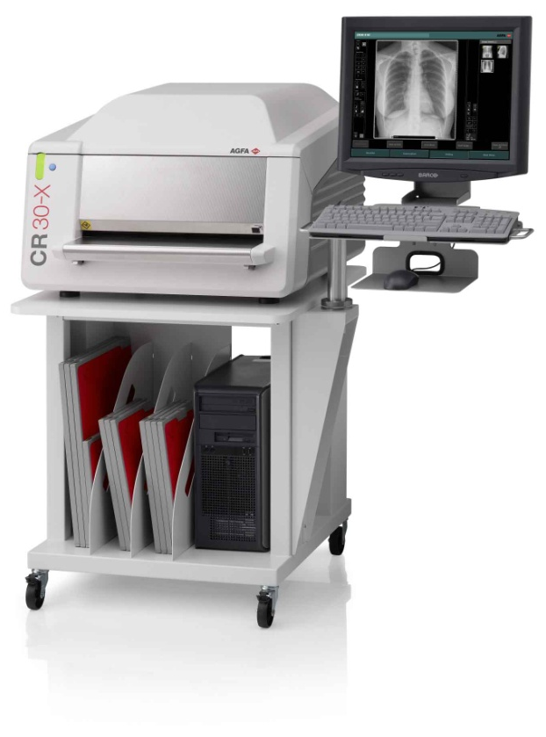
Digital Imaging (PSP/CR)
Computed Radiography (CR): a cassette-based system that uses photo-stimulable phosphorus to produce radiographic images
developed by Fujifilm
process:
expose cassette or imaging plate (IP) with x-ray
insert into reader to be scanned by laser, and
read and manipulate on monitor

Slide 10
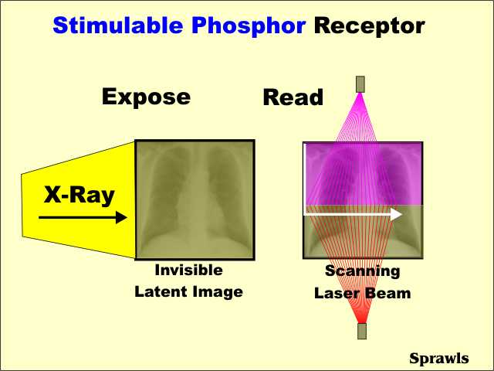
PSP (CR)
X-RAYS
Storage Phosphor Plate (PSP)
SCANNER
ADC
11011101

Slide 11
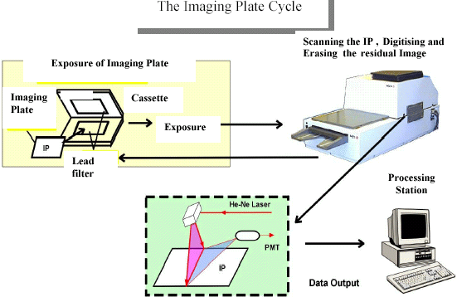
Digital Imaging (PSP/CR)

Slide 12
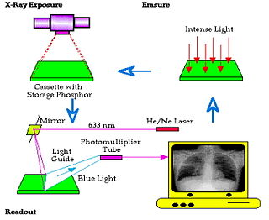
Digital Imaging (PSP/CR)

Slide 13
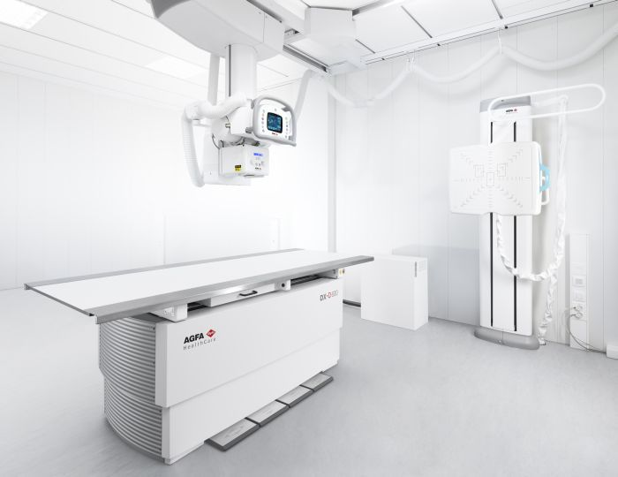
Digital Imaging (FPD/DR)
Digital Radiographic (DR): a flat panel device using a x-ray absorber material coupled with a detector to make an image
make exposure with x-ray,
directly transfer to computer,
read and manipulate on monitor
it can be cassette-based (wireless portable FPD)
it can be cassette-less (fixed detector)

Slide 14
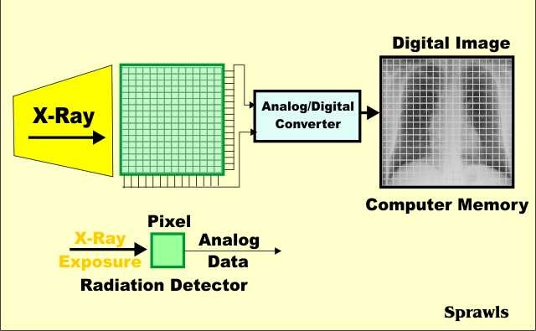
FPD (DR)
X-RAYS
FPD
DETECTORS
DIRECT READOUT (no laser needed)
ADC
11011101

Slide 15
Digital Imaging - Advantages
Wide Dynamic Range: the range of shades of gray that can be displayed
High Contrast Resolution: the ability of a system to resolve adjacent structures of similar mass densities
Signal to Noise Ratio (SNR): a ratio of useful data (signal) to useless data (noise)
dependent on mAs (a quantity of radiation exposing the patient and reaching the detector)
Higher SNR is desirable as low SNR have a noise which makes diagnosis difficult

Slide 16
Digital Imaging - Disadvantages
Wide dynamic range can obscure the concept of ‘correct exposure’ i.e. displayed density and exposure factors has no relation due to internal scaling
Lack of visual feedback about exposure factors
potential for increased exposure or high dose of radiation, if unchecked
potential for underexposure: image noise can reduce diagnostic accuracy
hence, the development of Exposure Index (EI)

Slide 17
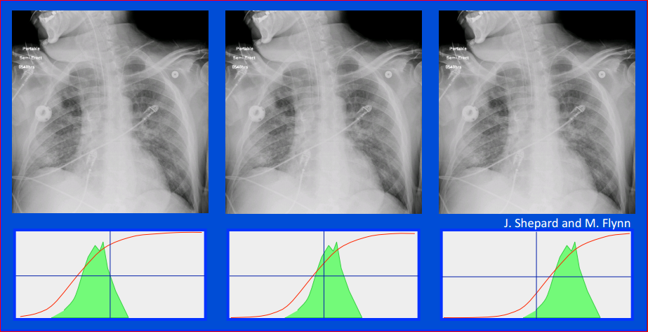
CR/DR systems use image processing to align the gray scale within the signals – NO feedback to the technologists

Slide 18
Exposure Index (CR)
a feedback method developed, by Fuji films in 1980, to measure the exposure reaching digital detector
manufacturers use proprietary method with a wide variety of terminology i.e. very inconsistent and confusing
value changes in a linear manner (Fuji, Philips, Konica-Minolta, Siemens),
In Fuji system, it is called Sensitivity number or S#
S# increases, exposure reduced
value changes in a logarithmic manner (Agfa, Kodak)
Kodak calls EI #, has direct relationship
Value increases, exposure increases

Slide 19
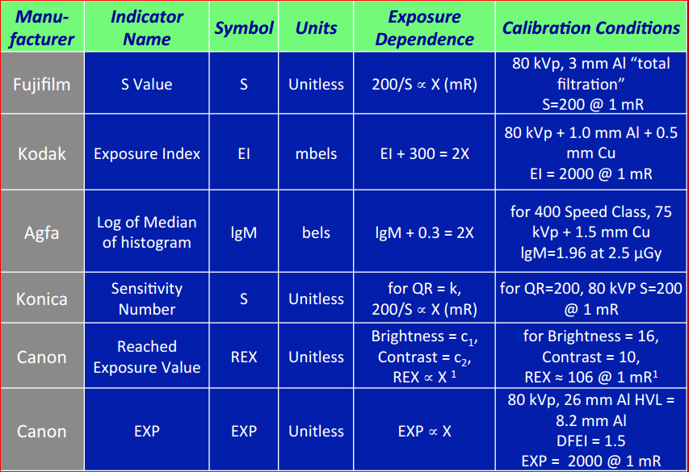
Exposure Index (CR)

Slide 20
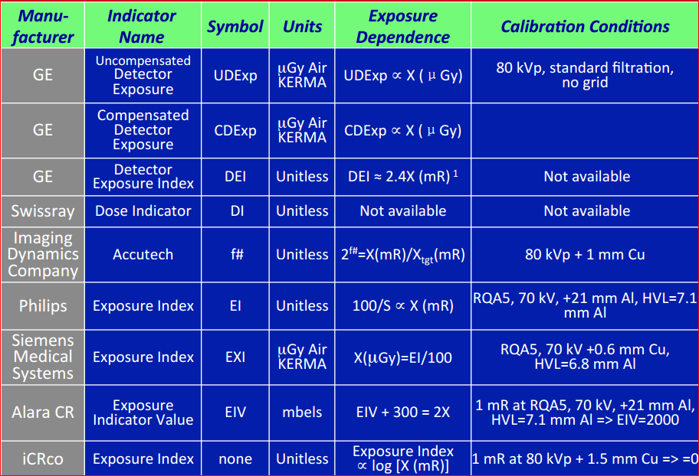
Exposure Index (CR)

Slide 21
Exposure Index (CR)

Slide 22
Standardization of Exposure Index (DR) (IEC 62494 -1)
Standardization done by:
IEC (International Electrotechnical Commission), &
AAPM (American Association of Physicists in Medicine) Task Group 16

Slide 23
Exposure Index (DR)
developed common “Exposure Indices” and “Deviation Indices” across detectors and manufacturers/vendors
purpose:
to monitor exposure consistency (prevention of over and under exposure) within an exam type especially with initiatives of Image Gently and Image Wisely using ALARA principle
producing image of accepting quality

Slide 24
Exposure Index (DR)
consists of three values
Exposure Index (EI):
is a measure of radiation in the relevant image region on the receptor
is a function of the region of interest (ROI) selected by the digital radiography workstation for the examination type, image processing, and exposure used
is linear in relation to detector exposure i.e. double the mAs means double the EI

Slide 25
Exposure Index (DR)
consists of three values
Target Exposure Index (EI_{T}):
is the reference exposure value obtained for each exam type using the statistical average of 50 exposures
set by the manufacturer or by the local imaging center
is dependent on the body part, view, procedure, and imaging receptor

Slide 26
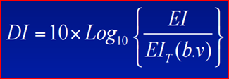
Exposure Index (DR)
consists of three values
Deviation Index (DI):
quantifies how much the actual EI varies from the EI_{T}, defined by the following formula
b = body part, v = view
a good indicator of under and over exposure
3 deviation units equals 2x exposure or ½ exposure (+3 or -3)
DI = 0 when EI = EI_{T}
DI = +3.0 i.e. 2 x EI_{T}
DI = -3.0 i.e. ½ x EI_{T}

Slide 27
Exposure Index & Patient Dose
EI can not calculate or is not related to patient dose
patient dose is related to the followings:
patient body habitus
detector type
type of filters used
use of collimation
use of grid

Slide 28
Exposure Index (DR) - AGFA
3 colors Dose-Bar graph which helps radiologic technologist to monitor the exposure technique quality personally
Color improves the interpretation of lgM/DI
Green: within range
Yellow: slightly over or slightly under exposure
Red: significantly over or significantly under exposure

Slide 29
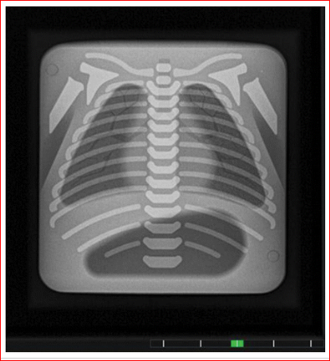
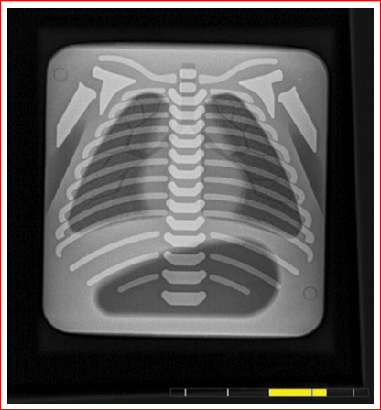
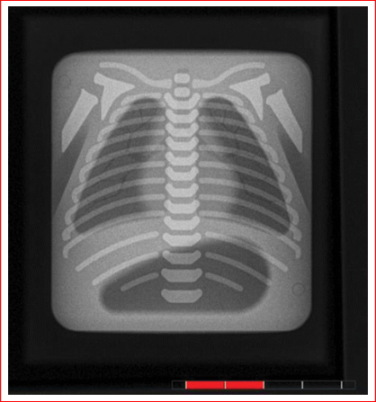
Exposure Index (DR) - AGFA
-3 < D.I. < +3
Green bar
-6 < D.I. < -3 or
+ 3 < D.I. < +6
Yellow bar
D.I. < -6 or
+6 < D.I
Red bar

Slide 30
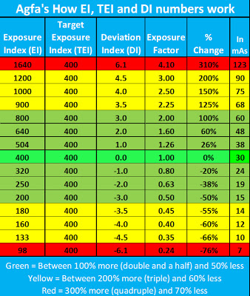
Exposure Index (DR) - AGFA

Slide 31
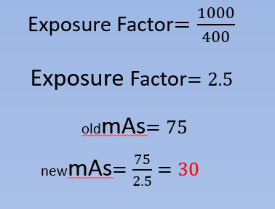
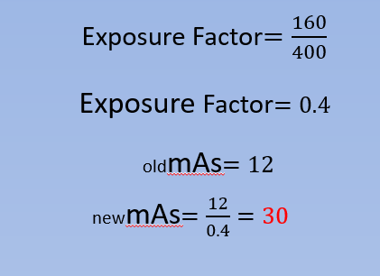
Technique Compensastion using EI and TEI

Slide 32
Technique Compensastion using DI
D$eviation Index=$ 4.0
Exposure Factor$={10}^{DI/10}$
Exposure Factor$={10}^{4.0/10}$
Exposure Factor$={10}^{0.4}$
Exposure Factor$=2.5$
oldmAs$=75$
newmAs$=\frac{75}{2.5}=30$

Slide 33
$$A=πr^{2}$$
$$DI=10 x log\frac{800}{400}$$
$$DI=10 x\log{2}$$
$$DI=10 x 0.3$$
$$DI=3$$
$$DI=10 x log\frac{200}{400}$$
$$DI=10 x\log{0.5}$$
$DI=10 x (−0.3$)
$$DI=−3$$

Slide 34
Exposure Index (DR) - AGFA

Slide 35
Exposure Index (DR) - AGFA

Slide 36
Exposure Index (DR) - AGFA

Slide 37
Exposure Index (DR) - AGFA

Slide 38
Exposure Index (DR) - AGFA

