Slide 1
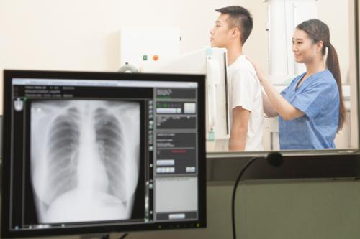
Exposure and Radiographic Technique

Slide 2
X-ray Emission
The intensity of the X-ray beam of an X-ray imaging system is measured in roentgens (R) or milliroentgens (mR) and is called the X-ray quantity. Another term, radiation exposure ( primary signal intensity), is often used instead of x-ray intensity or x-ray quantity. All have the same meaning and all are measured in R or mR.
X-ray quantity is the number of x-rays in the useful beam

Slide 3
Primary Factors
The primary exposure technique factors the radiographer selects on the control panel are milliamperage, time of exposure, and kilovoltage peak (kVp). Depending on the type of control panel, milliamperage and exposure time may be selected separately or combined as one factor, milliamperage/second (mAs). Regardless, it is important to understand how changing each separately or in combination affects the radiation reaching the IR and the radiographic image.

Slide 4
Prime Exposure Factors
mAs (mA x time)
kVp ( potential difference) kilo x volt x peak
SID ( distance)

Slide 5
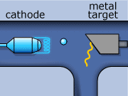
Potential difference kVp
mA
X-ray photons

Slide 6
The quantity of x-ray photons in an exposure cannot be determined by either the mA or the exposure time alone. Although mA determines the rate of x-ray production, it does not indicate the total quantity, because it does not indicate how long the exposure lasts. Exposure time does not indicate the total quantity either, because it does not measure the rate of x-ray production. To determine the quantity of radiation involved in an exposure, both mA and time must be considered.
mA x Time (sec) = mAs

Slide 7
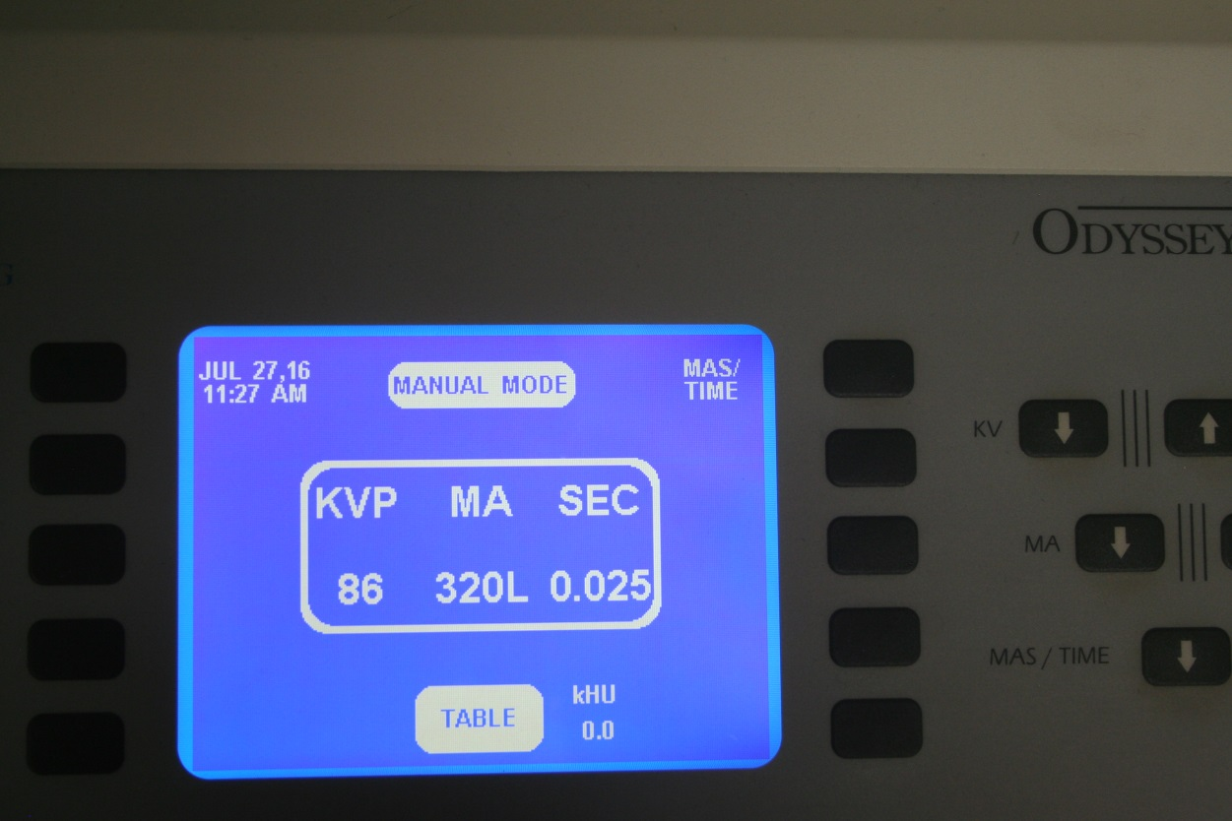
320 mA x 0.025 (sec) = 8 mAs

Slide 8
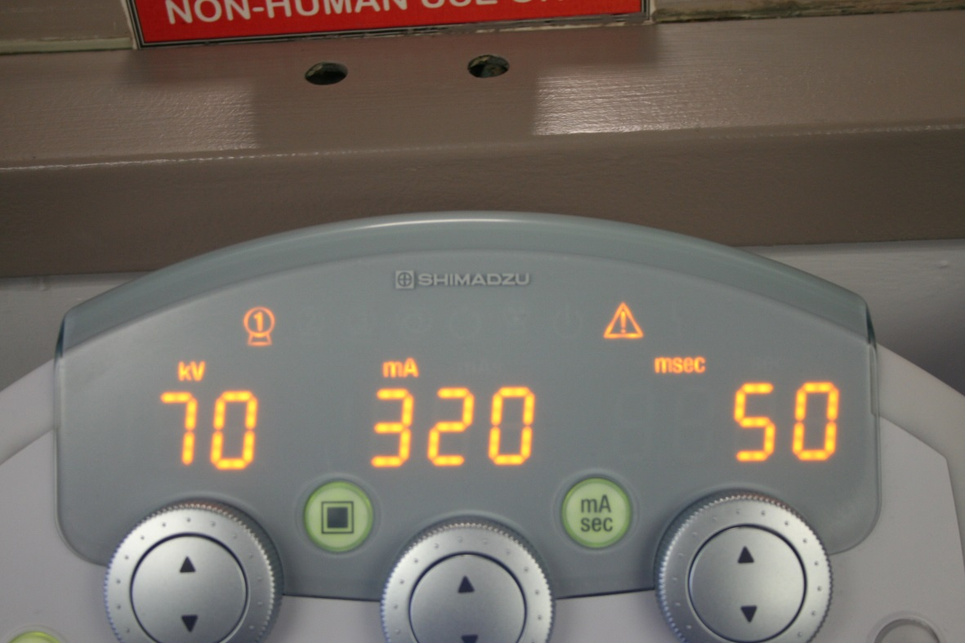
320 mA x 0.050 (sec) = 16 mAs

Slide 9
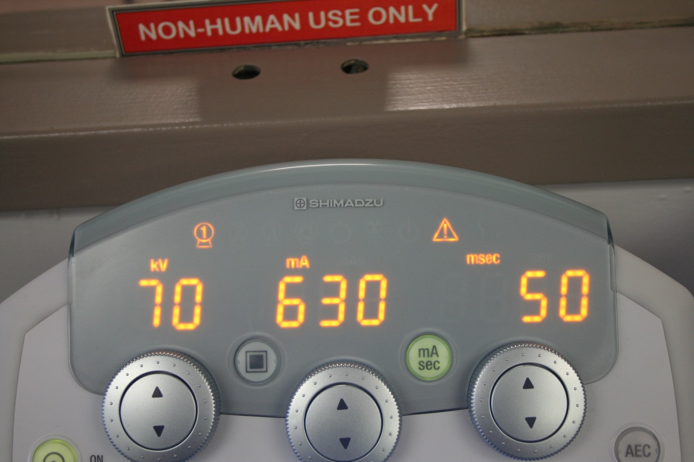
630 mA x 0.050 (sec) = 31.5 mAs

Slide 10
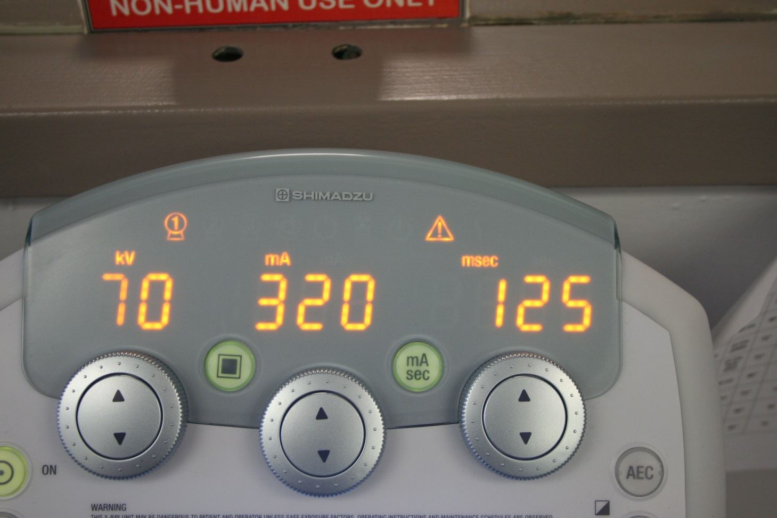
320 mA x 0.125 (sec) = 40 mAs

Slide 11
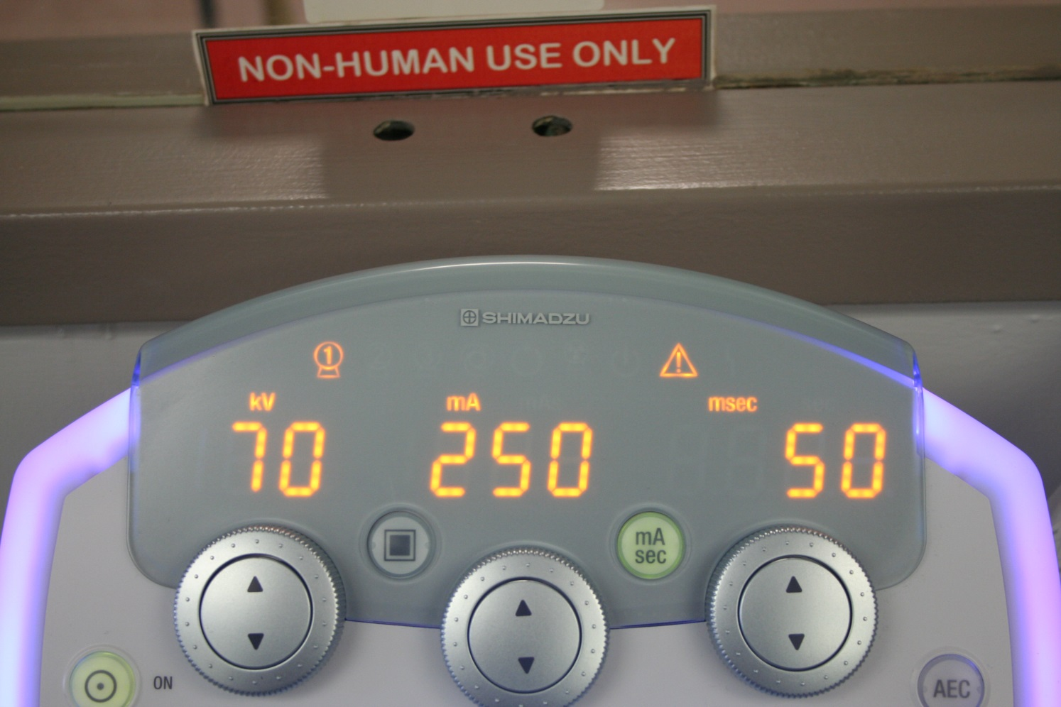
___ mA x ___ (sec) = ___ mAs

Slide 12
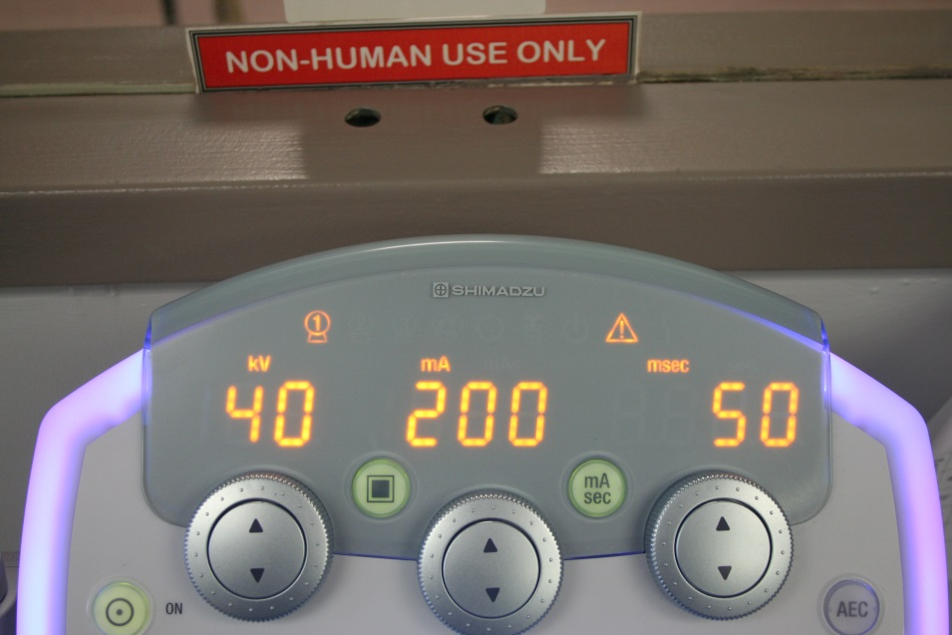
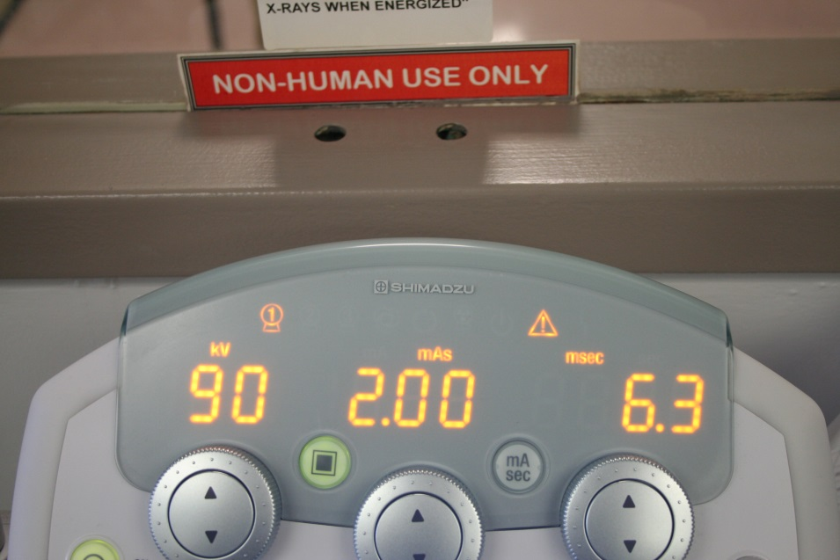
Three button mode
Two button mode

Slide 13
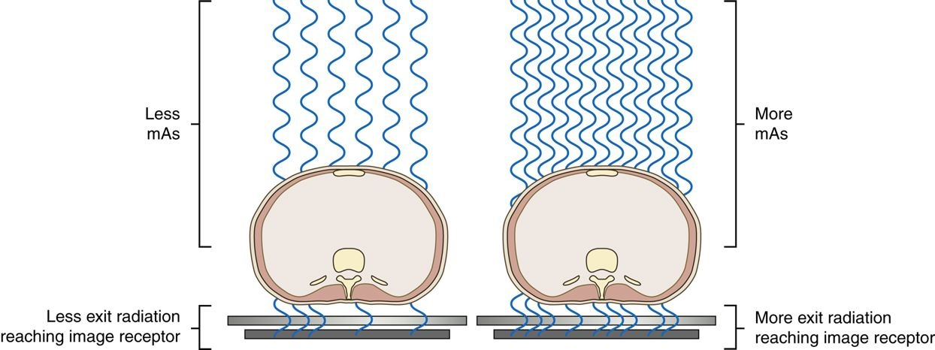
As the mAs is increased, the quantity of radiation reaching the IR is increased. As the mAs is decreased, the amount of radiation reaching the IR is decreased.

Slide 14
When the kVp is increased at the control panel, a larger potential difference occurs in the x-ray tube, giving more electrons the kinetic energy to produce x-rays and increasing the kinetic energy overall. The result is more photons (quantity) and higher energy photons (quality).

Slide 15
mAs reciprocity

Slide 16
2 factors that directly control exposure:
mA
time

Slide 17
Increase in mA:
increase in quantity of x-rays produced
increase in exposure

Slide 18
Decrease in mA:
decrease in quantity of x-rays produced
decrease in exposure

Slide 19
Time
controls how long the mA is working
only affects exposure (nothing else)
increase in time
increase in exposure
decrease in time
decrease in exposure

Slide 20
mA x time = mAs
primary controller of x-ray beam quantity and exposure
increase in mAs - increase in exposure
decrease in mAs - decrease in exposure

Slide 21
Reciprocity law:
states that a variety of different mA & time settings could produce the same mAs and therefore same exposure.

Slide 22
Relationship between mA & time:
- inversely proportional
- as mA increases, time decreases

Slide 23
Three instances to use law of reciprocity:
control motion - short exposure time, high mA
to use a small focal spot FSS (small filament) - improves sharpness
use breathing technique - low mA with long time

Slide 24
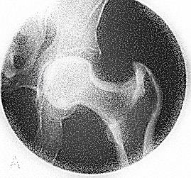

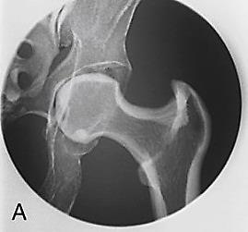
mA | time | mAs
50 | 1 sec | 50
100 | 1 sec | 100
200 | 1 sec | 200
200 mR
400 mR
800 mR

Slide 25
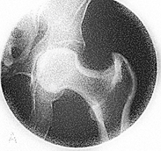

200 mR
400 mR
800mR

Slide 26
mA | time | mAs
100 | 0.5 sec | 50
100 | 1 sec | 100
100 | 2 sec | 200
200 mR
400 mR
800 mR

Slide 27
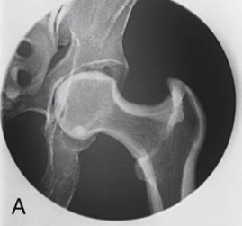
mA | time | mAs
400 | 0.5 sec | 200
200 | 1 sec | 200
100 | 2 sec | 200
800 mR
800 mR
800 mR

Slide 28
mA | time | mAs
200 | 1 sec | 200
100 | 2 sec | 200
50 | 4 sec | 200
800 mR
800 mR
800 mR

Slide 29
When the kVp is increased at the control panel, a larger potential difference occurs in the x-ray tube, giving more electrons the kinetic energy to produce x-rays and increasing the kinetic energy overall. The result is more photons (quantity) and higher energy photons (quality).
Kilovoltage

Slide 30
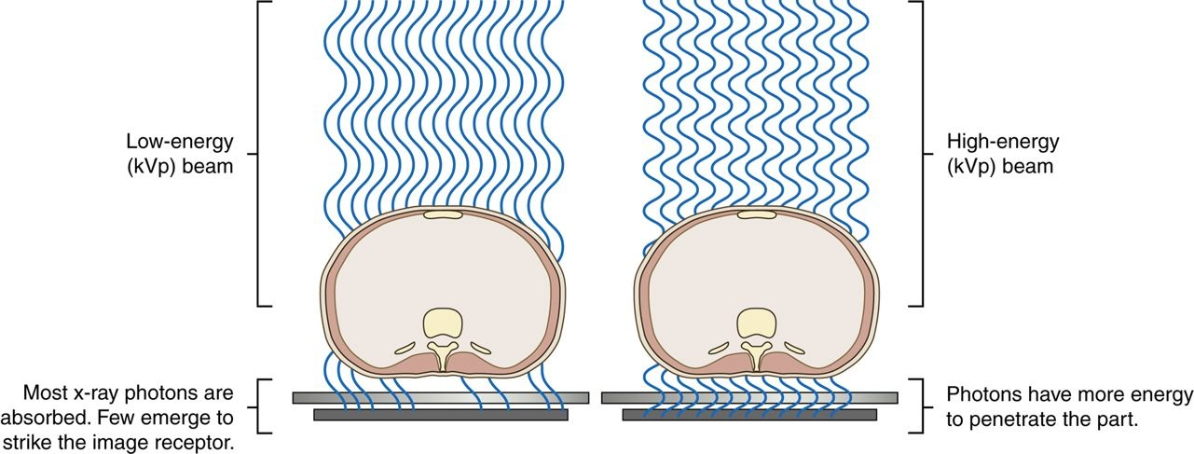
The kVp affects the exposure to the IR because it alters the amount and penetrating ability of the x-ray beam.
Altering the penetrating power of the x-ray beam affects its absorption and transmission through the anatomic tissue being radiographed. Higher kVp increases the penetrating power of the x-ray beam and results in less absorption and more transmission in the anatomic tissues

Slide 31
kVp is the primary controlling factor of
the x-ray beam quality

Slide 32
The area of interest must be adequately penetrated before the mAs can be adjusted to produce a quality radiographic image. When adequate penetration is achieved, further increasing the kVp results in more radiation reaching the IR. Unlike mAs, the kVp affects the amount of radiation exposure to the IR and radiographic contrast.
Kilovoltage
kVp mainly controls how well the X-ray beam penetrates the patient, and it also affects the contrast of the image

Slide 33
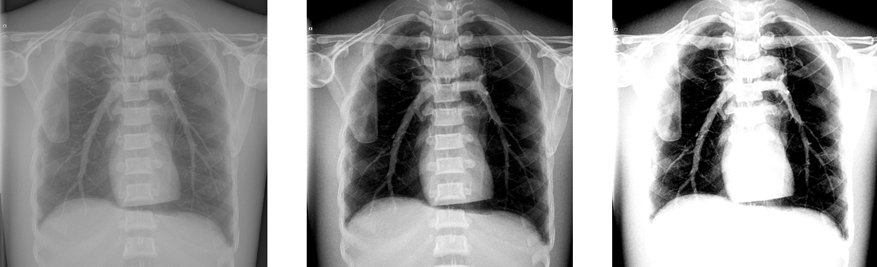
A high kVp results in less absorption and more transmission in the anatomic tissues, which results in less variation in the x-ray intensities exiting the patient (remnant), producing a low-contrast (long-scale) image. A low kVp results in more absorption and less transmission in the anatomic tissues, but with more variation in the x-ray intensities exiting the patient, resulting in a high-contrast (short-scale) image.

Slide 34
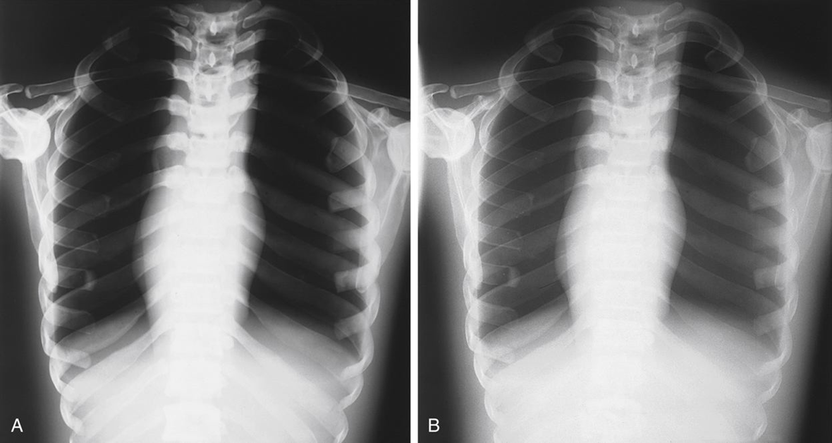
Low kVp
High kVp
High Contrast
Low Contrast

Slide 35
Maintaining or adjusting exposure to IR can be achieved by adjusting kVp using the 15% rule. The 15% rule states that changing the kVp by 15% has the same effect as doubling or halving the mAs.
For example:
Increasing the kVp from 82 to 94 (15%) produces the same exposure to the IR as increasing the mAs from 10 to 20.

Slide 36
The 15% rule was developed in the mid-50’s. Of course, this was back in the days of film/screen, but it still holds true today in the digital world.

Slide 37
There are really 2 main reasons why someone would do the 15% Rule with mAs compensation:
Dose reduction
Time reduction

Slide 38
Exposure Index (DR)
  Developed common “Exposure Indices” and “Deviation Indices” across detectors and manufacturers/vendors
Purpose:
  to monitor exposure consistency (prevention of over and underexposure) within an exam type, especially with initiatives of Image Gently and Image Wisely using ALARA principle
  producing an image of acceptable quality

Slide 39
Exposure Index (DR)
Consists of three values
  Exposure Index (EI):
    is a measure of radiation in the relevant image region on the receptor
    is a function of the region of interest (ROI) selected by the digital radiography workstation for the examination type, image processing, and exposure used
    is linear in relation to detector exposure i.e. double the mAs means double the EI

Slide 40
Exposure Index (DR)
Consists of three values
  Target Exposure Index (EI_{T}):
    is the reference exposure value obtained for each exam type using the statistical average of 50 exposures
    set by the manufacturer or by the local imaging center
    is dependent on the body part, view, procedure, and imaging receptor

Slide 41
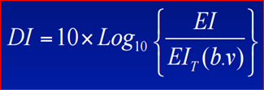
Exposure Index (DR)
Consists of three values
  Deviation Index (DI):
    quantifies how much the actual EI varies from the EI_{T}, defined by the following formula
    b = body part, v = view
    a good indicator of under and over exposure
    3 deviation units equals 2x exposure or ½ exposure (+3 or -3)
      DI = 0 when EI = EI_{T}
      DI = +3.0 i.e. 2 x EI_{T}
      DI = -3.0 i.e. ½ x EI_{T}

Slide 42
Exposure Index & Patient Dose
EI can not calculate or is not related to patient dose!
patient dose is related to the followings:
  patient body habitus
  detector type
  type of filters used
  use of collimation
  use of grid

Slide 43
Exposure Index (DR) - AGFA
Three colors Dose-Bar graph helps radiologic technologists to monitor the exposure technique quality personally
Color improves the interpretation of DI
  Green: within range
  Yellow: slightly over- or slightly under-exposure
  Red: significantly over- or significantly under-exposure

Slide 44
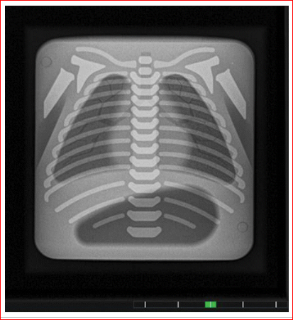
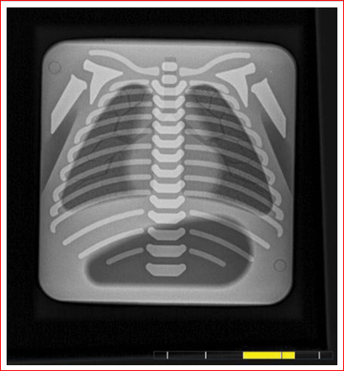
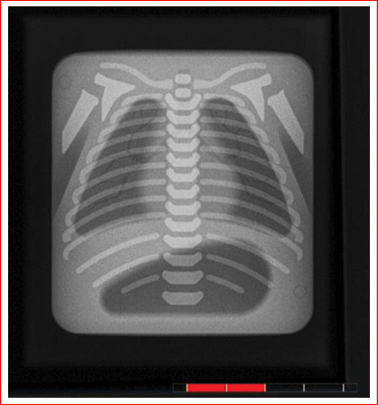
Exposure Index (DR) - AGFA
-3 < D.I. < +3
Green bar
-6 < D.I. < -3 or
+ 3 < D.I. < +6
Yellow bar
D.I. < -6 or
+6 < D.I
Red bar

Slide 45
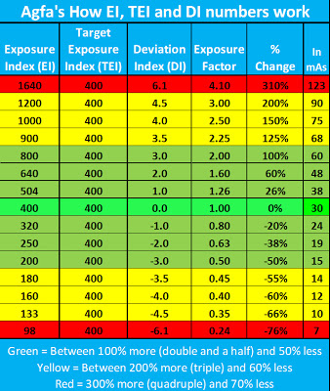
Exposure Index (DR) - AGFA

Slide 46








$$DI=10 x log\frac{800}{400}$$
$$DI=10 x\log{2}$$
$$DI=10 x 0.3$$
$$DI=3$$
$$DI=10 x log\frac{200}{400}$$
$$DI=10 x\log{0.5}$$
$DI=10 x (−0.3$)
$$DI=−3$$

Slide 47
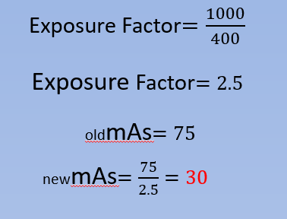
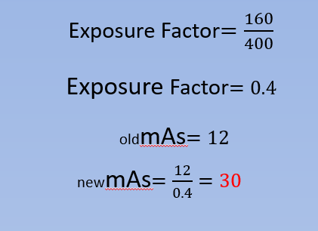
Technique Compensastion using EI and TEI

Slide 48







Technique Compensastion using DI
D$eviation Index=$ 4.0
Exposure Factor$={10}^{DI/10}$
Exposure Factor$={10}^{4.0/10}$
Exposure Factor$={10}^{0.4}$
Exposure Factor$=2.5$
oldmAs$=75$
newmAs$=\frac{75}{2.5}=30$

Slide 49
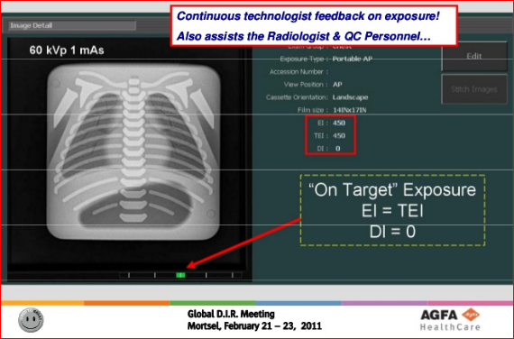
Exposure Index (DR) - AGFA

Slide 50
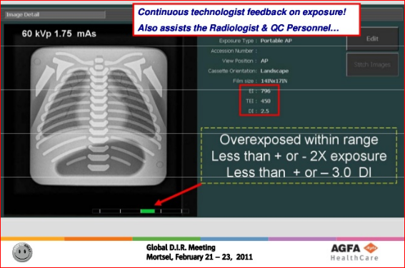
Exposure Index (DR) - AGFA

Slide 51
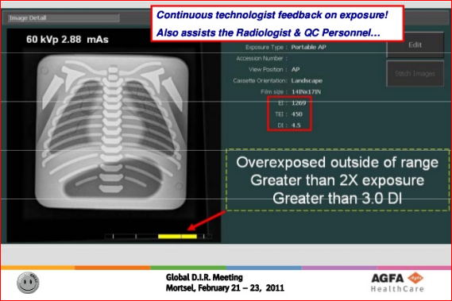
Exposure Index (DR) - AGFA

Slide 52
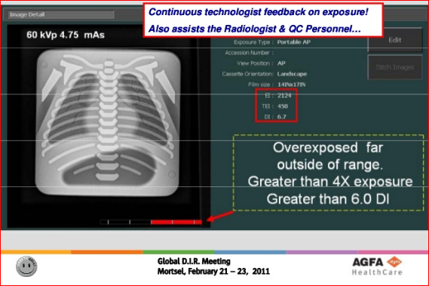
Exposure Index (DR) - AGFA

Slide 53
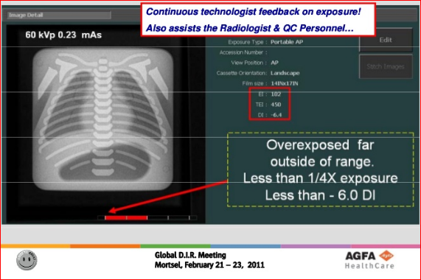
Exposure Index (DR) - AGFA

