Slide 1
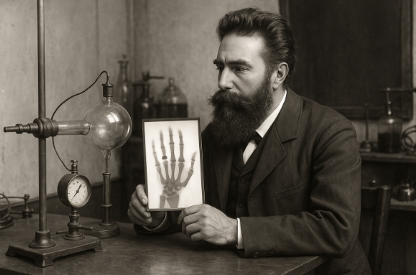
The Discovery of X-Rays and Their Nature
Prof. Jarek Stelmark
Hostos Community College – The City University of New York

Slide 2

Purpose of this lecture:
Learn what X-rays are and how they were discovered.
Understand their physical nature and properties.
See how they are produced in the X-ray tube.
Explore their uses, benefits, and potential risks.
Understand basic safety principles in radiologic technology.
This is a foundation lecture. We will start from absolute basics, so everyone can follow; no extensive science background is needed.

Slide 3

Matter and Energy: The Two Fundamentals
The physical universe can be divided into matter and energy.
Matter: anything that occupies space and has mass (the amount of material in it).
Examples: your body, air, a table, water.
Matter is made up of atoms — tiny building blocks with a nucleus and electrons.
Energy: the ability to do work or cause change.
Examples: a moving car, light from the sun, heat from a stove.
Connection to X-rays:
X-rays are energy, but they interact with matter (your body, detectors, walls).
To understand X-rays, you must understand both matter and energy.

Slide 4
Mass and Weight
Mass = how much matter an object contains (measured in kilograms).
Weight = the force of gravity pulling on mass.
  Your weight changes on the Moon, but your mass stays the same.
In radiology, we often talk about mass when describing matter that
absorbs X-rays (like bone).
Heavier or denser materials block more X-rays (bone) and appear white
on the radiographic image. We refer to them as radioopaque materials.
Less dense materials allow X-rays to go through them and appear dark (air in the lungs). We refer to them as radiolucent materials

Slide 5
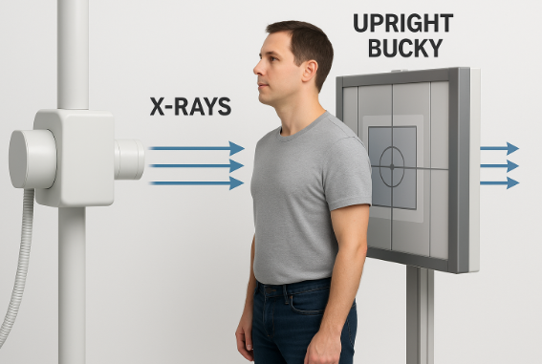
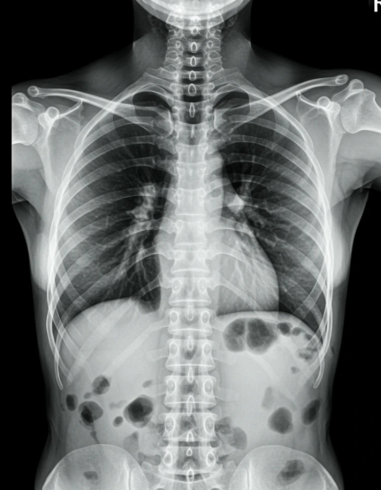
Air in the lungs
Bone

Slide 6
Forms of Energy
Energy comes in many types:
  Potential – stored due to position (a rock on a cliff).
  Kinetic – motion (a falling rock).
  Chemical – stored in bonds of molecules (food fuels your muscles).
  Electrical – movement of electrons (powers your X-ray machine).
  Thermal – vibration of atoms (heat from a light bulb).
  Nuclear – stored in the nucleus of an atom (released in nuclear power).
  Electromagnetic – energy traveling as waves (includes X-rays).
In X-ray imaging: electrical energy (electrons) → kinetic energy (electrons’ motion) → electromagnetic energy (X-rays) → sometimes chemical energy (in film) or digital signal.

Slide 7
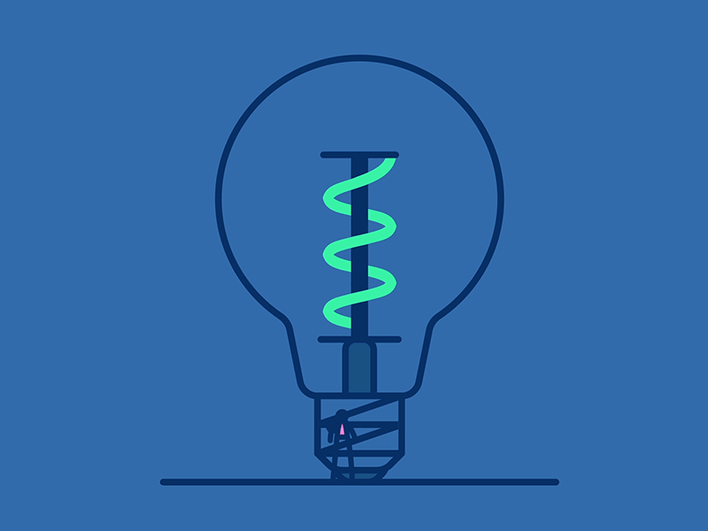


Slide 8
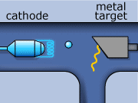

Slide 9
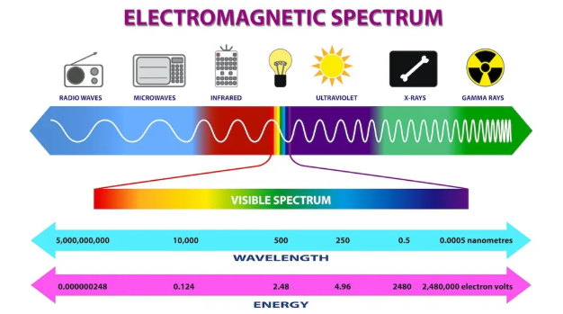
The Electromagnetic Spectrum
The spectrum is like a “family” of energy waves:
  Long wavelength / low energy: radio waves, microwaves.
  Medium: infrared, visible light, ultraviolet.
  Short wavelength / high energy: X-rays, gamma rays.
All electromagnetic waves travel at the speed of light (300,000 km/sec).
X-rays: wavelength very short→ very high energy → can penetrate many materials.
The shorter the wavelength, the greater the penetration and energy.

Slide 10
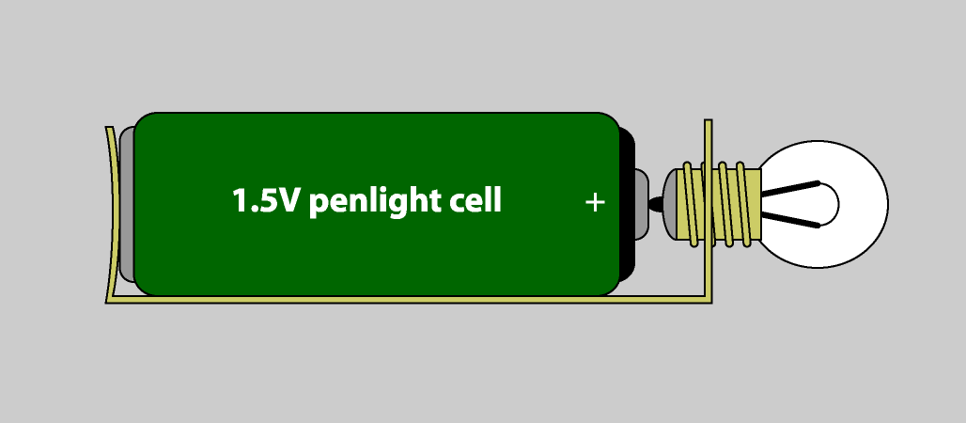
What is Radiation?
Radiation: energy traveling from one place to another.
Examples:
  Heat from the Sun.
  Light from a flashlight.
  Sound from a speaker.
Electromagnetic radiation (like X-rays) can travel in a vacuum. It doesn’t need air or matter.
Not all radiation is harmful but ionizing radiation can change atoms, which can change biological tissue.

Slide 11
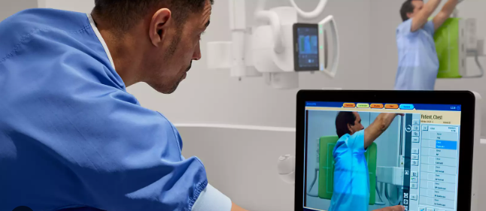
Exposure
Exposure = coming into contact with radiation.
Examples:
  Sitting in the sun — exposed to UV light.
  Having a chest X-ray — exposed to X-ray photons for a fraction of a second.
In medical imaging: we control exposure so we only use the amount needed for diagnosis.

Slide 12
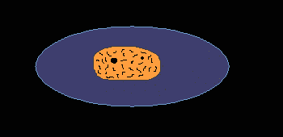
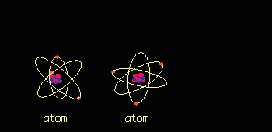
Ionization
Ionization = removing an electron from an atom.
Creates an ion pair:
  The freed electron (negative ion).
  The atom missing an electron (positive ion).
In living tissue, ionization can break molecular bonds, change DNA and affect cell function.
This is why radiation protection is important.

Slide 13
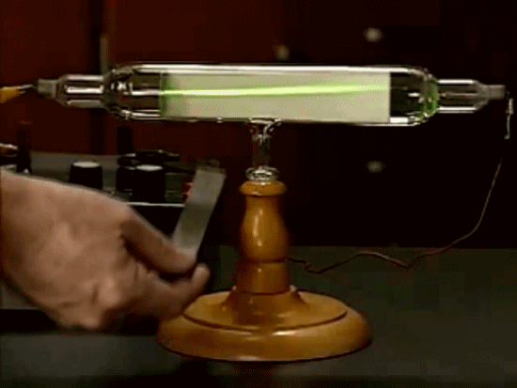
Scientific Climate Before 1895
Late 1800s: electricity was new, exciting, and mysterious.
Scientists were experimenting with cathode rays (streams of electrons) in glass tubes.
Tubes were large, partly emptied of air, with metal electrodes.
Many scientists — William Crookes, Ivan Puluj and others worked with these tubes and saw unusual effects, but didn’t realize they were seeing a new kind of radiation.

Slide 14
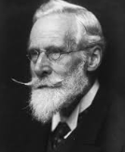
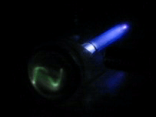
William Crookes and His Tube
William Crookes (England): self-taught experimental genius.
Invented the Crookes tube in the 1870s.
Partially evacuated glass tube with cathode (–) and anode (+).
When high voltage applied:
  Cathode rays (electrons) travel from cathode to anode.
  Glow produced when rays strike the glass or target.
This tube was the ancestor of the modern X-ray tube.

Slide 15
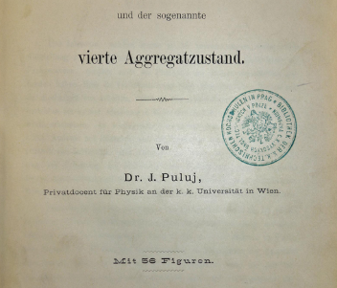
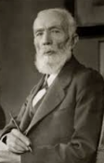
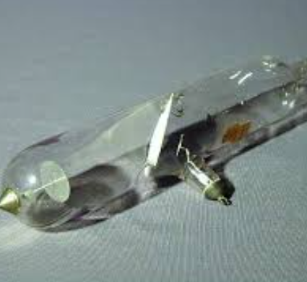
Ivan Puluj
Ukrainian physicist and inventor.
Designed the Puluj lamp — a type of gas-discharge tube.
Took photographs showing the inside of objects but didn’t interpret them as a new kind of ray.
His work indirectly influenced Röntgen’s approach.

Slide 16
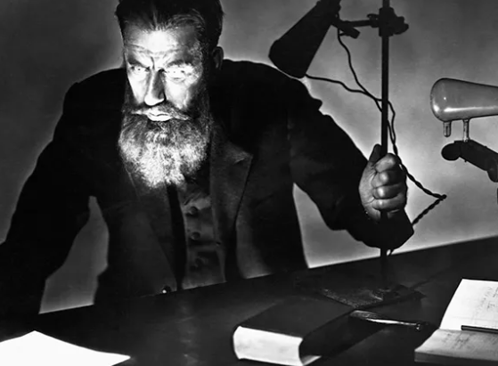
Wilhelm Konrad Röntgen
German physicist, very meticulous in his experiments.
November 8, 1895: working late with a Crookes tube wrapped in black cardboard.
Noticed a glowing fluorescent screen several feet away even though the tube was covered and the room was dark.
He realized an invisible ray was coming from the tube.

Slide 17
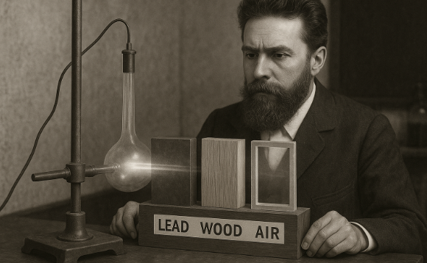
Testing the New Ray
Röntgen placed objects between the tube and the screen:
  Wood, books, aluminum allowed some rays through.
  Lead blocked them completely.
Rays could penetrate human flesh but not bone.
He called them X-rays (“X” meaning unknown).

Slide 18
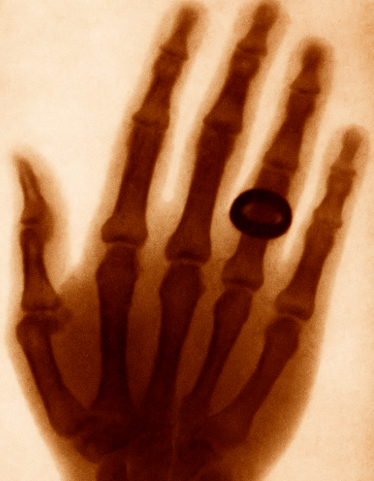
First X-Ray Image
December 22, 1895: X-ray of his wife Anna Bertha’s hand.
Bones and wedding ring clearly visible.
This image amazed the world — newspapers called it “seeing the invisible.”

Slide 19

Röntgen’s Follow-Up
Worked intensely for weeks, testing different materials and effects.
Discovered that X-rays could:
  Pass through flesh but not bone.
  Cause certain materials to fluoresce.
  Expose photographic plates.
Published results within weeks — revolution began.

Slide 20
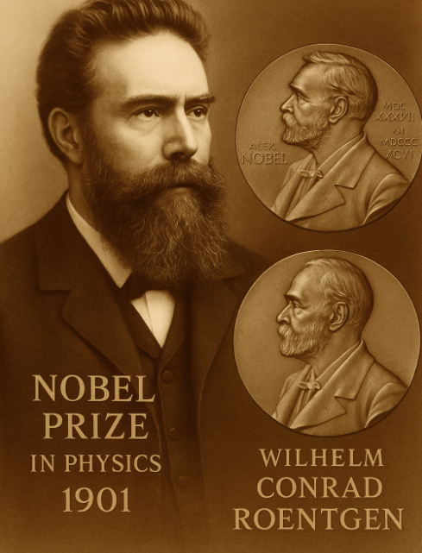
Why Röntgen’s Work Was Different
Many scientists saw hints of X-rays but ignored them.
Röntgen investigated thoroughly, documented results, and proved it was a new form of electromagnetic radiation.
Awarded the first Nobel Prize in Physics in 1901.

Slide 21
Properties of X-Rays
Invisible electromagnetic waves.
Travel in straight lines in a vacuum.
Move at the speed of light.
Can’t be seen, heard, smelled, or felt.
Cause fluorescence in some materials. Can blacken photographic film. Can ionize atoms and molecules.
Have biological effects — can be therapeutic or harmful.
Absorption: X-rays are absorbed by matter
Ionizing capability: X-rays interact with materials they penetrate and cause ionization

Slide 22
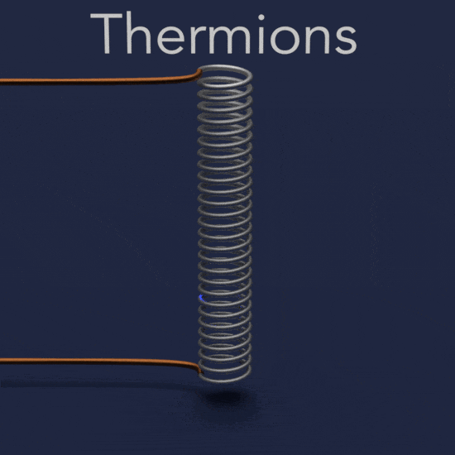
Crookes Tube vs Coolidge Tube
Crookes tube: electron source was ionized gas; partially evacuated; not easily controlled.
Coolidge tube (1913):
  Hot tungsten filament emits electrons (thermionic emission).
  High vacuum → precise control over X-ray production.
  Still basis for modern X-ray tubes.
Coolidge Tube

Slide 23
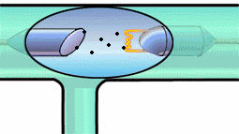
How X-Rays Are Produced
Electrons accelerated by a high voltage strike a metal target (usually tungsten).
Sudden deceleration → X-rays + heat.
99% of energy becomes heat, 1% becomes X-rays — why cooling systems are necessary.

Slide 24
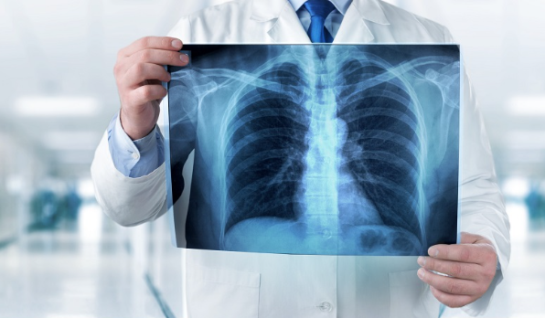
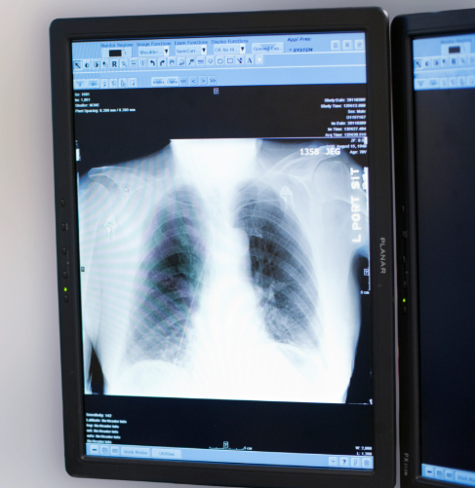
Radiography
Produces a still image (“snapshot”).
Dense areas (bone) appear white; less dense (soft tissue) appears gray; air appears black.
Images can be on film or digital.

Slide 25
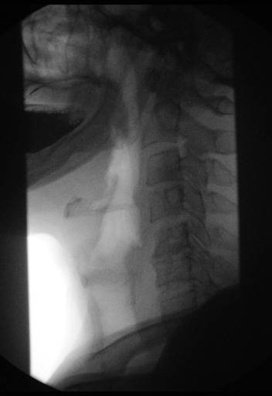
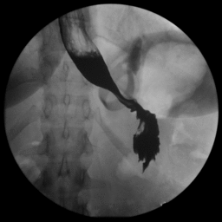
Fluoroscopy
Developed by Thomas Edison in 1898.
“Live” moving X-ray images.
Used for observing movement (e.g., swallowing, catheter placement).

Slide 26
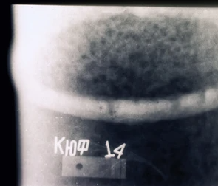
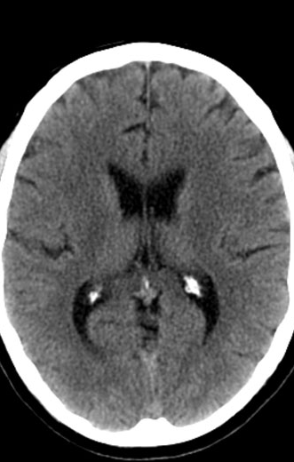
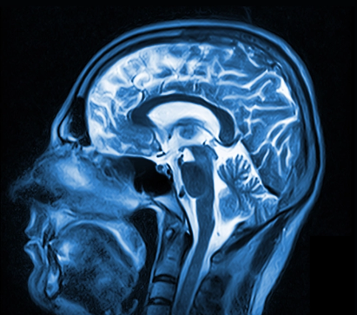
Other Applications
Medical: CT, MRI, interventional procedures.
Industrial: checking welds, inspecting pipelines.

Slide 27
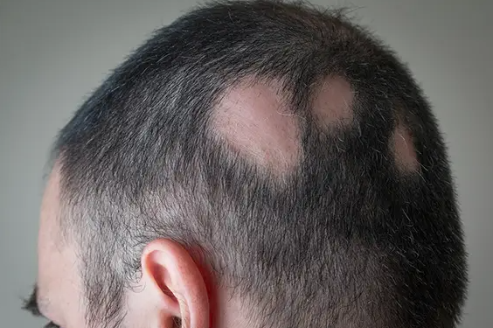
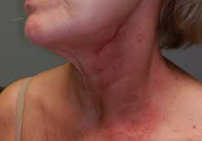
Biological Effects
Ionization can damage living cells.
Acute: skin redness, burns, hair loss.
Long-term: increased risk of cancer, cataracts.

Slide 28
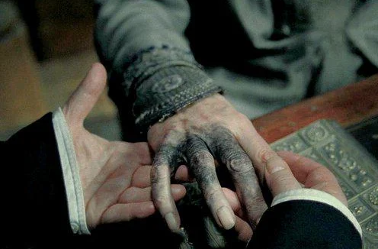
Hand of an X-ray Technologist – Royal London Hospital, 1900
In the early days of radiology, safety standards were unknown. Technologists often calibrated machines by taking X-rays of their own hands, unaware of the dangers of repeated exposure. Over time, many developed severe radiation burns, cancers, and, in some cases, required amputations. During this era, X-ray kits could even be purchased for home use as entertainment, further exposing users to harmful doses.

Slide 29
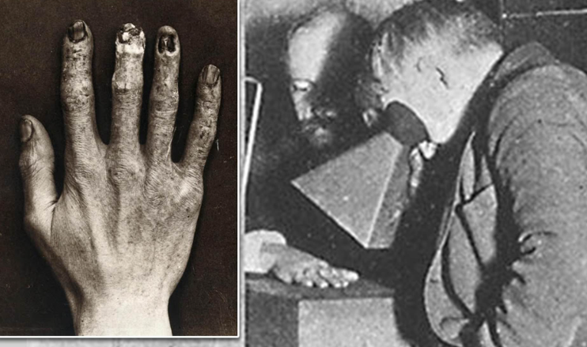
Clarence Madison Dally—Thomas Edison’s assistant—suffered severe hand and arm damage and eventually died from radiation-induced cancer; his case prompted Edison to halt his own X‑ray research

Slide 30
In modern diagnostic radiology, the primary focus of radiation control has shifted toward ensuring the safety of the patient. Evidence from recent studies indicates that even the relatively low doses of X-radiation administered during routine imaging procedures carry a small but measurable risk of latent, long-term biological effects, such as an increased probability of cancer development over time. This reinforces the importance of the ALARA principle (As Low As Reasonably Achievable) in clinical practice. Additionally, it is well established that the human fetus is especially sensitive to the effects of ionizing radiation during the early stages of pregnancy, when rapidly dividing cells and developing organ systems are most vulnerable.

Slide 31
1. Understand and apply the cardinal principles of radiation control: time, distance, and shielding.
2. Do not allow familiarity to result in false security.
3. Never stand in the primary beam.
4. Always wear protective apparel when not behind a protective barrier.
5. Always wear an occupational radiation monitor and position it outside the protective apron at the collar.
6. Never hold a patient during radiographic examination. Use mechanical restraining devices when possible. Otherwise, have parents or friends hold the patient.
7. The person who is holding the patient must always wear a protective apron and, if possible, protective gloves.
8. Use gonadal shields on all people of childbearing age when such use will not interfere with the examination.
9. Examination of the pelvis and lower abdomen of a pregnant patient should be avoided whenever possible, especially during the first trimester.
10. Always collimate to the smallest field size appropriate for the examination
Ten Commandments of Radiation Protection

Slide 32
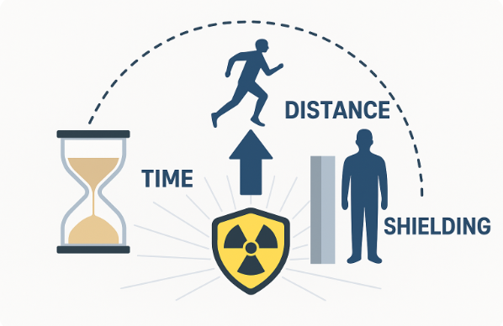

Slide 33


Slide 34
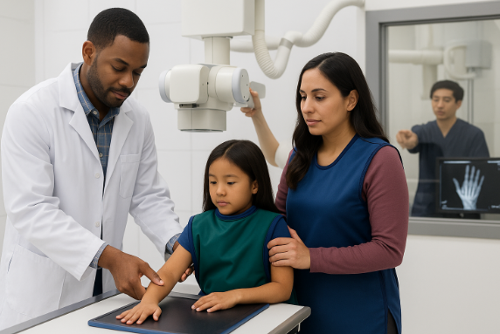

Slide 35
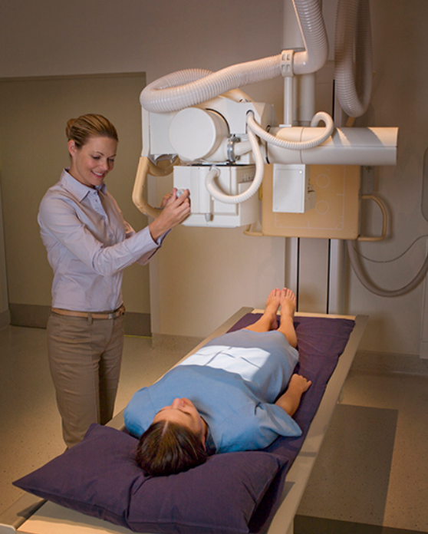
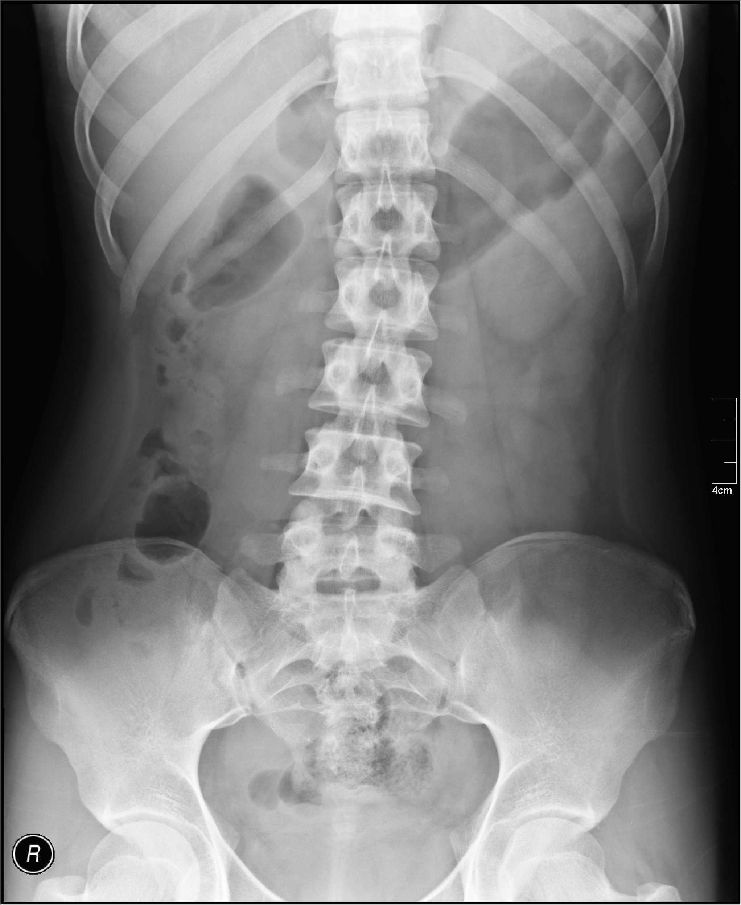
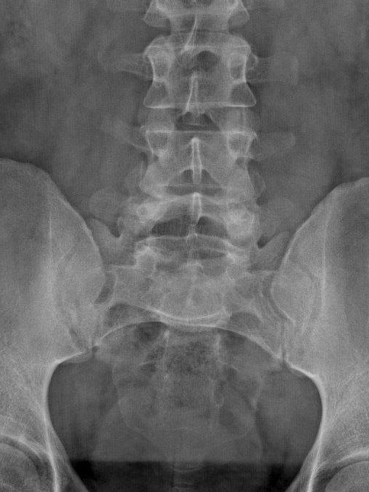
Collimation

Slide 36
