Slide 1

AEC Radiographic Simulations

Slide 2
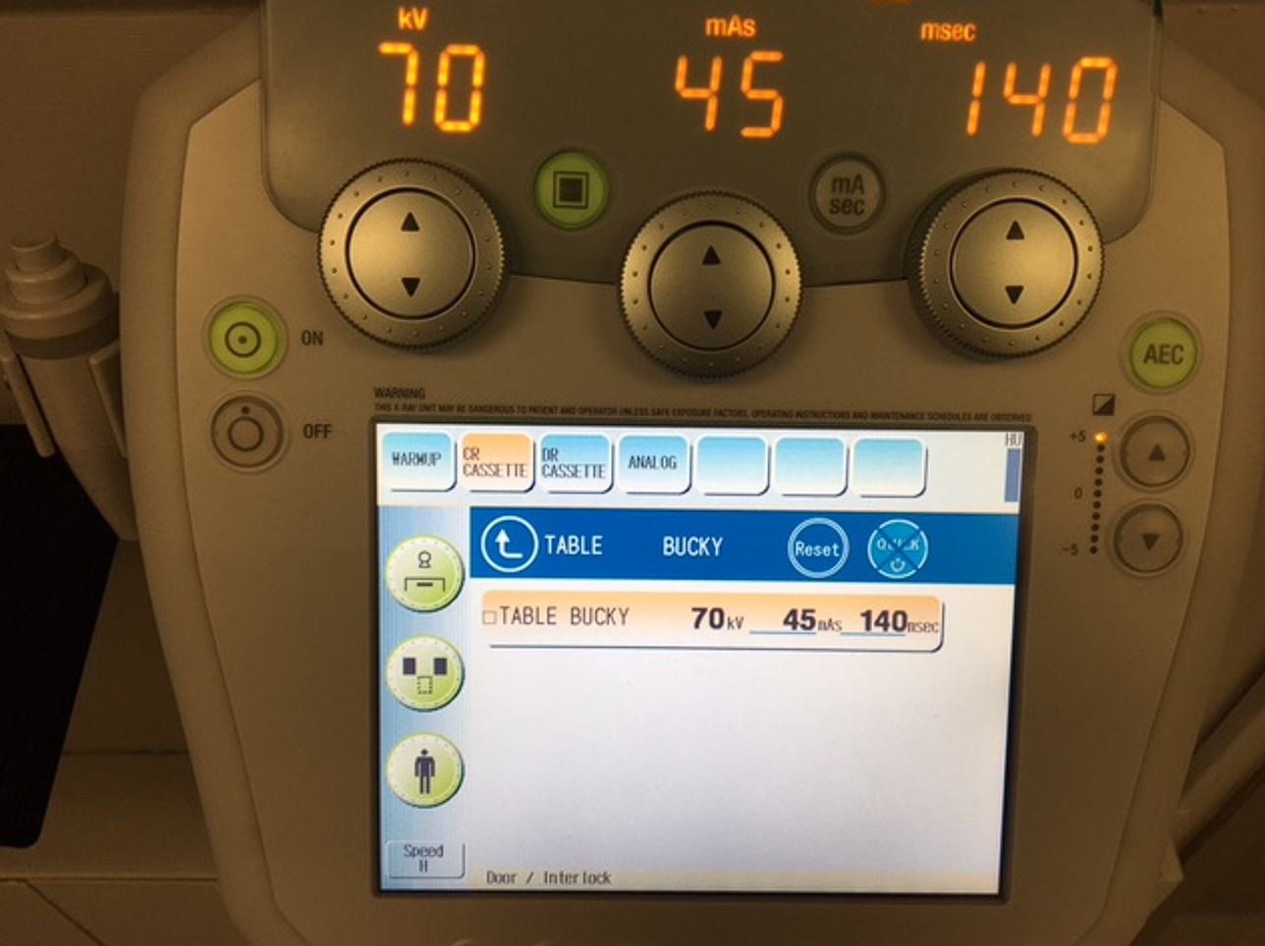
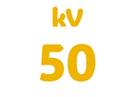




T-Spine AP (supine) Sthenic Patient
Is the setting correct?

Slide 3



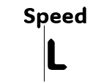
T-Spine Lateral Sthenic Patient
Is the setting correct?

Slide 4
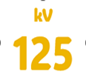
Chest AP or PA (Erect) Sthenic Patient
Is the setting correct?

Slide 5







Pelvis AP Sthenic Patient
Is the setting correct?

Slide 6
Chest AP Sthenic Patient
Is the setting correct?

Slide 7

Chest Lateral Sthenic Patient
kV
80
Speed
L
Is the setting correct?

Slide 8

Knee AP (supine) Sthenic Patient
Is the setting correct?

Slide 9
Knee AP (supine) TT Sthenic Patient
Is the setting correct?

Slide 10
Right Hip AP Sthenic Patient
Is the setting correct?

Slide 11
PelvisAP Sthenic Patient
Is the setting correct?

Slide 12

Left Scapula Sthenic Patient
Is the setting correct?

Slide 13
Left Scapula (Y view) Sthenic Patient
Is the setting correct?

Slide 14
C-Spine AP (Erect) Sthenic Patient
Is the setting correct?

Slide 15

Abdomen (supine) AP Hypersthenic Patient
Is the setting correct?

Slide 16


Abdomen (supine) AP Sthenic Patient
Is the setting correct?

