Slide 1
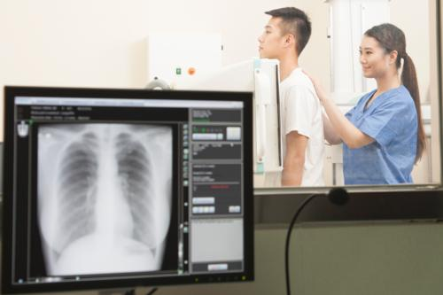
Prime Exposure Controlling Factors

Slide 2
X-ray Emission
The intensity of the x-ray beam of an x-ray imaging system is measured in roentgens (R) or milliroentgens (mR) and is called the x-ray quantity. Another term, radiation exposure ( primary signal intensity), is often used instead of x-ray intensity or x-ray quantity. All have the same meaning and all are measured in R or mR.
X-ray quantity is the number of x-rays in the useful beam

Slide 3
Primary Factors
The primary exposure technique factors the radiographer selects on the control panel are milliamperage, time of exposure, and kilovoltage peak (kVp). Depending on the type of control panel, milliamperage and exposure time may be selected separately or combined as one factor, milliamperage/second (mAs). Regardless, it is important to understand how changing each separately or in combination affects the radiation reaching the IR and the radiographic image.

Slide 4
Prime Exposure Factors
mAs (mA x time)
kVp ( potential difference) kilo x volt x peak
SID ( distance)

Slide 5
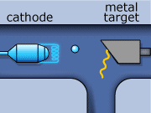
Potential difference kVp
mA
X-ray photons

Slide 6
The quantity of x-ray photons in an exposure cannot be determined by either the mA or the exposure time alone. Although mA determines the rate of x-ray production, it does not indicate the total quantity, because it does not indicate how long the exposure lasts. Exposure time does not indicate the total quantity either, because it does not measure the rate of x-ray production. To determine the quantity of radiation involved in an exposure, both mA and time must be considered.
mA x Time (sec) = mAs

Slide 7
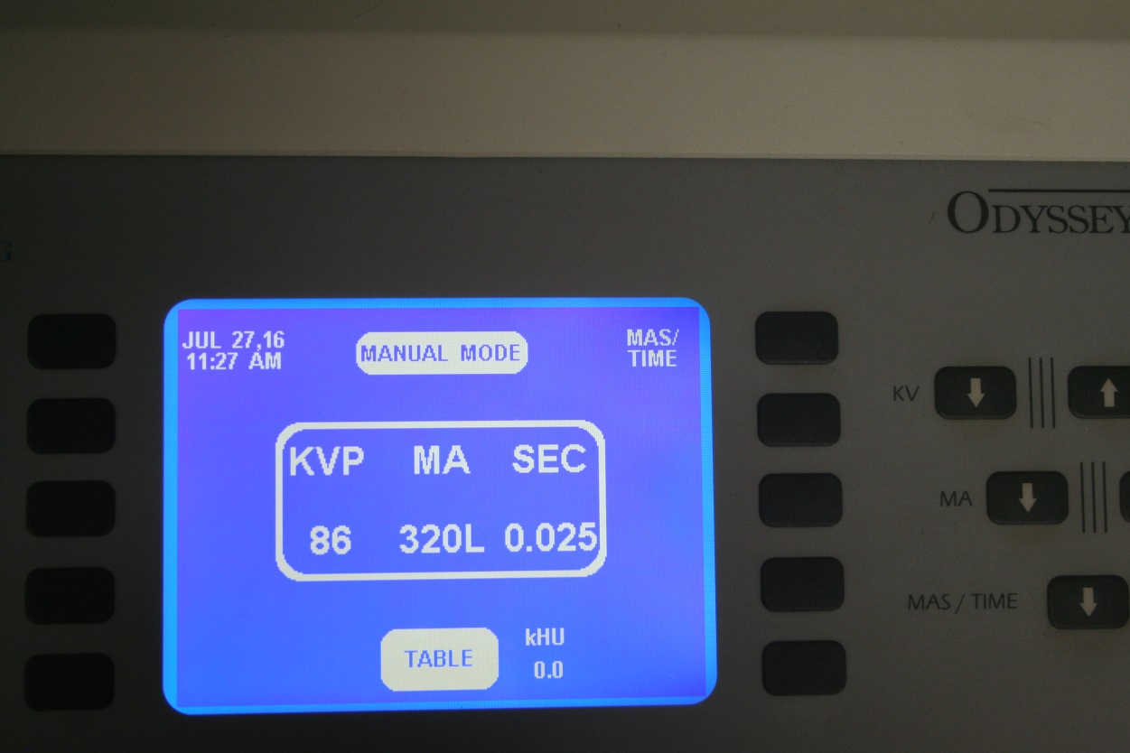
320 mA x 0.025 (sec) = 8 mAs

Slide 8
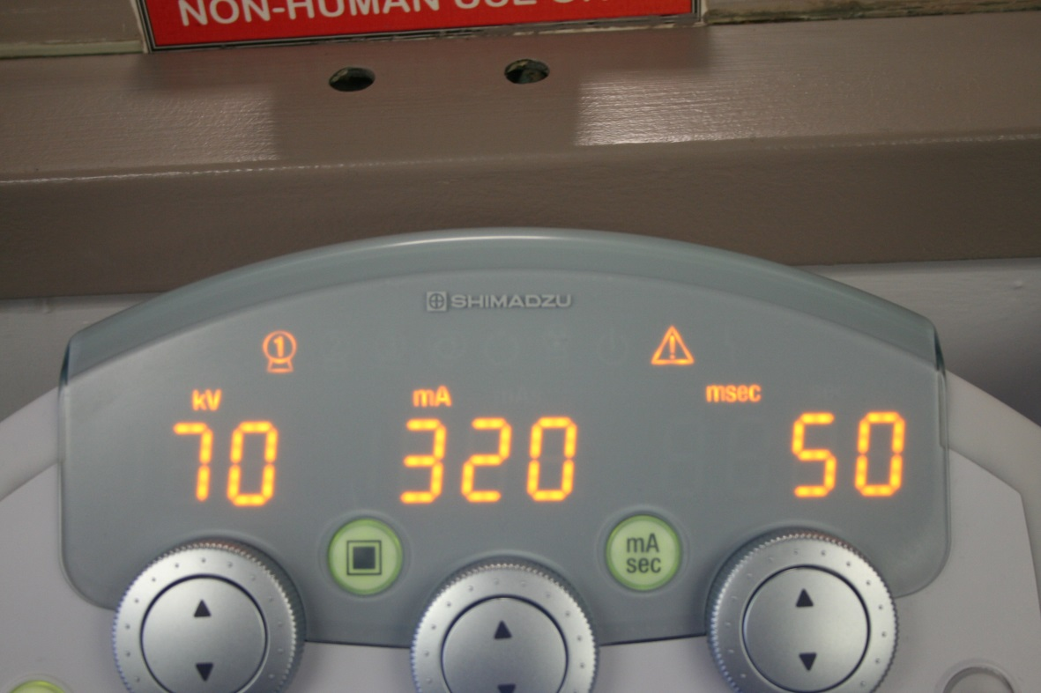
320 mA x 0.050 (sec) = 16 mAs

Slide 9
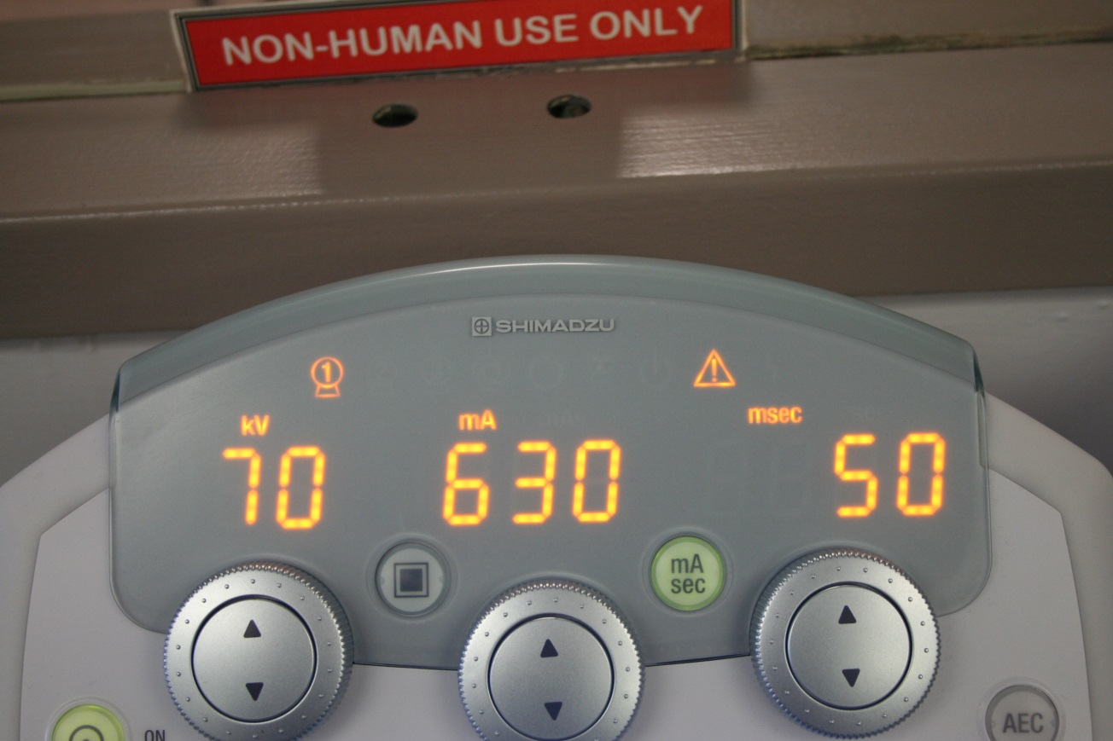
630 mA x 0.050 (sec) = 31.5 mAs

Slide 10
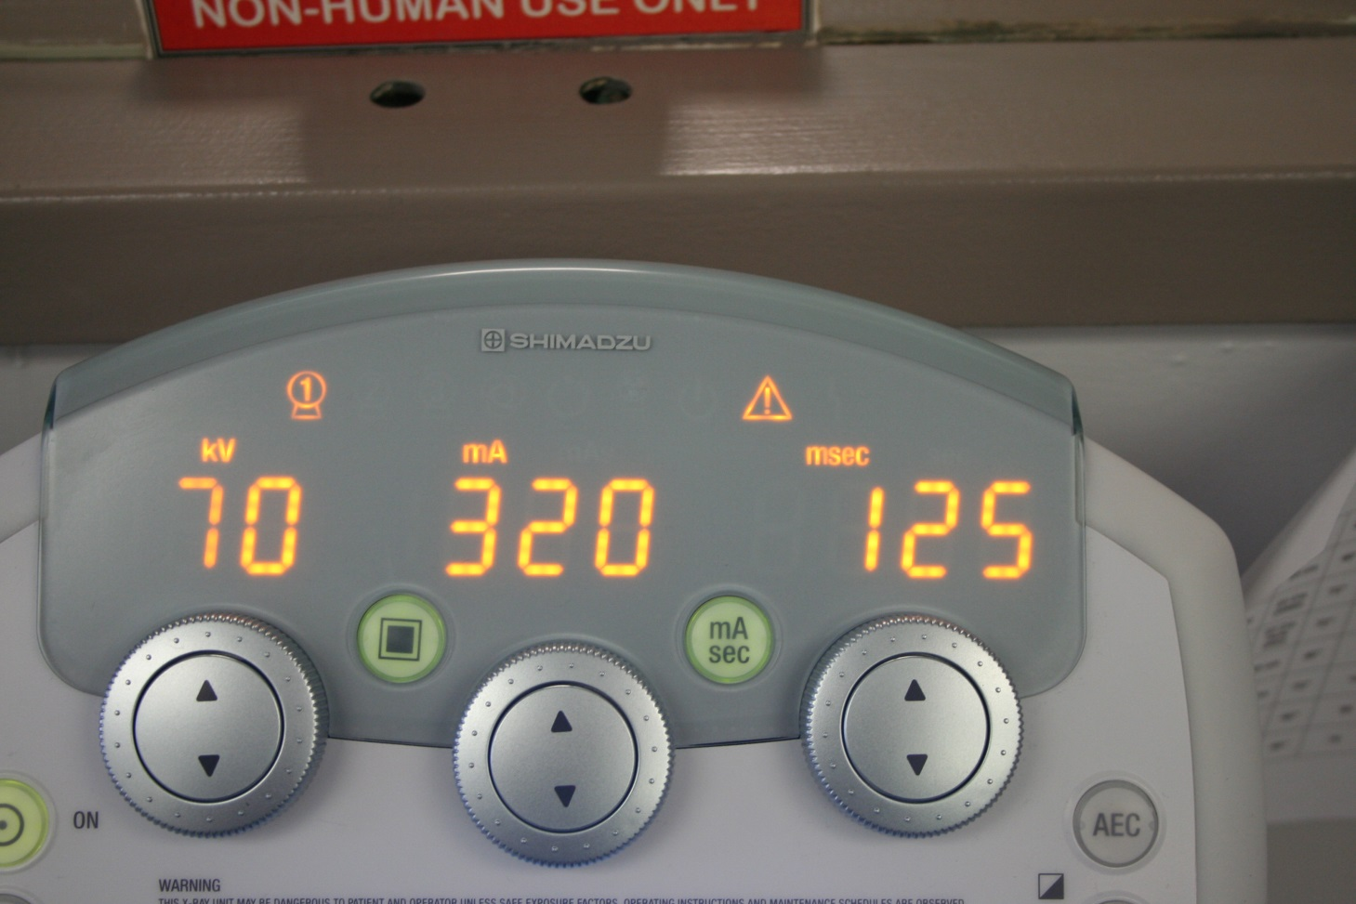
320 mA x 0.125 (sec) = 40 mAs

Slide 11
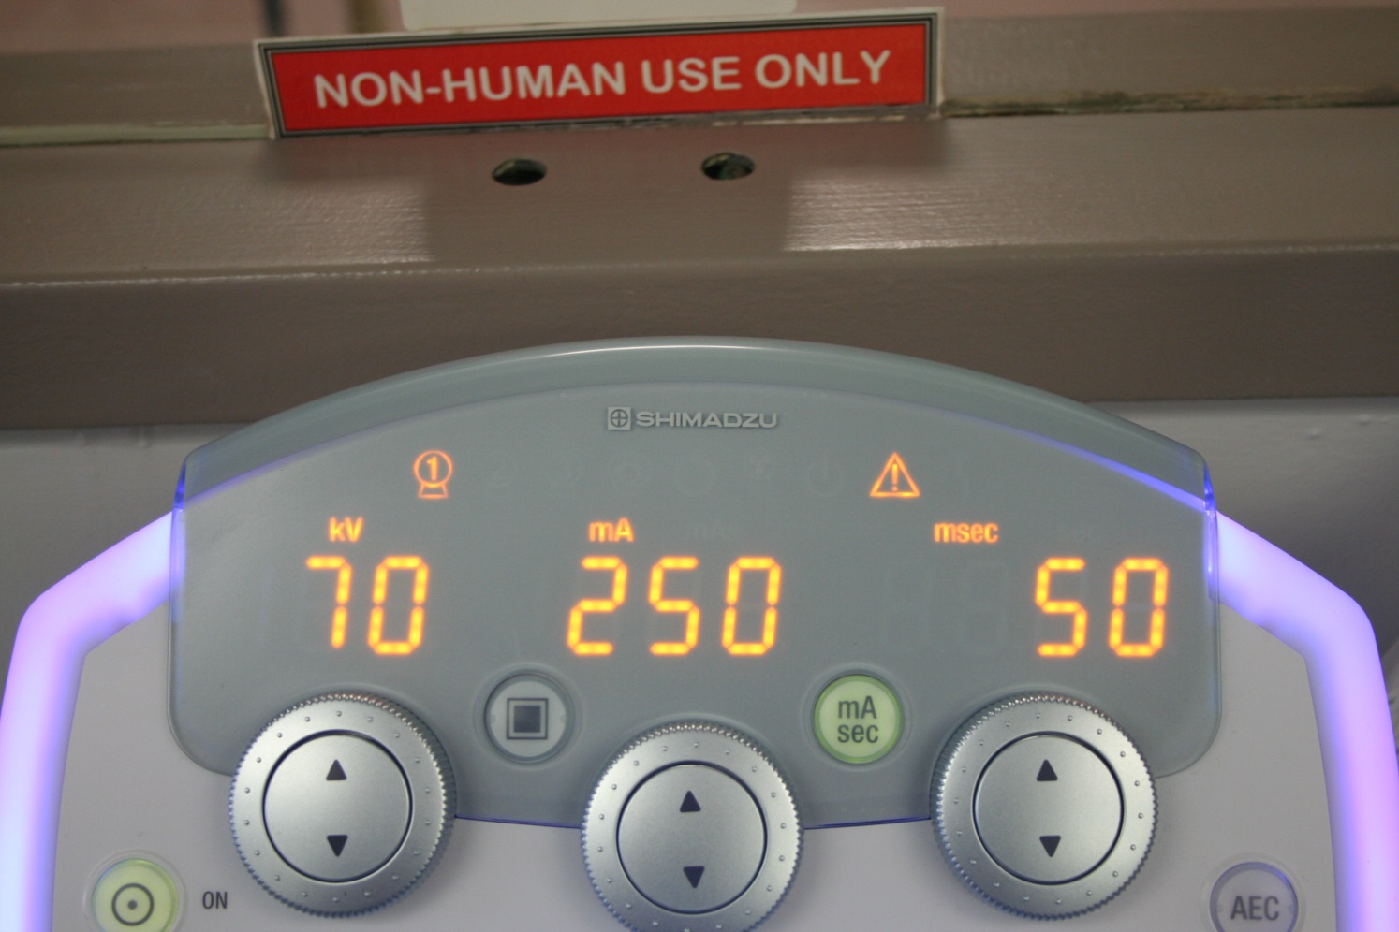
___ mA x ___ (sec) = ___ mAs

Slide 12
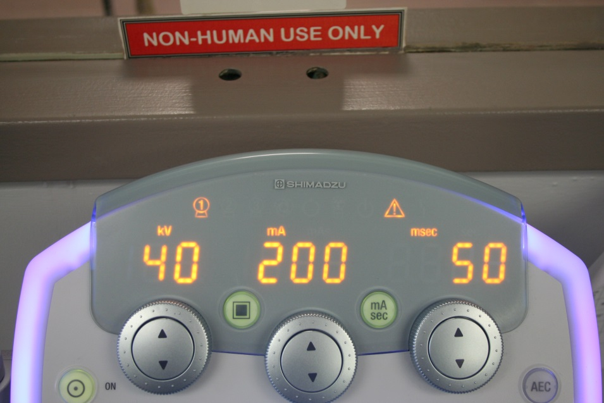
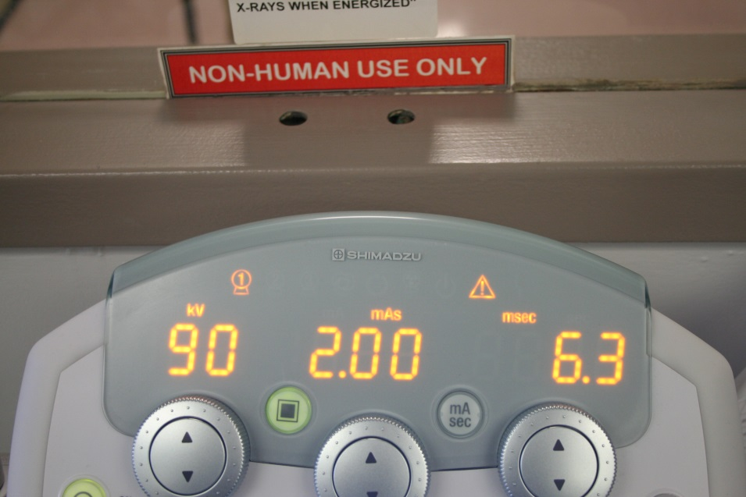
Three button mode
Two button mode

Slide 13
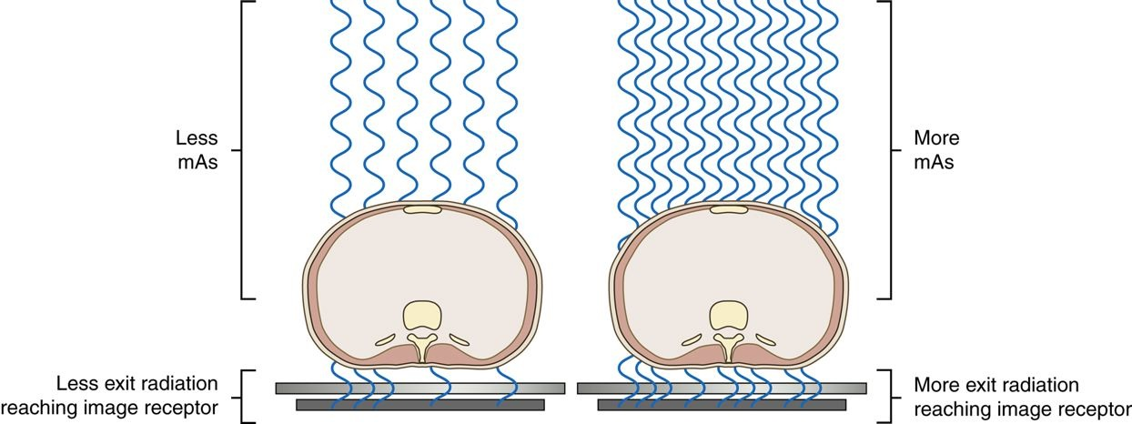
As the mAs is increased, the quantity of radiation reaching the IR is increased. As the mAs is decreased, the amount of radiation reaching the IR is decreased.

Slide 14
When the kVp is increased at the control panel, a larger potential difference occurs in the x-ray tube, giving more electrons the kinetic energy to produce x-rays and increasing the kinetic energy overall. The result is more photons (quantity) and higher energy photons (quality).

Slide 15
mAs reciprocity
By Prof. Stelmark

Slide 16
2 factors that directly control exposure:
mA
time

Slide 17
Increase in mA:
increase in quantity of x-rays produced increase in exposure

Slide 18
Decrease in mA:
decrease in quantity of x-rays produced decrease in exposure

Slide 19
Time
controls how long the mA is working only affects exposure (nothing else)
increase in time
increase in exposure
decrease in time
decrease in exposure

Slide 20
mA x time = mAs
primary controller of x-ray beam quantity and exposure
increase in mAs - increase in exposure
decrease in mAs - decrease in exposure

Slide 21
Reciprocity law:
states that a variety of different mA & time settings could produce the same mAs and therefore same exposure.

Slide 22
Relationship between mA & time:
- inversely proportional
- as mA increases, time decreases

Slide 23
Three instances to use law of reciprocity:
control motion - short exposure time, high mA
2. to use a small focal spot FSS (small filament) - improves sharpness
3. use breathing technique - low mA with long time

Slide 24
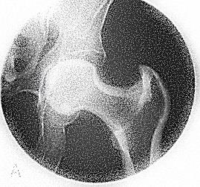
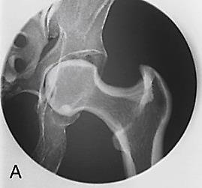
mA | time | mAs
50 | 1 sec | 50
100 | 1 sec | 100
200 | 1 sec | 200
200 mR
400 mR
800 mR

Slide 25
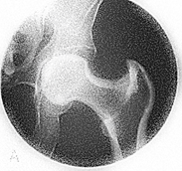
200 mR
400 mR
800mR

Slide 26
mA | time | mAs
100 | 0.5 sec | 50
100 | 1 sec | 100
100 | 2 sec | 200
200 mR
400 mR
800 mR

Slide 27
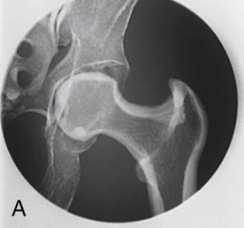
mA | time | mAs
400 | 0.5 sec | 200
200 | 1 sec | 200
100 | 2 sec | 200
800 mR
800 mR
800 mR

Slide 28
mA | time | mAs
200 | 1 sec | 200
100 | 2 sec | 200
50 | 4 sec | 200
800 mR
800 mR
800 mR

Slide 29
Kilovoltage
When the kVp is increased at the control panel, a larger potential difference occurs in the x-ray tube, giving more electrons the kinetic energy to produce x-rays and increasing the kinetic energy overall. The result is more photons (quantity) and higher energy photons (quality).

Slide 30
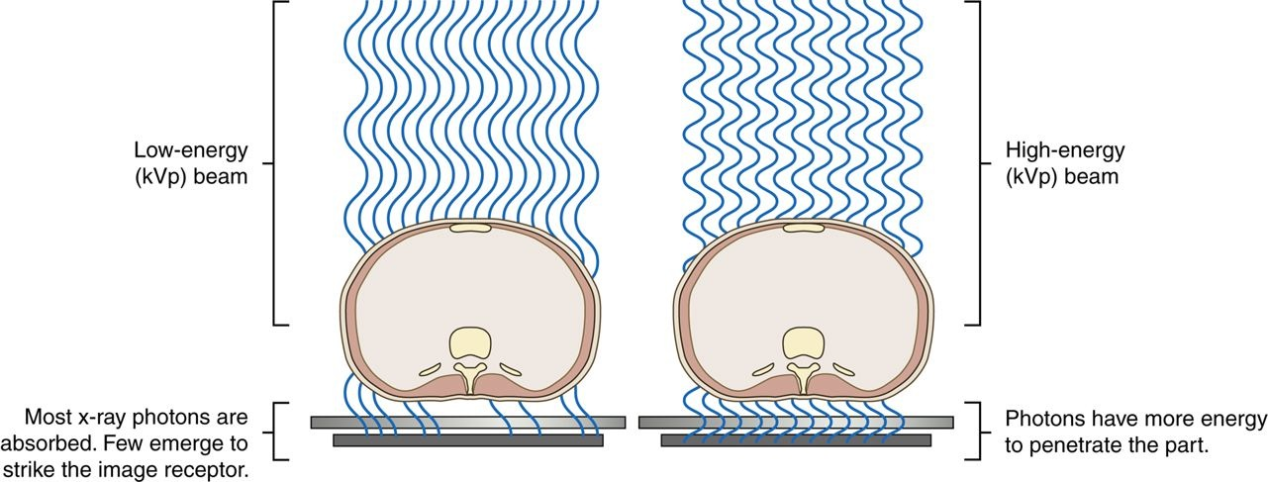
The kVp affects the exposure to the IR because it alters the amount and penetrating ability of the x-ray beam.
Altering the penetrating power of the x-ray beam affects its absorption and transmission through the anatomic tissue being radiographed. Higher kVp increases the penetrating power of the x-ray beam and results in less absorption and more transmission in the anatomic tissues

Slide 31
kVp is the primary controlling factor of
the x-ray beam quality

Slide 32
Kilovoltage
The area of interest must be adequately penetrated before the mAs can be adjusted to produce a quality radiographic image. When adequate penetration is achieved, further increasing the kVp results in more radiation reaching the IR. Unlike mAs, the kVp affects the amount of radiation exposure to the IR and radiographic contrast.
kVp is the main controlling factor of radiographic contrast

Slide 33
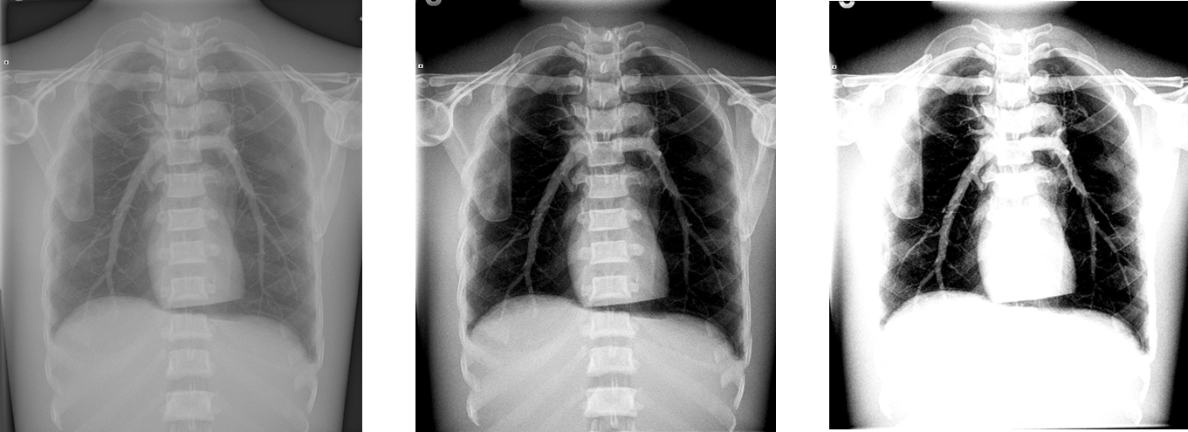
A high kVp results in less absorption and more transmission in the anatomic tissues, which results in less variation in the x-ray intensities exiting the patient (remnant), producing a low-contrast (long-scale) image. A low kVp results in more absorption and less transmission in the anatomic tissues, but with more variation in the x-ray intensities exiting the patient, resulting in a high-contrast (short-scale) image.

Slide 34
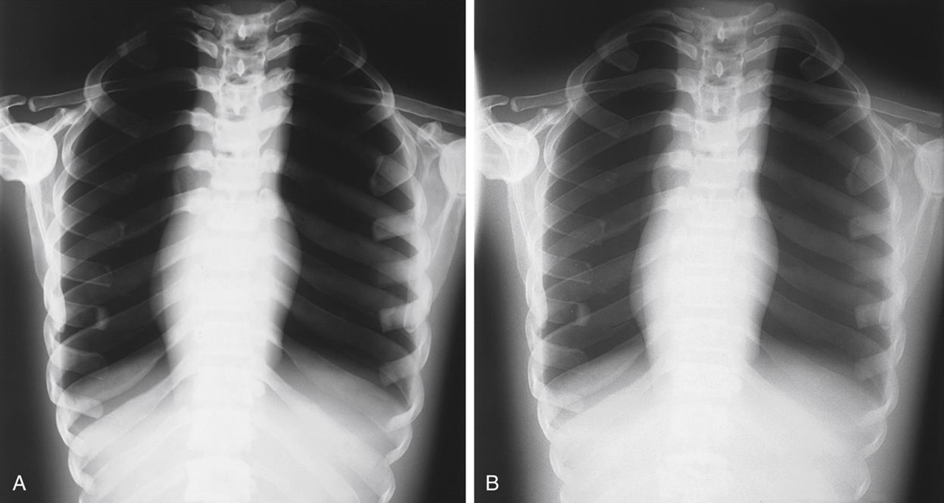
Low kVp
High kVp
High Contrast
Low Contrast

Slide 35
Maintaining or adjusting exposure to the IR can be accomplished with kVp by using the 15% rule. The 15% rule states that changing the kVp by 15% has the same effect as doubling the mAs, or reducing the mAs by 50%.
For example:
Increasing the kVp from 82 to 94 (15%) produces the same exposure to the IR as increasing the mAs from 10 to 20.

Slide 36
The 15% rule was figured out in the mid 50’s. Of course this was back in the days of film/screen, but it still holds true today in the digital world.

Slide 37
There are really 2 main reasons why someone would do the 15% Rule with mAs compensation:
Dose reduction
Time reduction

