Slide 1
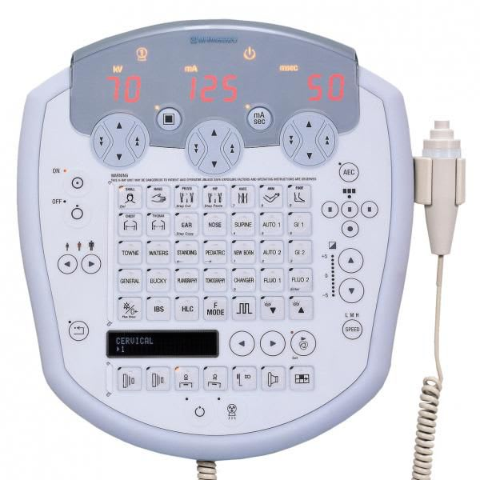
Understanding Exposure Timing: Image Receptor Type, Density Setting, Collimation, and SID
Prof. Jarek Stelmark
Hostos Community College – The City University of New York

Slide 2
Image Receptor Speed
What “speed” means:
Image receptor speed describes how sensitive the receptor is to radiation.
High-speed (H) → very sensitive
Medium-speed (M) → moderate sensitivity
Low-speed (L) → least sensitive
The receptor’s response determines how fast AEC reaches the target signal.

Slide 3
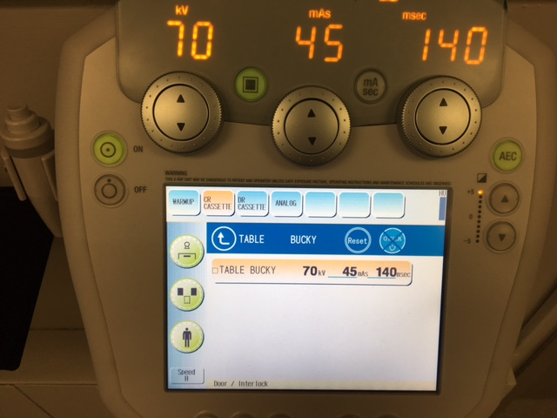

Slide 4
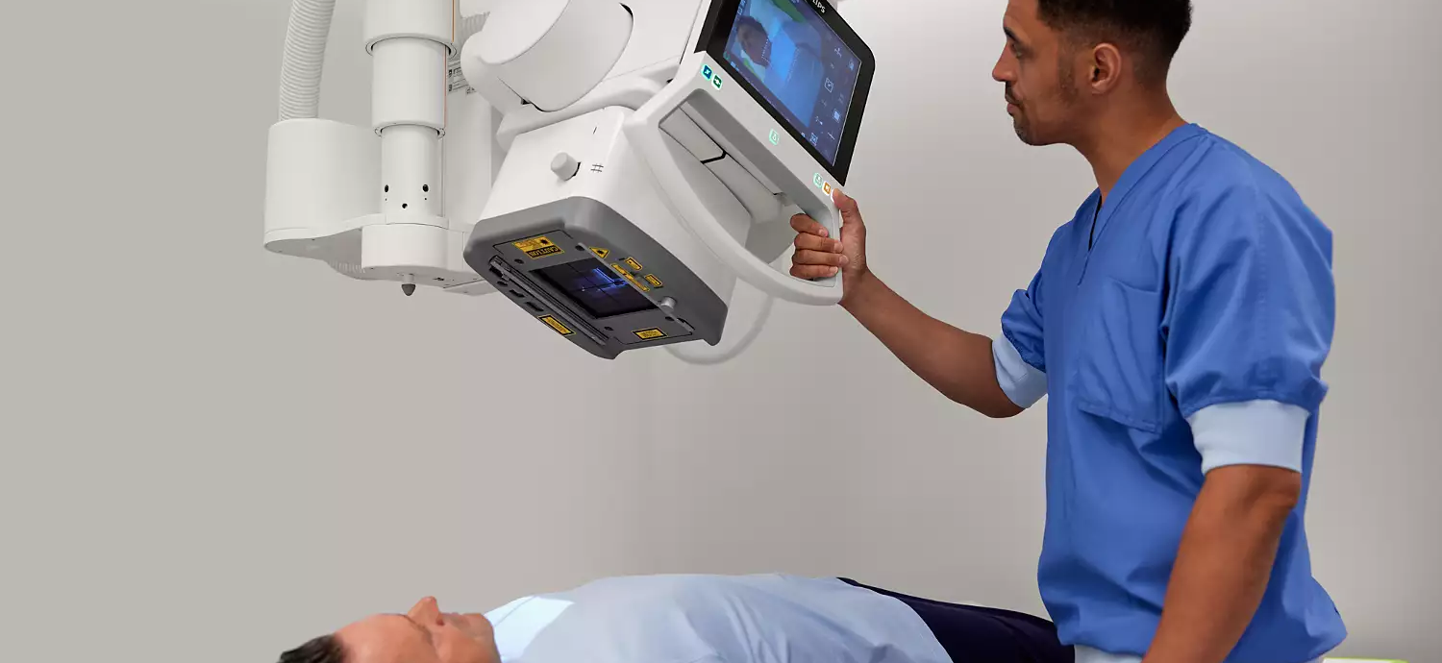
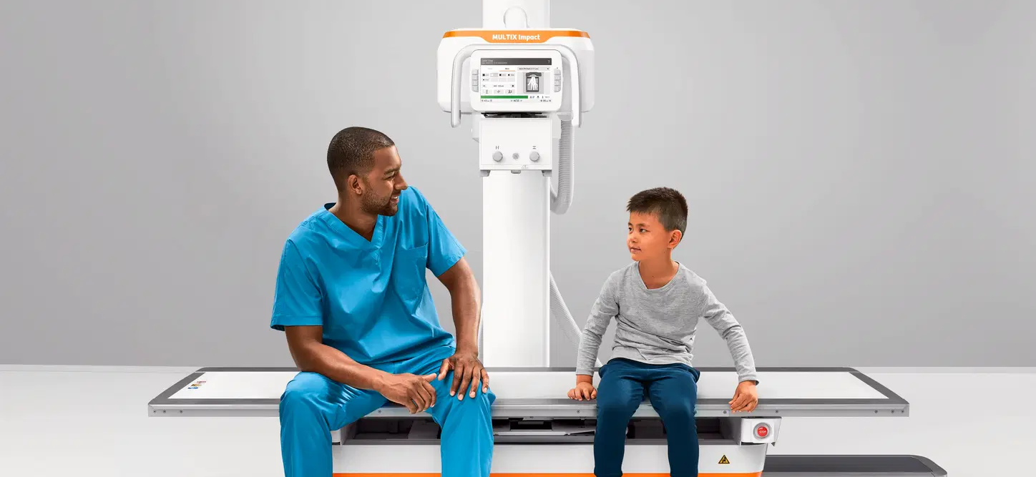
High-speed receptor (H)
Reaches the target signal quickly
Shorter AEC exposure time
Lower mAs
Useful in pediatrics or dose-sensitive patients
Medium-speed receptor (M)
Balanced response
Moderate AEC exposure time
Most routine radiography
Low-speed receptor (L)
Slow to respond
Needs more photons to reach the same signal
Longer AEC exposure time
Higher mAs
Higher patient dose
Used when maximum detail is required

Slide 5
AEC does not “know” the receptor type.
It only “sees” the amount of radiation reaching the chamber.
Changing the receptor speed changes how much radiation is required to produce the same signal (target):
High-speed → detector reaches signal faster → AEC shuts off sooner
Low-speed → detector is slower → AEC keeps the beam on longer
AEC continues the exposure until the ion chamber charge threshold is reached.

Slide 6
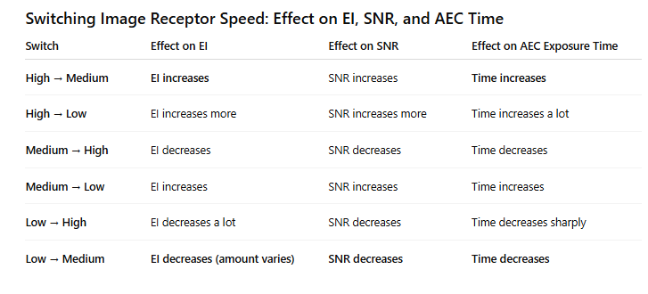

Slide 7
High to Medium
A medium-speed receptor needs more radiation than a high-speed receptor.
AEC keeps the exposure on longer.
EI, SNR, and time all go up.
High to Low
This is the most significant jump.
Low-speed receptors need the most radiation.
AEC must run for a much longer exposure.
EI and SNR rise significantly, and time increases significantly.

Slide 8
Medium to High
A high-speed receptor is much more sensitive.
AEC reaches its target quickly and shuts off.
So EI drops, SNR drops, and time shortens.
Medium to Low
Low-speed receptors need more radiation.
AEC leaves the beam on longer.
So EI rises, SNR rises, and time increases.

Slide 9
Low to High
This is the largest decrease.
High-speed receptors need very little radiation.
AEC cuts the exposure quickly.
EI falls sharply, SNR and time drop sharply.
Low to Medium
A medium-speed receptor needs less radiation than a low-speed one.
AEC turns off earlier.
EI decreases, SNR decreases, and time decreases.

Slide 10
Moving toward low speed = more radiation, more time, higher EI, higher SNR.
Moving toward high speed = less radiation, shorter time, lower EI, lower SNR.

Slide 11
Image receptor speed describes how sensitive the receptor is to radiation.
Speed can be labeled H, M, L, but it can also be expressed as numbers, the same way film used to be rated: 100, 200, 400, 800.
Higher numbers mean a faster receptor that needs less radiation.
Lower numbers mean a slower receptor that needs more radiation.
When you switch between these speed classes, AEC changes the exposure time to hit its target signal. That change in time affects EI and SNR.

Slide 12
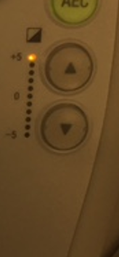
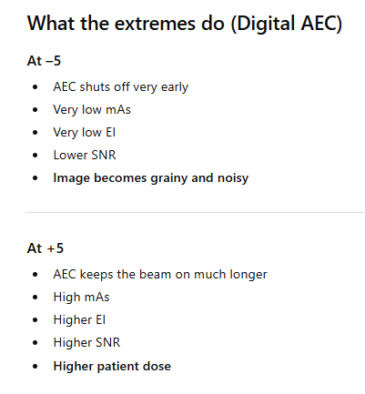
Density Setting in AEC
The density setting on an AEC panel adjusts the ion chamber’s termination threshold.
It does not change the sensitivity of the chamber and it does not change kVp or mA.
It simply tells the AEC to end the exposure sooner or later than the normal baseline.

Slide 13
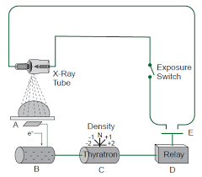
Density settings should be used rarely.
They are not meant to correct positioning errors or incorrect chamber selection.
They shift the exposure target up or down by design.

Slide 14
When to Use Density Setting (+)
Large patients. A lot of tissue, AEC may shut off early.
Lateral lumbar spine: Very thick. Generates a lot of scatter. Even with the lead behind the patient, the AEC may stop too soon.
Emphysema or very over-aerated lungs. Too much air. The radiation goes easily through the air and the exposure is terminated early.
Very thick pelvis or hips
Heavy scatter causes an early cutoff.
Use a positive density setting when the patient or the anatomy can fool the AEC into stopping early, resulting in low EI and increased noise.

Slide 15
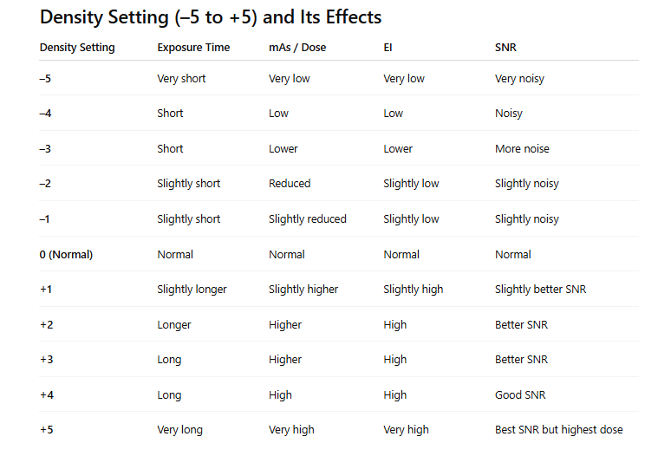
Negative settings (–5 to –1) → AEC stops early → lower mAs → low EI → more noise.
Positive settings (+1 to +5) → AEC runs longer → higher mAs → high EI → better SNR but higher dose.
0 is the calibrated, standard setting.

Slide 16
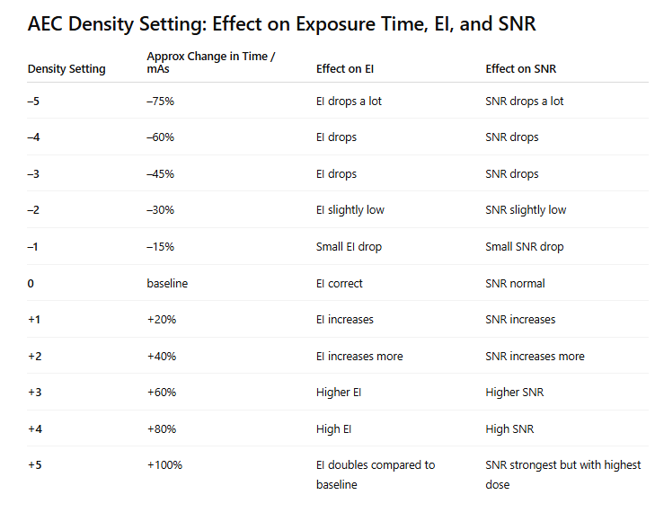

Slide 17
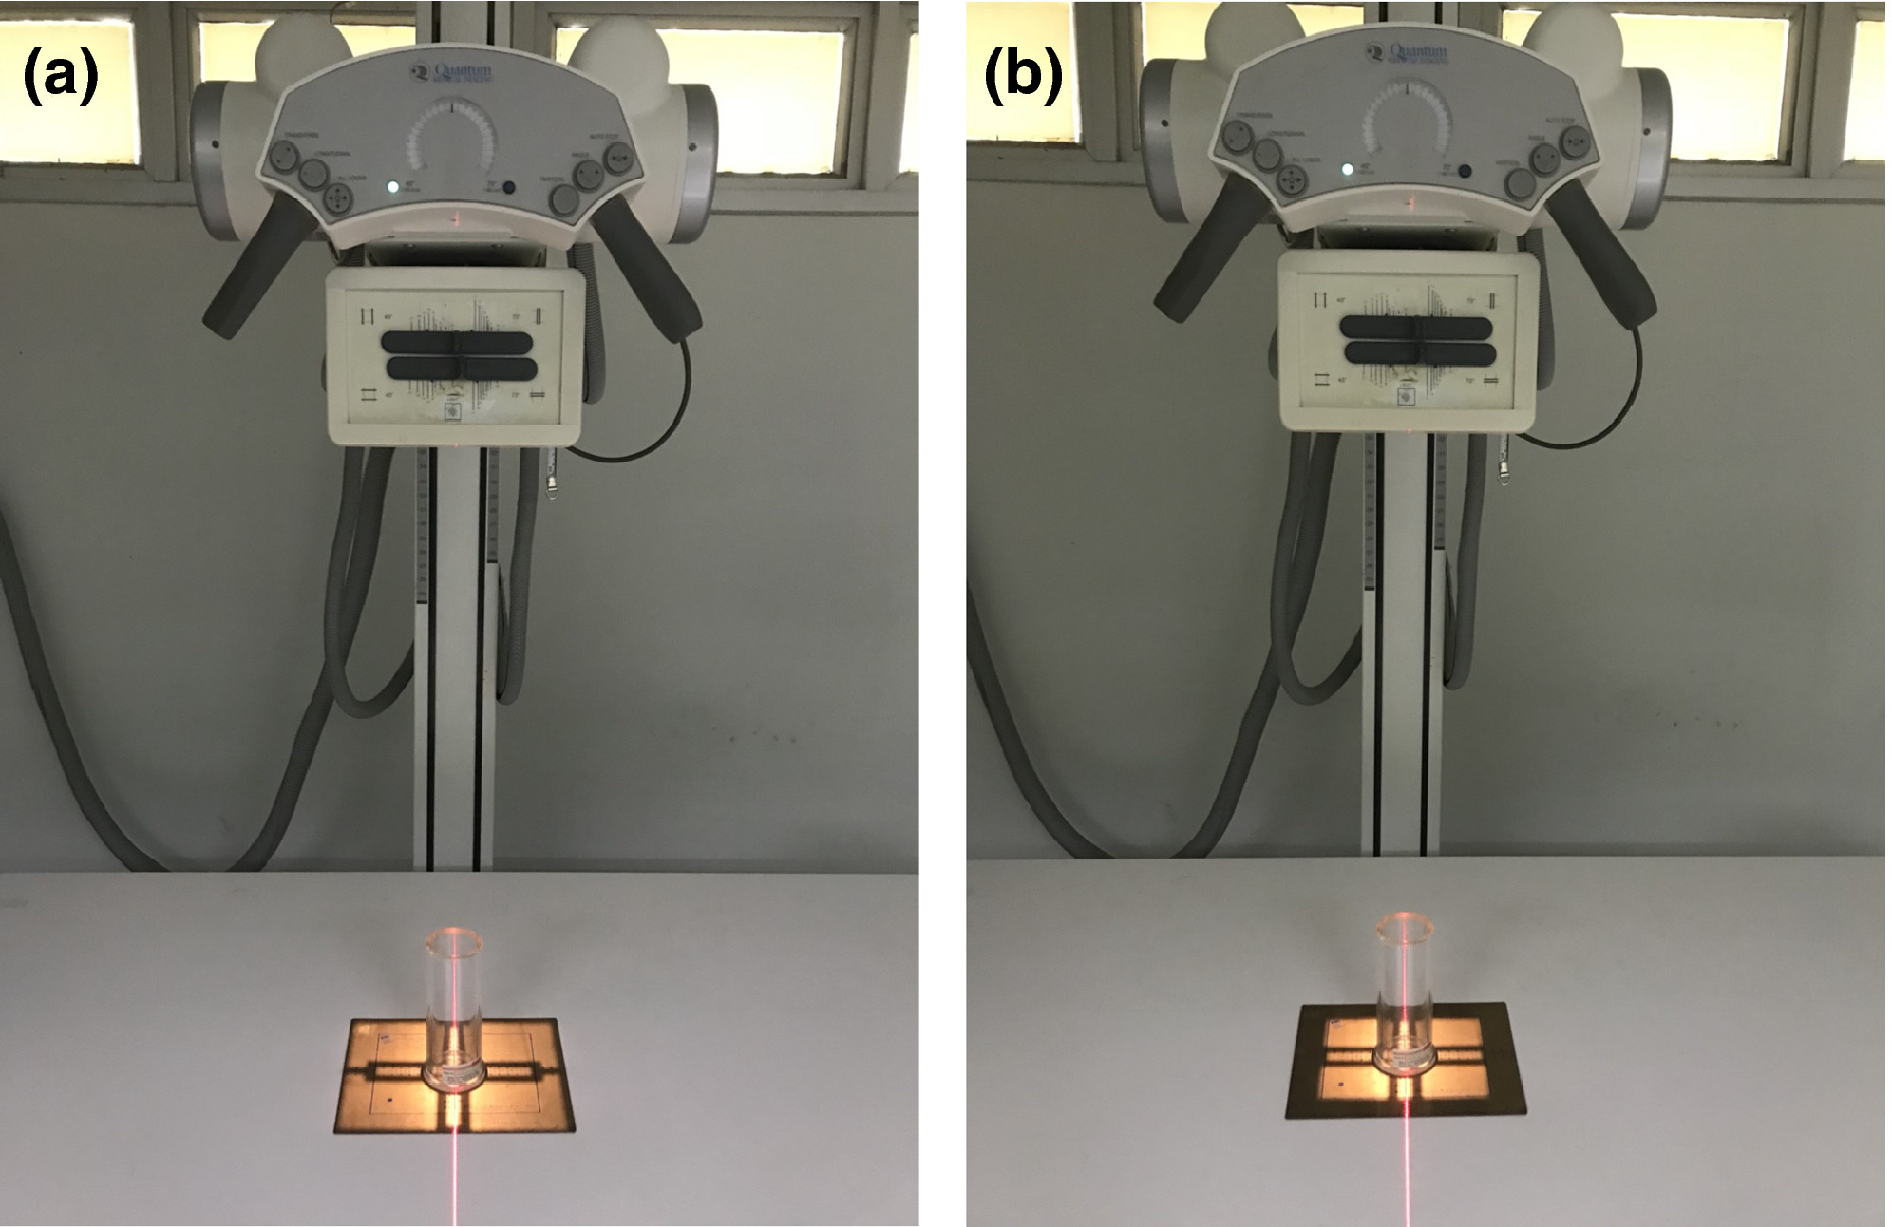
FINAL EFFECTS OF COLLIMATION (AEC)
More collimation
AEC chamber gets less scatter.
Not enough radiation reached the detector.
It keeps the exposure on longer.
EI stays the same because AEC will reach the correct level.
SNR stays the same because EI is unchanged.
Contrast goes up because scatter is reduced.
Patient dose goes down because the exposed area is smaller.
Less collimation
AEC chamber gets more scatter.
The detector received more radiation.
It stops the exposure earlier.
EI stays the same.
SNR stays the same.
Contrast goes down due to more scatter.
Patient dose increases because a larger area is irradiated.

Slide 18
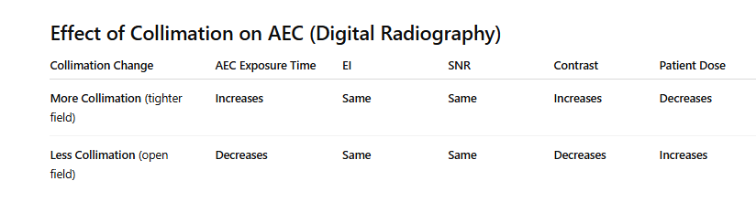

Slide 19
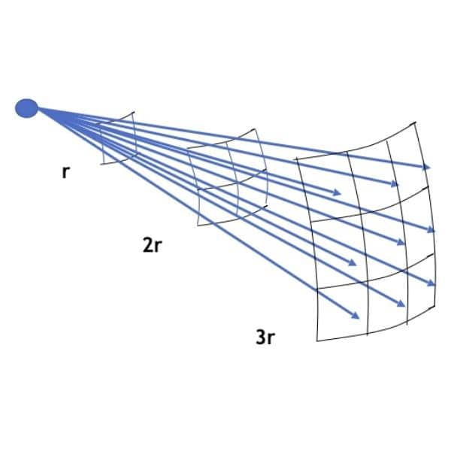
Source to Image Receptor Distance (SID)
SID is the distance from the x-ray tube to the image receptor.
Changing the SID changes the beam intensity at the receptor due to the inverse-square law.
1. Longer SID
Beam intensity at the receptor drops
AEC must increase the exposure time to maintain the same receptor exposure
EI stays the same because AEC compensates
Patient skin dose is lower
2. Shorter SID
Beam intensity at the receptor rises
Less mAs is needed
Exposure time decreases
EI stays the same (AEC compensates)
PT dose slightly higher

Slide 20
