Slide 1
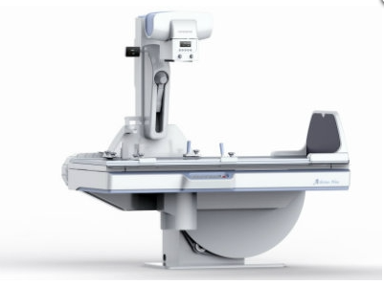
Digital Fluoroscopy

Slide 2
Digital fluoroscopy (DF) is a digital x-ray imaging system that produces dynamic images obtained with an area x-ray beam. The difference between conventional fluoroscopy and DF is the nature of the image and the manner in which it is digitized.
The early approach was to use fluoroscopic equipment while placing a computer between the television camera tube and the television monitor. The video signal from the television camera tube was routed through the computer, manipulated in various ways, and transmitted to a television monitor in a form ready for viewing.

Slide 3
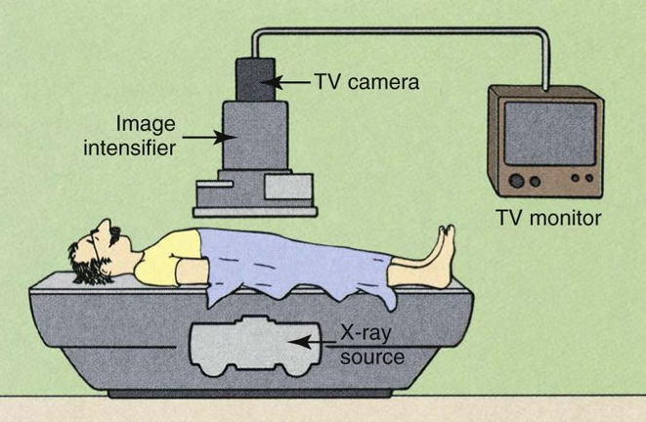
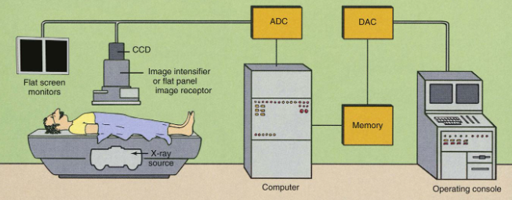
Advantages of DF over conventional fluoroscopy include the speed of image acquisition and postprocessing to enhance image contrast.

Slide 4
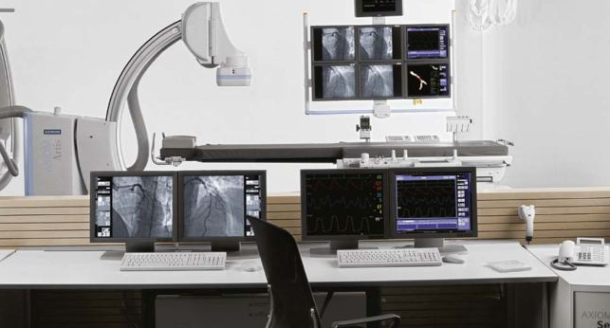

Slide 5
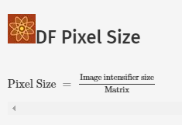
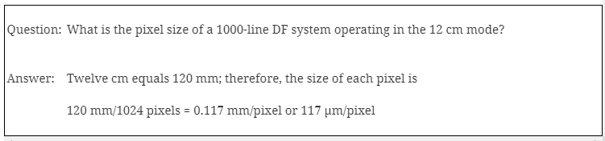
A 1024 × 1024 image matrix sometimes is described as a 1000-line system. In DF, the spatial resolution is determined both by the image matrix and by the size of the image intensifier. Spatial resolution is limited by pixel size.

Slide 6
A DF examination is conducted in much the same manner as a conventional fluoroscopic study. To the casual observer, the equipment is the same, but such is not the case. A computer has been added, as have multiple monitors and a more complex operating console
During DF, the under-table x-ray tube actually operates in the radiographic mode. Tube current is measured in hundreds of mA instead of less than 5 mA, as in image-intensifying fluoroscopy.
This is not a problem, however. If the tube were energized continuously, it would fail because of thermal overloading, and the patient radiation dose would be exceedingly high. Images from DF are obtained by pulsing the x-ray beam in a manner called pulse-progressive fluoroscopy.

Slide 7
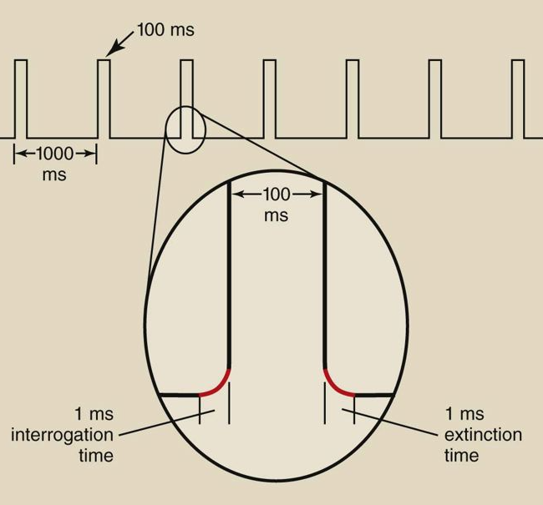
The x-ray generator must be capable of switching on and off very rapidly. The time required for the x-ray tube to be switched on and reach selected levels of kilovolt peak (kVp) and mA is called the interrogation time. The time required for the x-ray tube to be switched off is the extinction time. DF systems must incorporate high-frequency generators with interrogation and extinction times of less than 1 ms.
Pulse progressive fluoroscopy is essential for reducing patient radiation dose and should be routinely used.

Slide 8
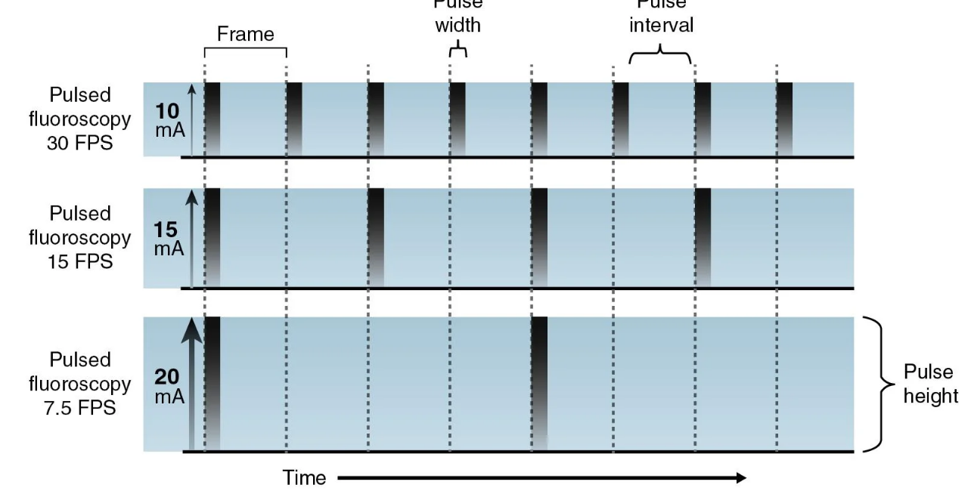
Operating the fluoroscope in a pulsed mode reduces the number of images each second, decreases the patient dose, and should match the dynamic motion of patient anatomy.

Slide 9
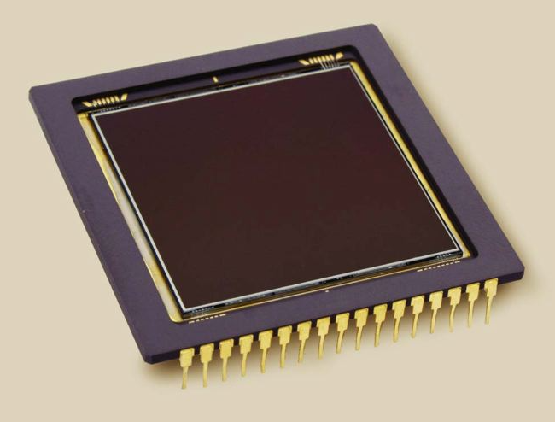
A major change from conventional fluoroscopy to DF is the use of a charge-coupled device (CCD) instead of a TV camera tube. The CCD was developed in the 1970s for military applications, especially in night vision scopes. Today, CCDs are used in the digital camera, commercial television, security surveillance, and astronomy
The sensitive component of a CCD is a layer of crystalline silicon. When this silicon is illuminated, electrical charge is generated, which is then sampled, pixel by pixel, and manipulated to produce a digital image

Slide 10
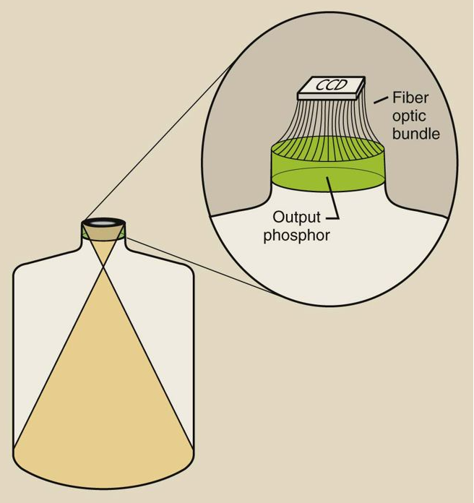

Slide 11
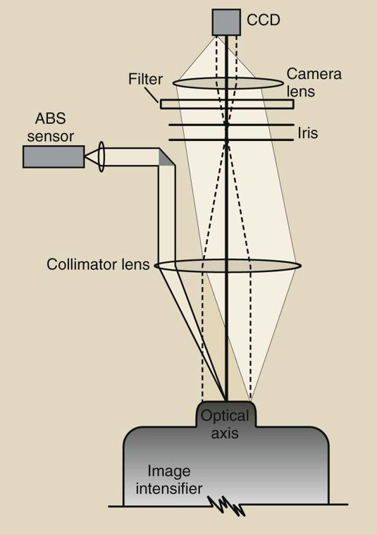
An example of a lens-coupling system for a charge-coupled device (CCD) to an image intensifier

Slide 12
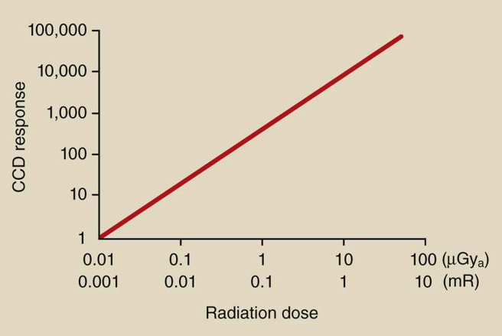

Slide 13
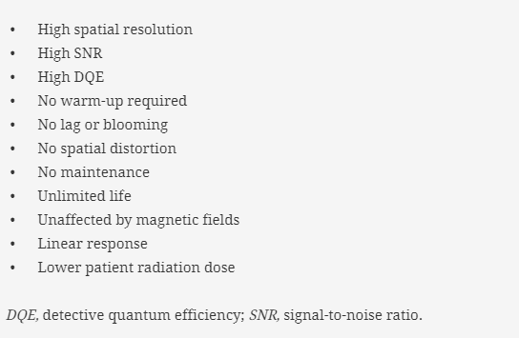
Advantages of CCD
DF with CCD results in wider dynamic range and better contrast resolution than conventional fluoroscopy.

Slide 14
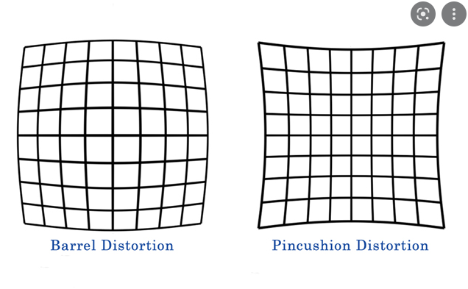
The CCD is mounted on the output phosphor of the image-intensifier tube and is coupled through fiberoptics or a lens system.
The spatial resolution of a CCD is determined by its physical size and pixel count. Systems that incorporate a 1024 matrix can produce images with 10 lp/mm spatial resolution. Television camera tubes can show spatial distortion in what is described as “pin cushion” or “barrel” artifact. No such distortion occurs with a CCD.

Slide 15
The CCD has greater sensitivity to light (detective quantum efficiency) and a lower level of electronic noise than a television camera tube. The results are a higher signal-to-noise ratio (SNR) and better contrast resolution. These characteristics also result in substantially lower patient radiation doses.
The response of the CCD to light is very stable. Warm-up of the CCD is not required. Neither image lag nor blooming is present. It has essentially an unlimited lifetime and requires no maintenance

Slide 16
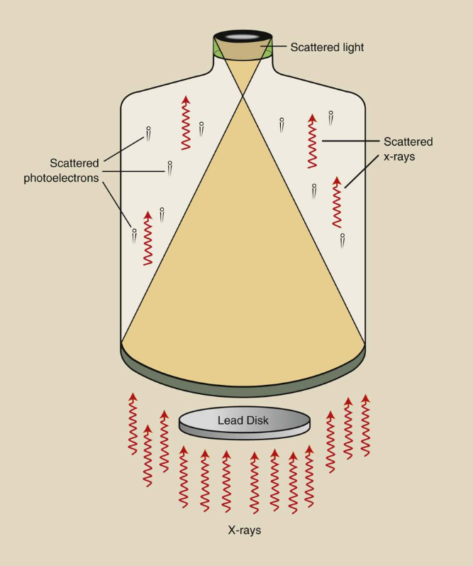
Veiling glare reduces the contrast of an image-intensifier tube

Slide 17
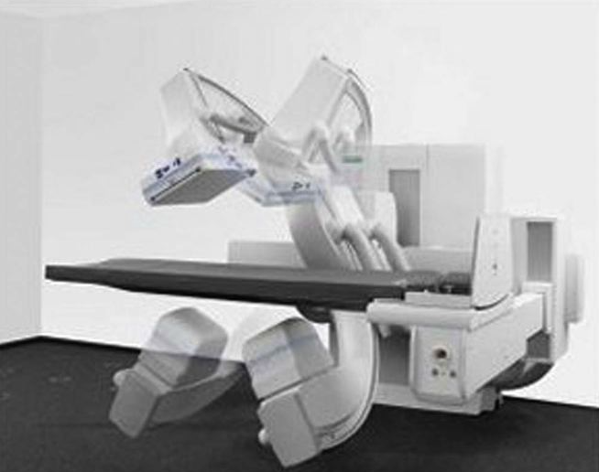
The further improvement of DF imaging is developing the flat panel image receptor (FPIR). Such an image receptor is composed of cesium iodide (CsI)/amorphous silicon (a-Si) pixels.

Slide 18
Advantages of Flat Panel Image Receptors Over Charge-Coupled Device Image Intensifiers in Digital Fluoroscopy
• Distortion-free images
• Constant image quality over the entire image
• Improved contrast resolution over the entire image
• High DQE at all radiation dose levels
• Rectangular image area coupled to similar image monitor
• Unaffected by external magnetic field
Flat-panel detectors used in fluoroscopy require rapid readout speeds for dynamic imaging. Current dynamic versions are capable of up to 60 frames per second.

Slide 19
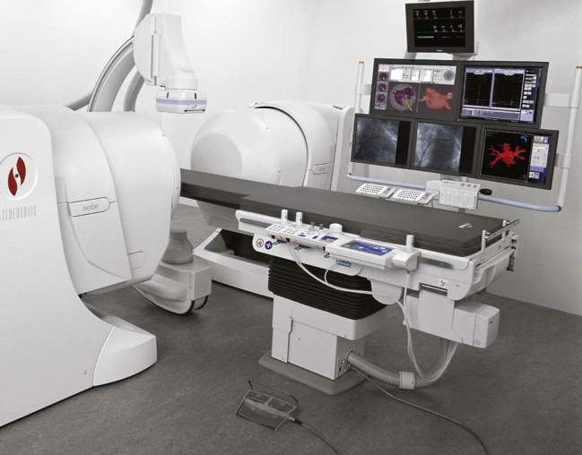
The image intensifier is limited by nonuniform spatial resolution and contrast resolution from the center to the periphery of the circular image. Veiling glare and pincushion distortion increase with age on an image intensifier. The response of an FPIR is uniform over the entire receptor and does not degrade with age.
A special catheter with a magnetic tip is introduced into the patient vasculature. This catheter is manipulated remotely through tortuous vessels by two large steering magnets that are located on either side of the patient. This technology will find advanced application in cardiology and in neurovascular radiology.

Slide 20
The principal advantages of DF examinations are the image subtraction techniques that are possible and the enhanced visualization of vasculature that results from venous injection of contrast material. Unfortunately, an area beam must be used, which reduces image contrast because of associated Compton scatter radiation.
Image contrast, however, can be enhanced electronically. Image contrast is improved by subtraction techniques that provide instantaneous viewing of the subtracted image during passage of a bolus of contrast medium

Slide 21


Slide 22
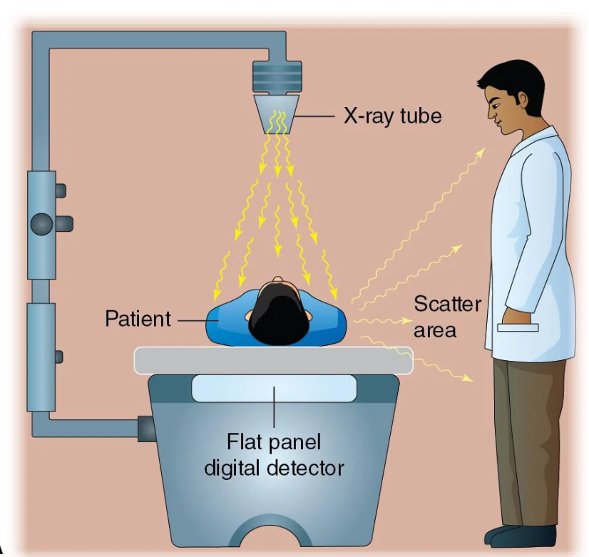
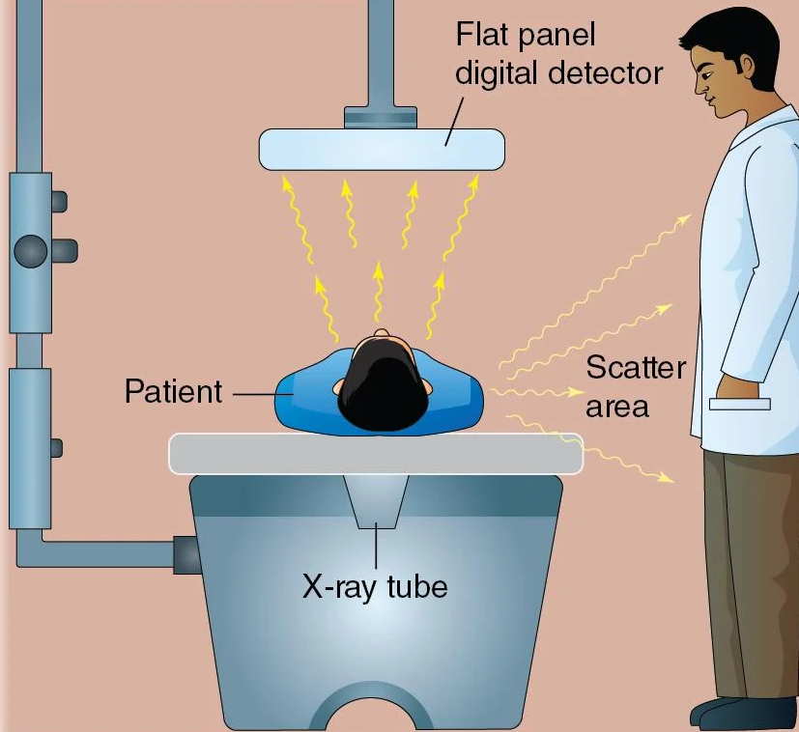

Slide 23
Modern fluoroscopic equipment offers several features that impact the quality of the fluoroscopic image and radiation dose to the patient. There are several controls and settings, both on the control console and tower, that allow adjustment of the radiation output and image quality. The consideration for selecting kVp is the same as for general radiography. Using higher kVp settings (appropriate for the examination) results in a higher energy beam and lower patient dose.
Cumulative air kerma (reference dose) is measured in Gy and provides an estimate about the total patient skin dose for the fluoroscopic procedure.

Slide 24
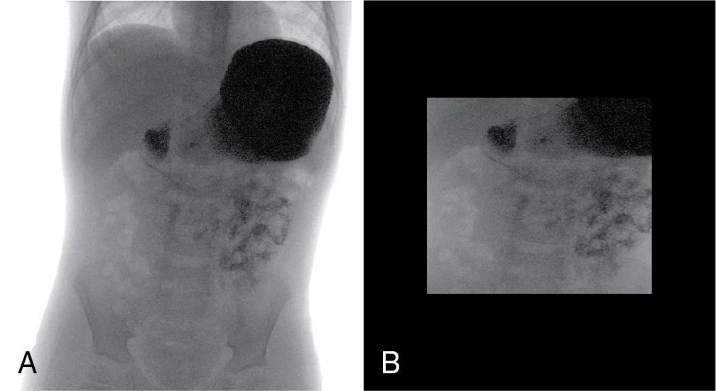
Collimation of the fluoroscopic beam reduces the field size exposing the patient. Fully open, the unit exposes the patient to a beam adequate to cover the full size of the image intensifier or detector. With the newest units, lines appear on the last image hold (LIH) displayed on the monitor, indicating the position of the collimator plates. This allows the collimator to be further adjusted without exposing the patient to additional radiation (virtual collimation). The collimator should be adjusted to eliminate all anatomic structures not necessary to the examination being performed. Collimation changes the field of view (FOV) displayed, but it does not magnify the image. By reducing the area of tissue being exposed, the overall patient dose is reduced.

Slide 25
The option to include the grid is also a control feature. The grid reduces the amount of scatter reaching the detector surface and improves image quality. But because it also removes some useful radiation from the remnant beam, mA (quantity of radiation) must be increased to maintain overall exposure to the detector. In general, its use increases radiation dose to the patient. The decision to use it should be based on the examination and the anatomic area’s capacity to produce scatter radiation. The abdomen, for example, produces more scatter radiation, and the grid should be selected; however, the extremities or pediatric patients may not require its use.

Slide 26
Modern fluoroscopic units also allow for the selection and interchangeability of added filtration thickness or material. The operation of this control may entail the substitution of filters of different thicknesses or switching of filtration material. The typical material used for beam filtration is aluminum, which has an atomic number ideally suited to removing low-energy x-ray photons. It is important to remove these low-energy photons from the beam before they can expose the patient and contribute only to patient dose. This filtration acts to increase the average energy of the beam by removing low-energy photons.
Higher atomic materials such as copper are used in some units and may be selected when additional filtration and beam hardening are desired. Advancements in the type and combination of materials used in spectral filtration are incorporated into the design of modern fluoroscopic equipment and assist in reducing patient skin dose while maintaining quality fluoroscopic images.

Slide 27
Use of virtual collimation during LIH, preset anatomic programs, and added filtration reduces the patient dose. Conversely, use of a grid increases the patient dose.

Slide 28
Automatic exposure rate control
Like ABC used in older image-intensified units, automatic exposure rate control (AERC) serves a similar function in modern fluoroscopy. AERC automatically adjusts the tube current (mA), voltage (kVp), filtration, and pulse width to maintain radiation exposure to the flat-panel detector. A variety of variables during a fluoroscopic examination can result in changes in the radiation exposure reaching the FPD. Changes in patient thickness, tissue attenuation, object-to-image receptor distance (OID), collimation, and FOV may require an increase or decrease in the radiation reaching the detector

Slide 29
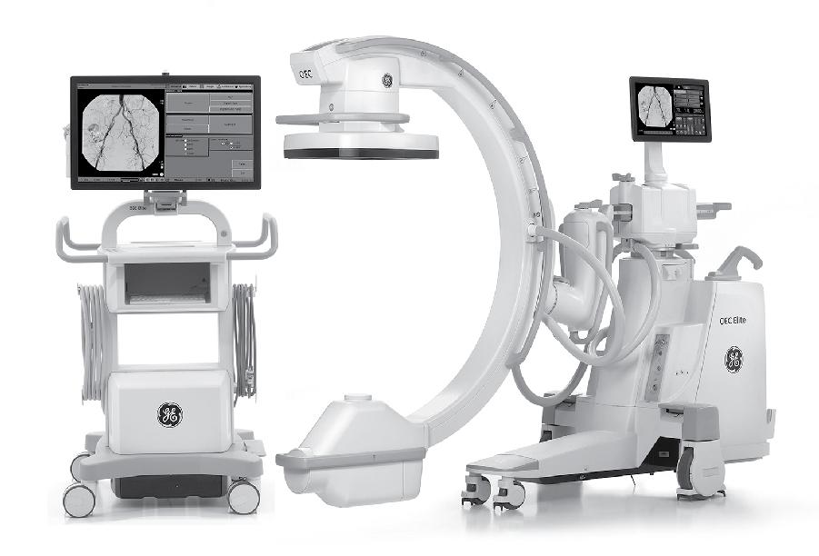

Slide 30
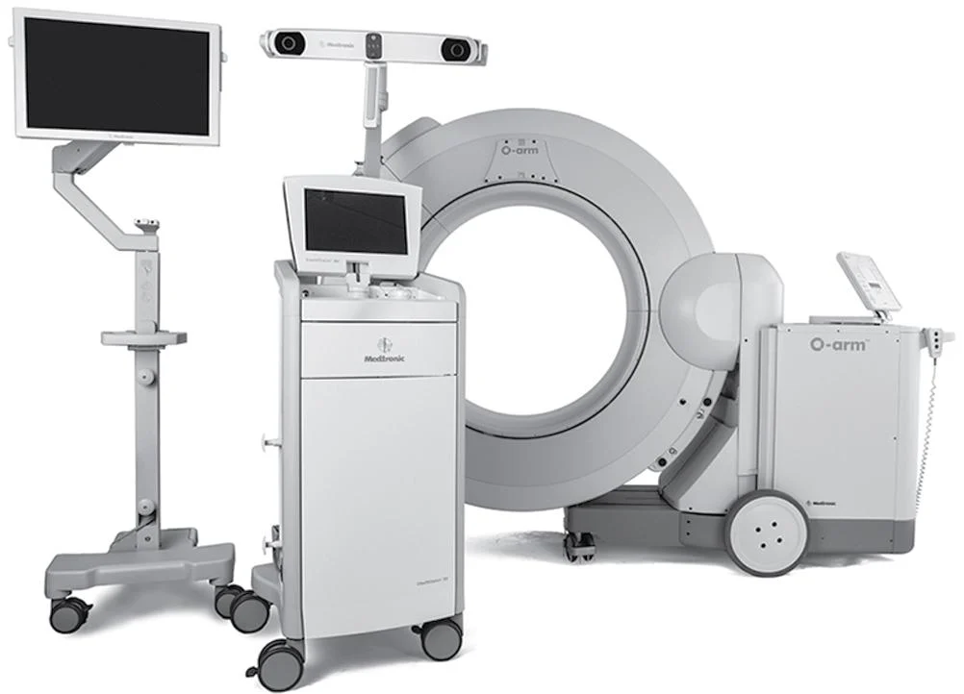
Surgical procedures have multiple imaging needs and the O-arm system can provide both static and dynamic images along with two- and three-dimensional (3D) images. The O-arm design places two flat-panel fluoroscopic detectors in an orthogonal (right-angle) orientation and permits fluoroscopy from two different views in real time. This viewing perspective is very important to surgeons for the placement of vascular lines and orthopedic devices such as pins, rods, and fixation plates. Equipment movement is motor controlled, the gantry opens for easy patient access laterally, and specialized draping is used to maintain sterility when the gantry is closed. Fluoroscopic and radiographic images are obtained with flat-panel detector technology, which allows the surgeon to assess the outcome of the procedure before closing the patient.

Slide 31
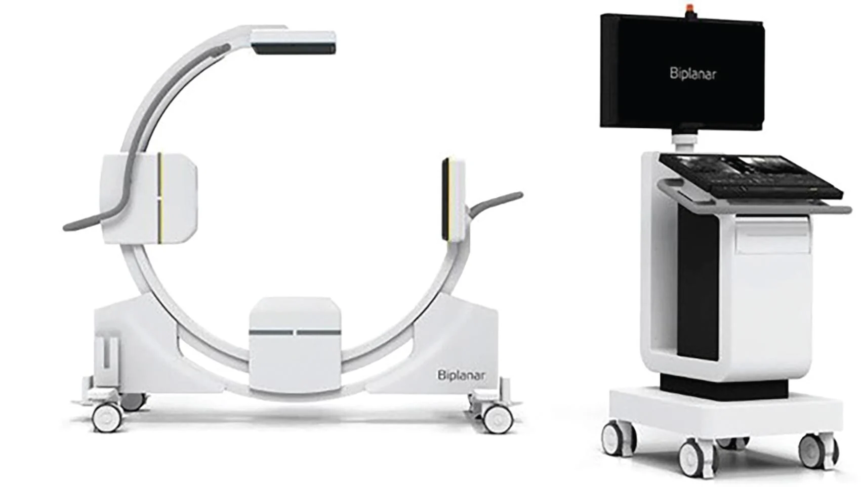

Slide 32
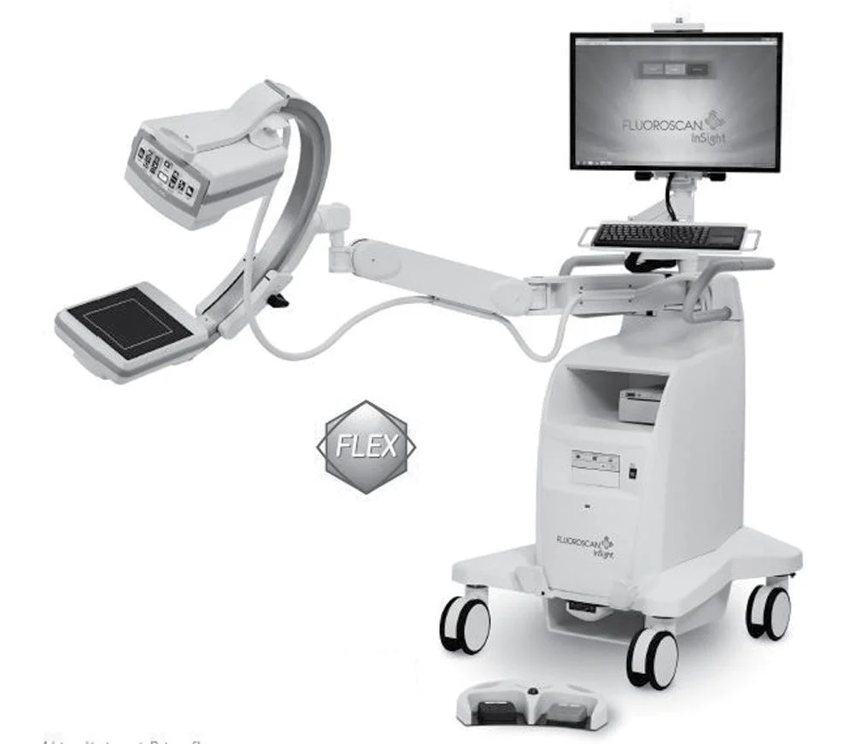

Slide 33
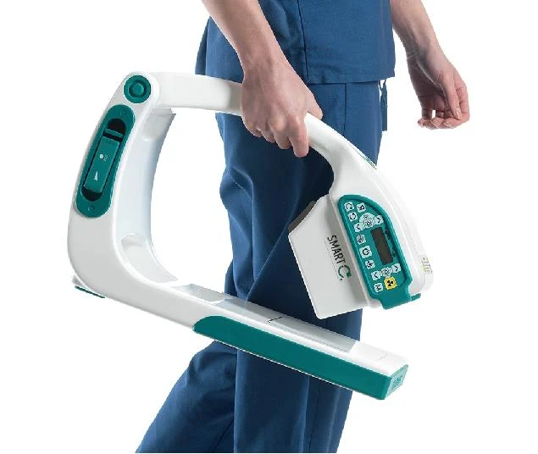

Slide 34
