Slide 1
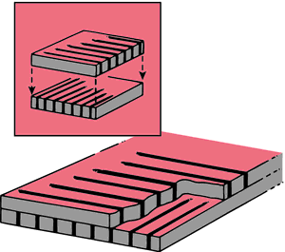
Radiographic Grids 1
Prof. Jarek Stelmark
Hostos Community College – The City University of New York

Slide 2
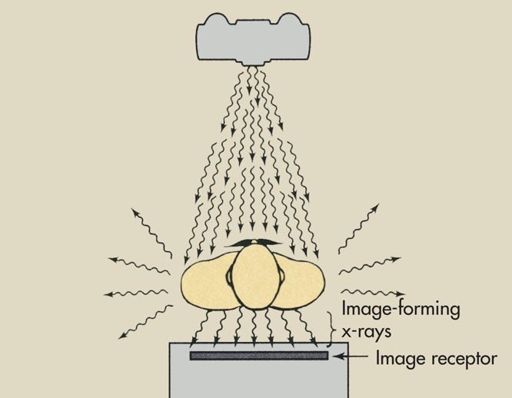
Even under the most favorable conditions, most remnant x-rays are scattered.
If the radiograph were taken with only scatter radiation and no transmitted x-rays reached the image receptor, the image would be dull gray. The radiographic contrast would be very low.

Slide 3
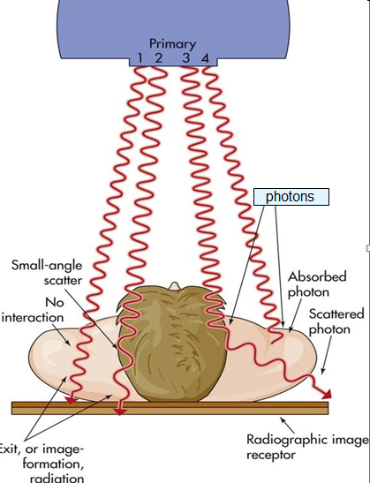

Slide 4
In the normal situation, however, x-rays arriving at the image receptor consist of both transmitted and scattered x-rays. This image would have moderate contrast. The loss of contrast results from the presence of scattered x-rays.

Slide 5
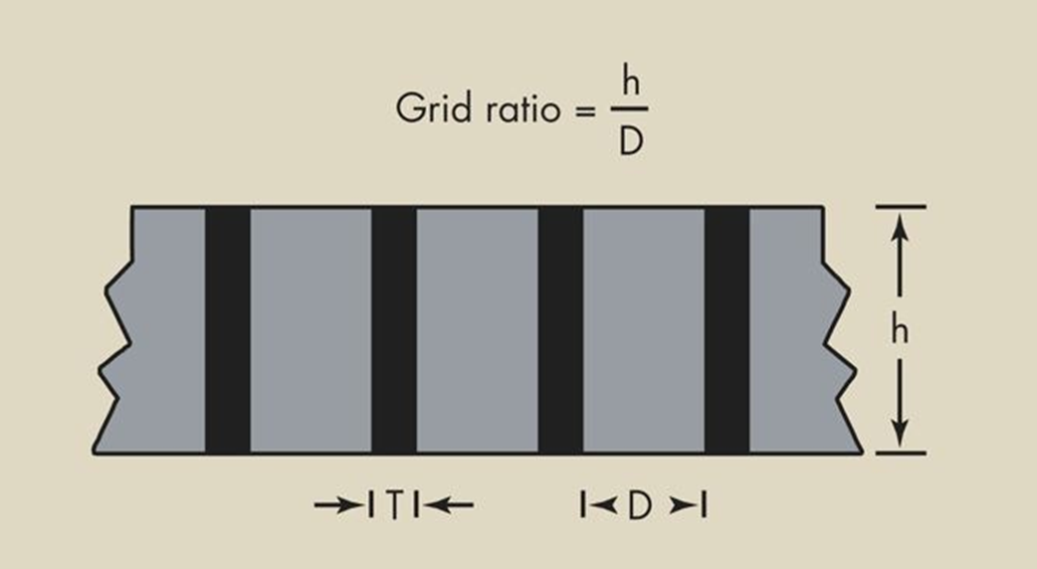
Radiographic Grids
Scattered x-rays that reach the image receptor are part of the image-forming process; indeed, the x-rays that are scattered forward do contribute to the image. An extremely effective device for reducing the level of scatter radiation that reaches the image receptor is the grid, a carefully fabricated series of sections of radiopaque material (grid strips) alternating with sections of radiolucent material (interspace material). The grid is positioned between the patient and the image receptor.

Slide 6
This technique for reducing the amount of scatter radiation that reaches the image receptor was first demonstrated in 1913 by Gustave Bucky. Over the years, Bucky's grid has been improved by more precise manufacturing, but the basic principle has not changed.

Slide 7
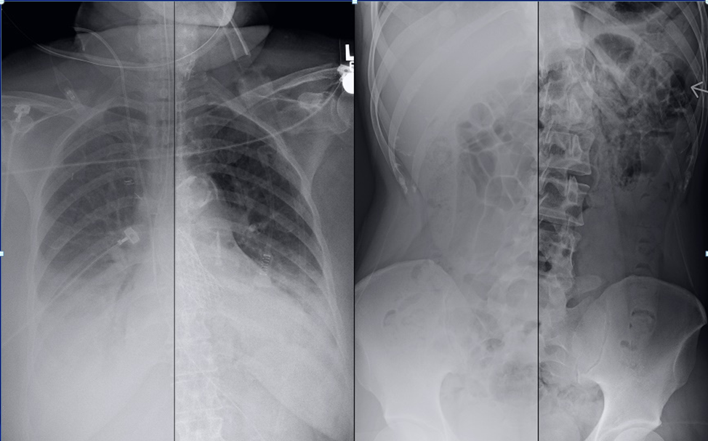
No Grid
No Grid

Slide 8
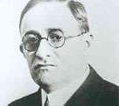

The grid is designed to transmit only those x-rays whose direction is on a straight line from the source to the image receptor. Scatter radiation is absorbed in the grid material.

Slide 9
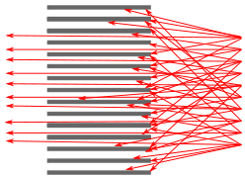

Slide 10
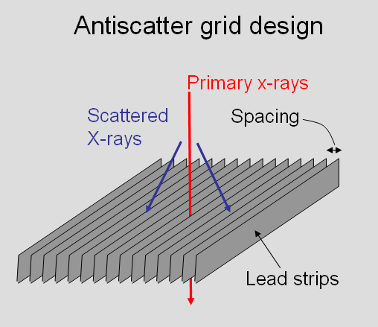

Slide 11
If the angle of a scattered x-ray is great enough to cause it to intersect a lead grid strip, it will be absorbed. If the angle is slight, the scattered x-ray will be transmitted similarly to a primary x-ray. Laboratory measurements show that high-quality grids can attenuate 80% to 90% of the scatter radiation. Such a grid is said to exhibit good “cleanup.”

Slide 12
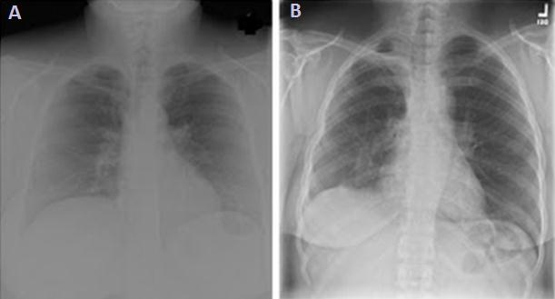

Slide 13
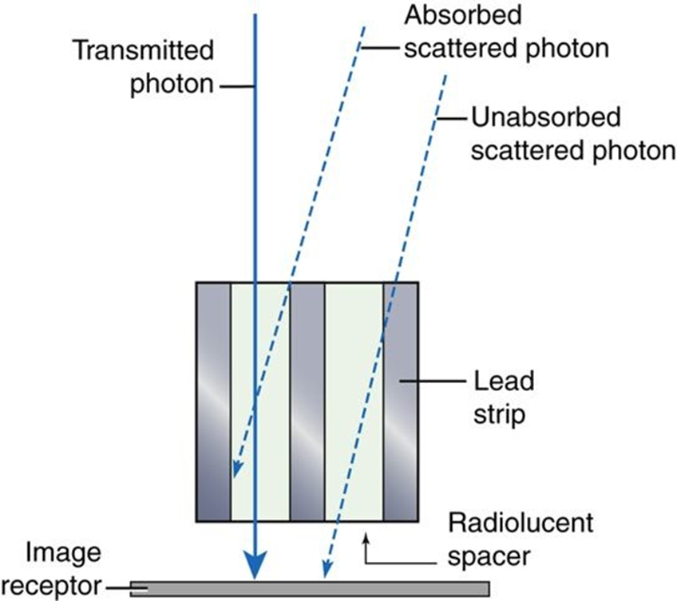
Grid Interspace Material
The purpose of the interspace material is to maintain a precise separation between the delicate lead strips of the grid. The interspace material of most grids consists of aluminum or plastic fiber; reports are conflicting as to which is better.

Slide 14
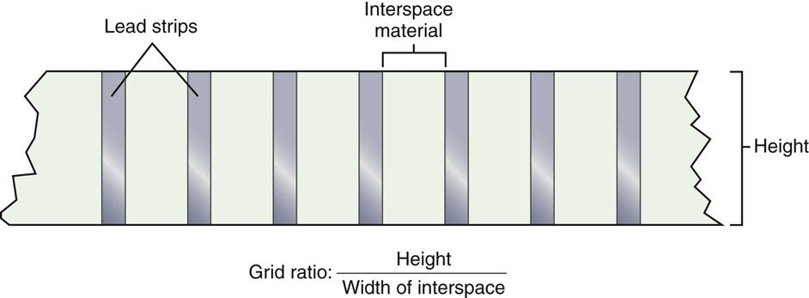

Calculating Grid Ratio
What is the grid ratio when the lead strips are 3.2 mm high and separated by 0.2 mm?

Slide 15
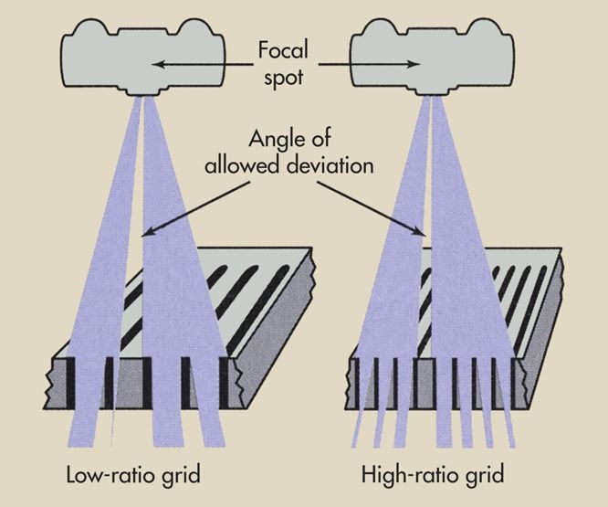
High-ratio grids are more effective in cleaning up scatter radiation than are low-ratio grids. This is because the angle of scatter allowed by high-ratio grids is less than that permitted by low-ratio grids.
High-ratio grids increase patient radiation dose.

Slide 16
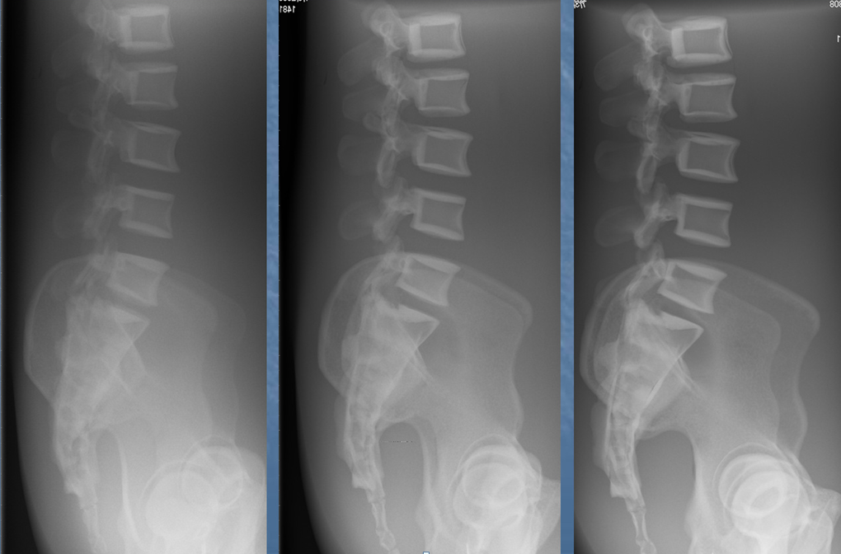
5:1
8:1
12:1

Slide 17
Aluminum has a higher atomic number than plastic and therefore may provide some selective filtration of scattered x-rays not absorbed in the grid strip. Aluminum also has the advantage of producing less visible grid lines on the radiograph.
On the other hand, use of aluminum as interspace material increases the absorption of primary x-rays in the interspace, especially at low kVp. The result is higher mAs and higher patient dose. Above 100 kVp, this property is unimportant, but at low kVp, the patient dose may be increased by approximately 20%. For this reason, fiber interspace grids usually are preferred to aluminum interspace grids.

Slide 18
Still, aluminum has two additional advantages over fiber. It is nonhygroscopic, that is, it does not absorb moisture as plastic fiber does. Fiber interspace grids can become warped if they absorb moisture. Also, aluminum interspace grids of high quality are easier to manufacture because aluminum is easier to form and roll into sheets of precise thickness.

Slide 19
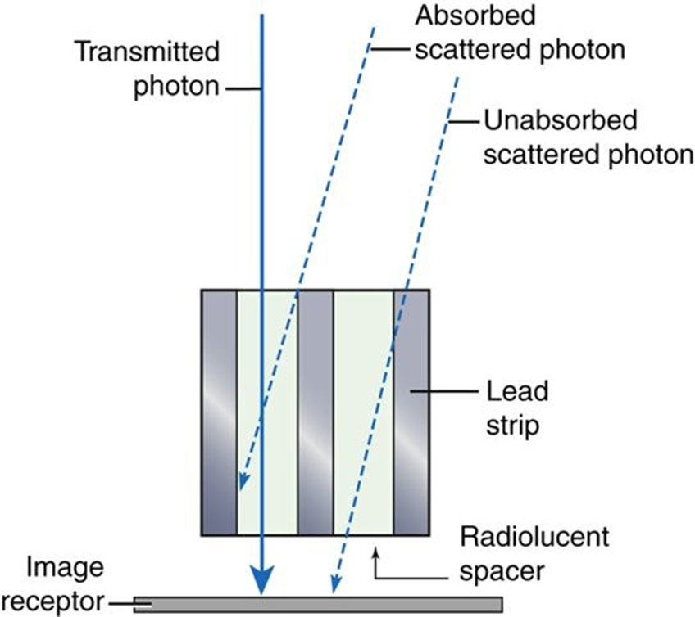
Grid Strip
Theoretically, the grid strip should be infinitely thin and should have high absorption properties. These strips may be formed from several possible materials. Lead is most widely used because it is easy to shape and is relatively inexpensive. Its high atomic number and high mass density make lead the material of choice in the manufacture of grids. Tungsten, platinum, gold, and uranium all have been tried, but none has the overall desirable characteristics of lead.

Slide 20
Types of Grids
Parallel
Crossed
Focused
Air gap technique

Slide 21
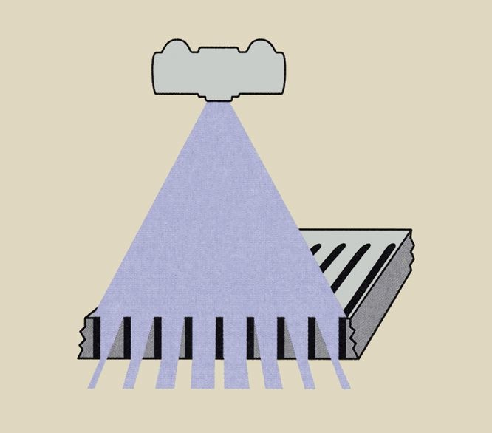
Parallel Grid
The simplest type of grid is the parallel grid. In the parallel grid, all lead grid strips are parallel. This type of grid is the easiest to manufacture, but it has some properties that are clinically undesirable, namely grid cutoff, the undesirable absorption of primary x-rays by the grid.

Slide 22
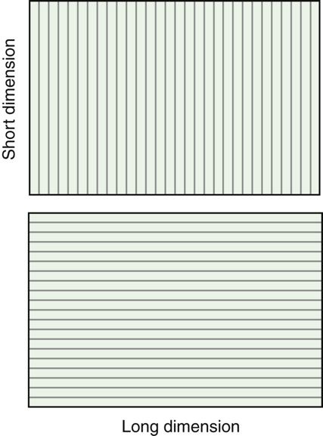

Slide 23
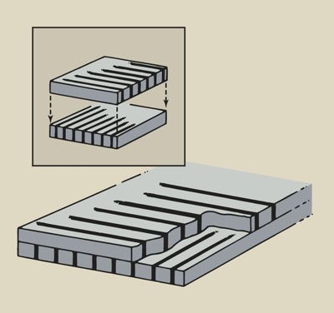
Crossed Grid
Parallel grids clean up scatter radiation in only one direction, along the axis of the grid. Crossed grids are designed to overcome this deficiency. Crossed grids have lead grid strips that run parallel to the long and short axes of the grid. They are usually fabricated by sandwiching two parallel grids together, with their grid strips perpendicular to one another.

Slide 24
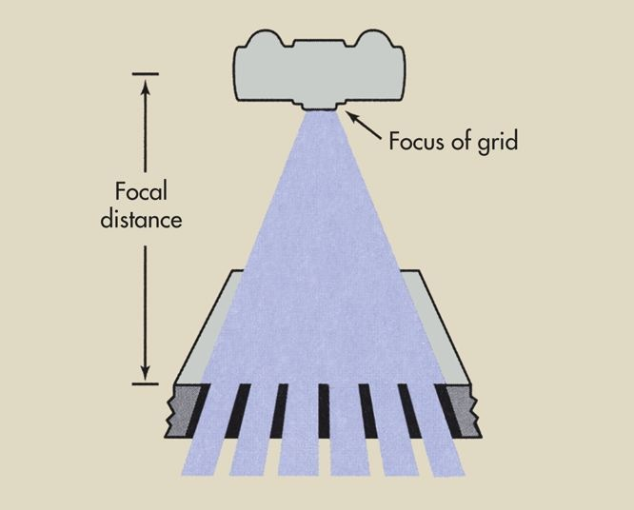
Focused Grid
The focused grid is designed to minimize grid cutoff. The lead grid strips of a focused grid lie on the imaginary radial lines of a circle centered at the focal spot, so they coincide with the divergence of the x-ray beam. The x-ray tube target should be placed at the center of this imaginary circle when a focused grid is used

Slide 25
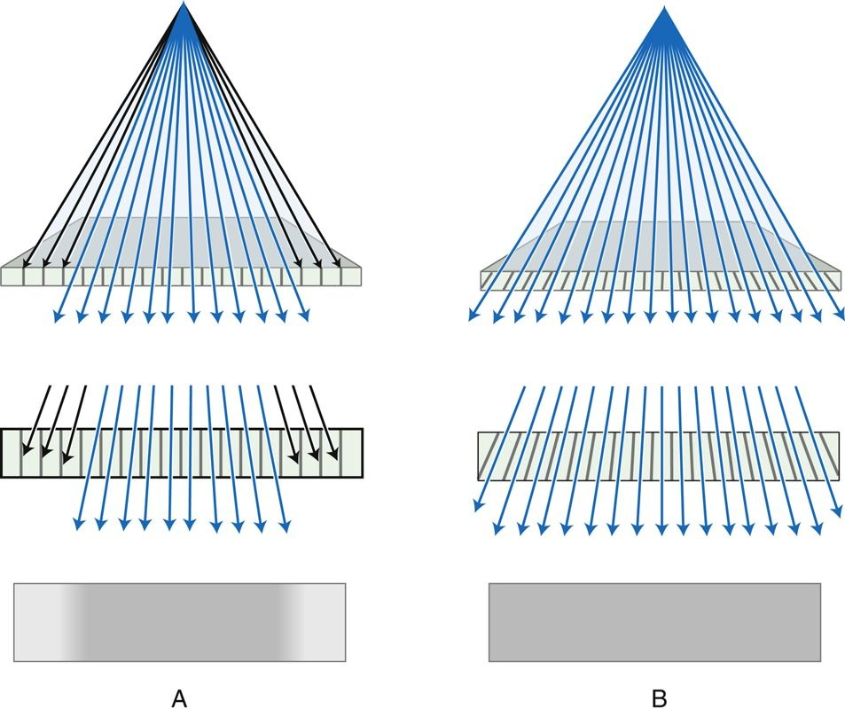

Slide 26
Focused grids are more difficult to manufacture than parallel grids. They are characterized by all the properties of parallel grids, except that when properly positioned, they exhibit no grid cutoff. The radiologic technologist must take care when positioning focused grids because of their geometric limitations.

Slide 27
Every focused grid is marked with its intended focal distance and the side of the grid that should face the x-ray tube. If radiographs are taken at distances other than those intended, grid cutoff occurs.

Slide 28
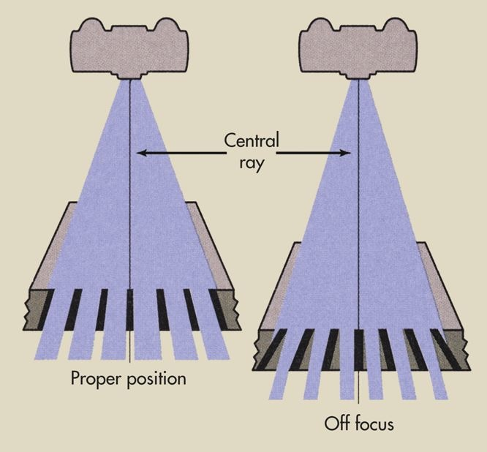

Slide 29
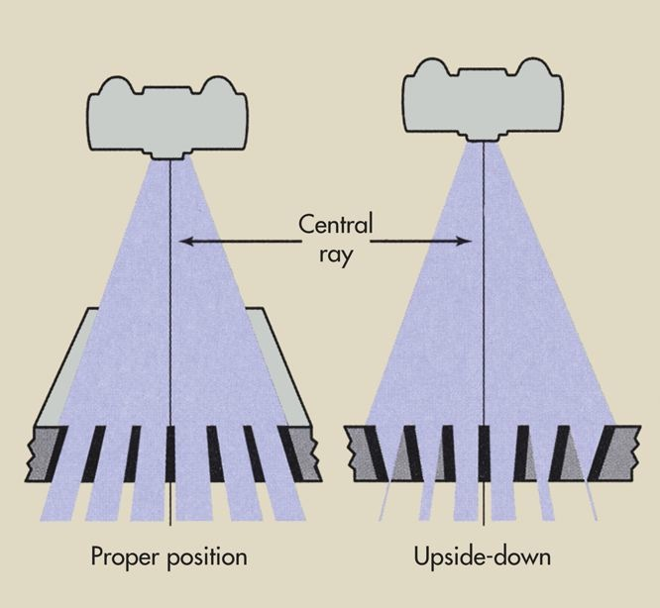

Slide 30
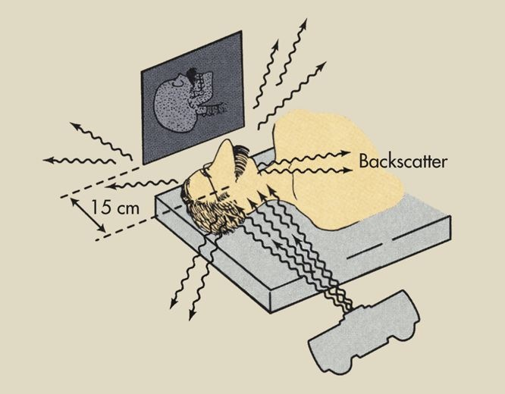
Air-Gap Technique
A clever technique that may be used as an alternative to the use of radiographic grids is the air-gap technique. The air-gap technique is another method of reducing scatter radiation, thereby enhancing image contrast.

Slide 31
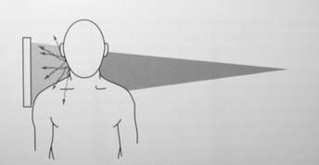

Slide 32
When the air-gap technique is used, the image receptor is moved 10 to 15 cm from the patient. A portion of the scattered x-rays generated in the patient would be scattered away from the image receptor and not be detected. Because fewer scattered x-rays interact with the image receptor, the contrast is enhanced.
Usually, when an air-gap technique is used, the mAs is increased approximately 10% for every centimeter of air gap. The technique factors usually are about the same as those for an 8:1 grid. Therefore, the patient dose is higher than that associated with the non-grid technique and is approximately equivalent to that of an intermediate grid technique.

Slide 33
The Grid Conversion factor
Grid Ratio
mAs Compensation
Non –grid
5:1
6:1
8:1
12:1
16:1
2 ( 2 x non-grid mAs)
3 ( 3 x non-grid mAs)
4 ( 4 x non-grid mAs)
5 ( 5 x non-grid mAs)
6 ( 6 x non-grid mAs)

