Slide 1
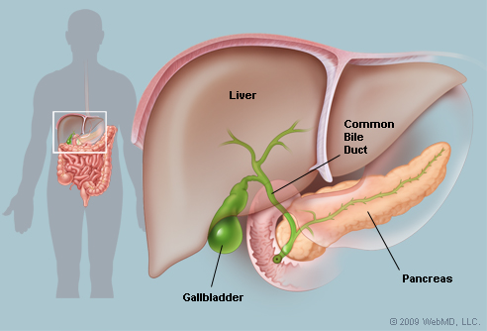
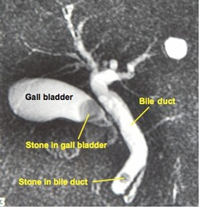
Contrast Media Liver & Biliary System
Prof. Arya

Slide 2
Liver
the largest solid organ in the human body: absolutely essential to life
occupies most of the right upper quadrant (RUQ)
extends to slightly below the lateral portion of the tenth rib just above the right kidney: right border is its greatest vertical dimension
lobes: 4
major lobes: 2: Falciform ligament divides liver into two major lobes
Right lobe (larger than left lobe)
Left lobe
minor lobes: 2: on visceral surface
Caudate lobe
Quadrate lobe

Slide 3
Liver
highly vascular
can be easily lacerated, hence well protected by lower right rib cage
blood supply:
Hepatic artery: supplies oxygenated blood from abdominal aorta
Portal vein: carries blood from digestive system to be filtered by liver
functions: performs more than 100 different functions
primary function: production of bile; 800 to 1000 ml, or about 1 quart per day

Slide 4
Gallbladder
thin-walled musculomembranous sac
found on visceral surface of right lobe of liver
distal end extends below the anterior and inferior margin of liver
rest of the gallbladder lies along the inferior and posterior surface of the liver
position of gallbladder varies with body habitus
neck of gallbladder consistent with cystic duct
functions:
to store bile
to concentrate bile
releases bile when stimulated by hormone, ‘cholecystokinin pancreozymin’ (CCK-PZ) produced by duodenal mucosa

Slide 5
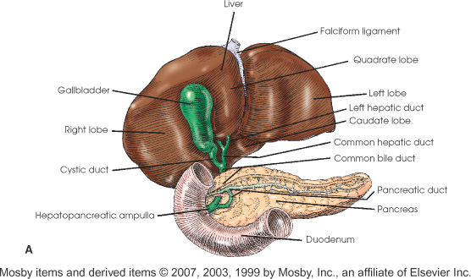
Gallbladder

Slide 6
Gallbladder Location
Hypersthenic:
high and almost transverse (lateral) and lies well to the right of the midline
located near duodenal bulb and pylorus region of the stomach
LAO 15⁰ – 20⁰ to prevent superimposing spine
Sthenic:
less transverse and lies midway between the lateral abdominal wall and the midline
between Xiphoid and lower rib margin
LAO 20⁰-25⁰ to prevent superimposing spine
Asthenic:
near the midline on the right side at the level of the iliac crest (L3-L4)
LAO 35⁰- 40⁰ to prevent superimposing spine

Slide 7
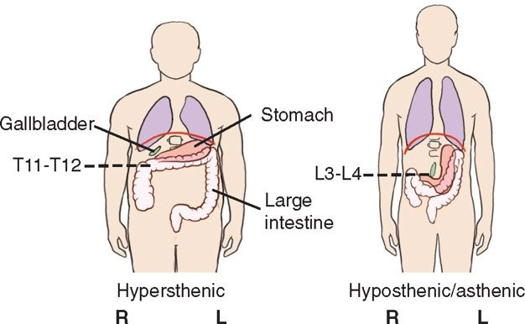
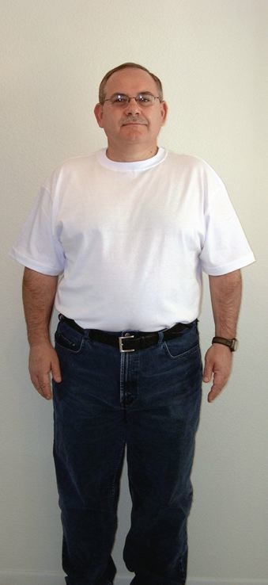
Hypersthenic Body Habitus & Gallbladder (high and lateral)

Slide 8
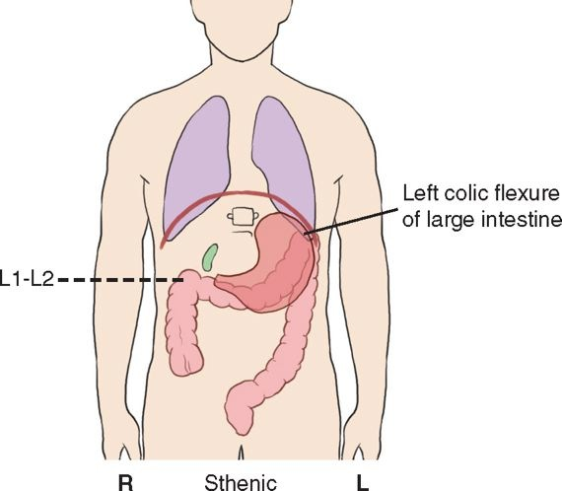
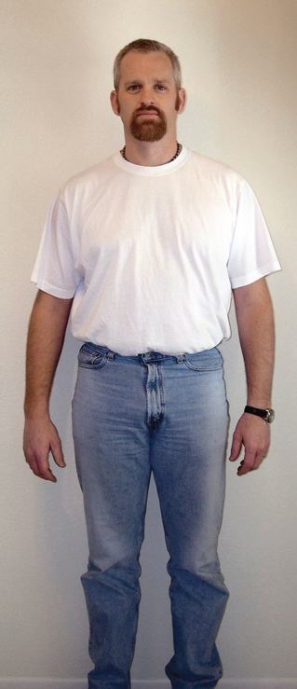
Sthenic Body Habitus & Gallbladder (between Xiphoid and lower rib margin)

Slide 9
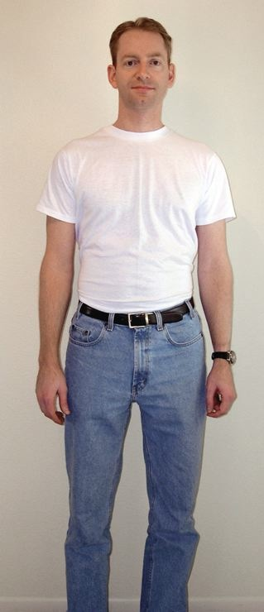
Hyposthenic/Asthenic Body Habitus & Gallbladder (near iliac crest)

Slide 10
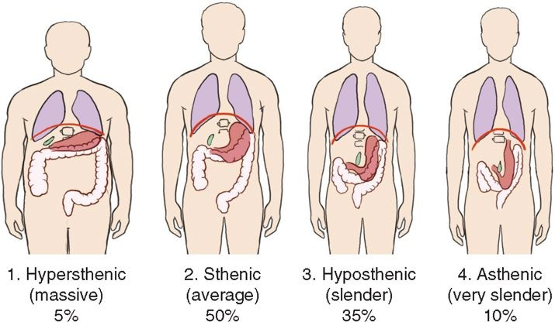
Gallbladder Location
(high and lateral)
(between Xiphoid and lower rib margin)
(near iliac crest)

Slide 11
Bile
a bitter-tasting, dark green to yellowish brown color
manufactured by the liver
transported by various ducts, and
stored in the gallbladder
major function: to aid in the digestion of fats by emulsifying or breaking down fat globules and the absorption of fat following its digestion

Slide 12
Biliary System/Tree (Gallbladder & Bile ducts)
bile is formed by liver lobules and travels to two main hepatic ducts in liver: right and left
Right and Left hepatic ducts join to continue as Common Hepatic Duct (CHD)
bile is carried to gall bladder by cystic duct for temporary storage
CHD unites with cystic duct of gall bladder to form Common Bile Duct (CBD)
CBD joins the pancreatic duct and together empty into the duodenum via the hepatopancreatic ampulla (ampulla of Vater)
Ampulla of Vater is controlled by muscle, called ‘sphincter of hepatopancreatic ampulla or sphincter of Oddi’

Slide 13
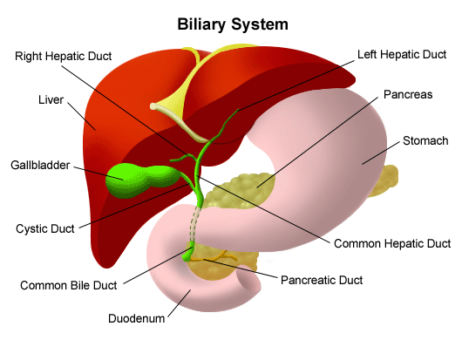
Biliary System/Tree
radiographic examination of the biliary system involves studying the manufacture, transport, and storage of bile

Slide 14
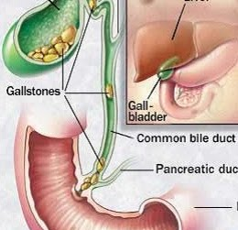
Pathology
if bile is not needed for digestive purposes:
it is stored in the gall bladder
it is concentrated within the gall bladder as a result of hydrolysis (removal of water)
if too much water is absorbed or more commonly if the cholesterol becomes too concentrated, gallstones (choleliths) may form in the gallbladder
the gallbladder normally contracts when foods such as fats or fatty acids are in the duodenum

Slide 15
Radiographic Appearance of Gallstones
60%: are primarily made up of cholesterol, making them highly radiolucent
25% to 30%: are composed of primarily cholesterol and/or crystalline salts, which also are radiolucent
10% to 15%: are composed of crystalline calcium salts, which are often visible on an abdominal radiographic image without contrast media

Slide 16
Terminology
Chole_: prefix related to bile
Cysto_: prefix related to gallbladder
Cholecystography: radiographic study of gallbladder
Cholangiography: radiographic study of biliary ducts
Cholecystocholangiography: radiographic study of gallbladder and biliary ducts
Choleliths: gallstones
Cholelithiasis: condition of having gallstones
Choledocholithiasis: condition of gallstones in biliary ducts
Cholecystitis: inflammation of gallbladder
Cholecystectomy: removal of gallbladder
Stenosis: narrowing
Bilirubin: yellow bile pigment which is byproduct of RBC breakdown

Slide 17
Cholelithiasis
a condition of gallstones due to abnormal calcification of bile in the gallbladder
causes:
increased levels of bilirubin
increased level of calcium
increased level of cholesterol
occurrence: most common in obese female patients
symptoms:
right upper quadrant pain usually after a meal
nausea
vomiting
* patients with complete blockage of the biliary ducts may develop jaundice.

Slide 18
Choledocholithiasis
the presence of gallstones in the biliary ducts
either moved from gall bladder or formed in the ducts itself
symptoms:
pain & tenderness in the right upper quadrant
jaundice, and
Pancreatitis (sometimes)

Slide 19
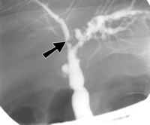
Biliary Stenosis
is a narrowing of one of the biliary ducts
results in reduced flow of bile
leads to complete obstruction of duct, if small stones do not pass into duodenum
ultimately may lead to Cholecystitis and jaundice

Slide 20
Cholecystitis
is inflammation of the gallbladder
Acute: often a blockage of the cystic duct restricts the flow of bile from the gallbladder into the common bile duct
Chronic: the blockage is frequent
* after a period of time, the bile begins to irritate the inner lining of the gallbladder and it becomes inflamed

Slide 21
Neoplasm
are new growth
may be benign or malignant
malignant or cancerous tumors of the gallbladder can be aggressive and spread to the liver, pancreas, or GI tract
* fortunately, neoplasms of the gallbladder are relatively rare

Slide 22
Contrast & Technical factors
contrast:
water-soluble Iodinated
Non-injectable: (Oral): Telepaque, Bilopaque
Injectable: Hypaque, Cholografin, Conray, Isovue, Renografin
technical factors:
low kVp (60-70) as gallbladder is low contrast organ and bile dilutes the contrast

Slide 23
Types of Studies/Route of Administration
Indirect routing:
Oral: Oral CholecystoGraphy (OCG)
Injection: into vein; Intravenous Cholangiography (IVC)
Direct routing:
Percutaneous Transhepatic Cholangiography (PTC)
Operative Cholangiography
T-tube Cholangiography: post-operative
Endoscopic Retrograde Cholangiopancreatography (ERCP)

Slide 24
Indications & Contraindications
indications (when to do the study)
biliary calculi (gallstones)
biliary stenosis
Cholecystitis
contraindications (when NOT to do the study)
in case of confirmed jaundice: DO NOT do the study as liver is not functioning normally
if confirmed gallstone: no fatty food as it may lead to convulsion in OCG study
hepatorenal disease
vomiting
diarrhea
hypersensitivity to Iodine containing compounds
pregnancy

Slide 25
Oral CholecystoGraphy (OCG)
purpose: to measure the functional ability of liver and gallbladder, & patency of biliary ducts
procedure: patients were prepared 24 hours before the study; given the contrast orally
images were taken before and after providing the patient with fatty food
Sonography (Ultrasound) has replaced the OCG exams
advantages of Sonography over contrast study:
no ionizing radiation
no contrast medium
detection of small calculi
less patient preparation

Slide 26
Intravenous Cholangiography (IVC)
reasons:
when patient has no gallbladder
when patient can not tolerate oral contrast medium
contrast:
inject Cholografin through vein
not more than 20 cc
wait 30-45 minutes
position:
LAO or RPO as less magnification and easy for patient

Slide 27
Percutaneous Transhepatic Cholangiography (PTC)
is done on patient who has jaundice (as OCG can not be done)
is pre-operative sterile procedure to check the blockage of biliary ducts
procedure:
patient supine local anesthesia
Chiba needle is used, parallel to floor, inserted through skin into right lateral intercostal space towards liver hilum
remove needle once contrast is in biliary tree
projections/position:
AP image
risks:
lung puncture
liver bleeding
air while injecting

Slide 28
Operative Cholangiography
purpose: done after gallbladder is removed surgically, open or laparoscopic, to
see the patency (expanded or unobstructed or condition of being open) of biliary tree
see the patency of hepatopancreatic ampulla of Vater
see the presence of residual stone
contrast: water soluble, injectable (Isovue, Renografin)
procedure:
cystic duct is tied proximal to gallbladder neck
surgeon inserts a catheter into stump of cystic duct and inject contrast media
can be done by open or laparoscopic surgery (less recovery time)

Slide 29
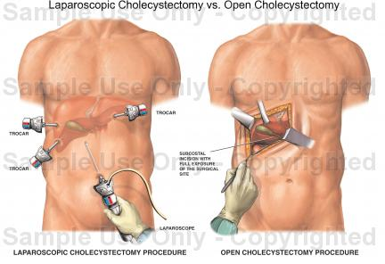
Operative Cholangiography

Slide 30
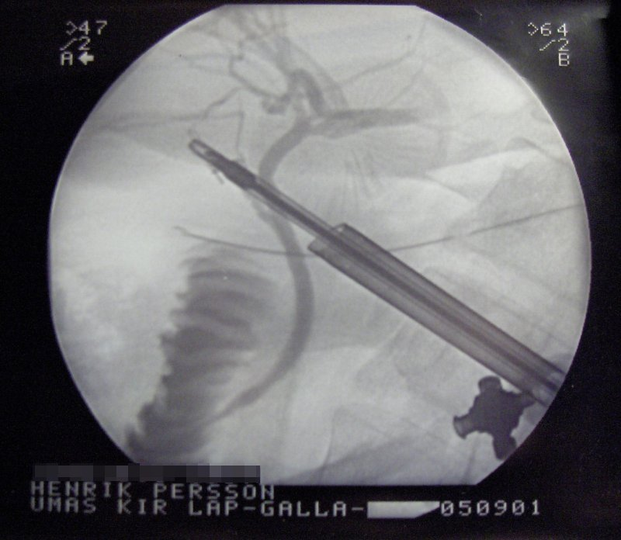
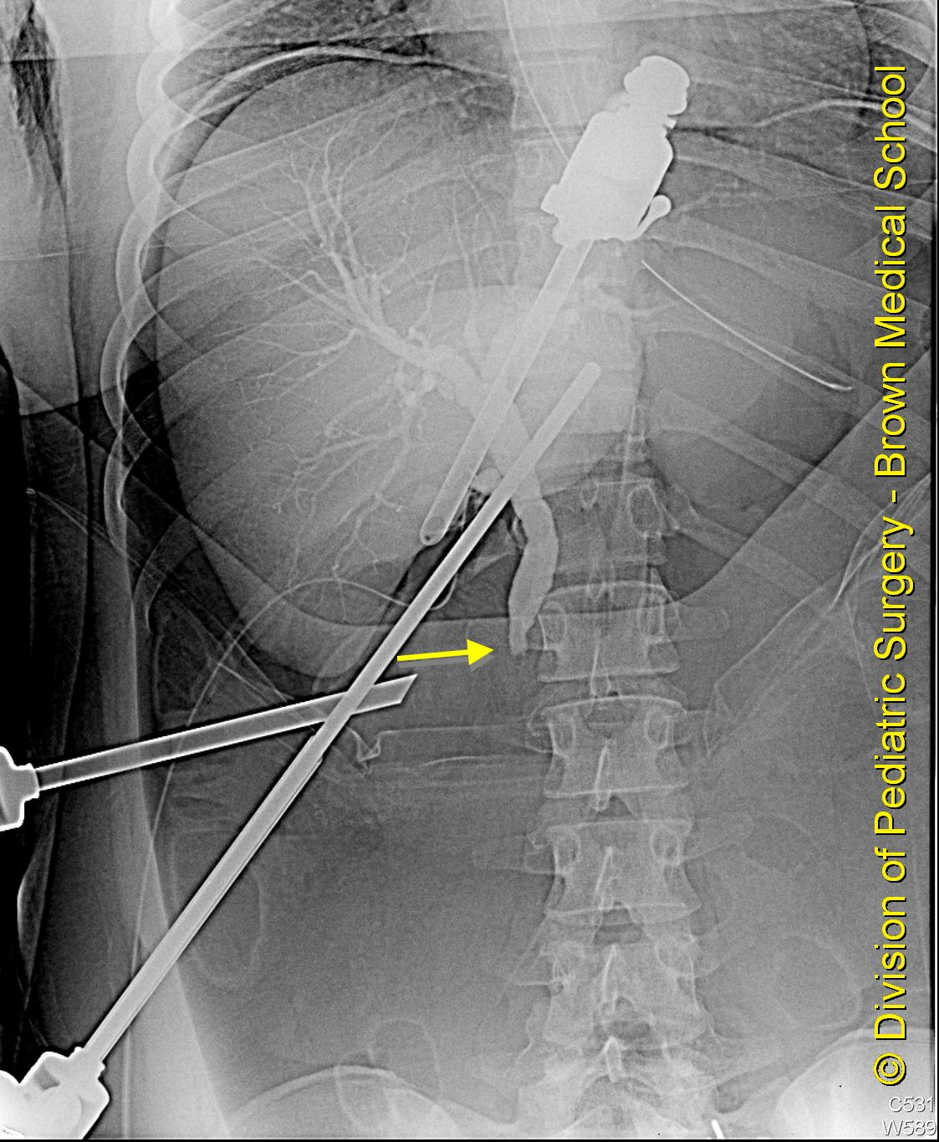
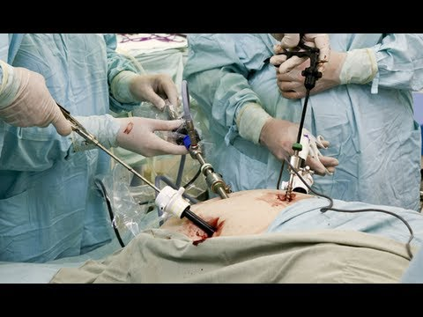
Operative Cholangiography

Slide 31
T-tube Cholangiography: post-operative
purpose: done after gallbladder is removed to
see the patency of biliary tree
see the patency of hepatopancreatic ampulla of Vater
see the presence of residual stone
contrast: water soluble, injectable (Isovue, Renografin)
procedure:
cystic duct is tied proximal to gallbladder neck
surgeon inserts a catheter into stump of cystic duct and inject contrast media
can be done by open or laparoscopic surgery (less recovery time)
projections/position:
scout
RPO
lateral

Slide 32
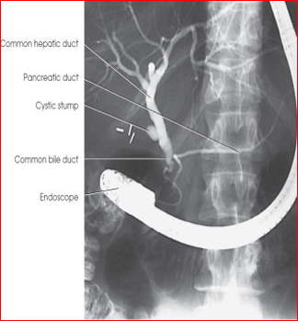
Endoscopic Retrograde CholangioPancreatography (ERCP)
Endoscopic Retrograde CholangioPancreatography (ERCP)
thin catheter fed into CBD or pancreatic duct from duodenal C-loop
purpose: to visualize biliary system and main pancreatic duct for obstruction, bleeding disorders

Slide 33
Endoscopic Retrograde CholangioPancreatography (ERCP)
purpose: both diagnostic and therapeutic to
diagnose biliary and pancreatic pathological conditions
useful when biliary ducts are not dilated
useful when no obstruction at the level of ampulla of Vater
contrast: water soluble, injectable (Isovue, Renografin)
procedure:
no meal 1 hour before procedure
patient sedated
fiber optic endoscope is inserted from mouth to duodenum
small cannula with contrast into CBD via ampulla
projections/position:
left lateral oblique to prevent overlap of CBD and pancreatic duct

Slide 34
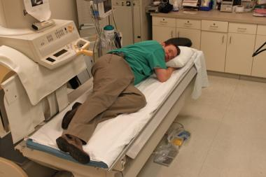
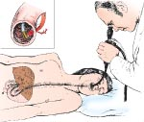
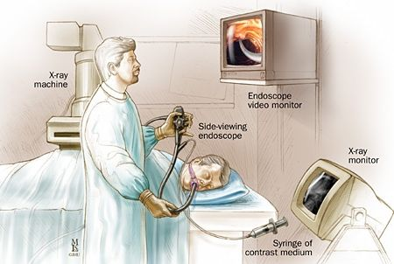
ERCP Endoscopic Retrograde CholangioPancreatography

