Slide 1
PACS Archiving

Slide 2
The term archive can be defined as a place where records or documents are preserved. In a picture archiving and communication system (PACS), the electronic archive serves as the new file room and warehouse for all digital imaging and communications in medicine (DICOM) imaging modalities.
The PACS archive stores all patient and image data, often on magnetic tape or optical disk. Also, the PACS archive controls the receipt, storage, and distribution of new and historic images. Because of the explosive growth in the use of digital imaging in radiology, the archive is one of the fastest growing components in the PACS.

Slide 3
Archive technology continues to make drastic improvements each year; the storage capacity is said to double every 18 to 24 months, and the price per gigabyte also continues to decrease.

Slide 4
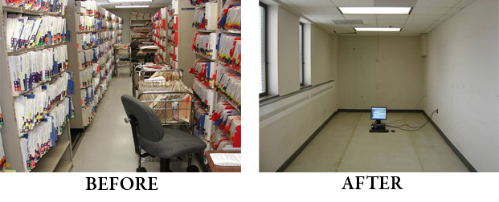

Slide 5
The image storage or archive server consists of the physical storage device of the archive system. It commonly consists of two or three tiers of storage. A tier is a level, layer, or division of something. In an archive server, a tier represents a specific level of archive: short-term, mid-term, or long-term.
Most PACS archive systems are set up with a short-term tier and a long-term tier.

Slide 6
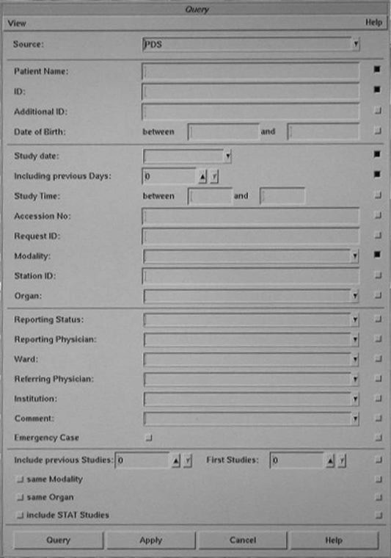
Short-term means being online or available very quickly, usually within 3 to 5 seconds.

Slide 7
Long-term means images that must be retrieved from a tape or disk storage device.

Slide 8
The short-term tier is commonly a RAID. A RAID is composed of several magnetic disks or hard drives that are linked together in an array. The size of the RAID ranges from several hundred gigabytes to several terabytes. As the individual disk sizes continue to increase, so does the potential size of the RAID.

Slide 9
In 1988 David Patterson, Garth Gibson, and Randy Katz coined the term RAID in an article entitled “A Case for Redundant Arrays of Inexpensive Disks (RAID).”
RAID 0: Data are “striped” across all of the connected disks. Striping means that the data are broken up into pieces, and each disk will have one piece of the data. When the data are called up from the RAID, all of the data are put together from the disks and presented to the user as a whole.
RAID 1: All of the data sent to the RAID are mirrored onto two disks. Mirroring means that all of the data are duplicated and placed onto two separate disks. This RAID level has full redundancy

Slide 10
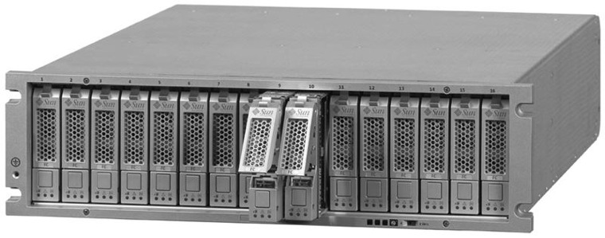

Slide 11
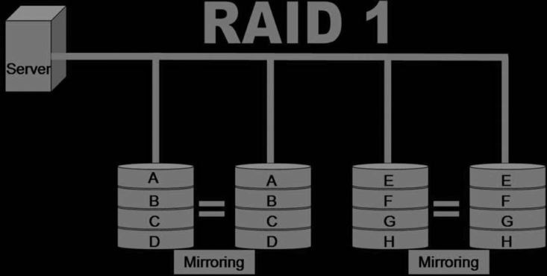

Slide 12
Because RAID is becoming more cost-effective, many hospitals use RAID storage for both their short-term and their long-term archive.

Slide 13
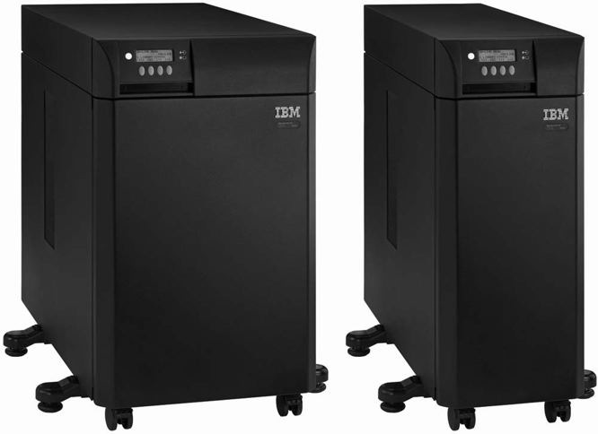
Other long-term storage products that are still widely used are optical disk, tape, and magnetic disk. Optical disk and magnetic tape archive solutions use a jukebox to hold the tapes or disks; the magnetic disk uses an array. The jukebox has controller software that interfaces with the image manager to keep track of exactly where each image is located.

Slide 14
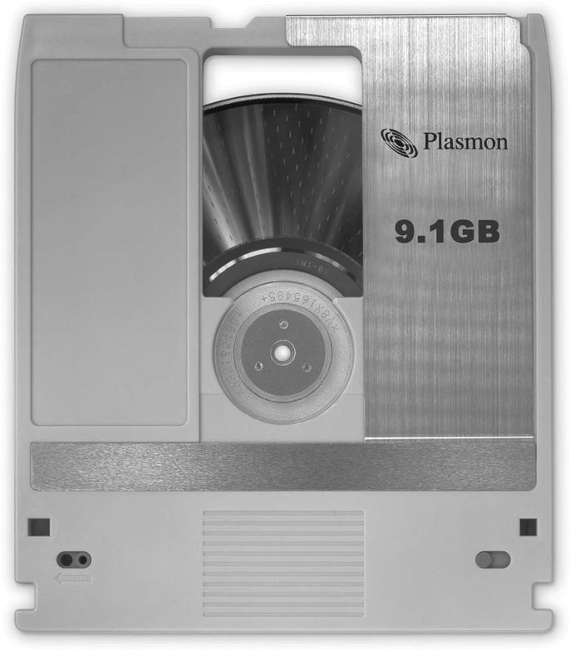
Magneto-optical Disk.
A magneto-optical disk (MOD) is very similar to a compact disk (CD) or digital versatile disk (DVD) in that it is read optically with a laser, but the disk itself is housed within a plastic cartridge. MODs tend to be more reliable than some of the other long-term storage options. The disks are rather robust and can withstand many years of reading. They can be read faster than some of their counterparts. The cost per gigabyte is a bit higher for MODs than for some of the other long-term storage options, but MODs are still a viable long-term storage option.

Slide 15
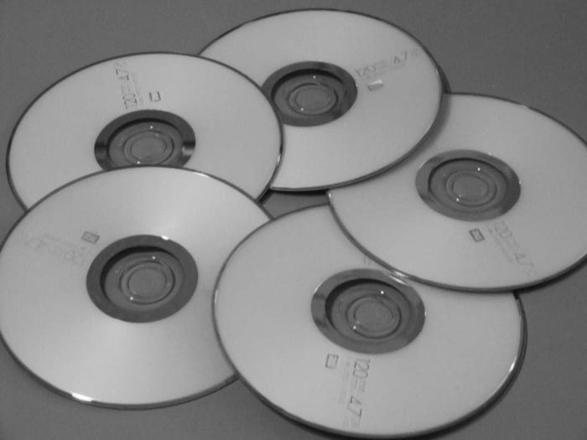
Digital versatile disks (DVDs) were first introduced for use in video. CDs were used by a few early PACS adopters, but users found that the CDs could not hold enough data to make a CD archive cost and space efficient. DVDs have a much higher capacity. In 2006, a double-sided, two-layered DVD held 17 GB of data, whereas a CD held 650 MB. DVDs are the least expensive method for long-term archiving per gigabyte.

Slide 16
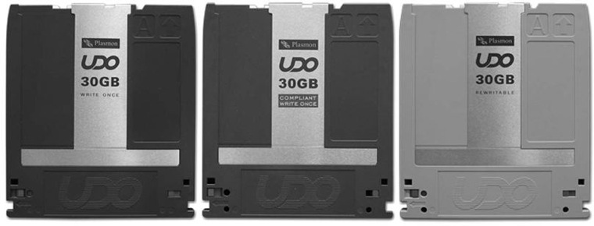
Ultra density optical (UDO) disk is the new-generation MOD. A UDO disk uses blue laser technology in its read and write activities. Plasmon (Plasmon PLC, Hertfordshire, UK) introduced the first UDO disk in 2004 with a disk capacity of 30 GB (2006 MOD technology was at 9.1 GB), and the capacity is predicted to increase to 60 GB and then to 120 GB to accommodate industry needs. Currently, UDO technology operating costs are less than MODs and very competitive with DVD technology. The tape libraries being offered in 2006 held between 24 and 638 disks.

Slide 17
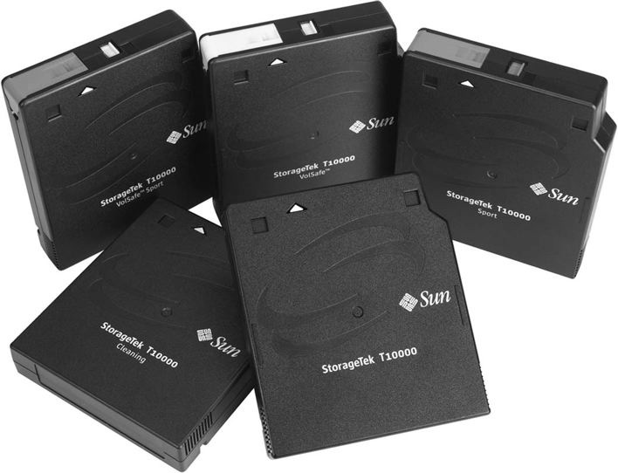
Tape is a fairly low-cost archive medium that comes in various sizes. These tapes are contained within a jukebox or library that has multiple drives and a robot arm to move the tapes in and out of the drives. These libraries can hold between 10 and 1448 tapes in one library. Most of the libraries are scalable, meaning that additional libraries can be added to the original.

Slide 18
Alternative to in-house archiving is an application service provider (ASP). An ASP is a company that provides outsourcing of archiving and management functions for a pay-per-use or pay-per-month charge. ASPs give smaller institutions access to the level of hardware and software they could not otherwise afford. Moreover, they assume responsibility for the day-to-day management of the archive system. Many ASP models have a short-term archive located on hospital premises, and the long-term archive is handled at the off-site location run by the ASP company. The short-term archive may be leased by the ASP, and the controller will pre-fetch images from the long-term off-site storage during the evening and night hours for the next day's schedule.

Slide 19
Another common use for an ASP is as a disaster recovery mechanism. Disaster recovery involves making copies of each tape or disk and sending them to another building or off-site location or, by using the ASP model, shipping them to an outside company for storage on a pay-per-use policy.

Slide 20
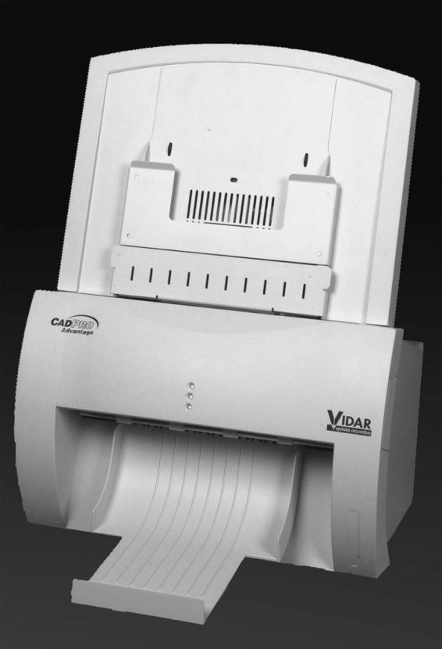
The film digitizer scans the analog film and produces numeric signals for each part of the scanned film. The numbers are fed into a software application that is attached to the scanner, and the scanner digitally reproduces the image using the numeric signals that represent each part of the radiograph.

Slide 21
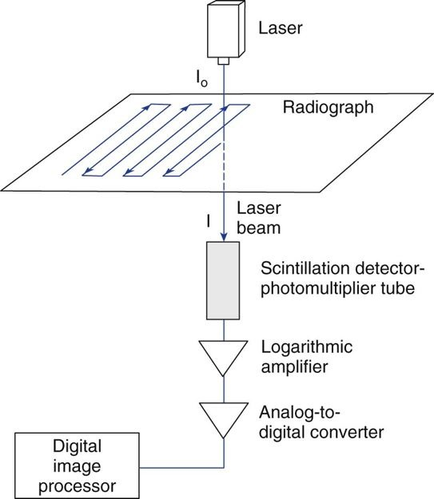
A laser film digitizer uses a helium neon laser beam to convert the analog film image into a digital image. A laser inside the digitizer is bounced off a series of mirrors and scanned across the image. A photomultiplier tube picks up the light that is transmitted through the film.

Slide 22
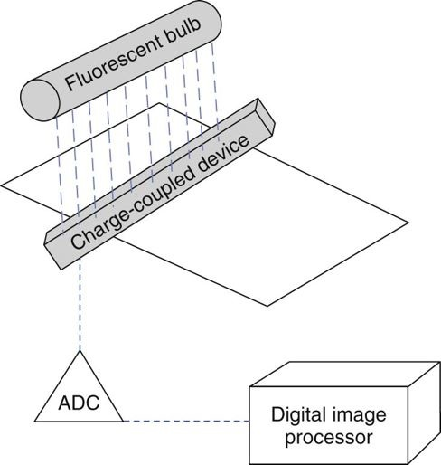
A CCD film digitizer uses fluorescent bulbs that shine through the film and a CCD array that detects the light and transforms it into an electrical signal. The signal is then sent to an analog-to-digital converter and changed into a number that represents the intensity of light that passed through the film.

Slide 23
There are many uses for the film digitizer in the modern radiology department. Most departments list the following reasons for using a digitizer:
Teleradiology
Compare outside or old films
Film duplication
Computed aided diagnosis (CAD)

Slide 24
Imagers, also known as film printers, receive an image from a workstation and print the image based on printer LUTs and preset print layouts. Both of these parameters vary for each modality that produces digital images.
There are two major types of imagers: wet (chemical) laser imagers and dry laser imagers

Slide 25
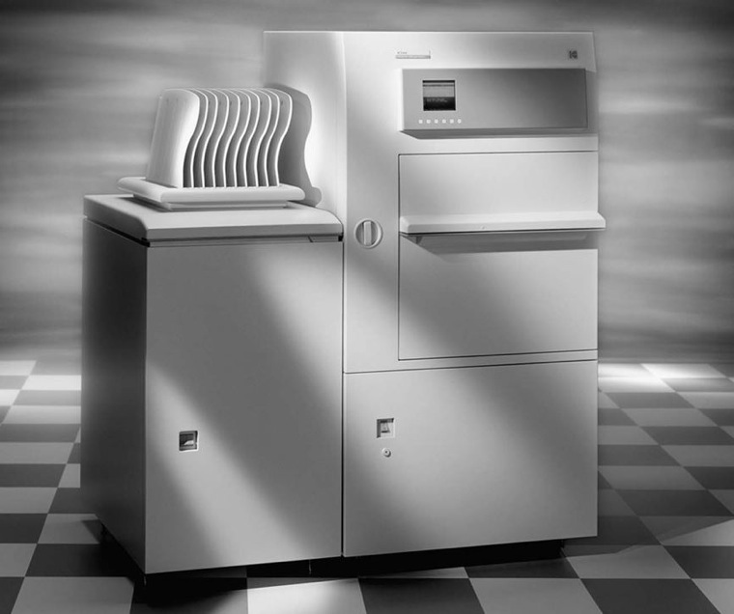
Wet imagers use chemicals to process the film that has been exposed to the laser. The laser beam produces an intensity of light that is proportional to the signal being received to regulate the brightness recorded on the film. The laser emits a red light, so the film that is used must be red sensitive. As mentioned earlier, conventional film has silver halide crystals suspended in an emulsion; the wet laser film is not much different other than being red sensitive so that the laser may etch the image into the film. Because this film is sensitive to red light, it must be placed in its film magazine and processed in total darkness. This processing takes place in a bath of chemicals just like film used in the traditional film/screen department.

Slide 26
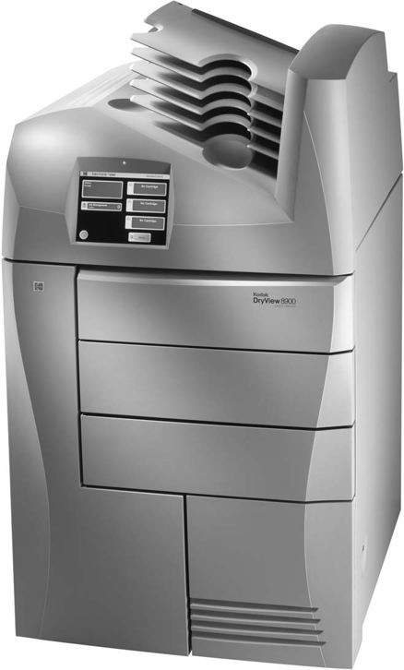
Dry imagers use heat to process the latent image that is etched into the silver emulsion by the laser. Just like conventional film, dry laser film also has silver within its emulsion, but instead of silver halide crystals, the dry film has silver behenate. The film is exposed with a laser in a fashion similar to the wet imager. The silver salts are then exposed to heat and turn to metallic silver to create the image on the film.

Slide 27
Reasons why film can and will be used in what nevertheless is called the filmless radiology department:
Backup
Difficult PACS locations (surgery)
Outside physicians
Legal cases
Teaching purposes

Slide 28
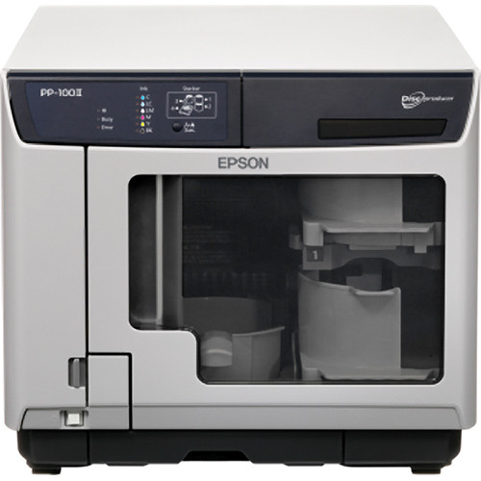
Most hospitals try to reduce the amount of printing done in the department. One alternative to printing hard copies is to burn images to an optical disk.
All PACS vendors offer the ability to burn images to a CD or DVD for the purpose of sharing the images outside of the PACS. When a disk is burned with the patient's images, a DICOM viewer is also burned onto the disk. When the disk is put into a drive, the software automatically launches and displays the images. The software is generally very intuitive and easy to use and allows for minor image enhancements such as window/level adjustments and simple measurements.

Slide 29
Many referring physicians prefer having the images on disk rather than film because it takes up less space, can be added directly to the patient's office chart, and the images can be manipulated.
Disks also are much less expensive to produce and send out to physicians. One sheet of dry laser film costs approximately 48 cents, whereas a CD costs approximately 28 cents. The CD can hold multiple studies, and multiple sheets of film would be needed to print an entire study. The CD is also much less expensive to mail than the film. Disks will become much more common outside of the radiology department as the advantages are seen by those outside of the department.

