Slide 1
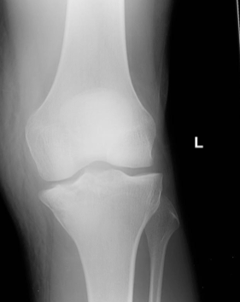
Direct Square Law
Prof. Jarek Stelmark
Hostos Community College – The City University of New York

Slide 2

Direct Square Law
Purpose: keep receptor exposure constant when changing distance
$$\frac{mAs_{1}}{mAs_{2}}=\frac{(SI{D)}_{1}^{ 2}}{(SI{D)}_{2}^{2}}$$

Slide 3
Inverse Square vs Direct Square
Inverse Square Law → describes beam intensity (physics principle)
Direct Square Law → technologist’s formula to adjust mAs in practice
Inverse = physics, Direct = clinical application

Slide 4
Why Distance Matters
As SID increases → beam spreads out → intensity decreases
As SID decreases → beam intensity increases
Must adjust mAs to keep exposure to detector constant

Slide 5
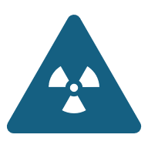
Advantages of Correct Use
Prevents underexposure (quantum mottle)
Prevents overexposure (dose creep)
Consistency across projections and patient positioning

Slide 6
Common Mistakes
Forgetting to square the distance
Confusing inverse vs direct square law
Forgetting to round mAs to the closest machine setting

Slide 7
100 cm
65 kVp@4 mAs
EI 800
TEI 800
400 cm
65 kVp@16 mAs
EI 800
TEI 800

Slide 8
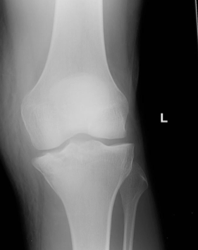
400 cm
65 kVp@4 mAs
EI 800
TEI 800
100 cm
65 kVp@1 mAs
EI 800
TEI 800

Slide 9
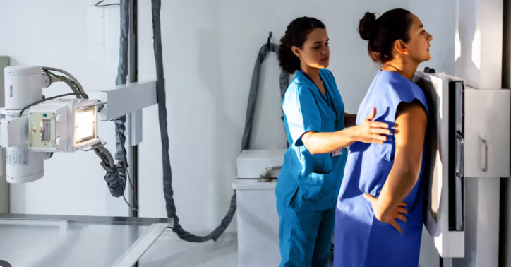

Applications in Practice
Chest radiographs at 72″ → standard technique
Portable chest at 56″ → adjust mAs using formula
Trauma or OR cases where distance varies

Slide 10

Summary
Direct Square Law = exposure maintenance formula
Adjust mAs whenever SID changes
Keeps EI constant in digital radiography
Prevents repeats and dose creep

