Slide 1
X-ray Production in Diagnostic Radiology
Understanding Bremsstrahlung & Characteristic Radiation
Prof. Jarek Stelmark
Hostos Community College – The City University of New York
Note: This presentation covers the physics of x-ray production, with emphasis on both continuous (Bremsstrahlung) and discrete (Characteristic) emissions.

Slide 2
Purpose of This Lecture:
1
Provide a clear understanding of how x-rays are generated in diagnostic radiology.
2
Explain the physical principles behind Bremsstrahlung and Characteristic radiation.
3
Discuss the role of tube design, including stationary vs. rotating anodes, in x-ray production.
4
Relate x-ray production concepts to image quality, patient dose, and equipment performance.
5
Prepare students to apply this knowledge in selecting proper imaging parameters in clinical practice.
6

Slide 3
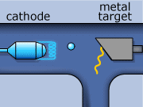
Overview of X-ray Production
X-rays are created when high-speed electrons are suddenly decelerated or interact with target atoms.

Slide 4
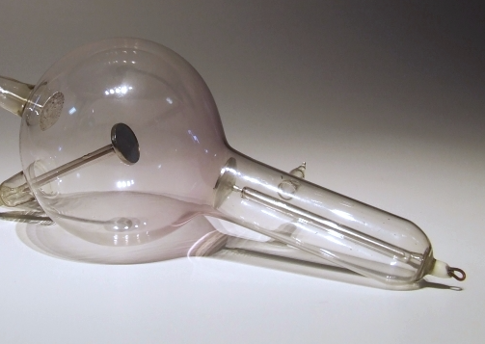
Xray tube Glass envelope:
Made of Pyrex, designed to withstand high temperatures and maintain a vacuum.

Slide 5
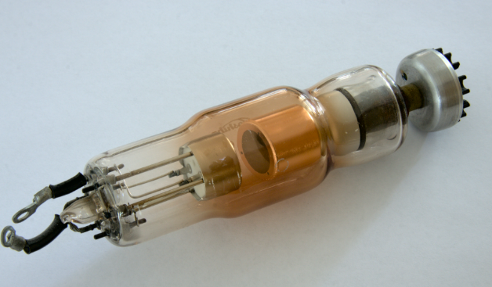
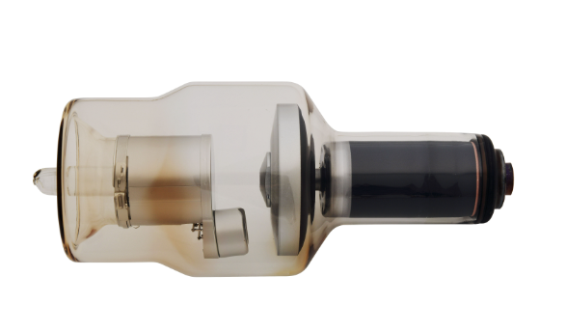
Stationary vs. Rotating Anodes
Stationary anode:
  Fixed target, used in low-output systems (e.g., dental units, portable machines).
  Simpler design but less heat dissipation.
Rotating anode:
  Target rotates at high speeds (3,000–10,000 rpm).
  Spreads heat over a larger surface area, allowing higher exposures without damage.

Slide 6
X-ray Tube Structure
Cathode: Contains heated tungsten filament; produces electron cloud via thermionic emission.
Anode: Can be stationary or rotating tungsten target.
-
+

Slide 7
Why rotate today?
Modern diagnostic tubes almost exclusively use rotating anodes.
Rotation allows heat dissipation by spreading the thermal load over a larger target area, preventing localized overheating.
Heat is dissipated through conduction into the anode body, convection to the tube housing oil, and radiation from the anode surface.
This improves tube lifespan and allows higher mA techniques without damage.

Slide 8
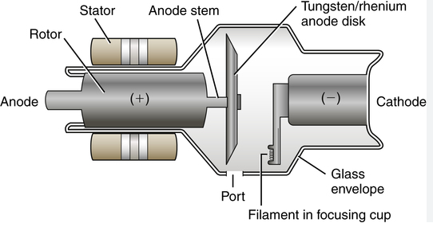

Slide 9
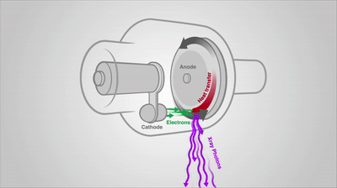

Slide 10
Two main interactions inside the anode target:
Bremsstrahlung Radiation – majority of diagnostic beam.
Characteristic Radiation – adds discrete energy peaks.

Slide 11
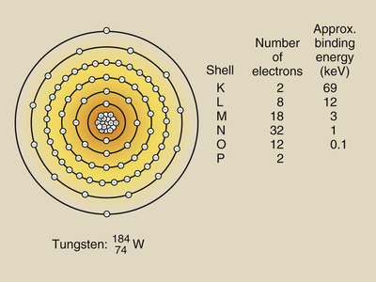
Tungsten Atom

Slide 12
Bremsstrahlung Radiation – Introduction
“Bremsstrahlung” is German for “braking radiation.”
Occurs when a high-speed electron passes close to the nucleus of a target atom and is deflected by its strong electric field.
The change in velocity causes the electron to lose kinetic energy, released as an x-ray photon.
The closer the electron gets to the nucleus, the greater the deceleration and photon energy.
Clinical note: Bremsstrahlung accounts for ~80–90% of diagnostic x-ray beam production.

Slide 13
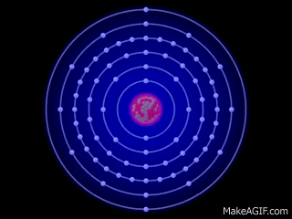
Bremsstrahlung Radiation
This energy is not lost—it is converted from the electron’s kinetic energy into photon energy.

Slide 14
Example scenario:
  Incoming electron energy: 80 keV.
  Electron passes near nucleus and slows due to deflection.
  Energy lost during deceleration: 50 keV.
  This 50 keV is converted into an x-ray photon of equal energy.
  Remaining electron energy: 30 keV (electron may produce additional, lower-energy photons in subsequent interactions).
Key point: The photon's energy equals the kinetic energy lost by the electron during that interaction

Slide 15
Characteristic Radiation
Occurs when an incoming high-speed electron collides with and ejects an inner-shell electron (usually from the K-shell) of a tungsten atom.
An outer-shell electron drops down to fill the vacancy.
The difference in binding energies between the two shells is converted into an x-ray photon.
This photon has a discrete energy determined by the target material’s electron binding energies.
Clinical note: Characteristic photons make up about 10–20% of the diagnostic x-ray beam for tungsten targets at typical operating kVp.

Slide 17
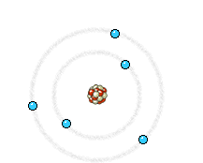
Characteristic Radiation

Slide 18
Example: In tungsten:
  K-shell binding energy ≈ 69 keV.
  L-shell binding energy ≈ 12 keV.
  If an L-shell electron fills the K-shell vacancy: 69 − 12 = 57 keV photon is emitted.
  What if M-shell electron fills the K-shell vacancy?
Clinical note: Characteristic photons make up about 10–20% of the diagnostic x-ray beam for tungsten targets at typical operating kVp.

Slide 19
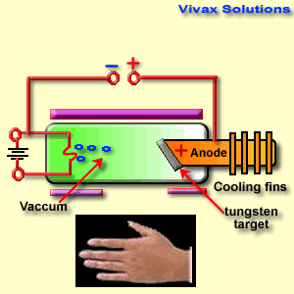

Slide 20
