Slide 1
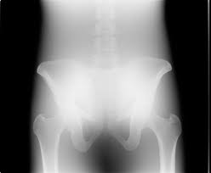
X-ray Beam Restriction
Prof. Jarek Stelmark
Hostos Community College – The City University of New York

Slide 2
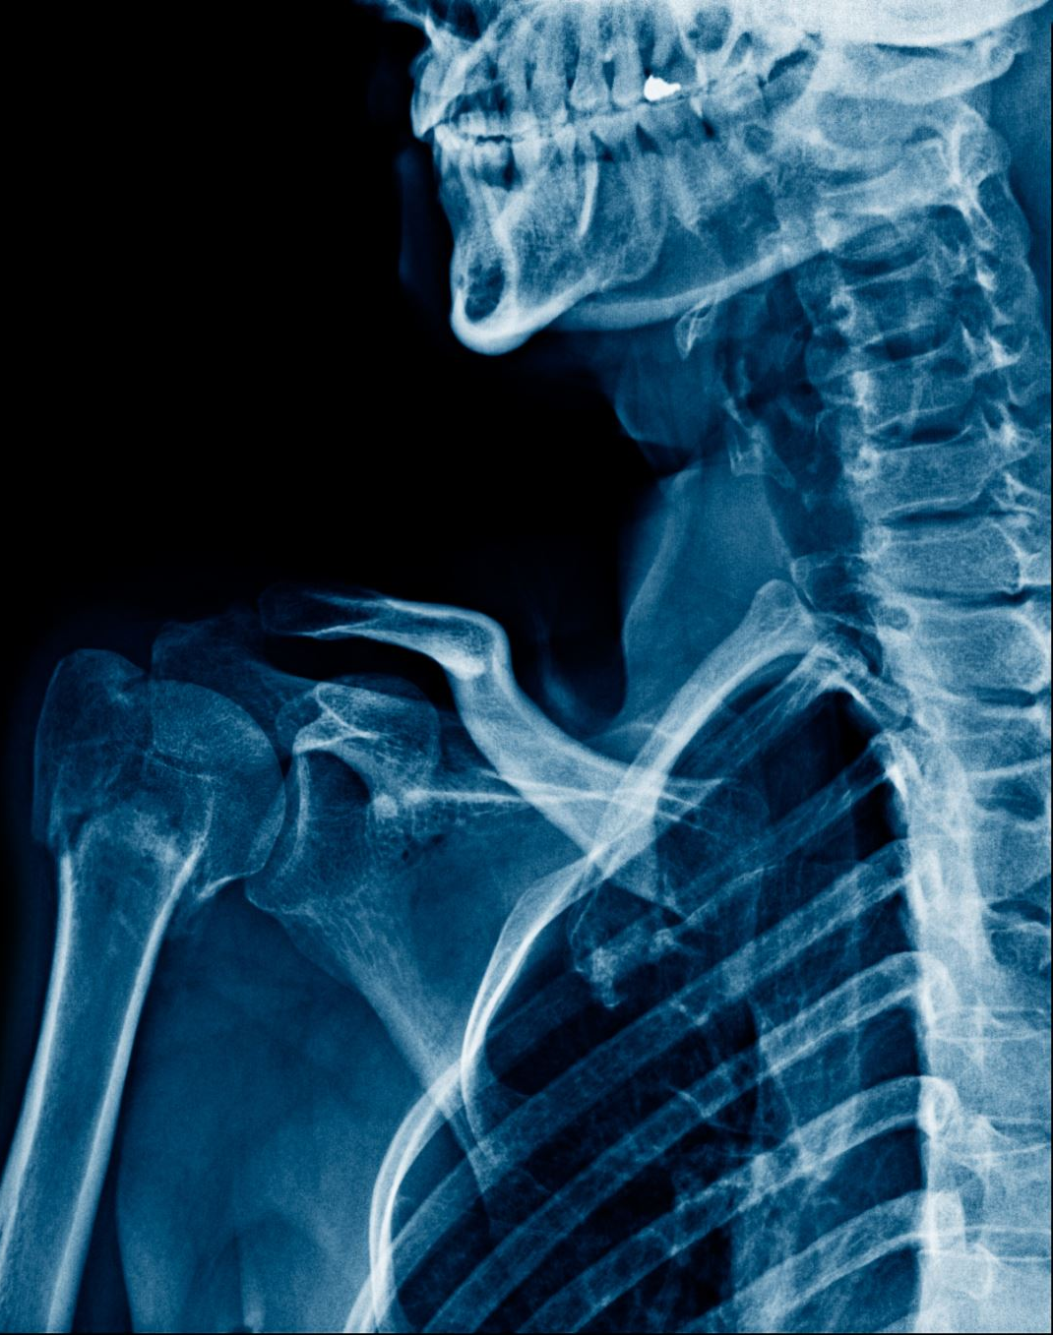
In digital radiography, two types of x-rays contribute to image formation and contrast: those that pass through the patient without interacting, and those scattered within the patient through Compton interaction. The x-rays that emerge from the patient are referred to as remnant radiation, and the portion that reaches and interacts with the digital detector is known as image-forming radiation, responsible for producing the final image displayed on the monitor.

Slide 3
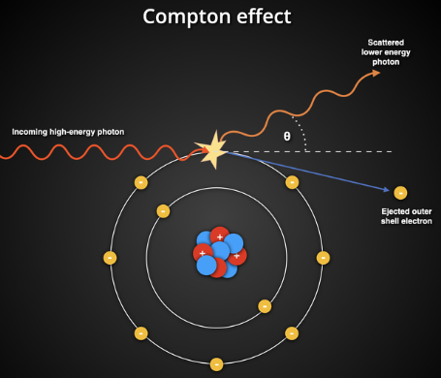
The Compton interaction, or Compton scattering, is a process in radiology and physics where an incoming X-ray photon collides with an outer shell electron in an atom, causing the photon to lose energy and change direction. When this happens, the electron is ejected from the atom (now called a recoil electron), and the scattered photon continues in a new direction with reduced energy.

Slide 4
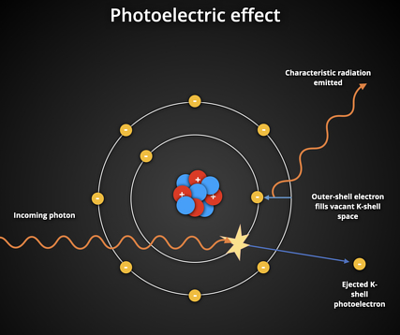
The photoelectric interaction, or photoelectric effect, is a type of interaction that occurs when an X-ray photon collides with an inner shell electron (typically K or L shell) in an atom. In this process, the photon is fully absorbed, and its energy is transferred to the electron, which is then ejected from the atom. This ejected electron is called a photoelectron.

Slide 5
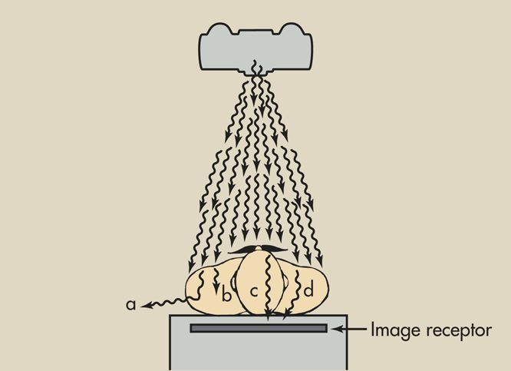
a – X-rays that are absorbed completely within the patient. They contribute to patient dose but not to image formation.
b – X-rays that undergo partial attenuation within the patient and lose energy.
c – X-rays that pass through the patient without interaction. These carry the true anatomical information and form the useful or image-forming radiation recorded by the detector.
d – Scattered photons produced by Compton interaction. These travel in different directions and may reach the detector, adding unwanted signal (scatter noise) that reduces image contrast.

Slide 6
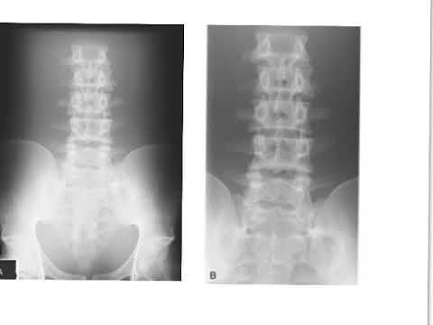
Proper collimation of the x-ray beam has the primary effect of reducing patient dose by restricting the volume of irradiated tissue. Proper collimation also improves image contrast. Ideally, only those x-rays that do not interact with the patient should reach the image receptor.

Slide 7
As scatter radiation increases, the radiograph loses contrast and appears gray and dull. Three primary factors influence the relative intensity of scatter radiation that reaches the image receptor:
kVp
Field size
Patient thickness

Slide 8
kVp
As x-ray energy is increased, the absolute number of Compton interactions decreases, but the number of photoelectric interactions decreases much more rapidly. Therefore, the relative number of x-rays that undergo Compton interaction increases.

Slide 9
Approximately 1% of x-rays incident on the patient reach the image receptor.

Slide 10
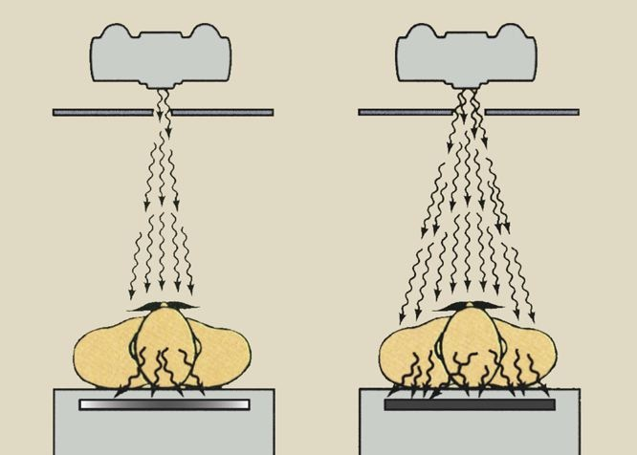
Field Size
Another factor that affects the level of scatter radiation and is controlled by the radiologic technologist is x-ray beam field size. As field size is increased, scatter radiation also increases

Slide 11
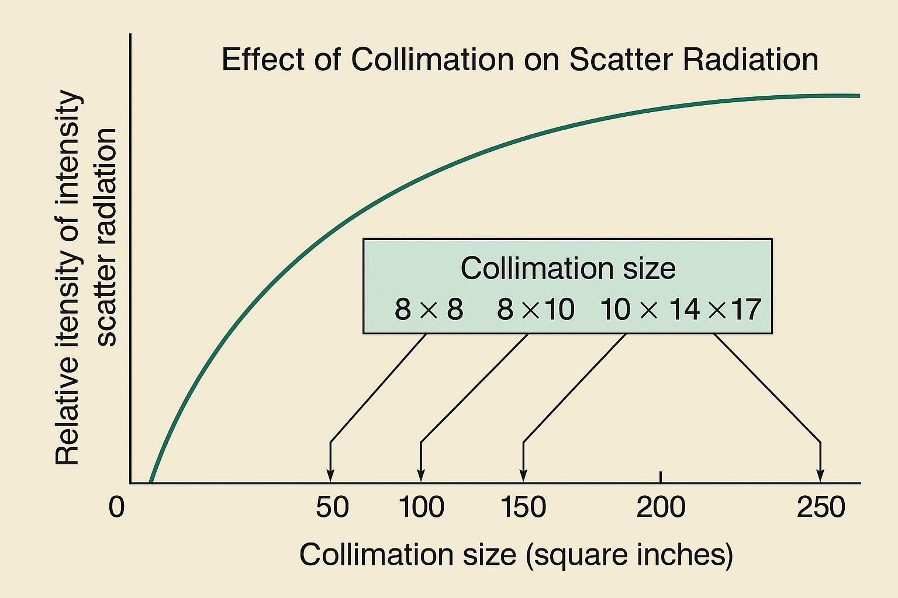

Slide 12
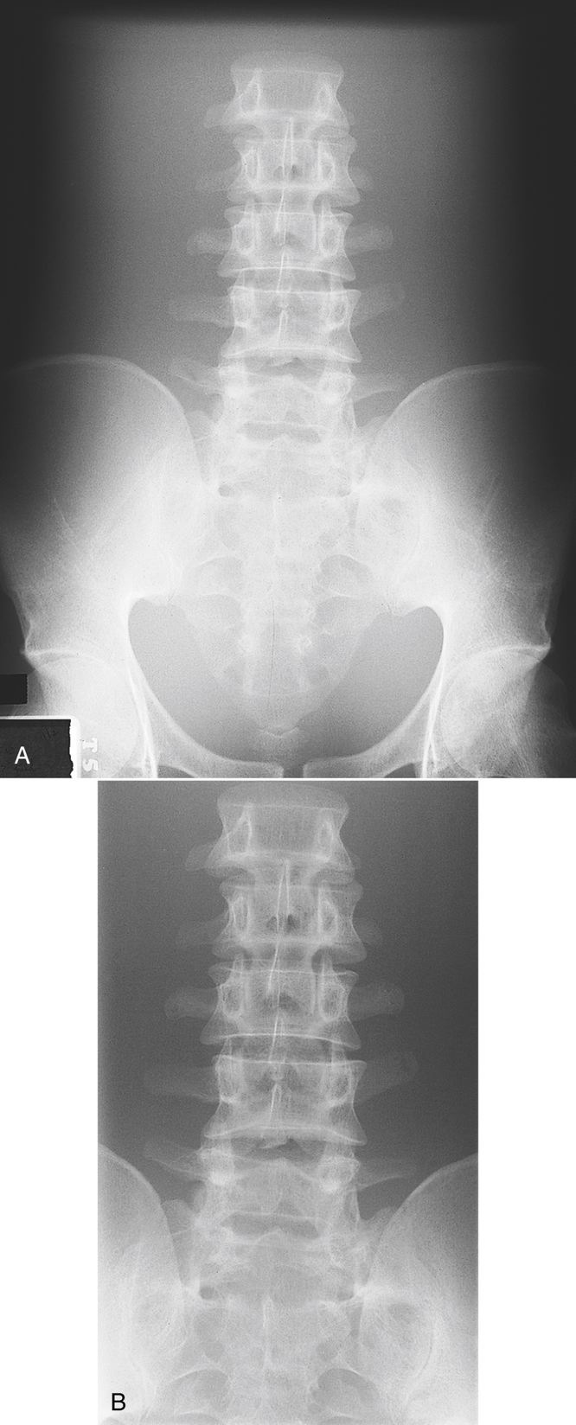

Slide 13
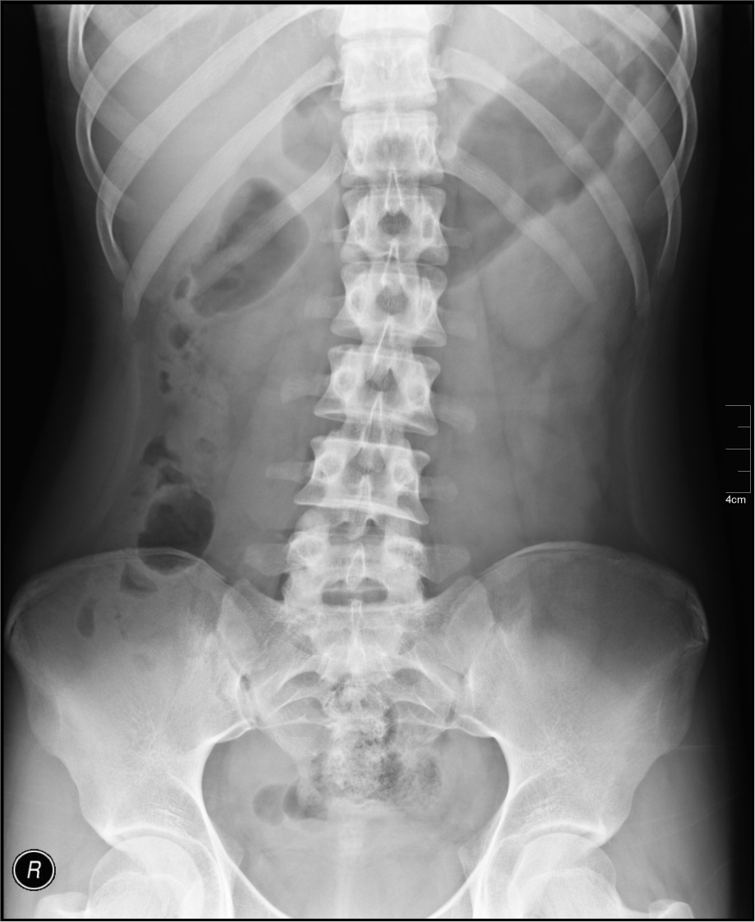

Slide 17
Beam Restrictors
Basically, three types of beam-restricting devices are used:
The aperture diaphragm
Cones or cylinders
The variable-aperture collimator

Slide 18
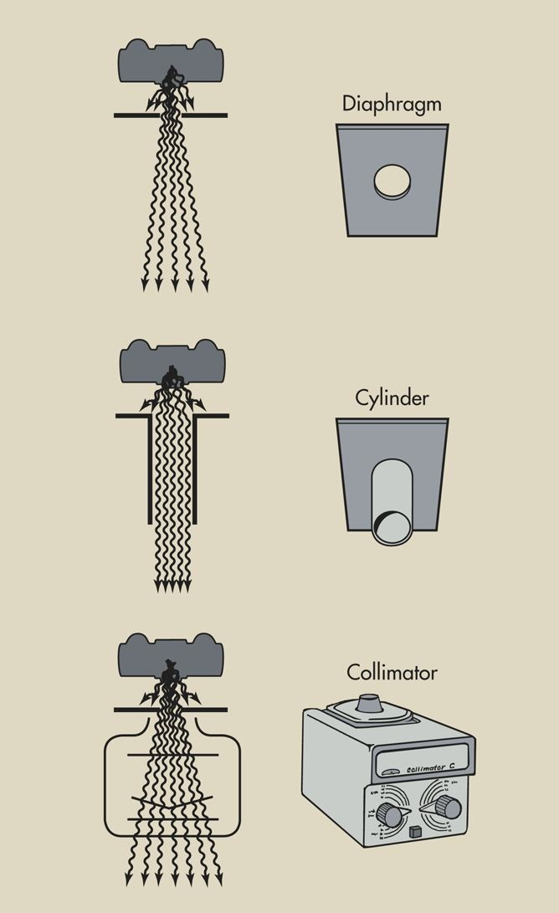

Slide 19
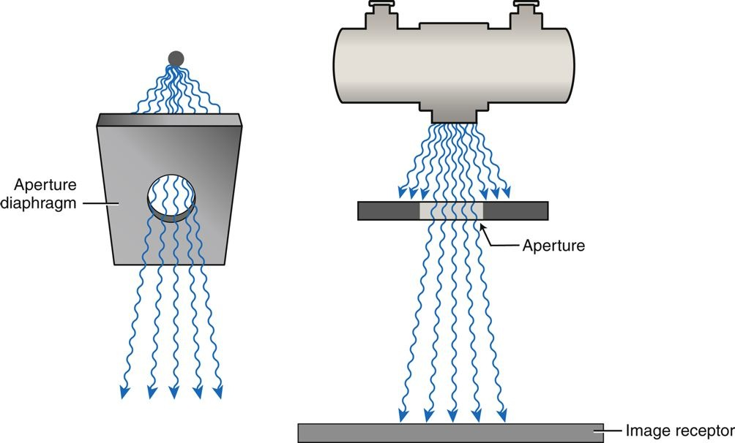
Aperture diaphragm is a fixed lead opening designed for a fixed image receptor size and constant source-to-image receptor distance

Slide 20
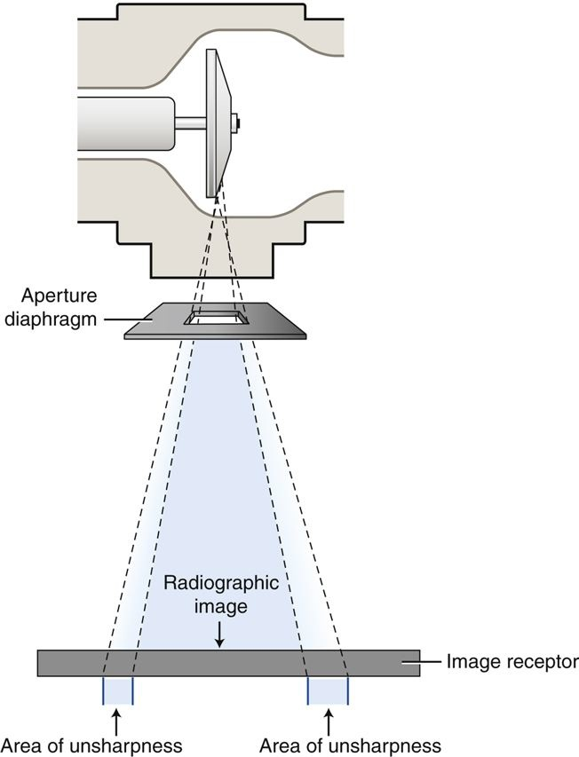

Slide 21
Cones and cylinders are both types of beam-restricting devices that function similarly to aperture diaphragms but include an extended metal flange. This flange may be shaped as a cone or a cylinder and can vary in length. Some designs are telescopic, allowing the length to be adjusted for different field sizes and procedures. Like aperture diaphragms, cones and cylinders are simple to use—they attach directly below the x-ray tube window to help limit the beam and reduce scatter radiation.

Slide 22
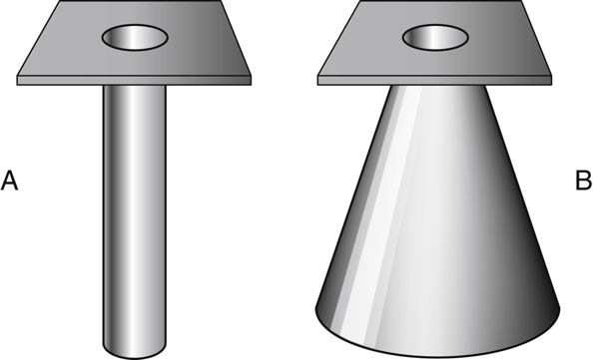
Cones and cylinders limit unsharpness surrounding the radiographic image more than aperture diaphragms do, with cylinders accomplishing this task slightly better than cones. However, they are limited in terms of the sizes that are available, and they are not necessarily interchangeable among tube housings

Slide 23
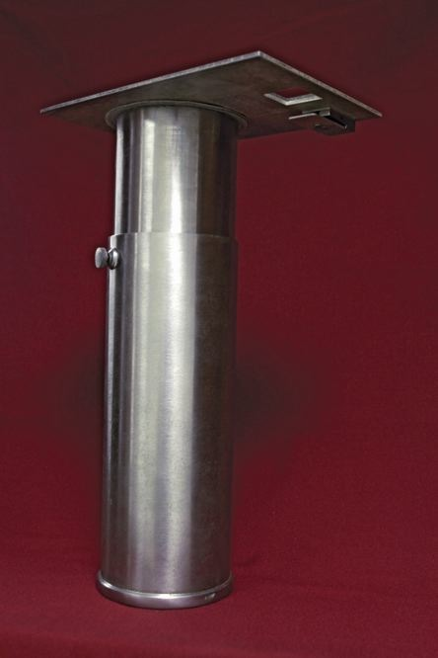

Slide 24
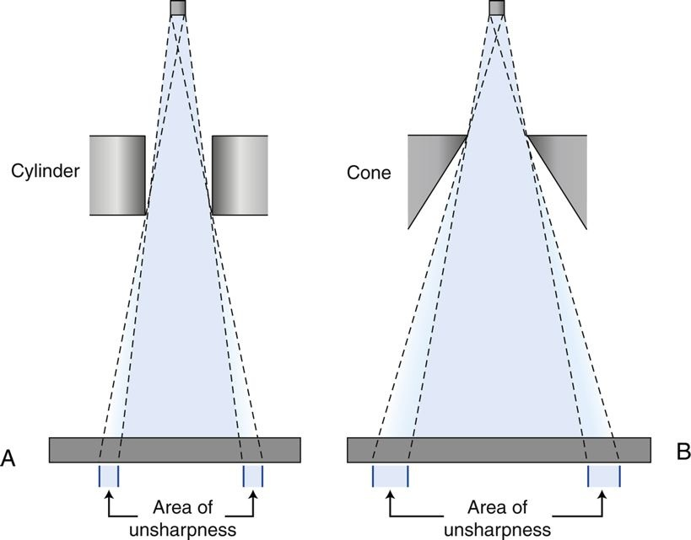

Slide 25
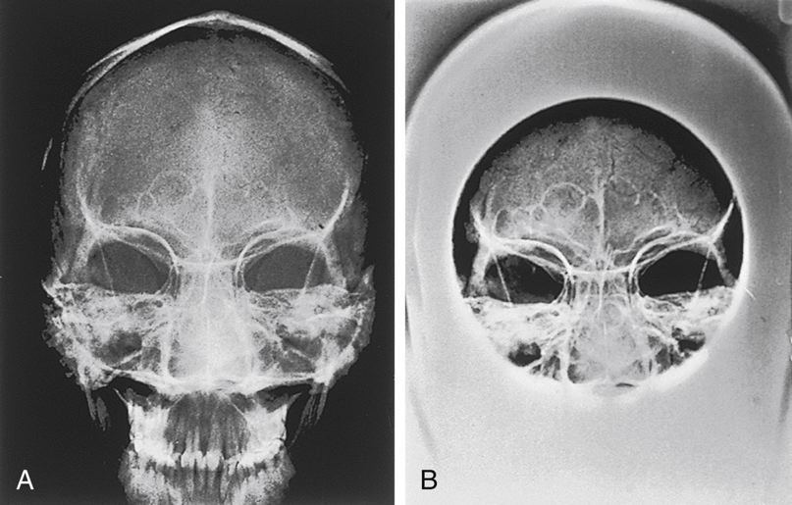
Images with and without a Cylinder. Radiograph of the frontal and maxillary sinuses.
A, Not using a cylinder. B, Using a cylinder.

Slide 26
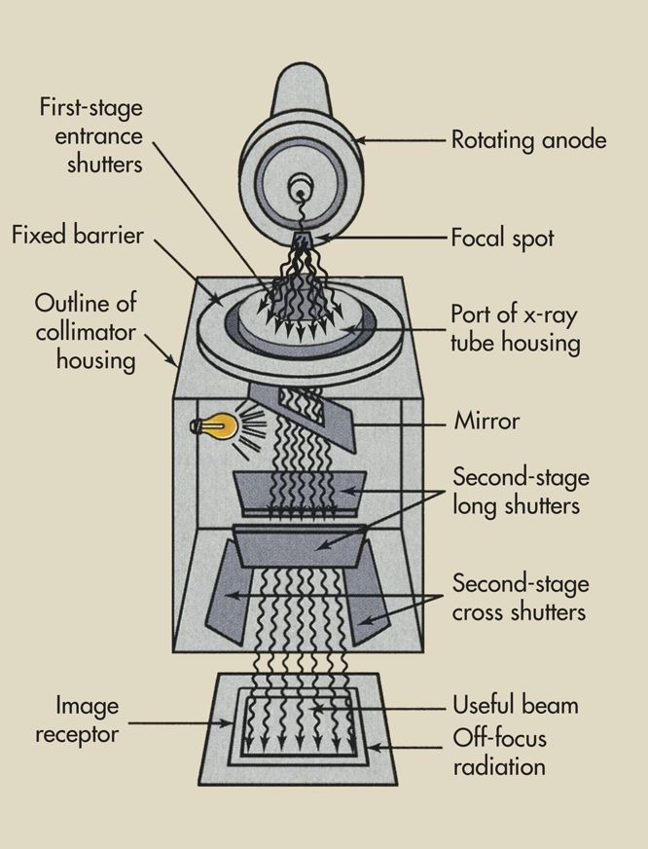
Variable Aperture Collimator
The light-localizing variable-aperture collimator is the most commonly used beam-restricting device in radiography.

Slide 27
Increased Factor | Result
Collimation | Patient dose decreases. Scatter radiation decreases. Radiographic contrast increases. Digital: Quantum noise increases.
Field Size | Patient dose increases. Scatter radiation increases. Radiographic contrast decreases. Digital: Quantum noise decreases.

Slide 28
Patient Thickness
Imaging thick parts of the body results in more scatter radiation than imaging thin parts does. Compare a radiograph of the bony structures in an extremity with a radiograph of the bony structures of the chest or pelvis. Even when the two are taken with the same screen-film combination, the extremity radiograph will be much sharper because of the reduced amount of scatter radiation

Slide 29
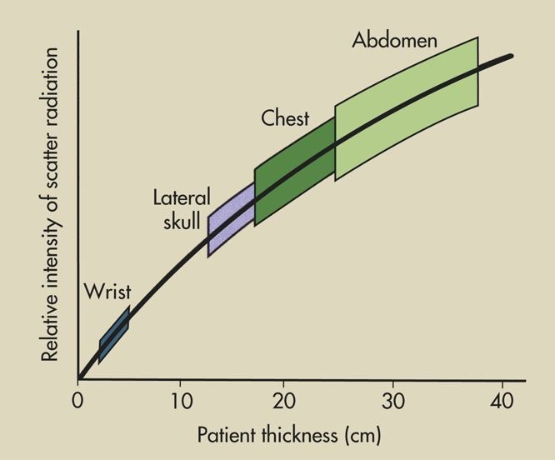

Slide 30
The radiologic technologist cannot control patient thickness, but understanding that scatter radiation increases with greater tissue thickness allows for proper image optimization. A high-quality radiograph can be achieved by selecting appropriate exposure factors and using scatter-reducing devices such as a compression paddle. Whenever possible, positioning the patient prone can also help reduce tissue thickness and minimize scatter, leading to improved image contrast and clarity.

Slide 31
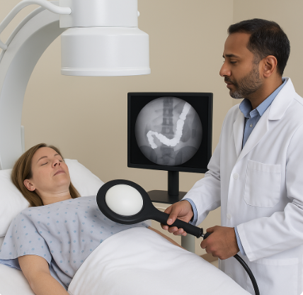
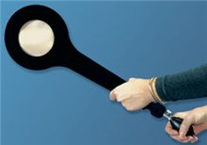

Slide 32
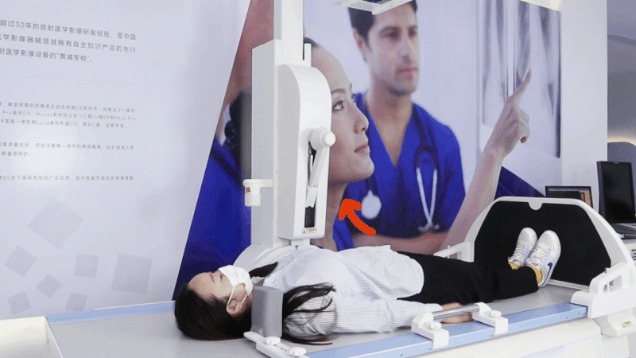

Slide 33
