Slide 1
Digital Image Processing 2
By Prof. Jarek Stelmark

Slide 2
The term digital image processing refers to various computer algorithms (mathematical computations) applied to electronic data to optimize images for display. Generally, digital image processing can be described in stages, preprocessing to prepare the data for processing and display or postprocessing, which includes computer operations available before and after the image is displayed.

Slide 3
When the released energy from the IR is digitized, several preprocessing operations occur to the raw data to account for flaws or imperfections in the electronic data set and to prepare the image data for processing and display. Bad or dead pixels and flat-fielding corrections are just two examples of computer operations applied to the raw image data. Because of the electronic components in a DR IR, imperfections can cause artifacts and malfunctioning pixels (bad or dead pixels). Software corrections can be applied to account for these imperfections, which only occur with DR-type IRs. Flat-fielding correction is the process of correcting nonuniformity in pixel values across the entire image.

Slide 4
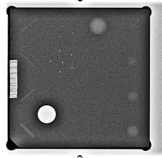
Without preprocessing, images would show detector artifacts, non-uniform brightness, and defective pixels. These are not patient-related findings—they are system errors. If not corrected, they can mimic pathology or obscure anatomy. Preprocessing ensures the image represents the patient, not the detector.

Slide 5
Not all detector elements respond equally to radiation. Some pixels are more sensitive, others less. This creates uneven brightness across the image. Preprocessing compensates for these variations to produce a uniform baseline image.

Slide 6
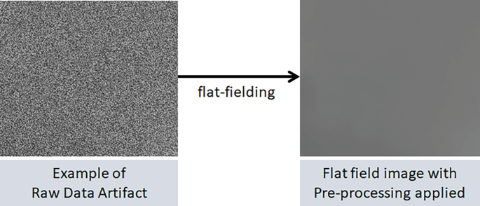
Flat fielding is a correction technique that normalizes detector response. A uniform exposure (no patient) is used to map detector inconsistencies. The system then adjusts each pixel mathematically so that equal exposure produces equal signal.
Before:
Image brightness varies because of detector imperfections
After:
Variations reflect actual anatomy and exposure only

Slide 7

Flat Field Calibration
Flat field correction is not a one-time event. It requires periodic calibration. Over time, detectors drift due to temperature, aging, and usage. If calibration is not maintained, artifacts begin to appear subtly before becoming obvious.

Slide 8
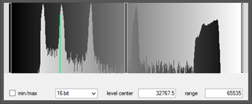
Following preprocessing, processing of digital data involves several operations to prepare the raw image for display:
histogram creation and analysis
automatic rescaling
lookup table (LUT) application
These processes are applied to all digital data, including CR and DR. Although CR and DR acquire the raw image differently, both systems create an electronic dataset of signal values that need to be processed by a computer. To create a quality digital image for display, the signal values need to be assembled and analyzed.

Slide 9
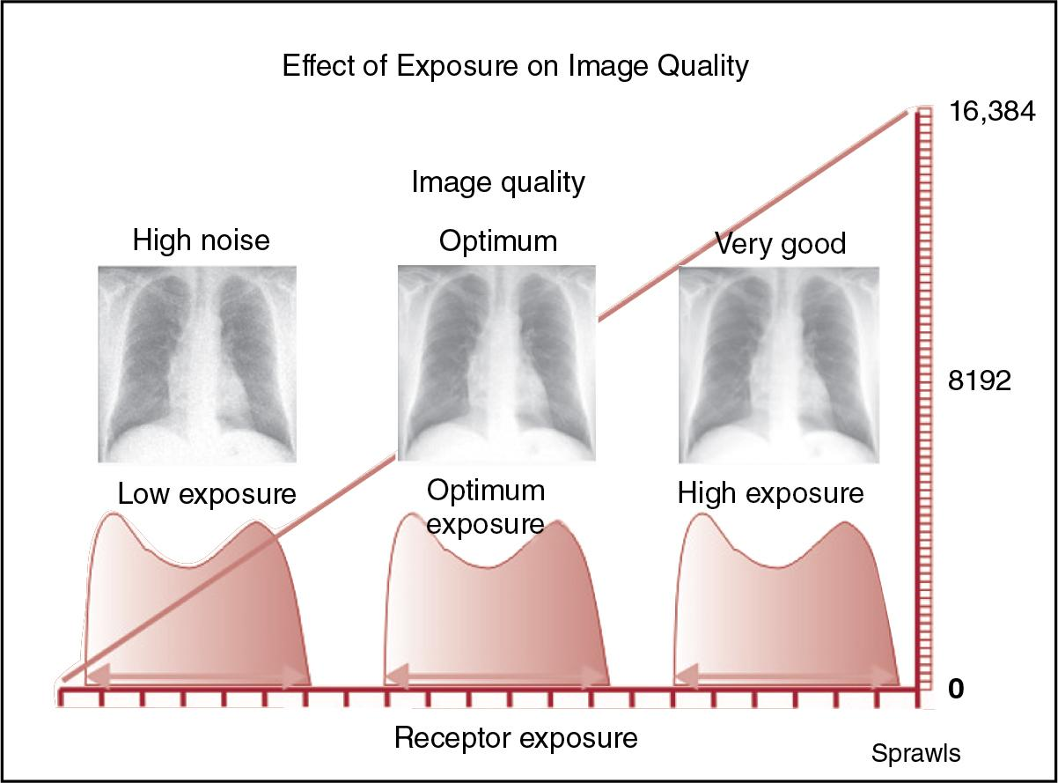
Automatic rescaling
Computer processing is used to maintain consistent image brightness despite over- or underexposure of the IR. This procedure is known as automatic rescaling. The computer rescales the image based on the comparison of the histograms. The brightness and contrast of the exposure histogram can be adjusted to match the reference histogram to produce a high-quality radiographic image. Although automatic rescaling is a convenient feature, radiographers should be aware that rescaling errors can occur because of positioning and collimation errors and with image artifacts, such as a hip prosthesis, and can result in poor-quality digital images. Rescaling will also compensate for patient overexposure, which is looked upon poorly by the profession and discouraged. Rescaling will not compensate for image noise due to underexposure.

Slide 10
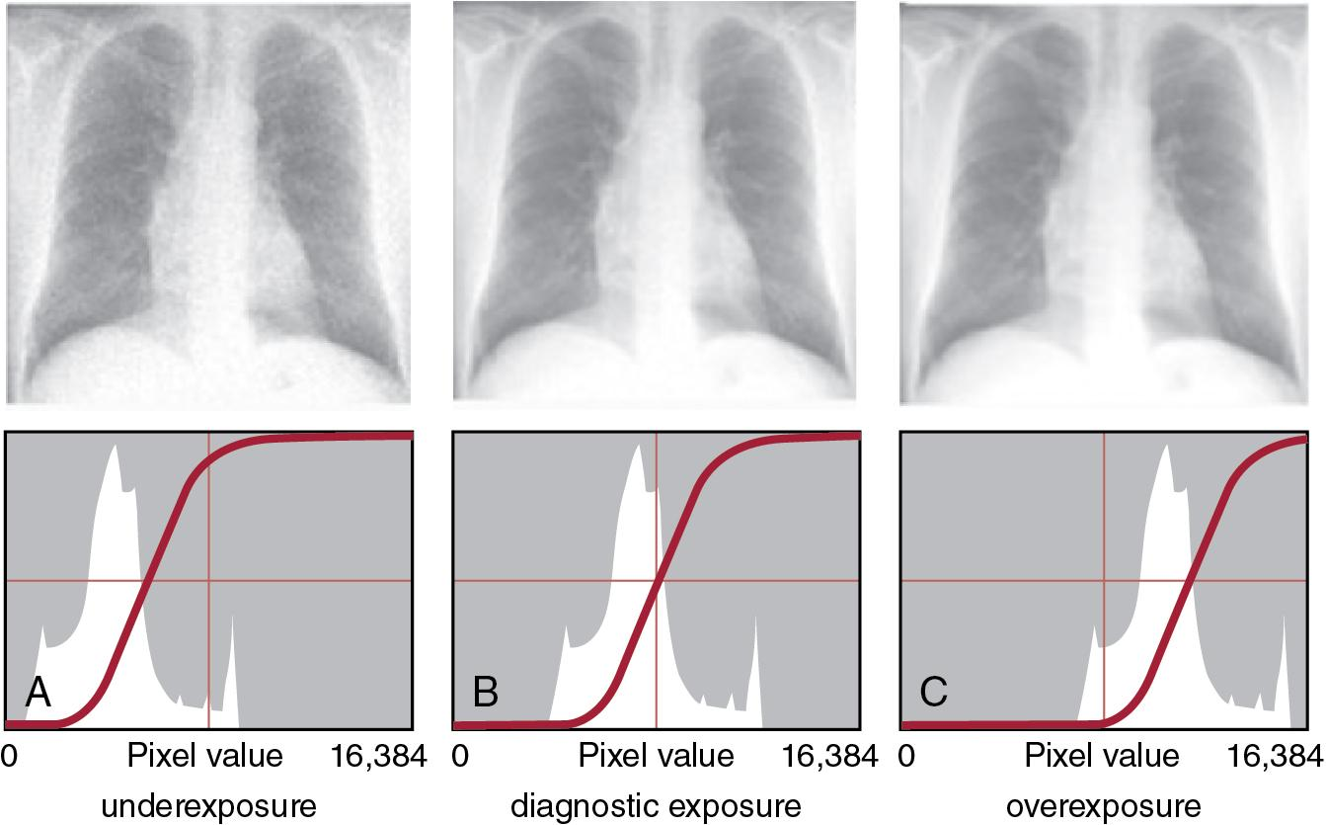

Slide 11
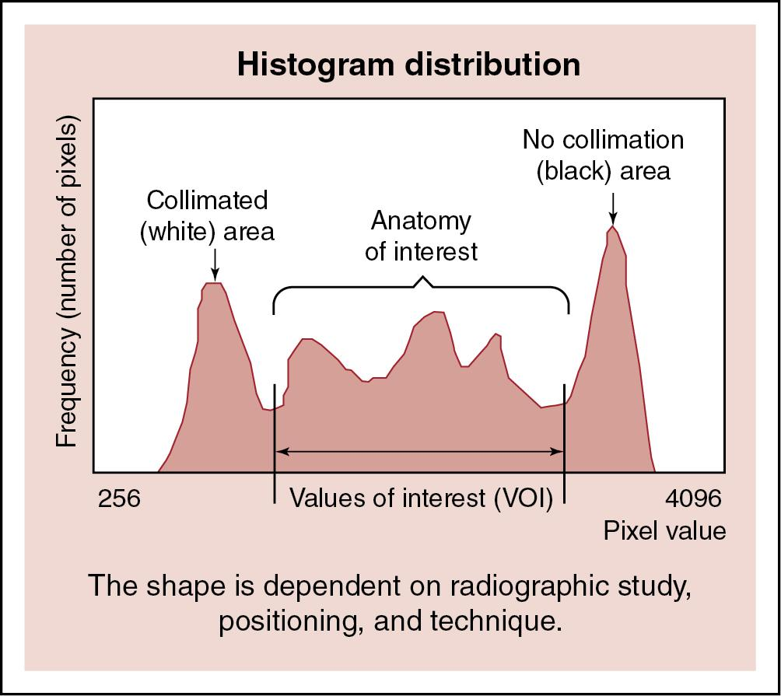
The first step in processing digital data is histogram creation and analysis. The computer creates a histogram (or graphic representation of a data set) of the image that includes all the pixel values that represent the invisible image (released energy) after the software corrections were applied and sometimes referred to as the exposure histogram.
The x-axis represents the range of pixel values assigned, and the y-axis represents the number (frequency) of pixels for each value. The location of the graph along the x-axis represents image brightness levels, and the shape of the graph represents image contrast (grayscale).

Slide 12
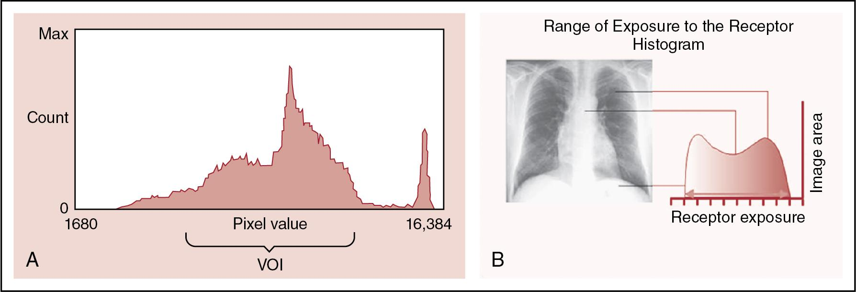
Histogram analysis is an important processing technique for identifying image edges and assessing exposure data (pixel values) before image processing and display. The location and shape of the exposure histogram are impacted by the anatomic area imaged, the exposure technique, positioning, and collimation. The computer analyzes the histogram using processing algorithms and compares it with a preestablished (reference) histogram specific to the anatomic part being imaged. This process is called histogram analysis. The computer software stores histogram models, each with a shape characteristic of the selected anatomic region and projection. These stored histogram models have values of interest (VOIs), which determine the range of the histogram data set that should be included in the displayed image

Slide 13
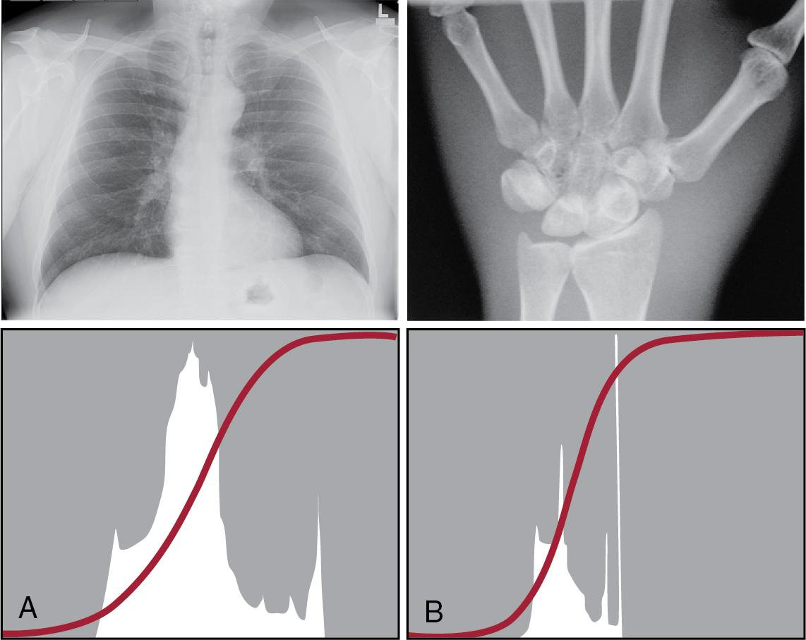
During histogram analysis, the exposure histogram is compared with a stored (reference) histogram for that anatomic part; VOIs are identified in preparation for image processing and display.

Slide 14
A lookup table (LUT) application processes image data based on the reference histogram to transform it into a high-quality image for display. Because digital IRs have a linear exposure response and a wide dynamic range, raw data images exhibit low contrast and must be altered to improve the visibility of anatomic structures. LUTs provide the means to alter the brightness and grayscale of the digital image using computer algorithms. Additionally, LUTs vary between manufacturers so an image of a body part from one vendor may have a different appearance when compared to another. Similarly, a body part’s appearance can be altered if different LUTs are applied to its histogram. It is important to use the correct LUT for the body part being examined.

Slide 15
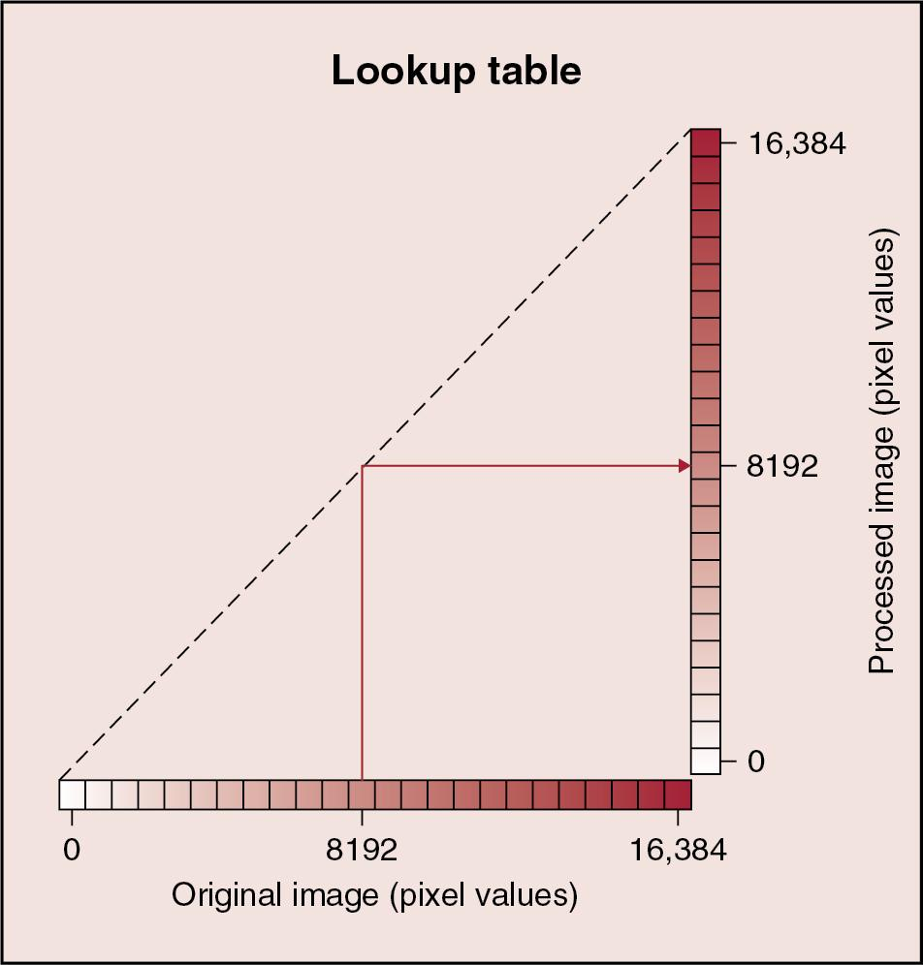
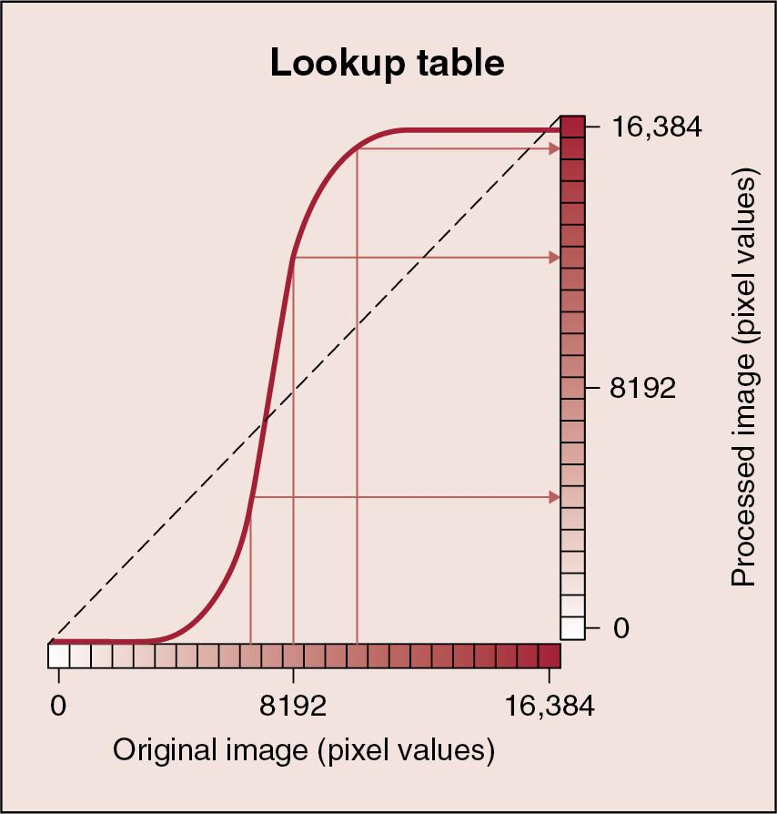
LUTs also provide a means to adjust the contrast or grayscale necessary to adequately view the anatomic region. If the image is not altered, the graph would be a straight line. If the original image is altered, the original pixel values would be different in the processed image, and the graph would no longer be a straight line but resemble an S-shaped curve For example, each pixel value could be altered to display the digital image with a change in contrast (grayscale). New pixel values would be calculated that result in the image being displayed with higher contrast. LUTs provide a method of processing digital images to change the displayed brightness and contrast required for each anatomic area

Slide 16
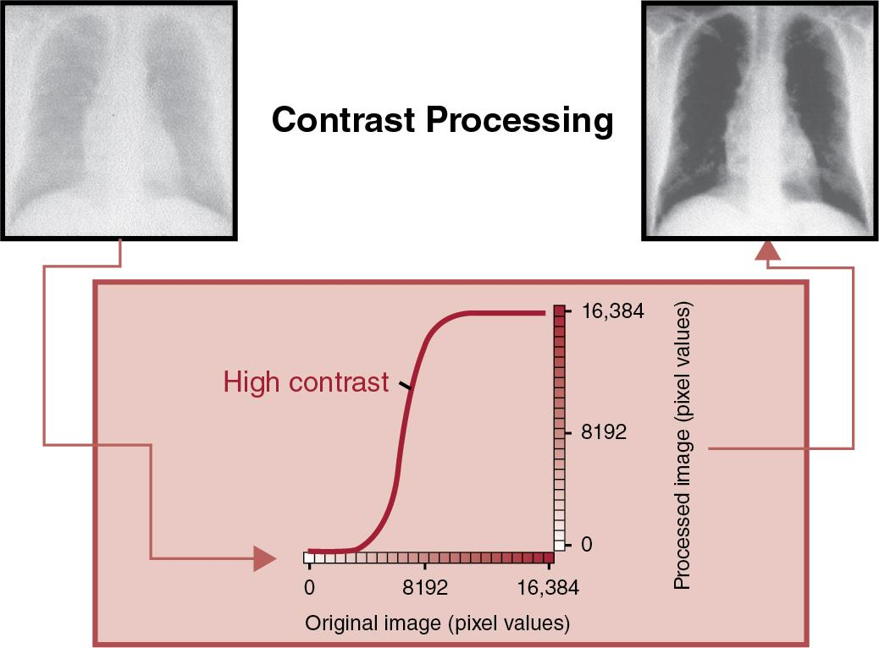

Slide 17
Postprocessing functions are computer software operations available to the radiographer and radiologist that allow manual manipulation of the displayed image. These functions allow the operator to manually adjust many presentation features of the image to enhance the diagnostic value.

Slide 18
After the image is processed, regions can be further altered using electronic masking, also known as shuttering. For example, when the area of interest is properly collimated, the image may display increased brightness surrounding the radiation-exposed field. This region of brightness provides no useful information and can be removed from the displayed image, a process that is automatic in newer digital equipment. In addition, electronic masking can remove regions surrounding the exposure field that provide no useful information and may affect histogram analysis. However, it is not within radiographers' standards of practice to make decisions about removing information in the radiation-exposed field. Proper collimation before radiation exposure is important and should not be replaced with electronic masking. A properly collimated X-ray field preexposure and automatic electronic masking of the bright intensities outside the radiation-exposed field should show a thin white line around the edges of the image, which indicates the image was collimated smaller than the size of the IR. Electronic masking has no effect on overall image quality (removal of scatter) or on patient exposure.
Proper collimation before radiation exposure is important and should not be replaced with electronic masking. It is not within radiographers' standards of practice to make decisions about removing information in the radiation-exposed field.

Slide 19
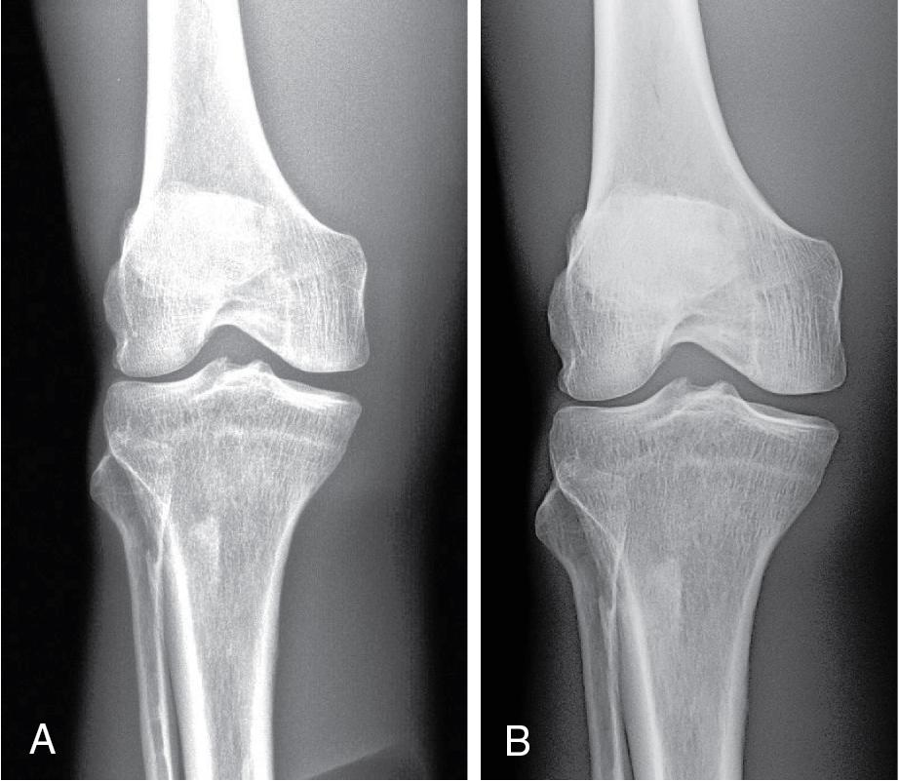
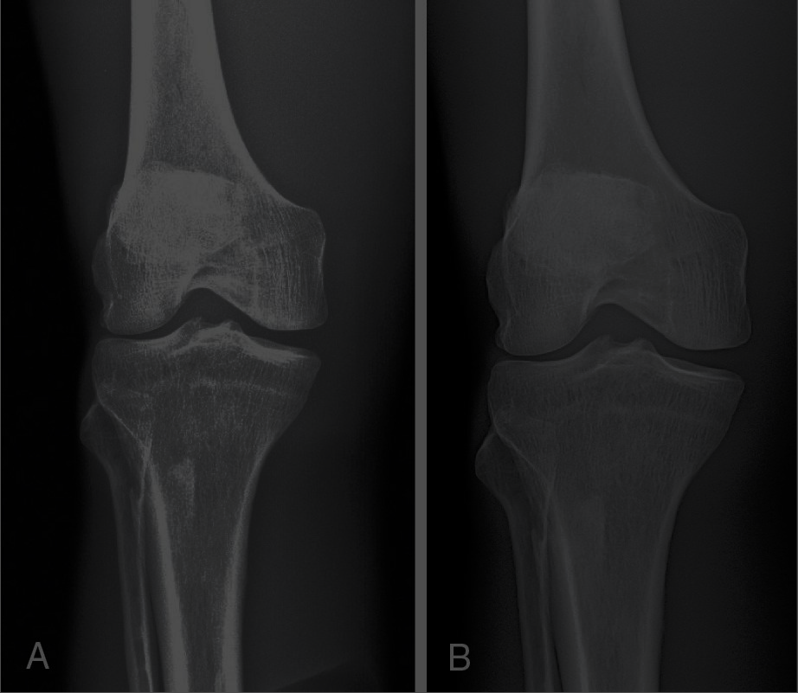
The digital image is composed of numerical data; the brightness level displayed on the computer monitor can be easily altered to visualize the range of the recorded anatomic structures. This adjustment is accomplished using a basic windowing function. The window level (or center) sets the midpoint of the brightness range visible in the image. Changing the window level on the display monitor allows the image brightness to be increased or decreased throughout the entire range. When the displayed brightness range is less than the maximum, the processed image presents only a subset of the total information stored in the computer

Slide 20
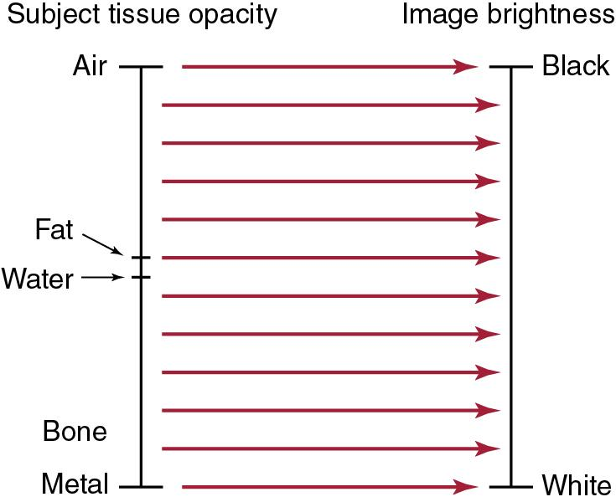
Changing the window level increases or decreases the image brightness throughout the range of tissue opacities recorded in the image.

Slide 21
The number of different shades of gray that can be stored and displayed by a computer system is termed grayscale. Contrast resolution is another term associated with digital imaging and is used to describe the ability of the imaging system to distinguish between objects that exhibit similar brightness levels because they attenuate the x-ray beam similarly. An important distinguishing characteristic of a digital image is its improved contrast resolution. The brightness level of a pixel is determined by the bit depth or number of bits (i.e., 12, 14, or 16), which affects the number of shades of gray available for image display. Increasing the number of shades of gray increases the contrast resolution within the image. An image with increased contrast resolution, when optimally windowed, increases the visibility of very subtle anatomic features.

Slide 22
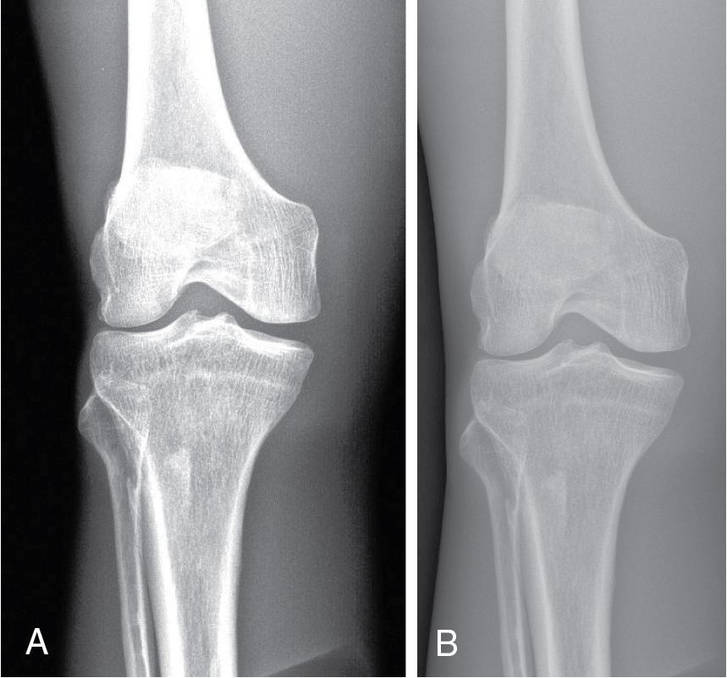
After the digital image is processed, radiographic contrast can be adjusted to alter the visualization of the area of interest; this is necessary because the human eye's contrast resolution is limited. Window width is a basic control that adjusts the radiographic contrast. Because a digital image can display shades of gray ranging from black to white, the display monitor can adjust the range or number of visible shades to show the desired anatomy. Adjusting the range of visible shades of gray varies the image contrast. When the entire number of shades of gray is displayed (wide window width), the image has lower contrast; when a smaller number of shades of gray is displayed (narrow window width), the image has higher contrast

Slide 23
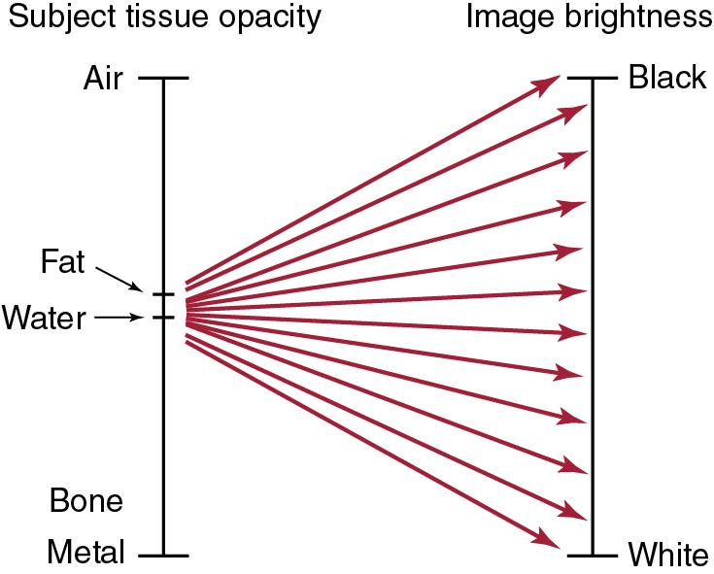
Changing the window width increases or decreases the range of visible brightness levels. A narrow window width decreases the range of brightness levels and increases contrast. A wider window width increases the range of brightness levels and reduces contrast.

Slide 24
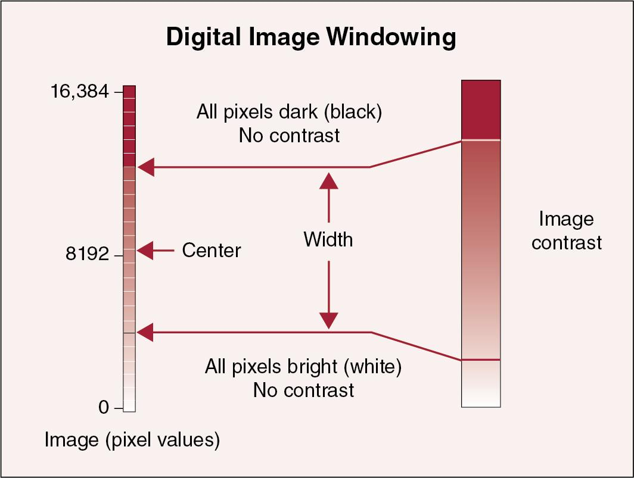

Slide 25
A narrow (decreased) window width displays higher radiographic contrast, whereas a wider (increased) window width displays lower radiographic contrast.

Slide 26
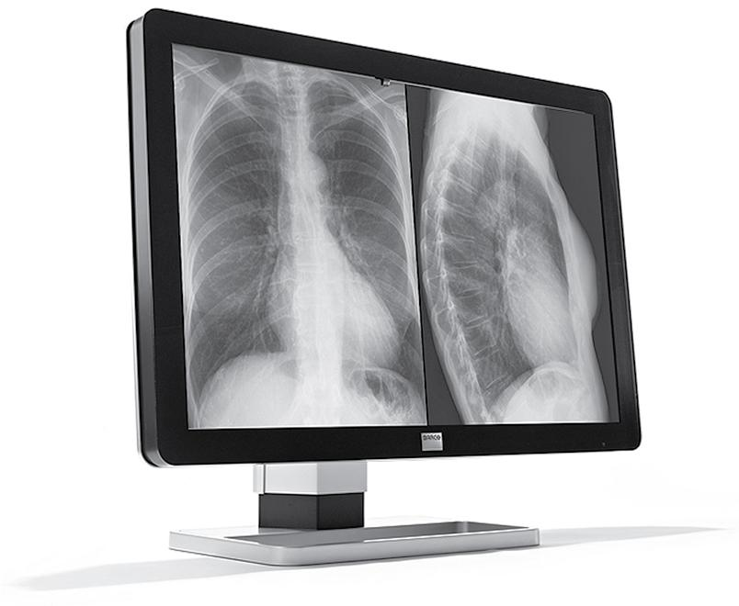
Display characteristics
The quality of the digital image is affected by its acquisition parameters and subsequent computer processing. In addition, the quality of the digital image is affected by the monitor’s performance. The quality of display monitors may not be uniform across all those used to view digital images. Monitors used by radiologists for diagnostic interpretation, referred to as primary, must be of higher quality than the monitors used only for routine image review (secondary). However, the radiographer’s monitor should be of sufficiently high quality to accurately discern all the image quality characteristics before sending the image to the radiologist for diagnostic interpretation. Display monitors used for radiographic diagnostic interpretation are typically monochrome, high-resolution monitors that can be set to portrait or landscape orientation and configured with one, two, or four monitors.

Slide 27
Several important features of display monitors (used in digital radiography) affect their performance. Digital images are captured and processed to display a specific matrix size. As previously discussed, an image created with a large matrix having many smaller-sized pixels improves the spatial resolution of the digital image (pixel image). If the monitor used to view the digital image cannot display a matrix of that size (because it has too few pixels), the image quality suffers.

Slide 28
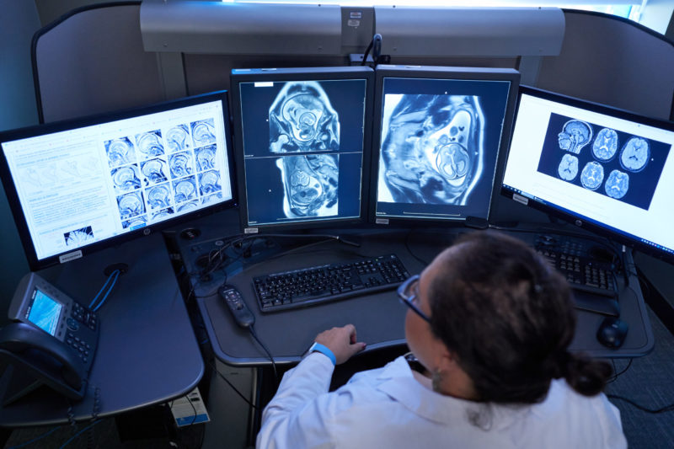
Display monitor
A high-resolution 5-megapixel (2048 × 2560 pixels) display monitor will provide improved visualization of the imaging system’s high spatial resolution. In addition, a display monitor having diagonal dimensions of 53 cm (21 inches) is adequate for viewing images sized 35 × 43 cm (14 × 17 inches) with a recommended pixel pitch of 0.200 mm at a standard viewing distance of about 60 cm (24 inches).

Slide 29
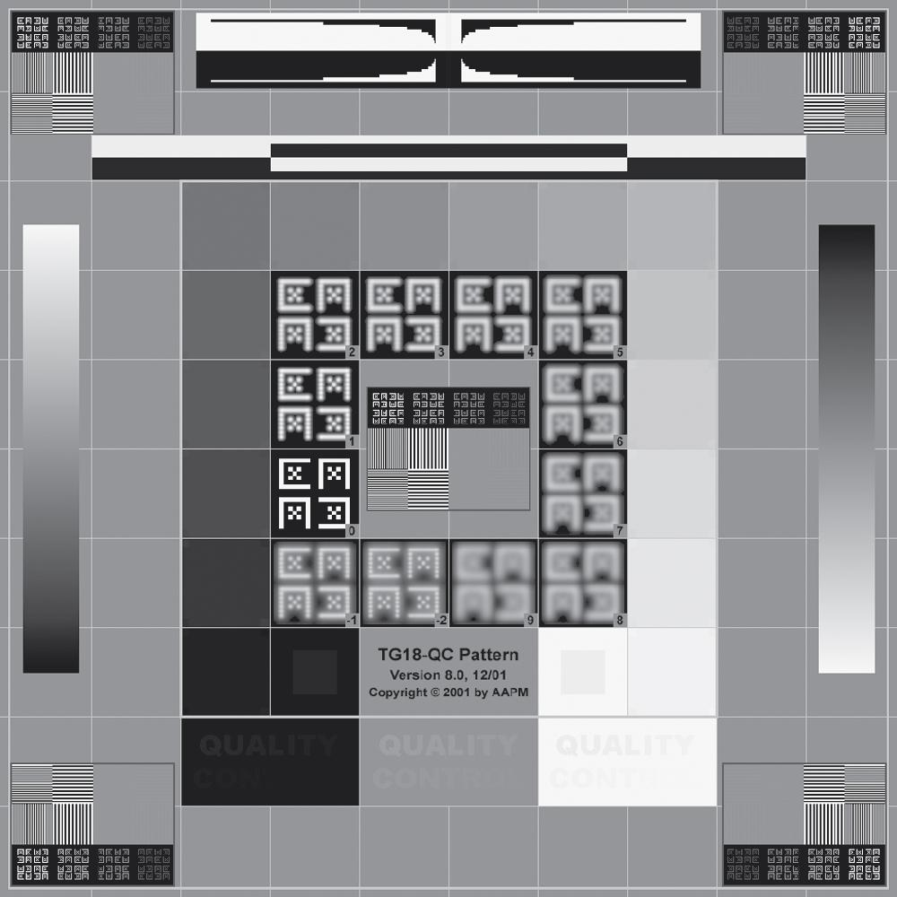
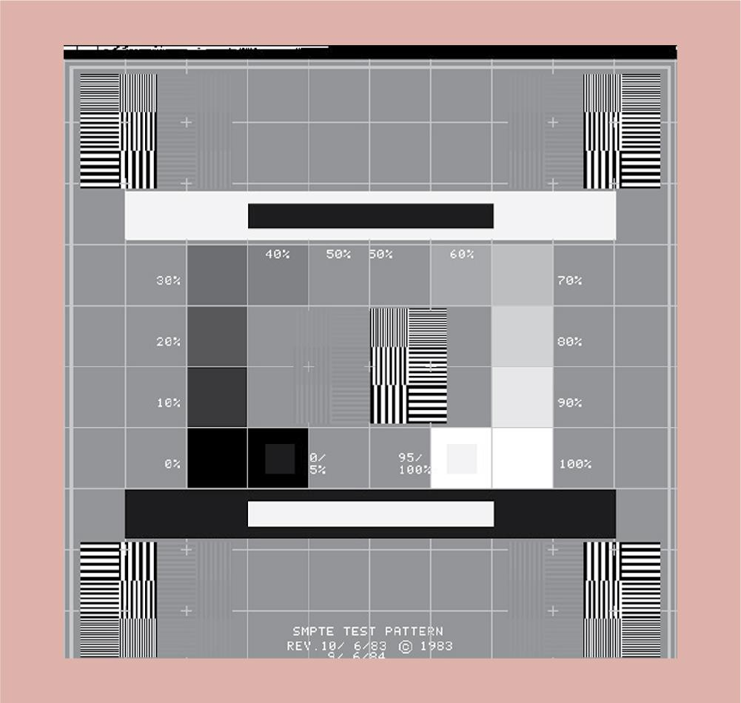
Quality Control Check: Display Monitor
Quality control (QC) test devices for evaluating the performance of the display monitor include the American Association of Physicists in Medicine (AAPM) TG18-QC test pattern and the Society of Motion Picture and Television Engineers (SMPTE) test pattern Several aspects of a display monitor can be evaluated with these test patterns, including geometric distortion, luminance, resolution, contrast resolution, noise, and veiling glare.

Slide 31

Attempting to adjust the image data using post-processing display functions will not correct for improper IR exposure and may result in noisy or suboptimal images that should not be submitted for interpretation.
Some of the newer digital imaging systems provide a mechanism for the radiographer to reprocess the image data using a different Lookup table to improve its presentation at the display monitor, known as alternative algorithms. Selecting an alternative anatomical region or projection will apply a different algorithm to the original image data, and the reprocessed image will be displayed with a change in brightness and/or contrast at the radiographer’s workstation. This could prevent the need for a repeat image, causing additional exposure to the patient. However, the reprocessed image is not assured to have improved quality and if sent to the medical image management and processing system

Slide 32
A word of caution is warranted regarding post-processing: overuse of these functions can drastically and negatively alter the original dataset, which is the digital image. Overwriting the original image with a postprocessed replica may reduce the diagnostic and archival quality of the data. One should also keep in mind that in many facilities, radiographers’ workstations use monitors of significantly lower quality and viewing conditions that differ markedly from those of radiologists’ workstations. How an image looks on the radiographer’s workstation in a brightly lit work area may be very different from the way it looks on the radiologist’s high-resolution monitor in a darkened reading room. Therefore, care should be taken in the postprocessing of an image before forwarding it for interpretation.

Slide 33
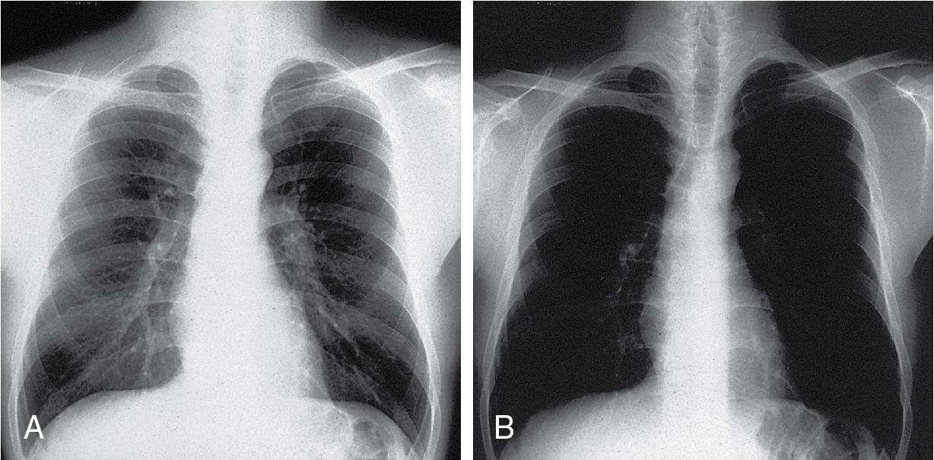

Slide 34
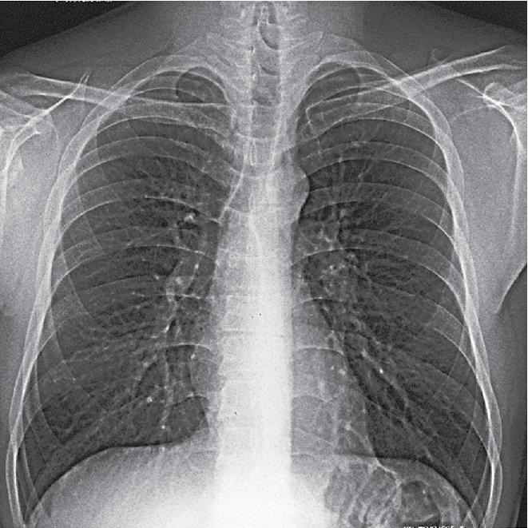
Edge enhancement (also known as high-band pass filtering) is a postprocessing technique that improves the visibility of small, high-contrast structures. However, image noise may increase slightly.

Slide 35
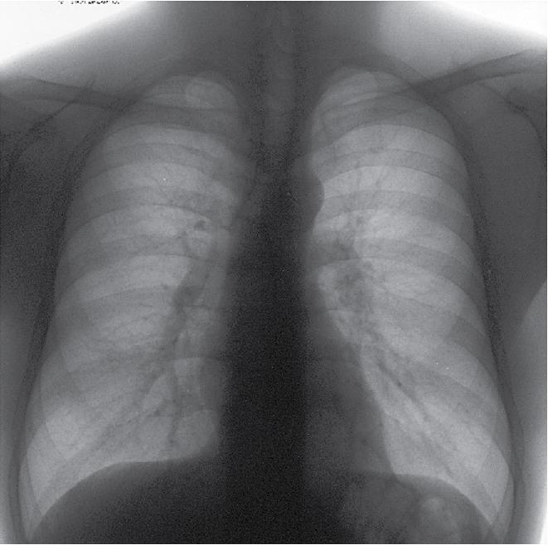
Smoothing (also known as low-pass filtering) is a post-processing technique that suppresses image noise (quantum noise). However, visible spatial resolution is degraded

Slide 36
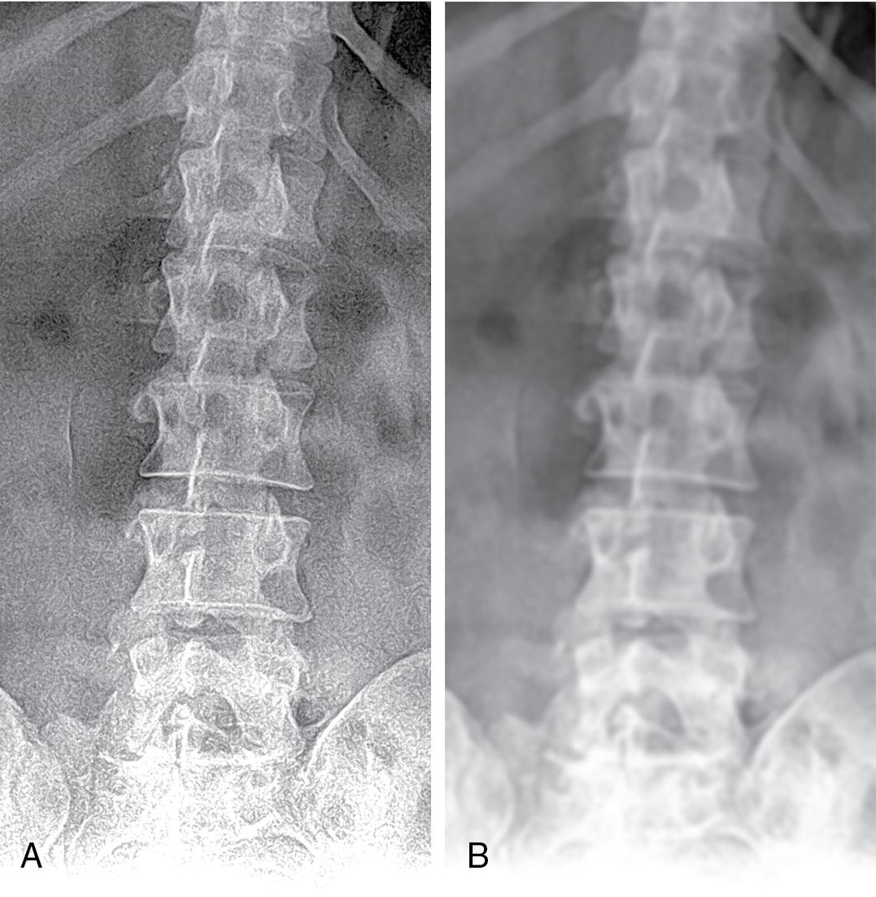
Smoothing (also known as low-band pass filtering) is a postprocessing technique that suppresses image noise (quantum noise). However, visible spatial resolution is degraded

Slide 37
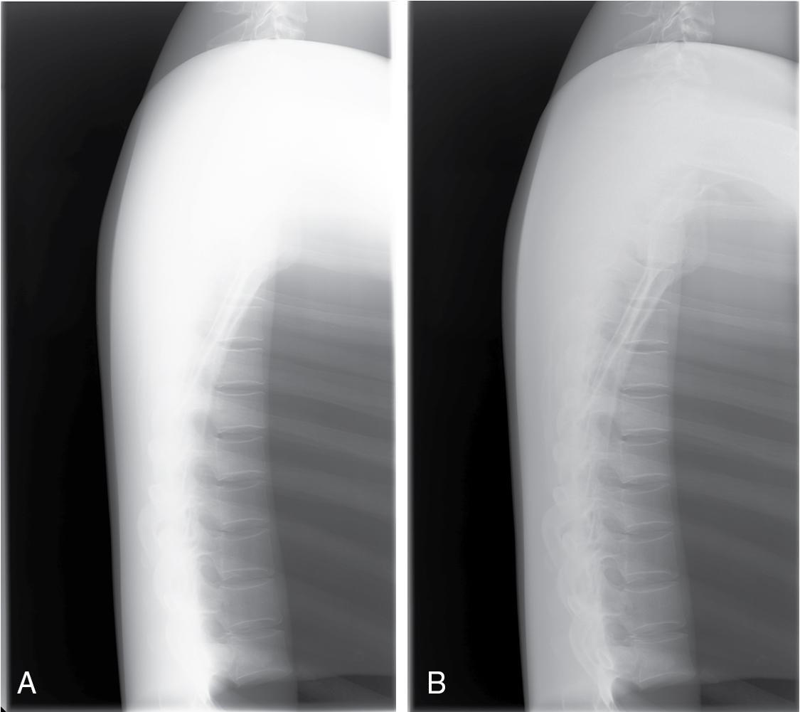
Equalization is a post-processing function in which underexposed (light) areas are made darker and overexposed (dark) areas are made lighter. The effect is an image that appears to have lower contrast so that dense and lucent structures can be better seen within the same image.

