Slide 1
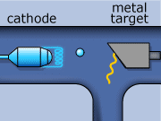
Producing an X-ray Exposure
Prof. Jarek Stelmark
Hostos Community College – The City University of New York

Slide 2
Phases of X-ray Exposure
Explanation: The process of producing an x-ray is divided into two main phases:
The prep phase
The exposure phase. Each has a distinct role in generating diagnostic images.

Slide 3
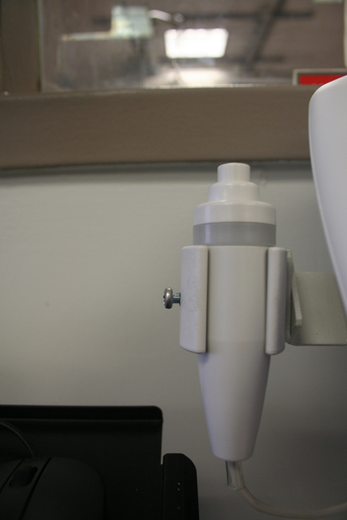
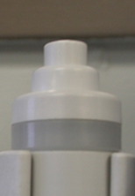
Prep Phase
Explanation: This is the preparation stage where the x-ray tube components are made ready. Activating this phase starts anode rotation and filament heating, setting the stage for electron production.
Activated by half-pressing the exposure switch or pressing a separate prep button.

Slide 4
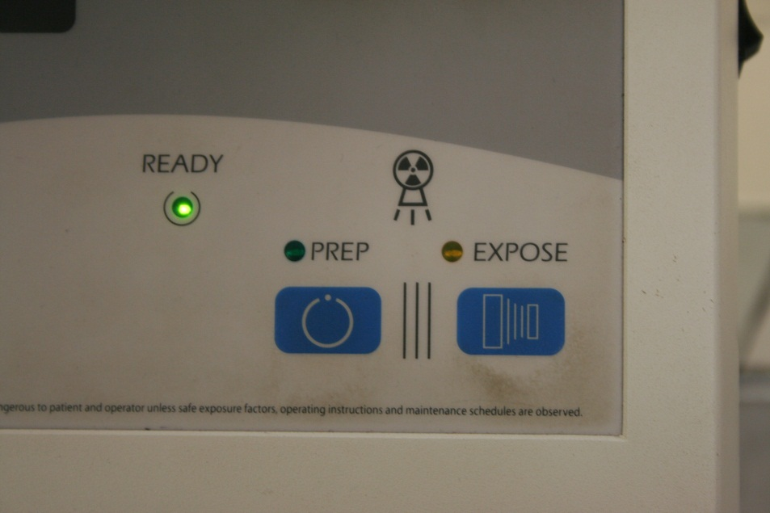
Ready Light
Explanation: Once the system is ready, a light indicates that conditions are optimal for exposure. This ensures proper timing for pressing the exposure switch fully.

Slide 5
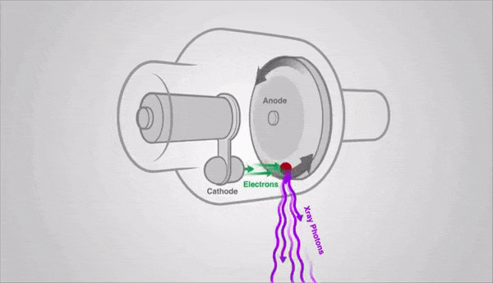
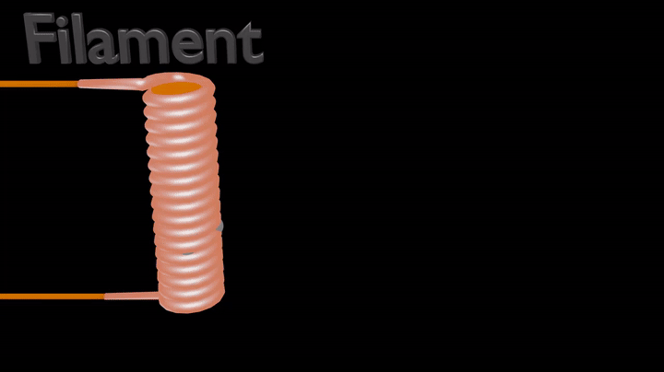
Prep Phase Explanation: The anode spins at high speed (3,000–4,000 rpm), the filament reaches ~2,200 °C, and electrons form a space charge cloud. Electrons just hover around the filament. Electrons don’t move towards the anode yet.

Slide 6
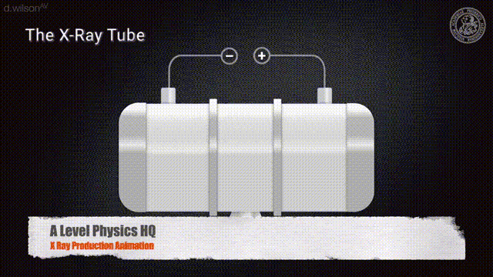

Slide 7
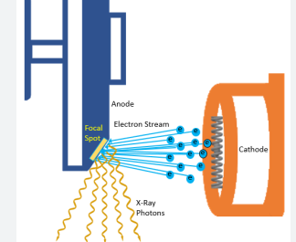
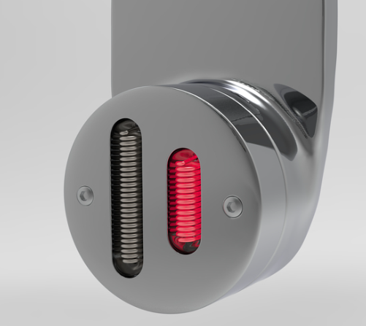
The X-ray Tube Filaments
Inside the cathode, there are usually two filaments: a small and a large.
Both are heated by current to produce electrons (thermionic emission).
The technologist selects which filament to use depending on the exam.

Slide 8
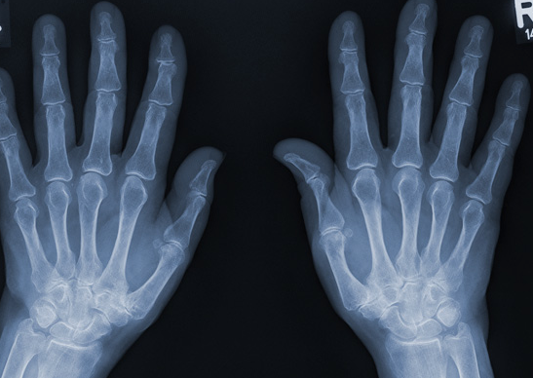
Small Filament
Characteristics:
Produces a small focal spot on the anode.
Electron beam is more focused → sharper x-ray beam.
Uses:
High detail imaging (extremities, small bones, fine structures).
Lower mA capacity (can’t tolerate high tube current without overheating).

Slide 9
Large Filament
Characteristics:
Produces a large focal spot on the anode.
Spreads electron stream over a larger area → more heat dissipation.
Uses:
High mA exams (chest, abdomen, spine) requiring short exposure times.
Useful when patient motion is a concern, since high mA allows shorter time

Slide 10
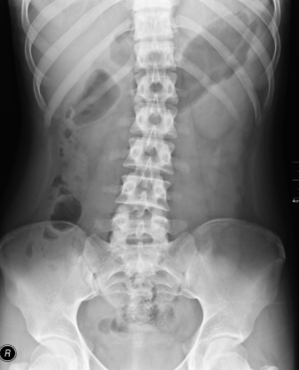
Summary – Choosing Small vs. Large Filament
Small filament = high detail, low mA exams.
Large filament = high mA, short-time exams where heat is a concern.
Key Teaching Point:
The filament choice controls focal spot size, which balances detail resolution vs. tube heat capacity.

Slide 11
Exposure Phase
Explanation: This begins when the exposure switch is pressed fully. The anode’s positive charge attracts electrons, which strike the target, producing x-rays at the focal spot.

Slide 12
Termination of Exposure
Explanation: Exposure stops when the timer runs out or the operator releases the switch. After this, no more x-rays are generated.
No x-rays are produced after the exposure is terminated !

Slide 13
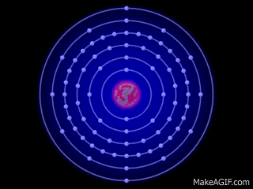
Origin of X-rays:
Target material (electron cloud within the target)

Slide 14

Origin of Gamma rays:
Atomic nucleus

Slide 15
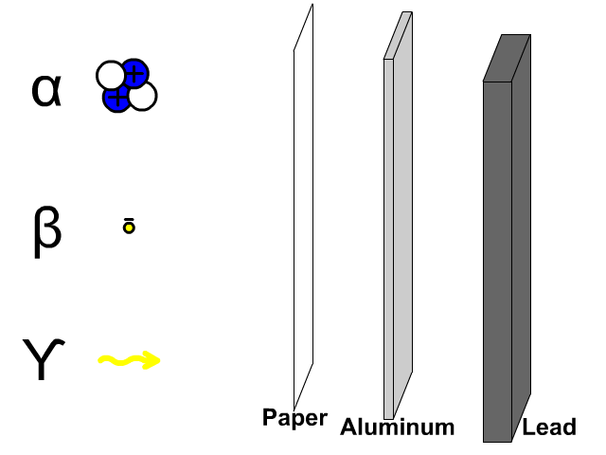

Slide 16
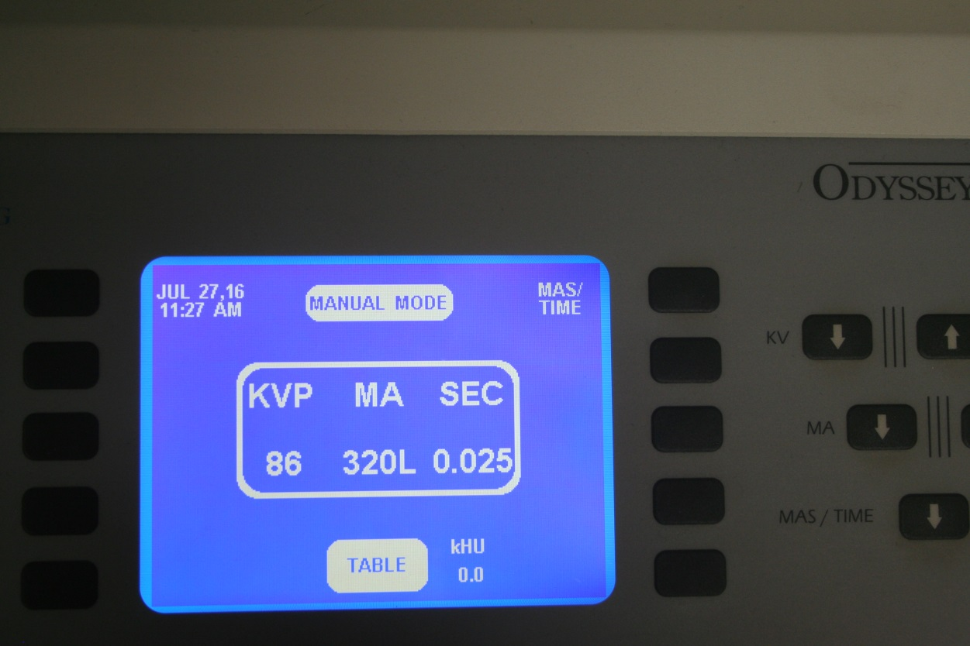
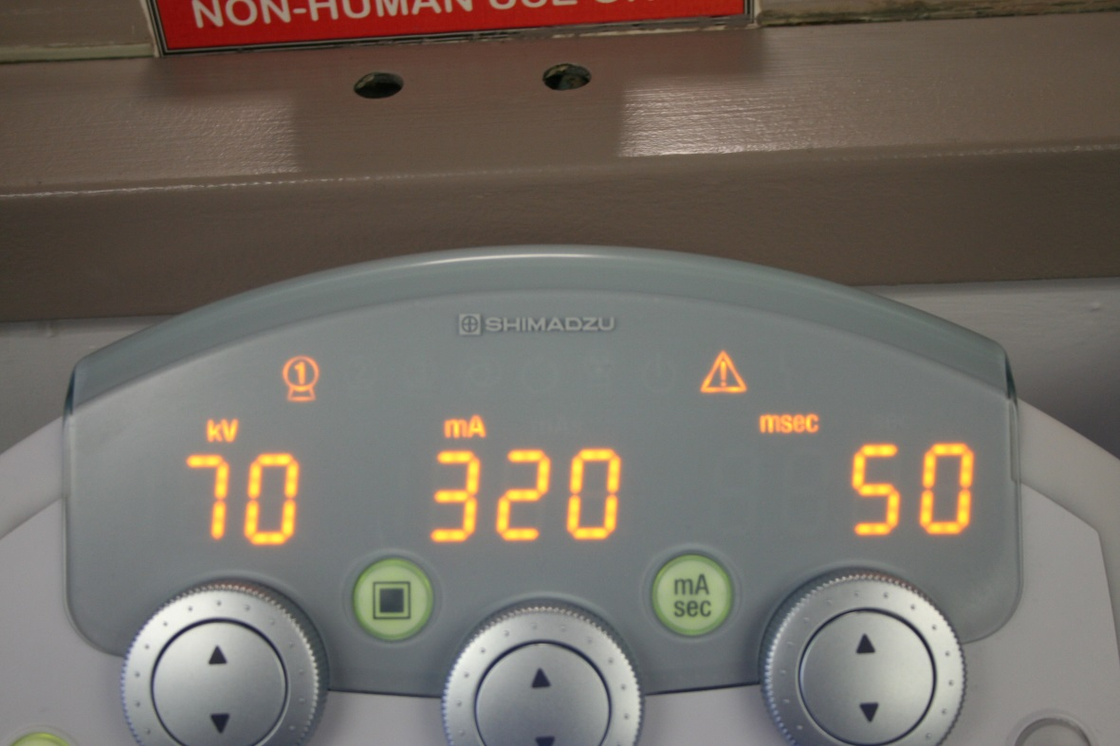
Primary Exposure Factors
mAs
kVp
They determine how many photons are produced, their energy, and how they interact with the patient and image receptor.

Slide 17
The quantity of x-ray photons in an exposure cannot be determined by either the mA or the exposure time alone.
Although mA determines the rate of x-ray production, it does not indicate the total quantity, because it does not indicate how long the exposure lasts.
Exposure time does not indicate the total quantity either, because it does not measure the rate of x-ray production.
To determine the quantity of radiation involved in an exposure, both mA and time must be considered.
mA x Time (sec) = mAs

Slide 18
320 mA x 0.025 (sec) = 8 mAs

Slide 19
Milliamperage (mA) – What It Is
Definition:
mA measures tube current — the number of electrons flowing from cathode to anode per second.
1 mA = 1 milliampere of current = 1/1000 ampere.
What It Represents Physically:
More mA → more electrons hitting the anode target every second → more x-ray photons produced.
Fewer mA → fewer electrons → fewer photons produced.

Slide 20
mA Controls Intensity
Intensity in X-ray Physics:
“Intensity” means the rate at which x-ray photons are produced (photon fluence per second).
Measured in mR/sec (traditional) or mGyₐ/sec (SI).
How mA Controls Intensity:
Direct relationship: Doubling mA doubles the x-ray photon production rate.
Example:
  200 mA produces twice as many photons per second as 100 mA, so the beam intensity doubles.
Important in Digital Radiography:
Higher mA → higher detector exposure in the same time → better signal-to-noise ratio (SNR).
Lower mA → lower detector exposure → more quantum mottle (graininess).
Brightness on display stays the same due to software, but noise level changes.

Slide 21
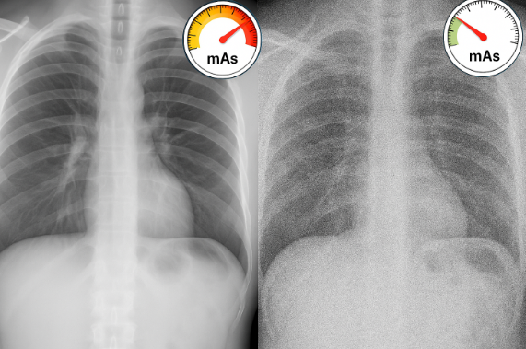

Slide 22
Exposure Time – What It Is
Definition:
Exposure time is the duration that the x-ray tube is energized and producing photons.
Measured in seconds (s), milliseconds (ms), or fractions of a second.
What It Represents Physically:
Determines how long electrons are accelerated toward the anode.
Longer time → more total photons produced.
Shorter time → fewer total photons produced.

Slide 23
How Time Controls Detector Exposure
In Digital Radiography:
Time controls the total number of photons by determining how long the selected mA is applied.
Direct relationship: doubling time doubles the total photons (if mA stays the same).
Example:
200 mA × 0.10 s = 20 mAs
200 mA × 0.20 s = 40 mAs → double the total photons.

Slide 24
Clinical Importance of Time
Short Time
  Reduces motion blur from patient movement, breathing, heartbeat, or peristalsis.
  Used for mobile imaging, pediatric patients, and chest x-rays.
Long Time
  Can be used for stationary body parts with no motion risk (e.g., extremities).
  Increases total photons if mA is constant.

Slide 25

Time in Digital Imaging
Brightness does not change with time adjustment (post-processing controls that).
Longer time → better signal-to-noise ratio (SNR) but higher patient dose if mA is not reduced.
Shorter time → higher noise but lower dose and less motion blur.

Slide 26
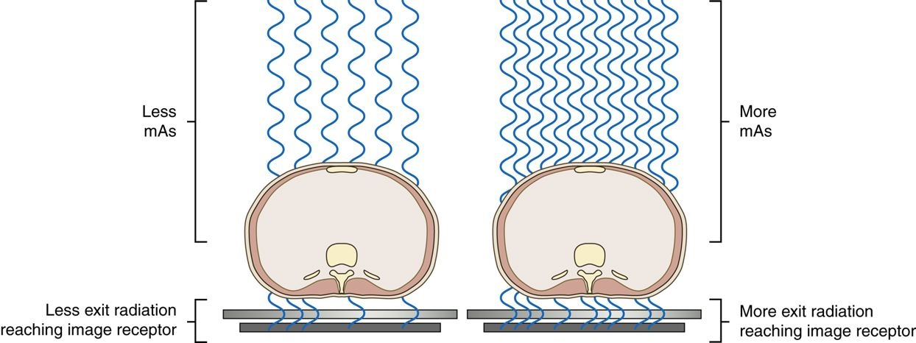
As the mAs is increased, the quantity of radiation reaching the IR is increased. As the mAs is decreased, the amount of radiation reaching the IR is decreased.

Slide 27
Example 1 – 10 mAs
100 mA × 0.10 sec = 10 mAs
➡️ Lower total exposure
Example 2 – 20 mAs
200 mA × 0.10 sec = 20 mAs
➡️ Twice as many photons as 10 mAs. Higher total exposure. Higher patient radiation dose.

Slide 28
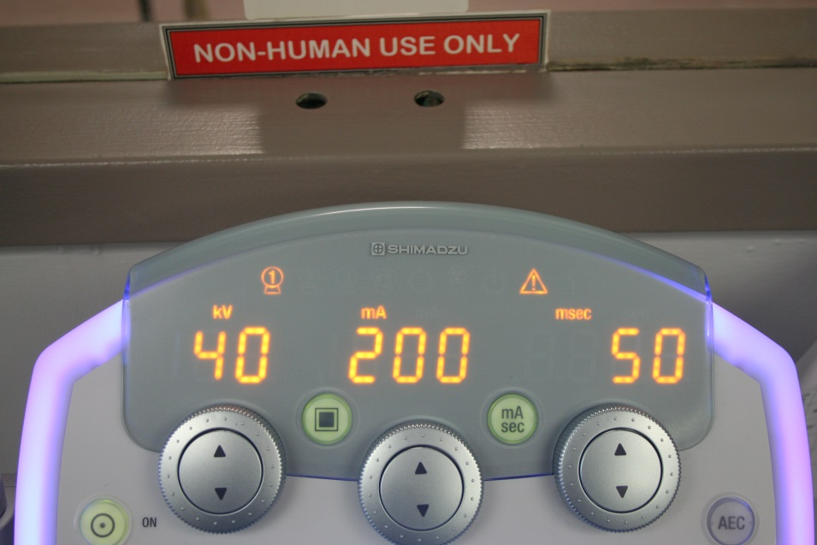
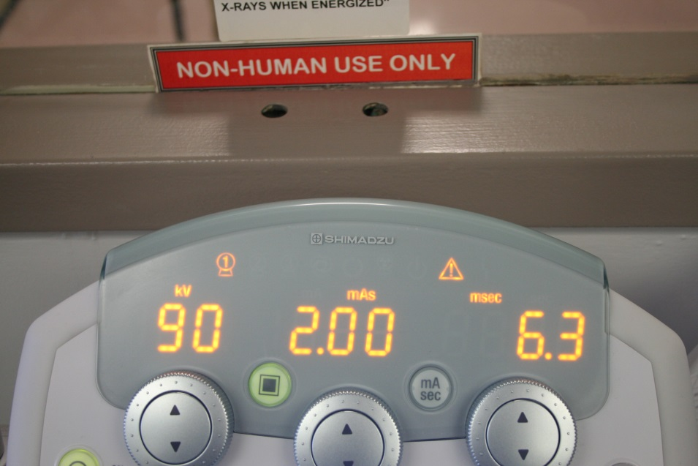
When the kVp is increased at the control panel, a larger potential difference occurs in the x-ray tube, giving more electrons the kinetic energy to produce x-rays and increasing the kinetic energy overall. The result is more photons (quantity) and higher energy photons (quality).

Slide 29
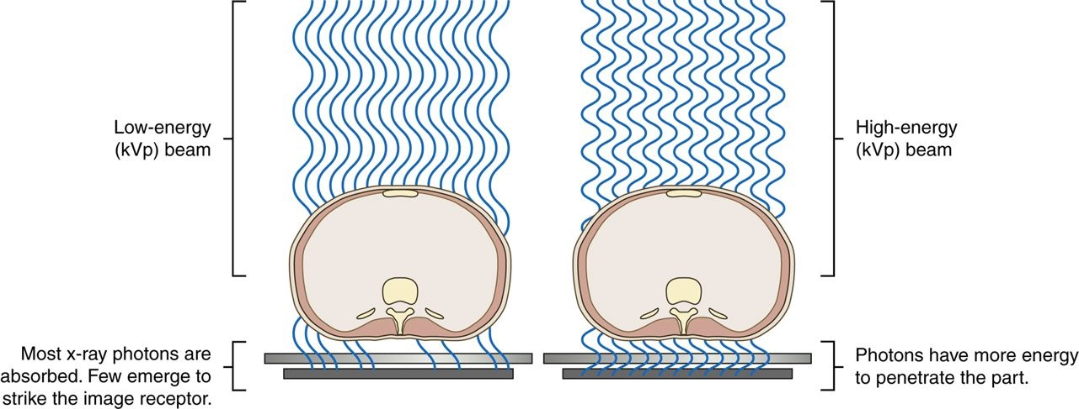
The kVp affects the exposure to the IR because it alters the amount and penetrating ability of the x-ray beam.
Altering the penetrating power of the x-ray beam affects its absorption and transmission through the anatomic tissue being radiographed. Higher kVp increases the penetrating power of the x-ray beam and results in less absorption and more transmission in the anatomic tissues

Slide 30
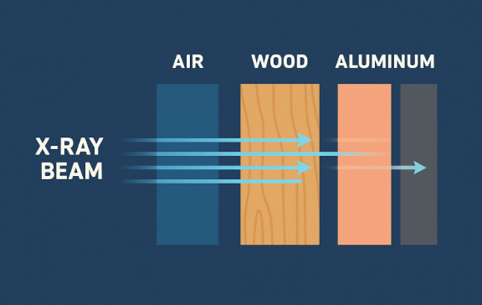
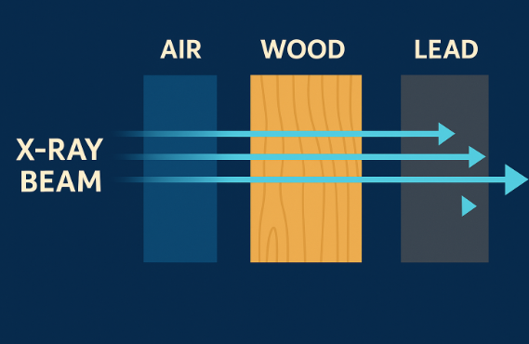
Low kVp
High kVp

Slide 32
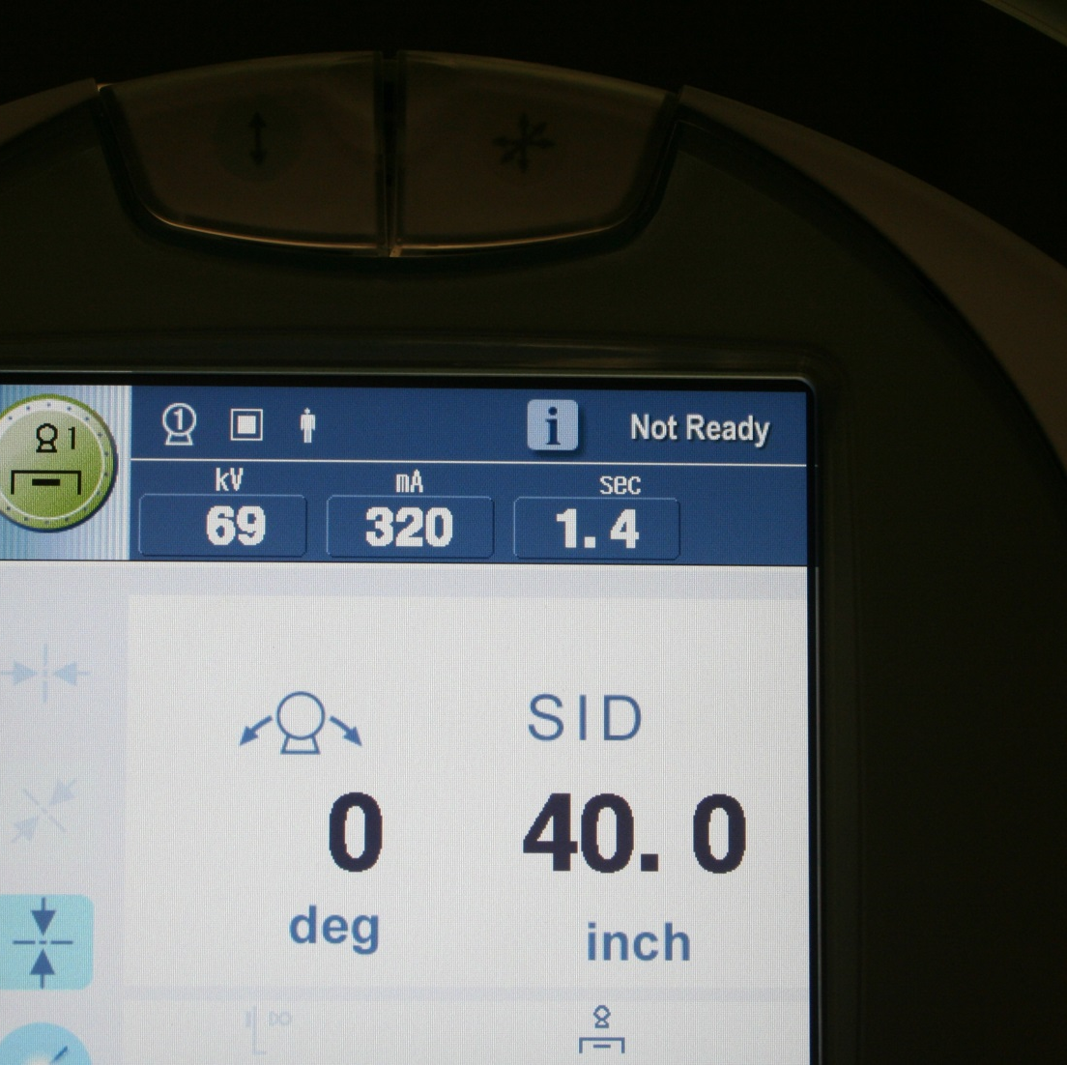
SID

Slide 33
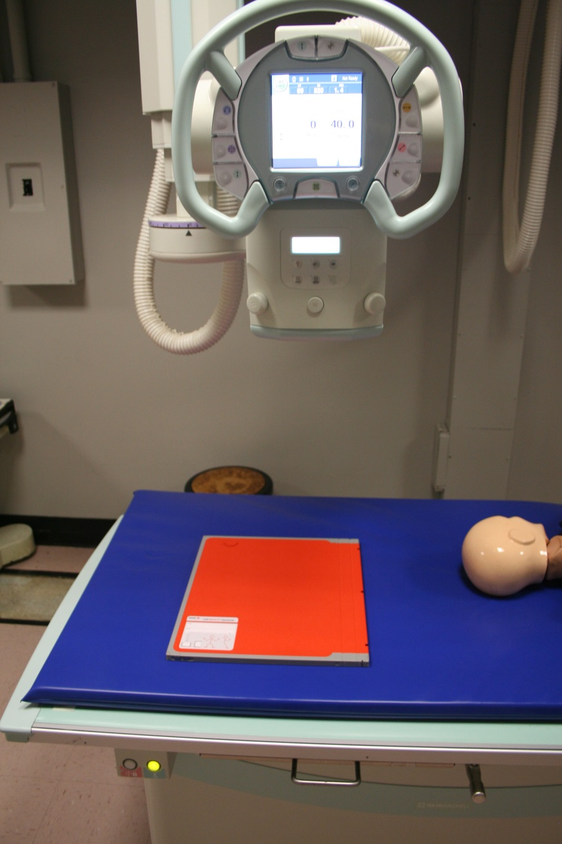
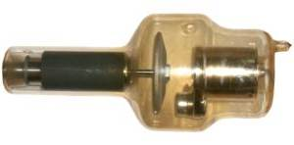
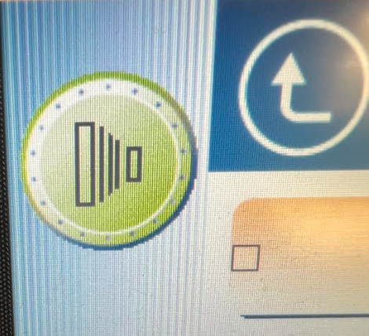
SID Source to Image Receptor Distance Table Top (TT)

Slide 34
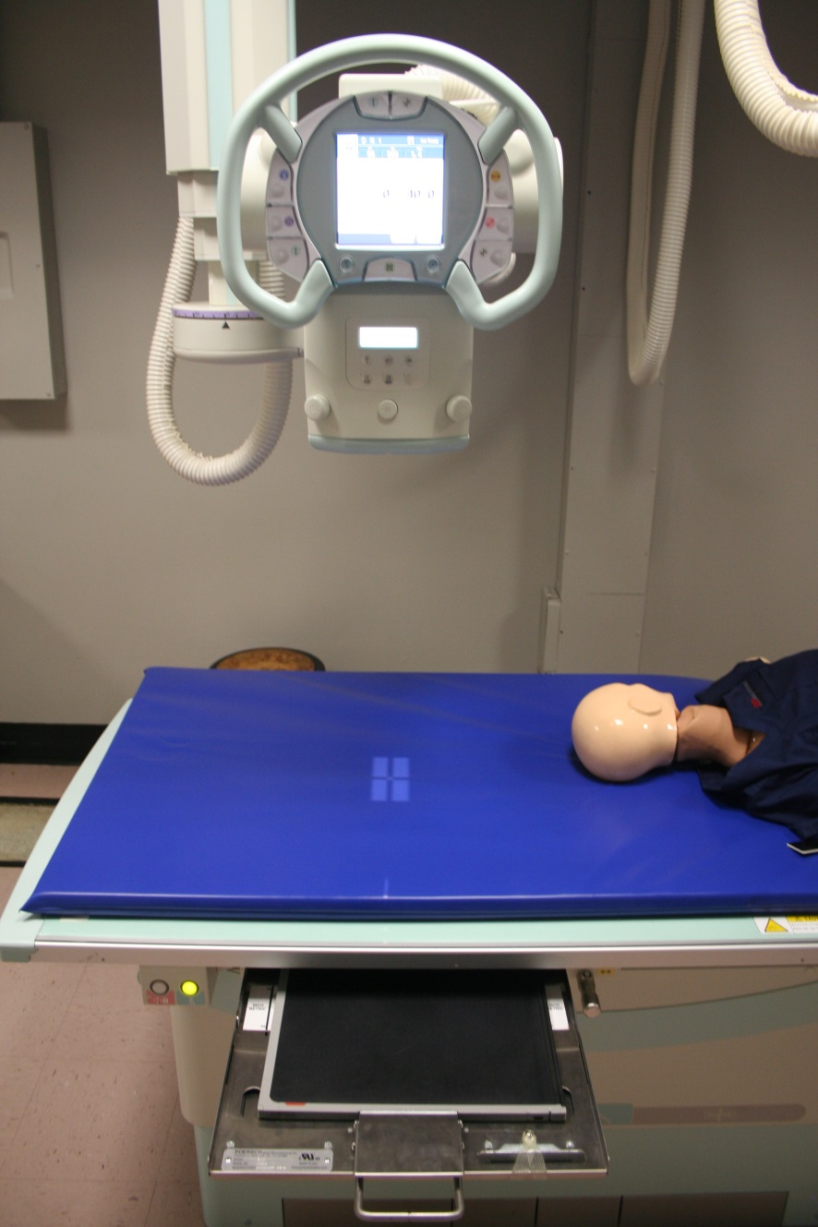

SID Source to Image Receptor Distance Table Bucky

Slide 35
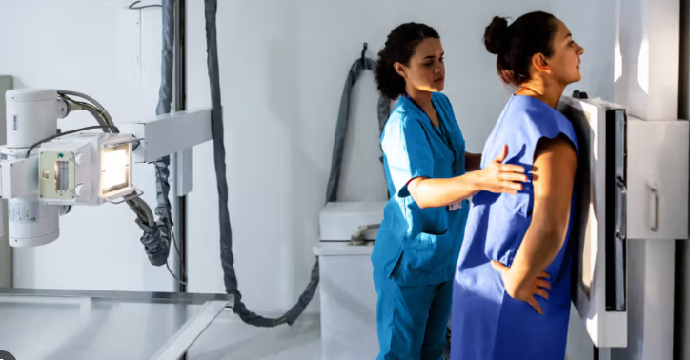
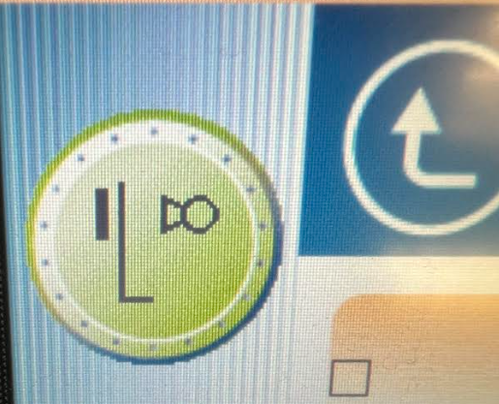
SID Source to Image Receptor Distance Vertical/Upright Bucky

Slide 36

Where is the Image Receptor (IR)? TT or Bucky

Slide 37
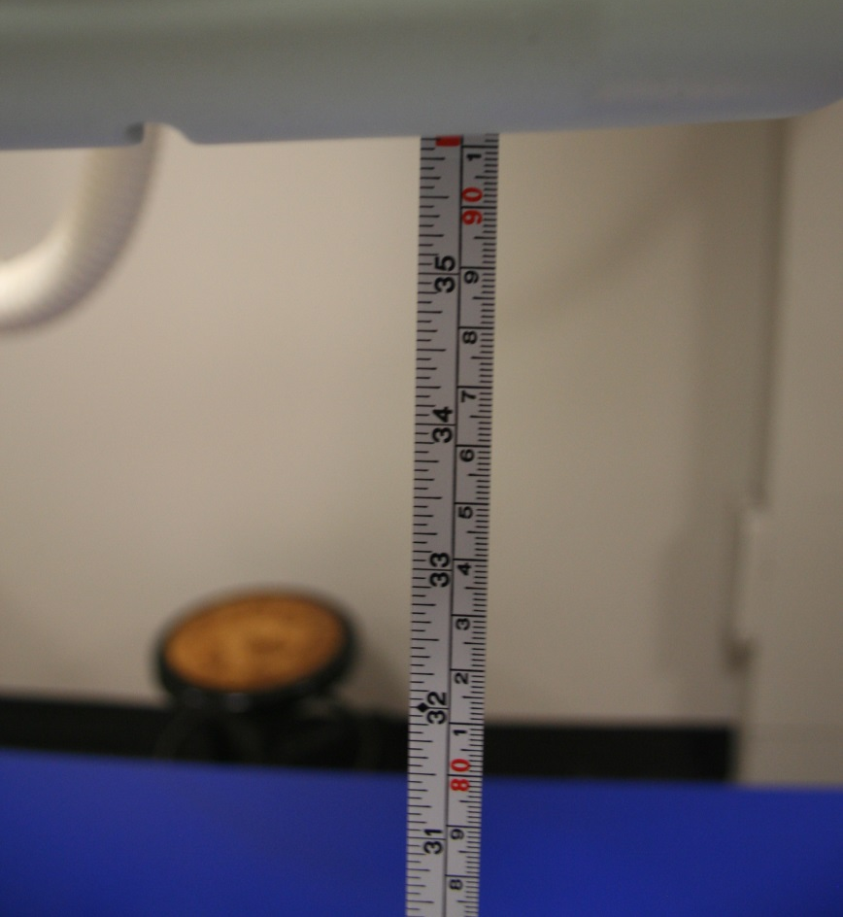
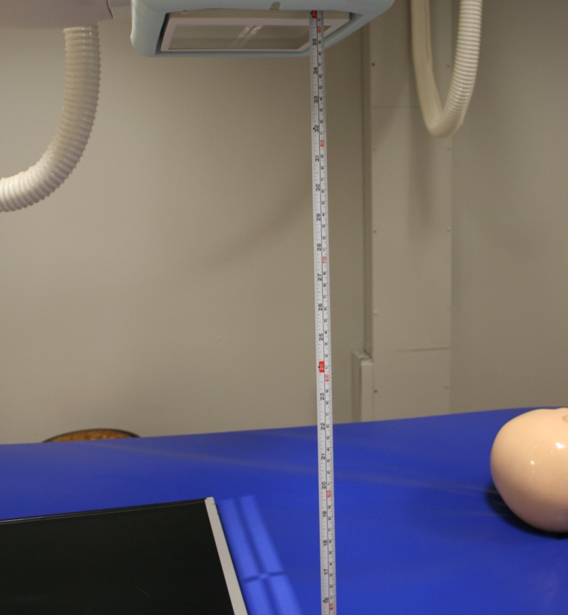

Slide 38
