Slide 1
Exposure Factors Compensation

Slide 2
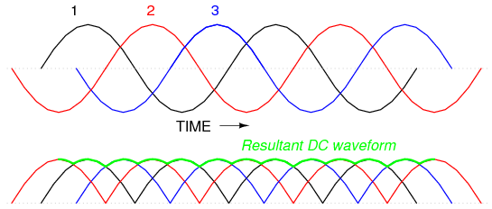
Voltage Waveform and Photon Production
The voltage waveform determines the consistency of the potential difference across the X-ray tube. The more constant the voltage, the more efficient photon production becomes. Ripple reduction directly affects beam quality and quantity.

Slide 3
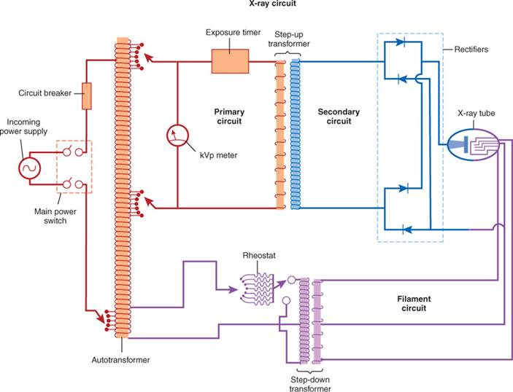

Slide 4
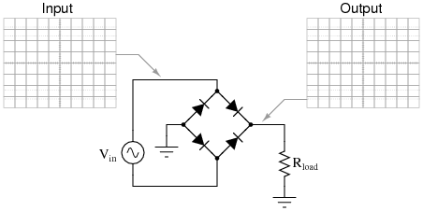

Slide 5
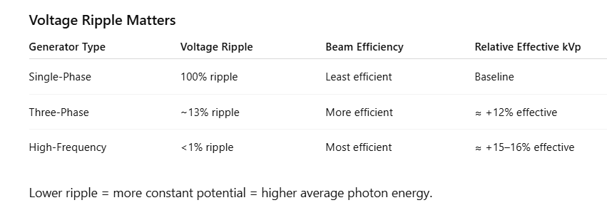

Slide 6
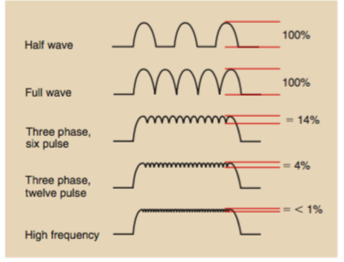

Slide 7
Ripple and Beam Efficiency
Single-phase systems have 100% ripple. Three-phase systems significantly reduce ripple. High-frequency systems approach a constant potential. Reduced ripple increases average photon energy and output.
If 100 kVp is required on single-phase equipment, approximately 88 kVp (12% reduction) is required on three-phase equipment to produce equivalent SNR.

Slide 8
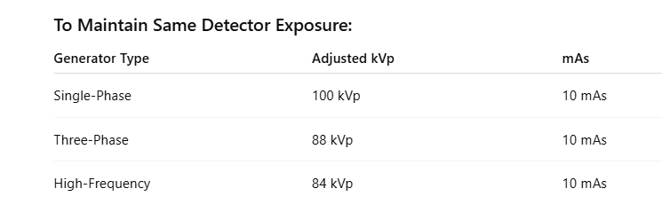

Slide 9
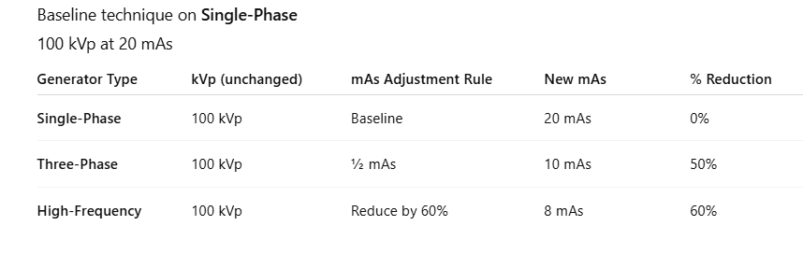

Slide 10
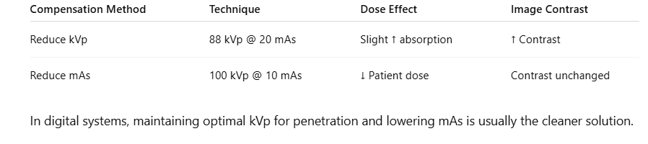
Reducing mAs is preferable.
mAs controls photon quantity
Patient dose is directly proportional to mAs
Lower mAs = lower entrance skin exposure
kVp changes affect contrast and scatter

Slide 11
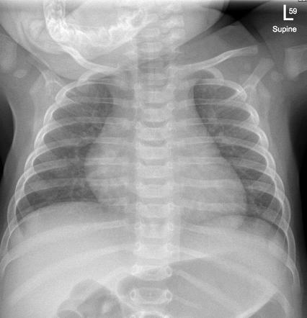
Pediatric Radiography Principles
Children are not small adults. Reduced bone density, smaller anatomy, and motion challenges require independent technique logic.

Slide 12
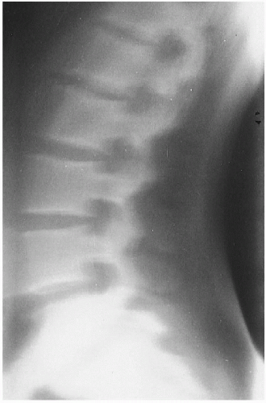
Motion and Exposure Time
Fast exposure time is essential in pediatric chest imaging to freeze diaphragmatic motion. AEC may not respond rapidly enough in small thoraces.

Slide 13
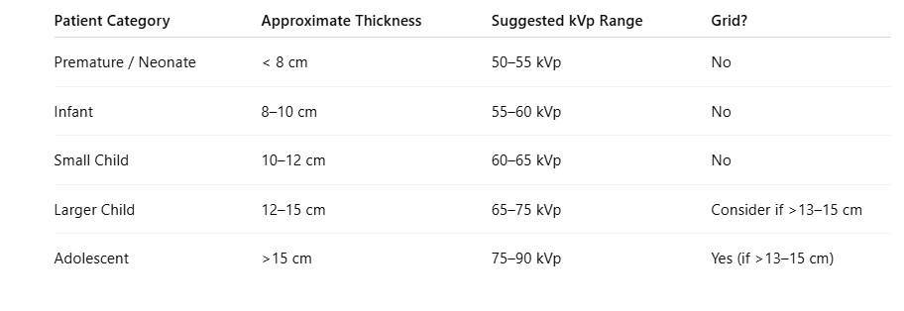
Chest kVp

Slide 14
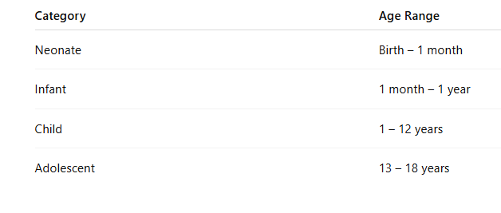

Slide 15
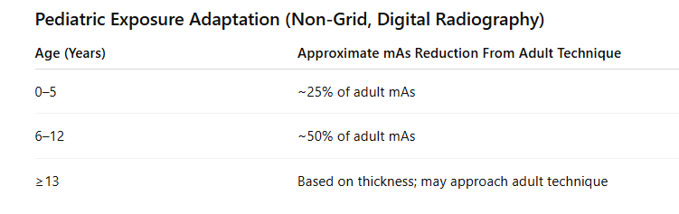
The pediatric exposure technique is derived from the adult technique charts but proportionally reduced based on patient size and tissue thickness. Because children have smaller body mass and reduced tissue attenuation, significantly less photon quantity is required to achieve adequate detector exposure
Age is only an approximation. Exposure decisions must be based primarily on part thickness and body habitus. A large 12-year-old may require a near-adult technique, whereas a small adolescent may not.
In digital radiography, mAs reduction is especially important because image brightness is automatically rescaled. Overexposure is not visually obvious and can lead to dose creep.
Pediatric imaging demands careful monitoring of exposure index and strict adherence to ALARA principles.

Slide 16
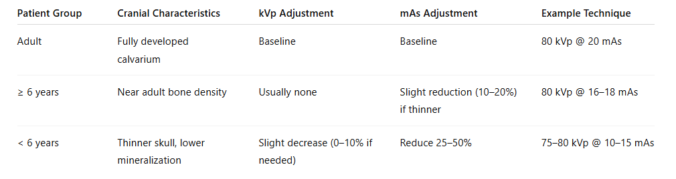
For pediatric skull imaging, adult exposure factors may be appropriate for patients aged approximately 6 years and older, as cranial bone density approaches adult levels.
For patients younger than 6 years, reduced tissue thickness and decreased bone mineralization require modifications to the technique. Exposure adjustments should primarily involve reducing mAs to reduce photon exposure while maintaining an adequate signal-to-noise ratio.
Significant kVp reduction is generally not recommended in digital radiography, as it increases absorbed dose and may require compensatory increases in mAs.
Technique selection should be based on part thickness and patient habitus rather than age alone.

Slide 17
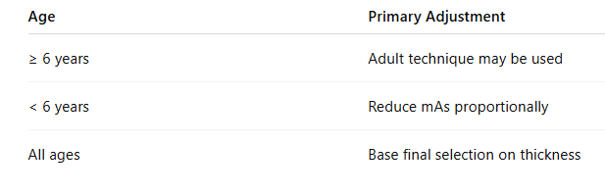

Slide 18
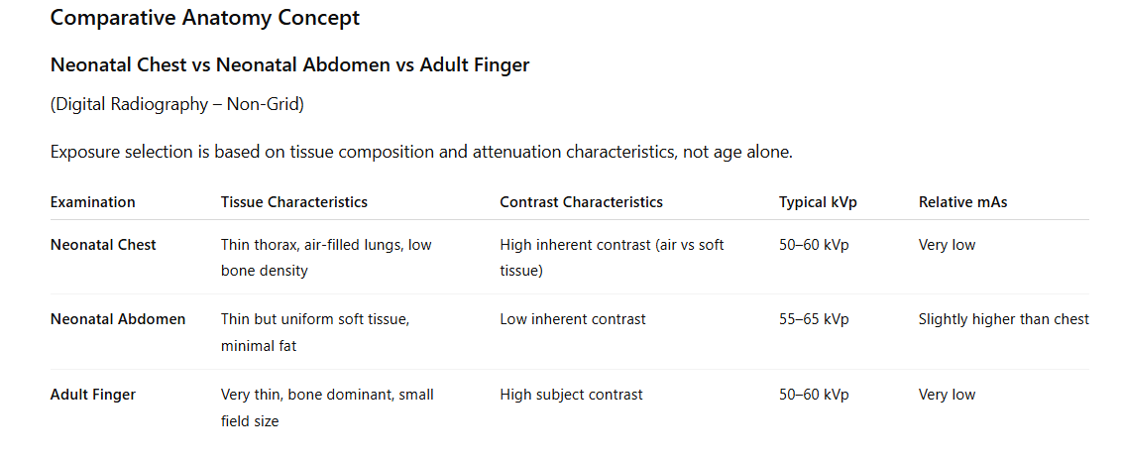

Slide 19
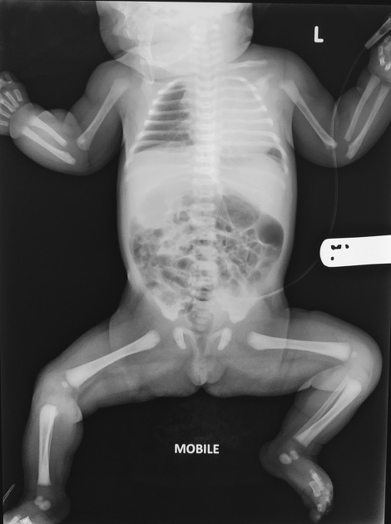

Collimation is Critical
Children have:
Smaller anatomy
Higher relative scatter-to-primary ratio if the field size is excessive
Tight collimation:
Reduces scatter
Improves contrast
Reduces dose
May eliminate grid need

Slide 20
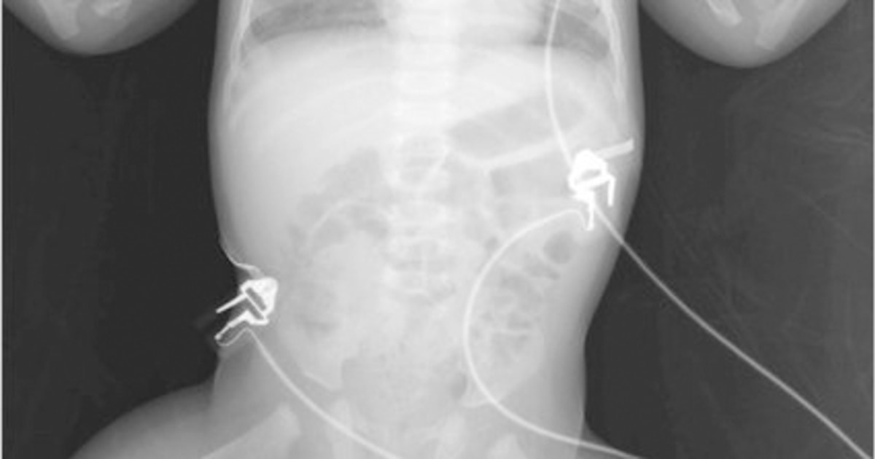
Babygrams are considered poor practice unless specifically justified.
Overexposure of non-essential anatomy
Large portions of anatomy not required for diagnosis are irradiated.
Increased scatter radiation
Large field size increases scatter → reduces image contrast.
Higher effective dose
Neonates are extremely radiosensitive.
Violation of ALARA principles

Slide 21
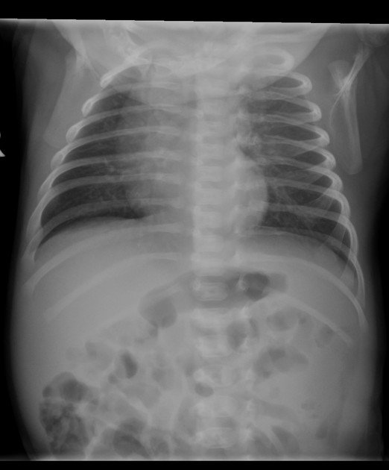
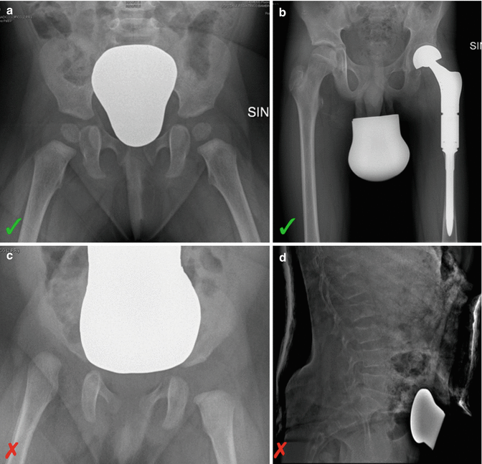
Collimation: The Standard of Care
Proper neonatal imaging should:
Collimate tightly to the anatomy of interest
• Use shielding when possible
• Minimize repeats
• Avoid irradiating extremities unless clinically required

Slide 22
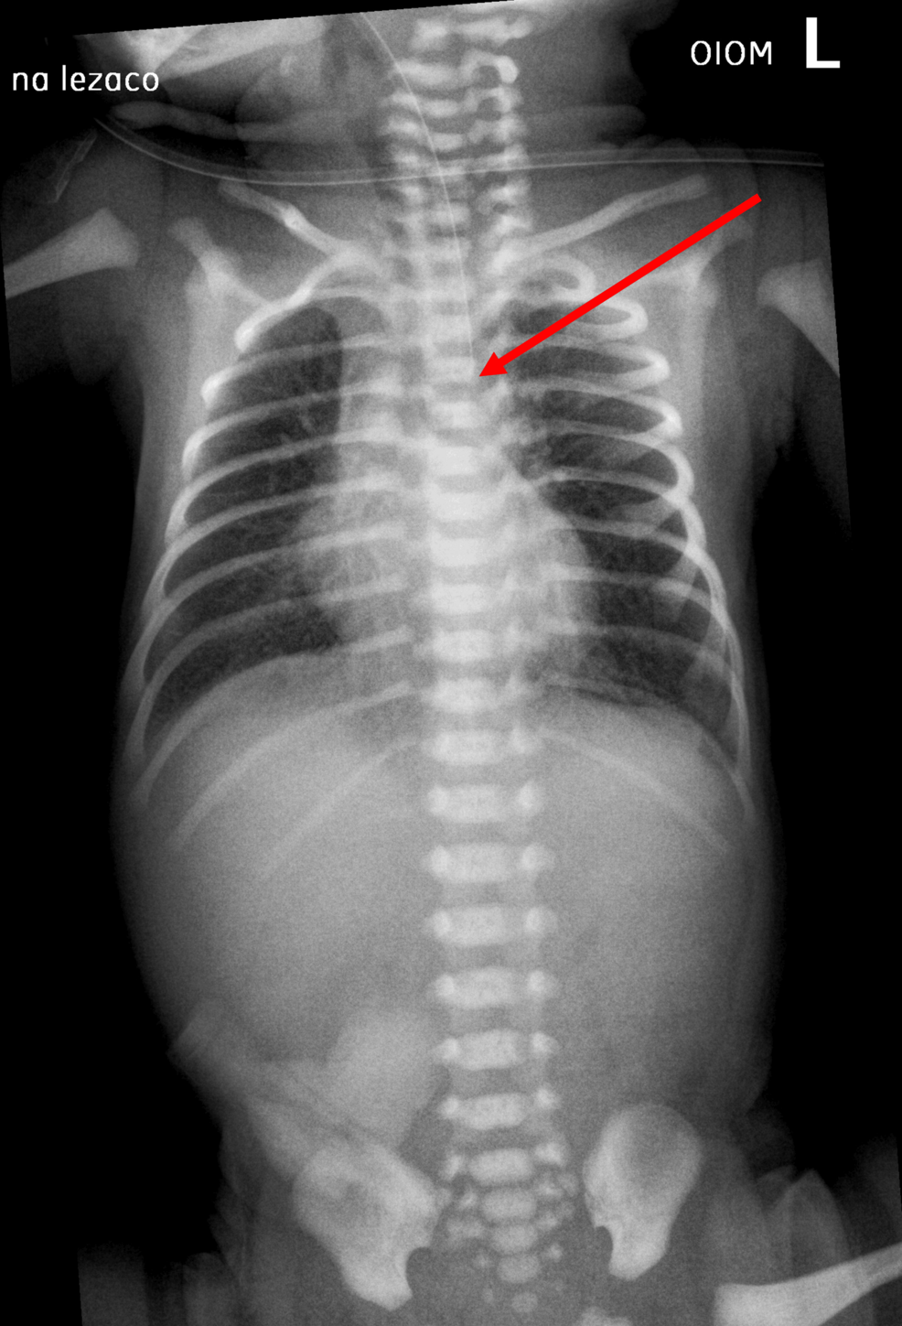
When Might a Babygram Be Justified?
Rare situations:
•Suspected multiple fractures (non-accidental trauma)
• Line and tube placement involving the chest and abdomen simultaneously
• Severe instability where repositioning is unsafe
Even then, collimation within a large field is expected.

Slide 23
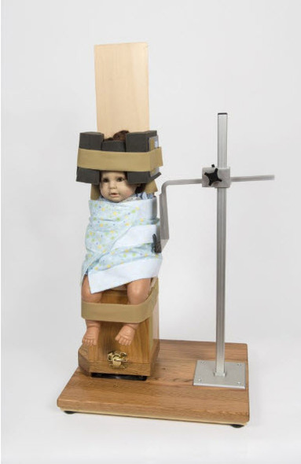
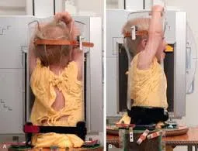
Shielding and Positioning
Modern guidance:
Gonadal shielding is declining in practice
Proper collimation preferred
Immobilization devices preferred over repeat exposures

Slide 24
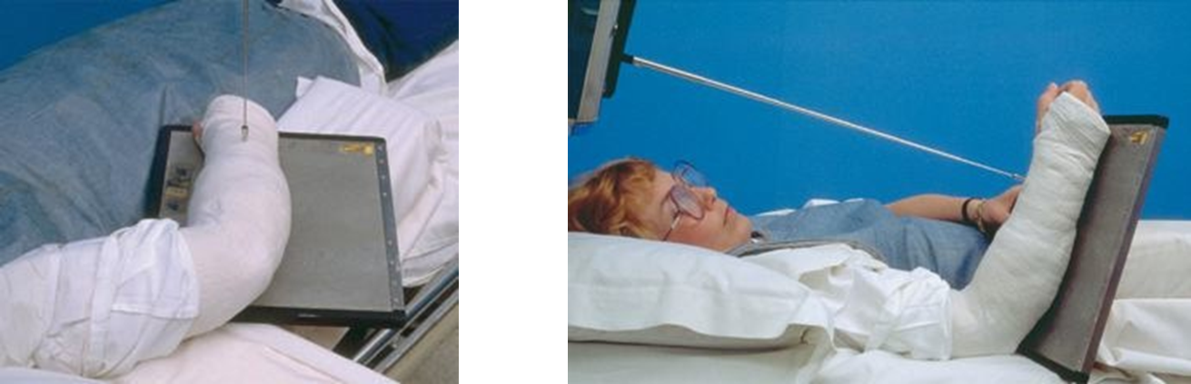
Casts and Splints: Exposure Modification Principles
Casts and splints are constructed from materials with varying atomic numbers, densities, thicknesses, and moisture content, all of which influence x-ray attenuation. Because attenuation depends on both material composition and total part thickness, exposure selection must be individualized rather than standardized.
Plaster casts, composed primarily of calcium sulfate, are denser and thicker than fiberglass casts and therefore attenuate a greater proportion of the primary beam. Fiberglass casts are lighter and less radiopaque, but they still increase the overall part thickness. Wet plaster further increases attenuation due to retained moisture, which significantly increases photon absorption.

Slide 25
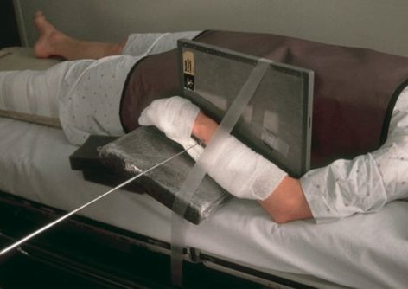
In addition to material composition, the radiographer must evaluate whether the cast or splint lies directly within the primary beam path. A device positioned lateral to the anatomy may not require technique adjustment in an AP projection but may require modification in a lateral projection if the beam traverses the device.

Slide 26
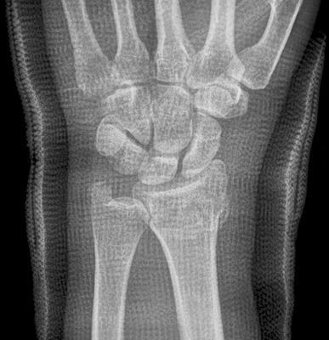
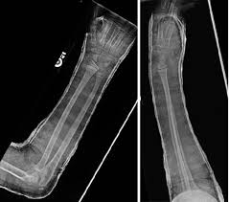
Exposure modification principles:
If attenuation increases due to cast thickness → increase mAs primarily
If penetration through dense plaster is inadequate → modest kVp increase may be indicated
Avoid excessive kVp increases that reduce contrast in fracture evaluation
Always reassess technique after cast application, especially in post-reduction imaging

Slide 27
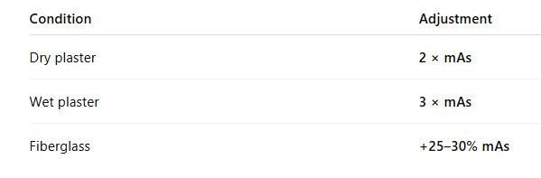

Slide 28
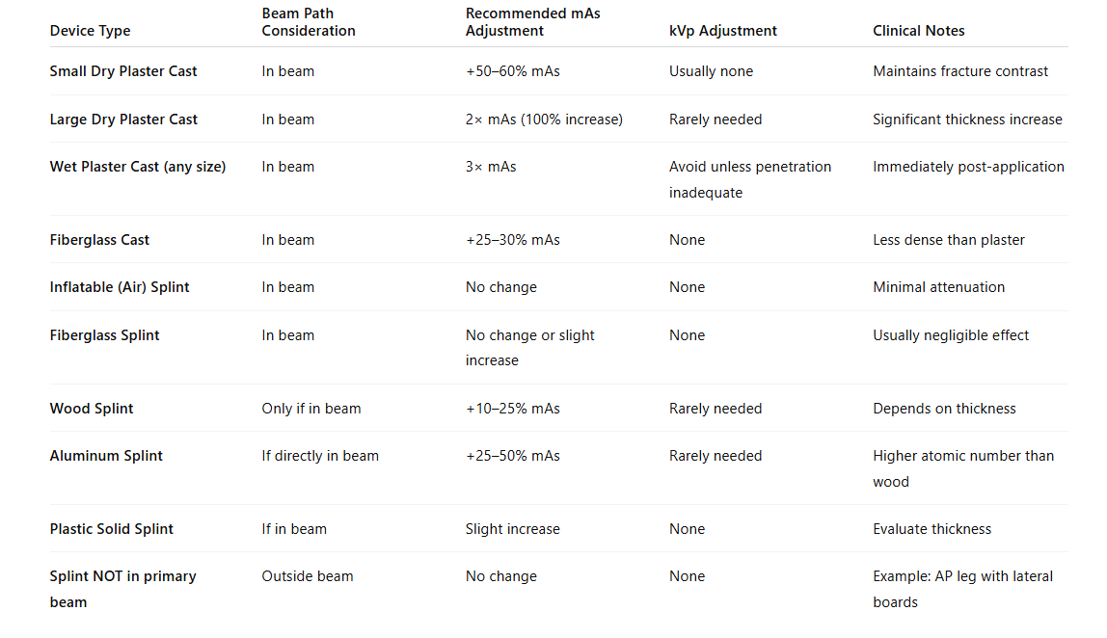

Slide 29
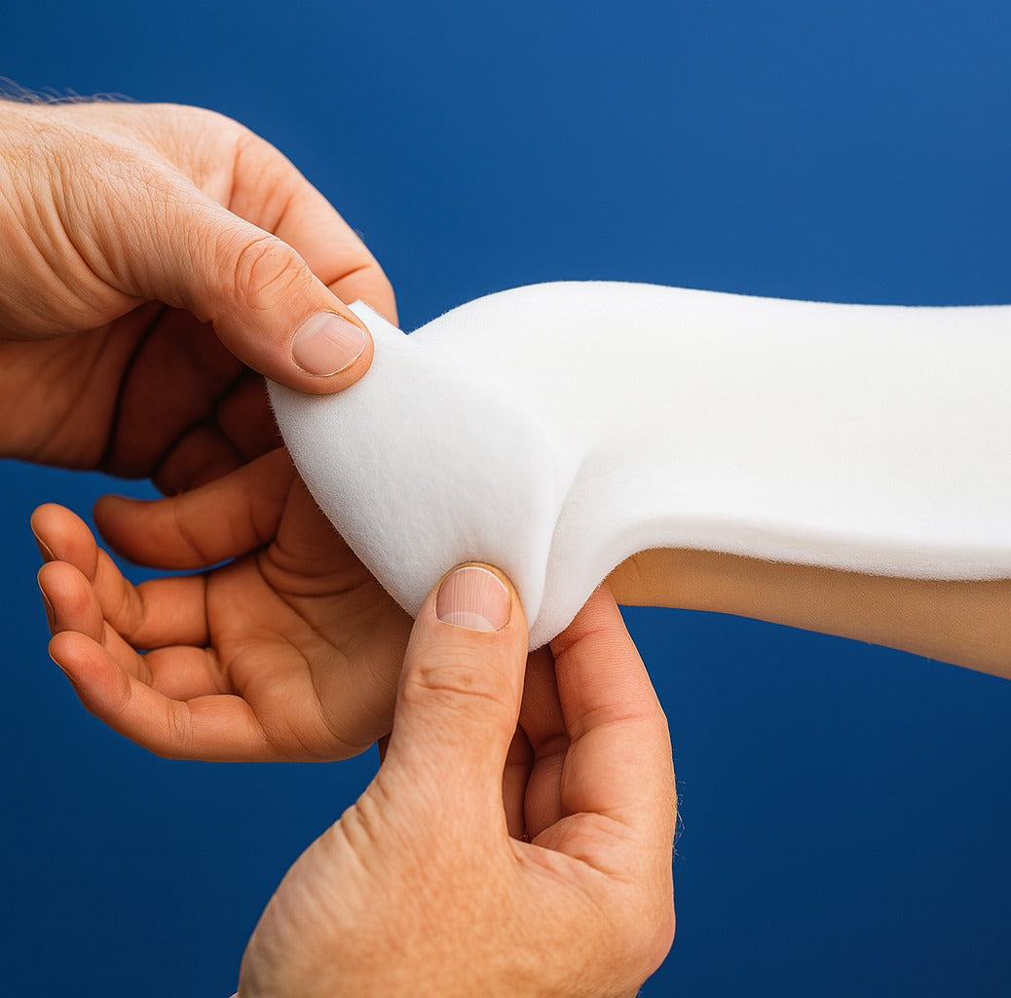
Fiberglass Splint

Slide 30
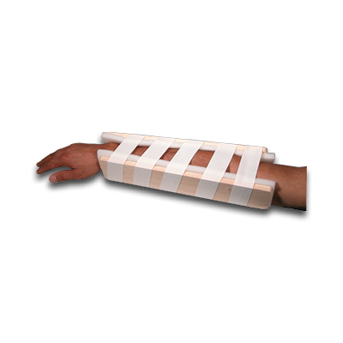
Wood splint

Slide 31
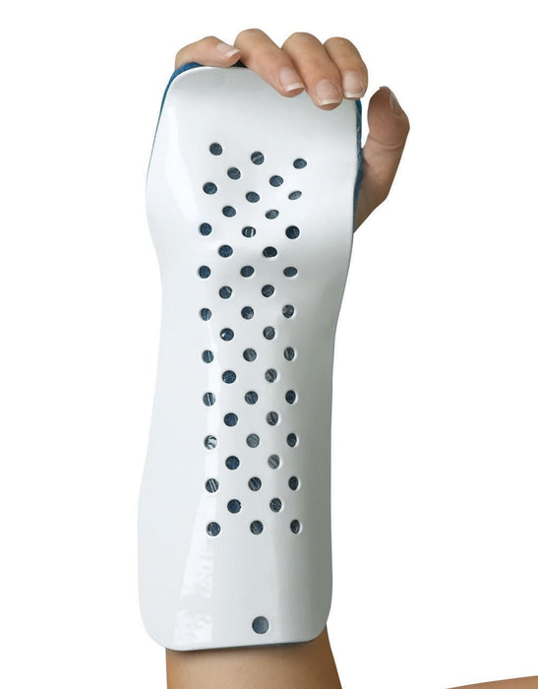
Aluminum Splint

Slide 32
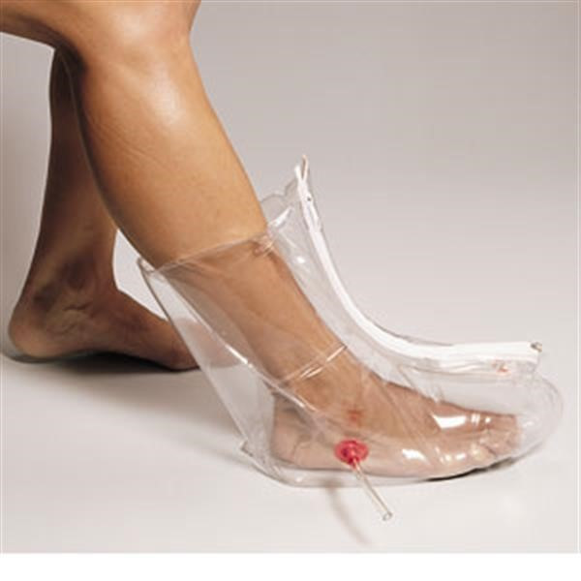
Air Splint

Slide 33
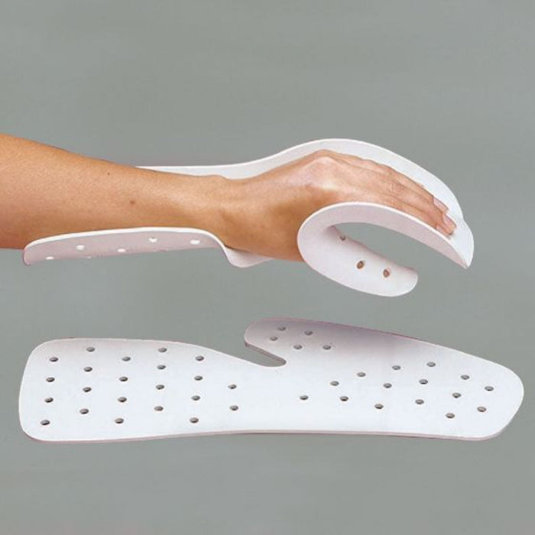
Plastic Splint

Slide 34
Trauma boards are rigid immobilization devices used in emergency and trauma settings to stabilize patients with suspected spinal or pelvic injury. These boards are typically constructed from dense plastic composites, carbon fiber, or reinforced polymer materials. The board remains beneath the patient during imaging. it lies within the primary beam path and increases overall attenuation and scatter production.
The presence of a trauma board results in additional photon absorption before the beam reaches the image receptor. This may produce a slightly underexposed image if technique factors are not adjusted. In most cases, a modest increase in mAs of approximately 10–25 percent is sufficient to compensate for the added attenuation. Larger increases are rarely necessary. Increasing kVp is generally discouraged because it reduces subject contrast, which is critical in trauma imaging for detecting subtle fractures and cortical disruptions.

Slide 35
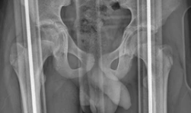
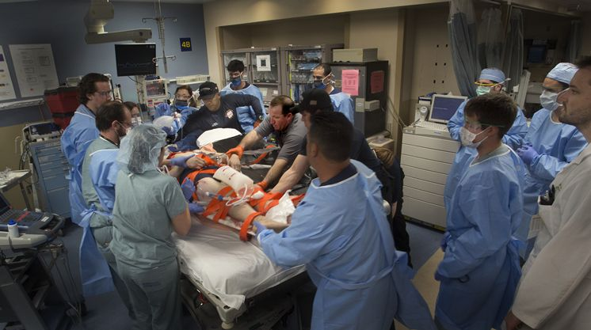
Trauma Board

Slide 36
Body habitus refers to the overall physique or build of an individual, including body shape, organ position, tissue thickness, and distribution of mass. In radiography, body habitus directly influences beam attenuation, organ positioning, field size selection, and exposure factor determination. Failure to account for body habitus may result in underpenetration, excessive exposure, or improper anatomical centering.
There are four recognized body habitus classifications:
Hypersthenic
Sthenic
Hyposthenic
Asthenic.
Each presents predictable anatomic and technical considerations that the radiographer must evaluate before selecting technique factors

Slide 37
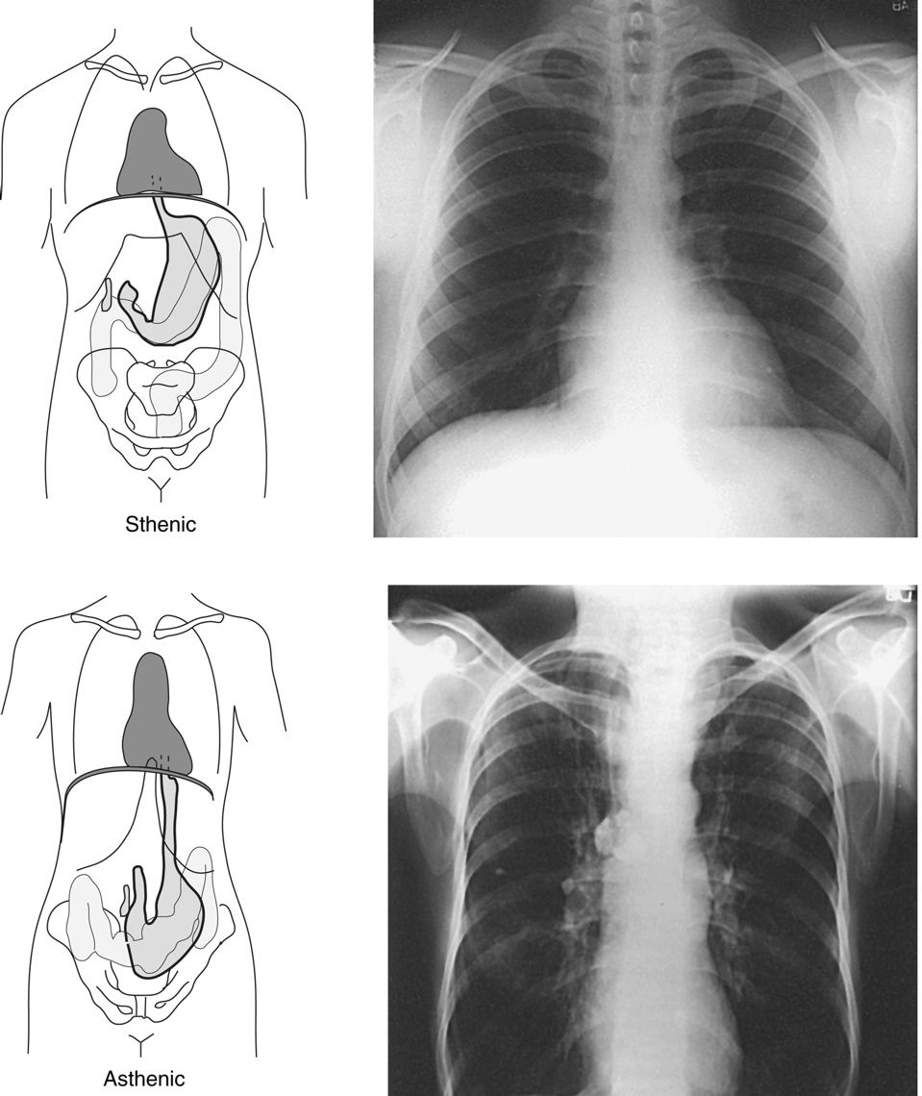
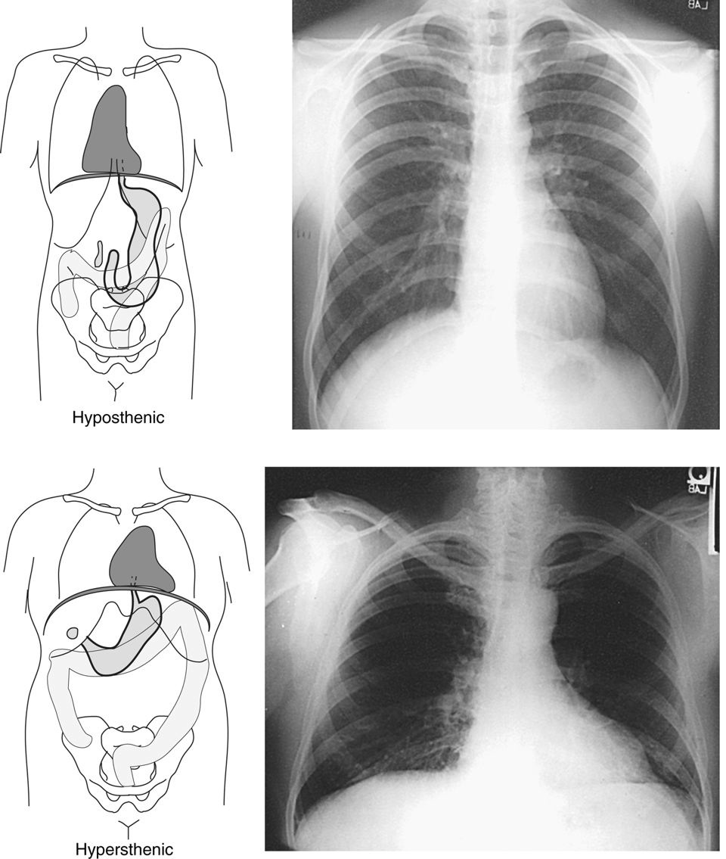

Slide 38
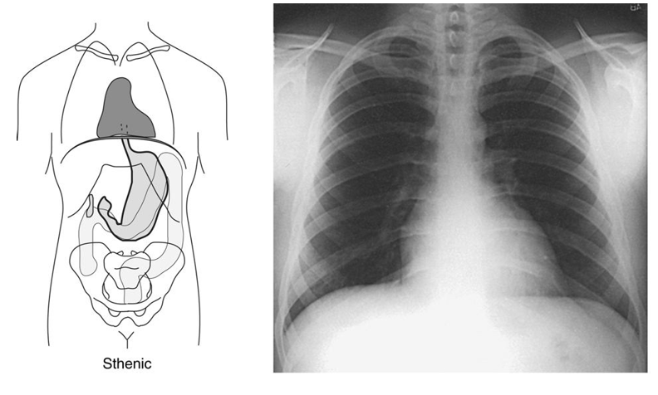
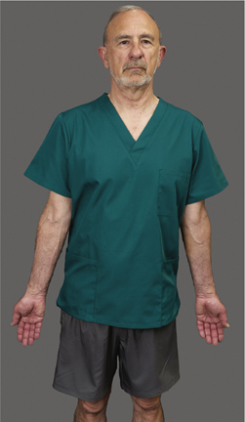
Sthenic Body Habitus
The sthenic body habitus represents the average body build and is observed in approximately 50 percent of the population. These patients typically have a balanced thoracic and abdominal cavity with moderate transverse and vertical dimensions. The stomach is positioned high and lies more transversely, and the diaphragm has a moderate curvature.
From a technical standpoint, standard technique charts are usually appropriate for sthenic patients. Only minimal modification of mAs or kVp is required, unless additional factors, such as pathology or trauma, are present.

Slide 39
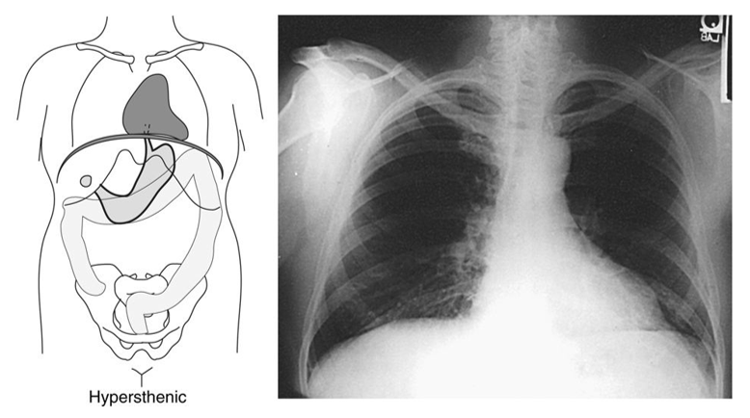
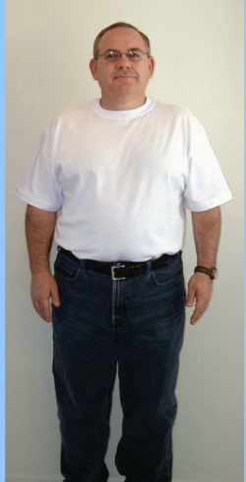
Hypersthenic Body Habitus
Hypersthenic patients have a massive build with increased transverse body diameter and shortened vertical length. The thorax is broad and deep, and the diaphragm is elevated. Abdominal organs are positioned higher and more laterally. The stomach lies high and horizontal.
In radiographic practice, these patients require increased exposure factors due to greater tissue thickness and increased attenuation. An increase in mAs is typically required, and in some cases a slight increase in kVp may be necessary to ensure adequate penetration. Grid use is essential in thicker body parts due to increased scatter production.

Slide 40
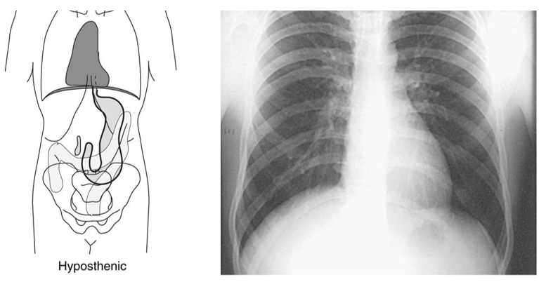
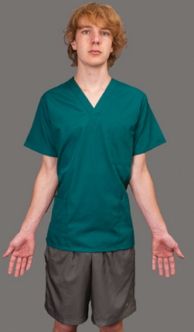
Hyposthenic Body Habitus
The hyposthenic body habitus falls between sthenic and asthenic types. These patients are slender with a somewhat longer thoracic cavity and lower diaphragm. The stomach tends to lie lower and more vertical than in sthenic individuals.
Technique modifications are generally minor. Slight reductions in mAs may be appropriate if tissue thickness is reduced. Organ positioning must be carefully considered when centering, particularly in abdominal imaging.

Slide 41
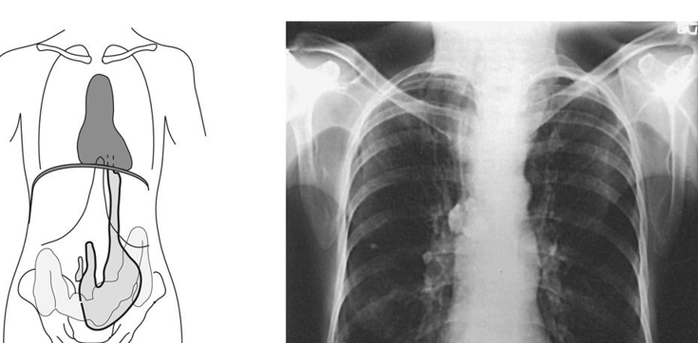
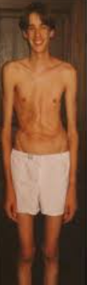
Asthenic Body Habitus
Asthenic individuals are extremely slender with a narrow thorax and elongated vertical body dimensions. The diaphragm is low, and abdominal organs are positioned lower in the cavity. The stomach is markedly vertical.
These patients typically require reduced exposure factors because of decreased tissue thickness. Failure to reduce mAs may result in overexposure in digital systems, contributing to dose creep. Precise centering is critical, as organs may lie lower than expected.

Slide 42
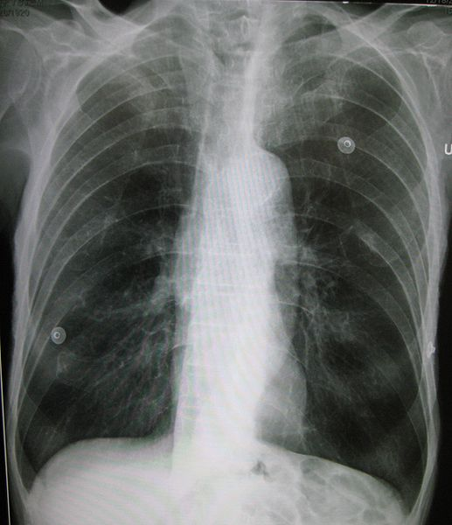
Pathology and Beam Attenuation
Pathologic processes alter the absorption characteristics of tissues and, therefore, change how the X-ray beam interacts with the body. Radiographic exposure technique must be modified whenever pathology changes tissue density, thickness, or composition. Failure to recognize these changes may result in under-penetration, loss of diagnostic detail, or unnecessary repeat exposures.
From a technical standpoint, pathologies are classified according to whether they increase or decrease the attenuation of the primary beam.

Slide 43
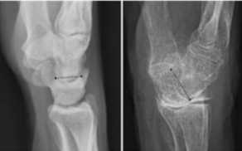
Additive vs Destructive Pathology
Pathologies alter radiographic technique because they change tissue density and beam attenuation. The conditions listed in this table are categorized based on whether they increase or decrease photon absorption.

Slide 44
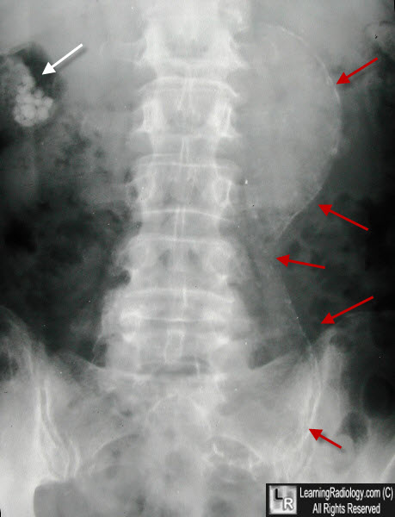
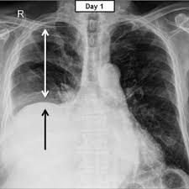


Abdomen - Additive
• Aortic aneurysm – increased soft tissue mass
• Ascites – free intraperitoneal fluid
• Cirrhosis – fibrotic changes
• Organ hypertrophy (hepatomegaly or splenomegaly) – increased organ size
Thoracic Aortic aneurysm
Hepatomegaly
Cirrhosis
Ascites

Slide 45





Chest Additive
• Atelectasis – collapsed lung tissue increases density
• Congestive heart failure – fluid overload
• Malignancy – mass effect
• Pleural effusion – fluid accumulation
• Pneumonia – consolidation
Aneurysm
Cirrhosis
Aneurysm
Pneumonia
Mass and Effusion
CHF

Slide 46



Skeleton Additive
• Hydrocephalus – increased intracranial fluid
Paget’s Disease
Osteopetrosis – excessive bone density
Osteopetrosis
Hydrocephalus
Paget’s Disease

Slide 47



Nonspecific Sites
• Abscess/infection
• Edema
• Sclerosis
Infection
Edema
Sclerosis

Slide 48
Destructive Conditions
Destructive conditions decrease tissue density or replace tissue with air.

Slide 49


Abdomen
• Bowel obstruction (gas distention)
• Free air
Obstruction
Free air/Pneumoperitoneum

Slide 50


Chest
• Emphysema – hyperinflated lungs
• Pneumothorax – air in pleural space
Emphysema
Pneumothorax

Slide 51


Skeleton
• Gout – bone erosion
• Osteoporosis – decreased bone mineral density
Gout
Osteoporosis

Slide 52


Nonspecific Sites
• Atrophy
• Emaciation
• Malnutrition
Malnutrition/Emaciation
Atrophy

Slide 53
We adjust kVp first (10%) because:
• Additive disease primarily affects penetration
• Destructive disease primarily reduces penetration need
mAs adjustments are secondary and fine-tuning.

Slide 54


Slide 55


