Slide 1
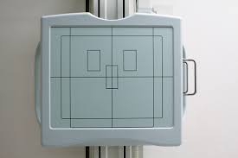
Automatic Exposure Control and Exposure Timers
Prof. Jarek Stelmark

Slide 2
Exposure Timing Controls
Definition:
Exposure timing refers to the duration that the X-ray tube remains energized and emits radiation during an exposure. It is typically measured in milliseconds (ms) or seconds (s).
Function:
The exposure time, combined with the tube current (mA), determines the total quantity of radiation produced, expressed as mAs (milliamperes × seconds).
Key Effects:
Receptor Exposure: Longer exposure time increases total photons reaching the image receptor.
Patient Dose: Directly proportional to time—doubling the time doubles the dose if mA remains constant.
Image Sharpness: Longer time increases the chance of motion blur, especially in mobile patients, chest, or abdomen studies.
Image Quality: Proper timing balances adequate exposure with minimal motion. Even slight differences (e.g., 0.01–0.02 s) can affect diagnostic quality, particularly in fast-moving anatomy.

Slide 3
Radiographer’s Role in Exposure Timing
Overview:
The radiographer is responsible for initiating the X-ray exposure, but the timing circuit precisely controls how long the X-ray tube remains energized. Once the preset exposure time is reached, the circuit automatically terminates the exposure, regardless of whether the technologist continues to press the switch.
Key Points:
The exposure switch must be held down for the duration of the exposure.
If released before the preset time, the system instantly terminates the exposure.
This automatic cutoff prevents continuous radiation emission and protects the patient from unnecessary dose.
It also protects the x-ray tube from overheating and excessive wear.
Modern systems include backup timers and fail-safe mechanisms that stop the exposure even in case of a timing malfunction.

Slide 4
The Guard Timer
Definition:
The guard timer is an independent fail-safe circuit that automatically terminates an exposure if the primary timing circuit malfunctions. It prevents continuous irradiation from a stuck switch or electrical failure.
Typical Setting:
Usually preset to a maximum of about 6 seconds, regardless of the selected exposure time.
In automatic exposure control (AEC) systems, the guard timer also serves as a backup to terminate exposure if the detector fails to respond correctly.
Regulatory Requirement:
Federal and state safety codes require all diagnostic X-ray units to include a fail-safe timer to protect both the patient and the equipment.
Maximum Values:
The maximum exposure time allowed by the guard timer is typically 6 seconds (or 6000 ms).
The maximum mAs limit varies by equipment. Still, it is often set between 600 and 800 mAs for most diagnostic radiography units.

Slide 5
Transition to Automatic Exposure Control (AEC)
Overview:
With Automatic Exposure Control (AEC), the radiographer no longer needs to manually set exposure time. Instead, the system automatically determines when the image receptor has received enough radiation.

Slide 6
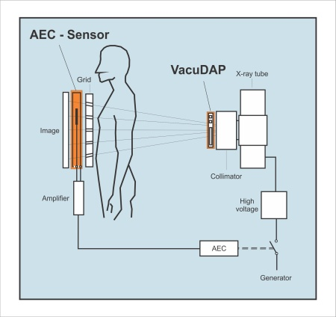
Automatic Exposure Control (AEC)
With Automatic Exposure Control (AEC), the radiographer no longer needs to manually set exposure time. Instead, the system automatically determines when the image receptor has received enough radiation.

Slide 7
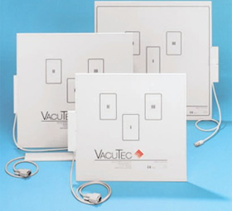
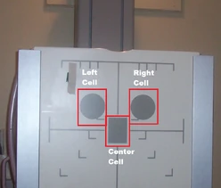
How It Works:
AEC uses one or more ionization chambers or solid-state detectors placed between the patient and the image receptor. These detectors measure the intensity of x-rays that pass through the patient in real time.
When the accumulated signal equals the preset optimal exposure level, the AEC circuit instantly terminates the exposure.

Slide 8
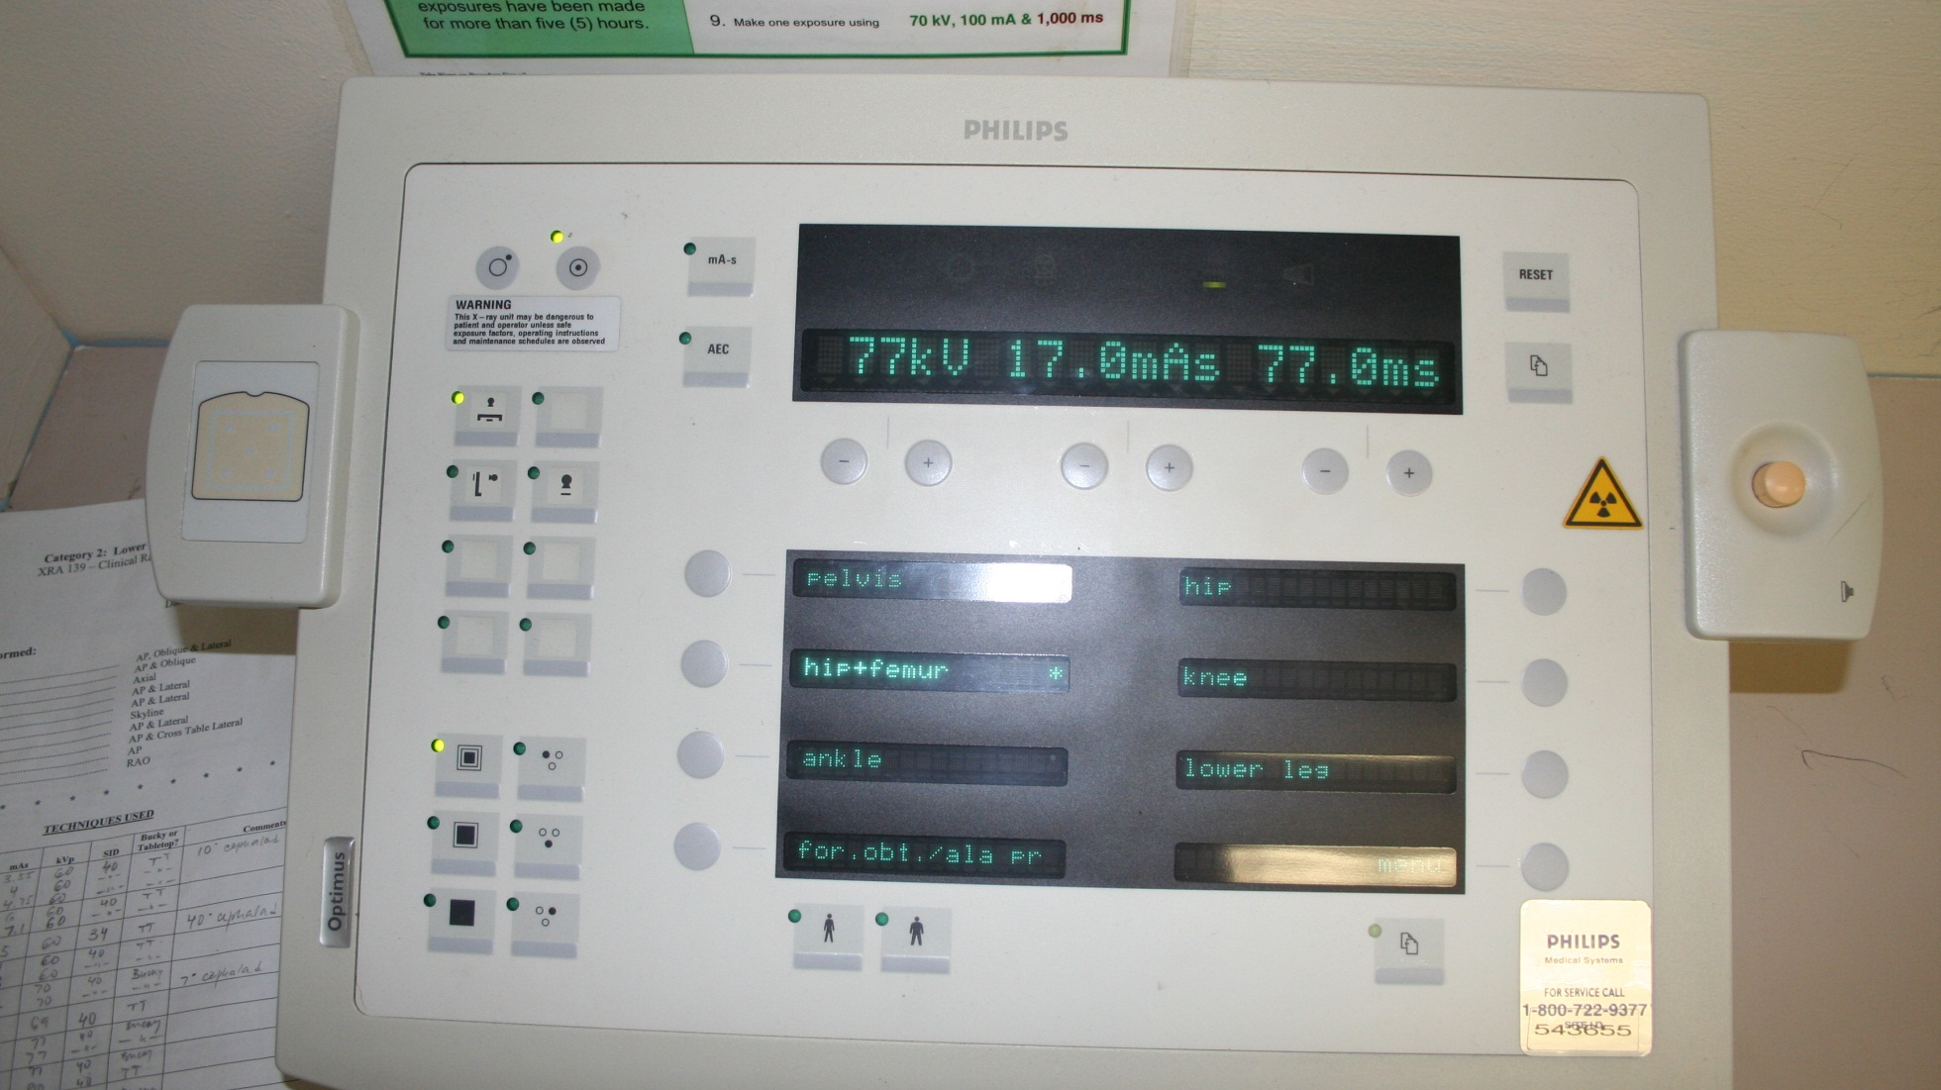

Slide 9
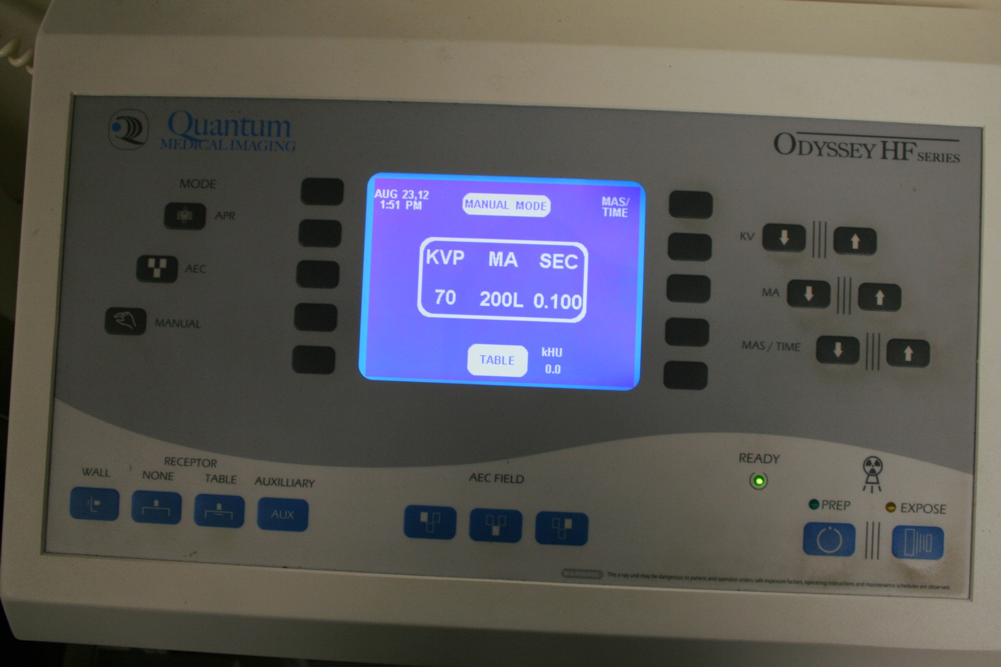

Slide 10
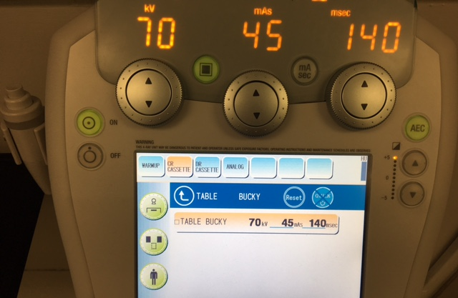

Slide 11
Key Advantages:
Ensures consistent image receptor exposure despite patient size or anatomy differences.
Reduces repeat exposures and helps maintain consistent image quality.
Minimizes patient dose by avoiding unnecessary radiation.
Protects the x-ray tube from overheating due to overexposure.

Slide 12
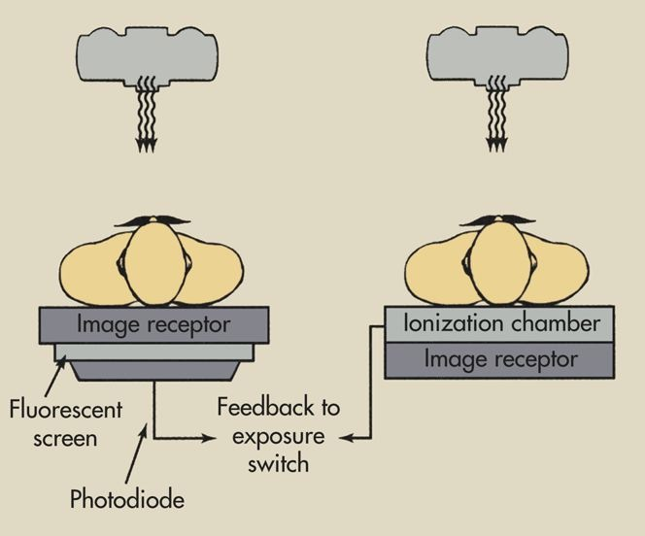
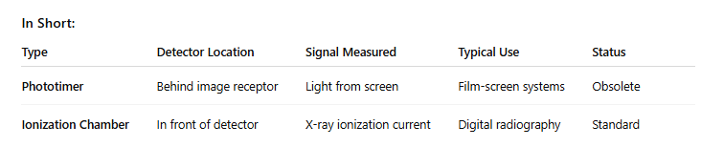
Types of Automatic Exposure Control (AEC)
AEC systems have evolved through two main designs: Phototimers and Ionization Chamber Systems.

Slide 13
Phototimer (Photomultiplier Tube System – Older Type)
Located behind the image receptor (film or cassette).
X-rays first strike the image receptor, then light emitted from the intensifying screen passes to a photomultiplier tube or photodiode.
When the light signal reaches a preset amount, the circuit terminates the exposure.
Limitation: Cannot be used with modern digital detectors because the sensor is positioned behind the image receptor.
Historical use: Common in film-screen radiography.
Summary:
Measures light exiting the image receptor → converts it to an electrical signal → stops exposure.

Slide 14
The phototimer is called an exit-type AEC because the detector is positioned behind the image receptor, so it measures the radiation that exits the receptor after passing through the patient and cassette.
In other words, the X-rays exit the image receptor before reaching the detector, which is why it’s termed exit-type

Slide 15
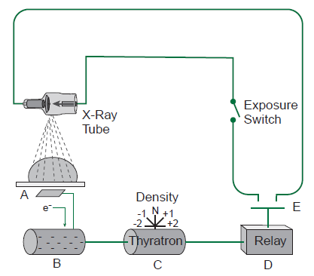
Ionization Chamber Type (Modern Type)
Located in front of the image receptor (between the grid and detector).
X-rays ionize gas within the chamber, generating an electrical current proportional to exposure.
When the collected charge reaches the preset value, the system ends the exposure.
Advantages: Works with digital detectors, reusable, and allows for multiple selectable cells (center, left, right).
Current standard in all modern radiographic systems

Slide 16
The ionization chamber type is called an entrance-type AEC because the detectors are positioned in front of the image receptor, between the patient and the detector.
That means the system measures the radiation as it enters the chamber before it reaches and exposes the image receptor, which is why it’s referred to as entrance-type.

Slide 17
Ionization Chambers
Overview:
Most modern AEC systems use ionization chambers as their detectors. These are flat, gas-filled cells positioned in front of the image receptor (between the patient and the detector), making them an entrance-type AEC design.
How They Work:
As X-rays pass through the patient and enter the chambers, they ionize the gas molecules inside. This ionization creates an electrical current directly proportional to the amount of radiation received. The AEC circuit continuously monitors this current, and when it reaches the preset value corresponding to the desired receptor exposure, it automatically terminates the exposure.
Advantages:
Fast response — provides real-time monitoring and termination.
Stable and reliable — unaffected by detector aging or temperature.
Reusable — requires no film or light conversion process.
Compatible with digital imaging — ideal for CR and DR systems.
Selectable chambers — typically three (left, center, right) to accommodate different anatomy.

Slide 18
Comparing Phototimers and Ion Chambers
Phototimers rely on the conversion of visible light and are more complex and maintenance-sensitive. Ionization chambers, in contrast, directly measure X-ray ionization in air, making them faster, less prone to failure, and ideal for modern DR systems

Slide 19
Technologist Knowledge Is Essential
Key Principle:
Automatic Exposure Control (AEC) simplifies exposure selection but does not replace professional judgment. The system only measures radiation at the active detector cells. It cannot recognize anatomy, positioning errors, or collimation mistakes.
Critical Points:
AEC cannot think for you. It follows physics, not anatomy.
If the anatomy is mis-centered, or the wrong detector chamber is activated, the exposure may terminate too early (underexposure) or too late (overexposure).
Improper collimation can also mislead the AEC by including excess air or excluding key anatomy, altering the detected signal.
The technologist must ensure correct positioning, detector selection, and field size before activating AEC.
Professional skill and anatomical knowledge remain the foundation of high-quality imaging.

Slide 20
A
B
C

Slide 21
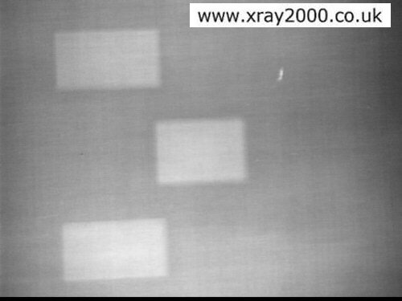

Slide 22
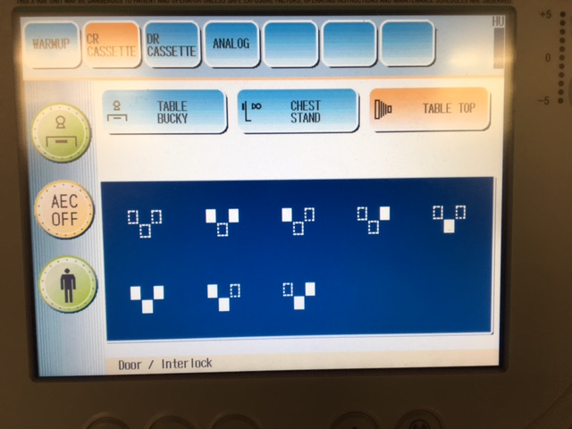

Slide 23
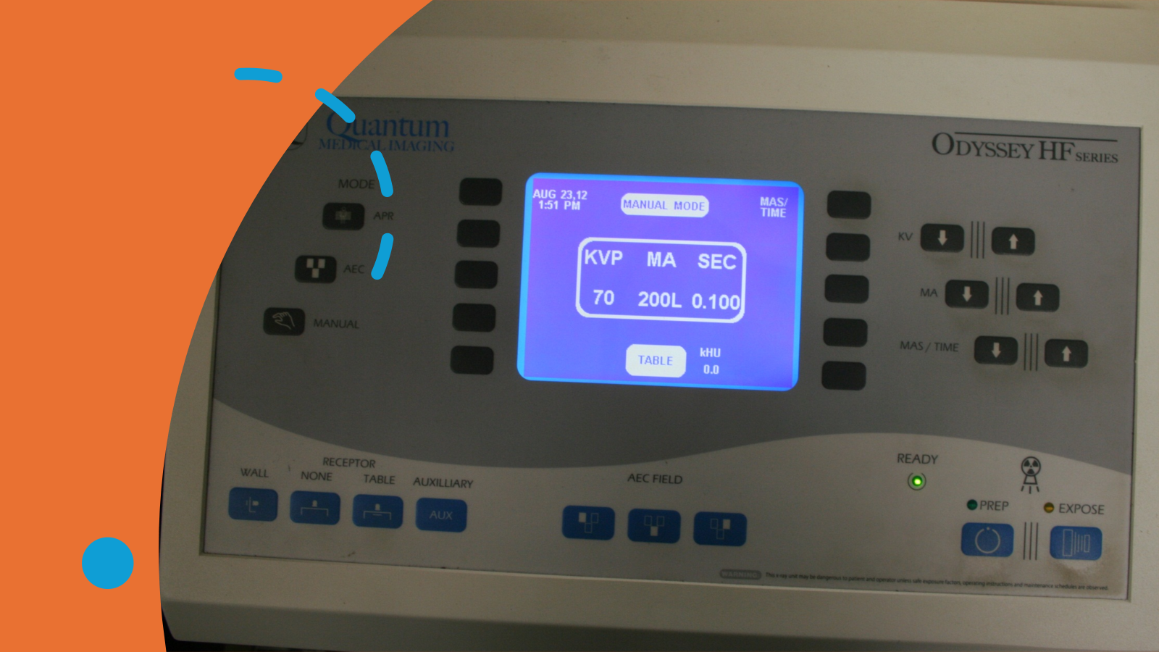
Detector Selection
Most AEC units have three chambers (left, center, right). The technologist can activate any combination. The exposure is typically averaged, but the chamber receiving the most radiation has the greatest influence on termination.

Slide 25
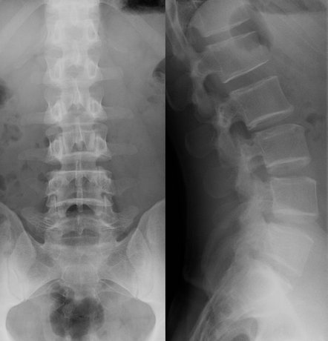
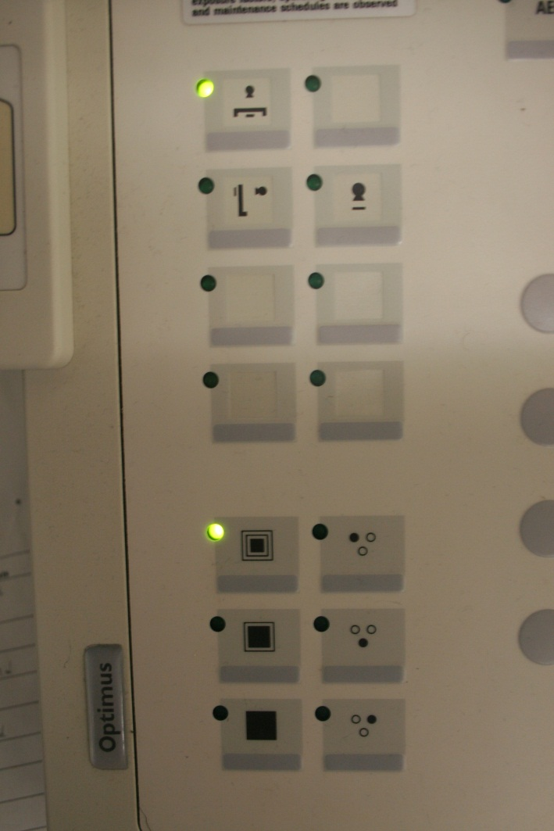

Slide 26
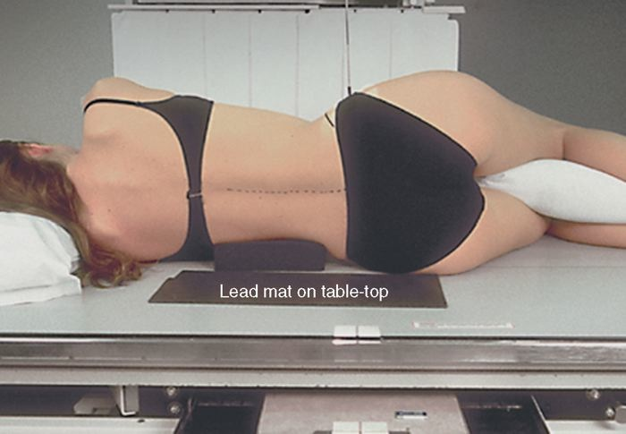

Slide 27
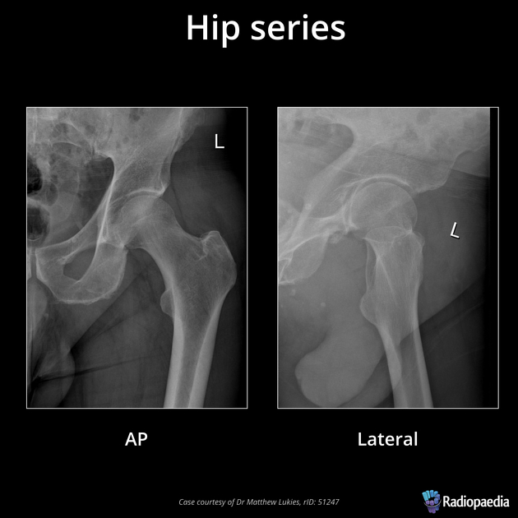



Slide 28
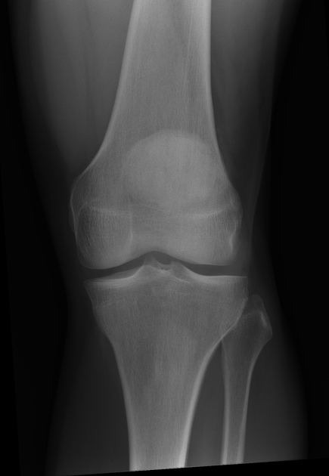

Slide 29
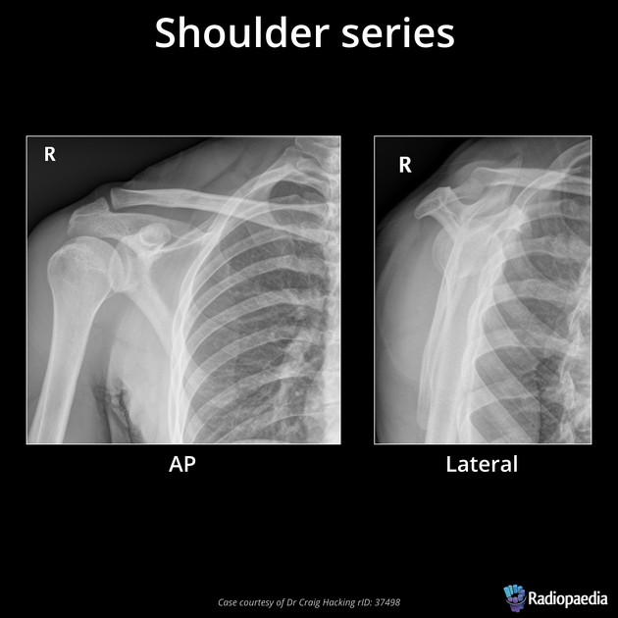
?

Slide 30
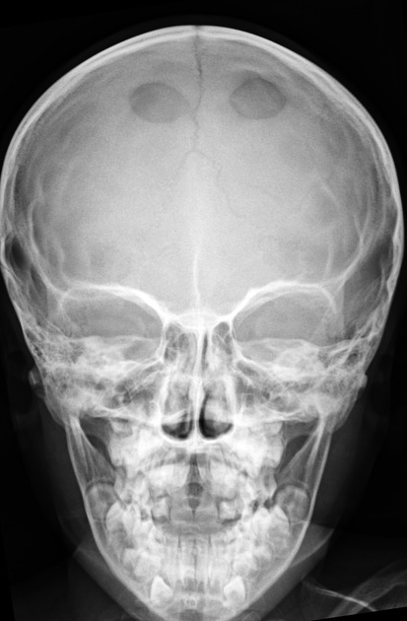

Slide 31
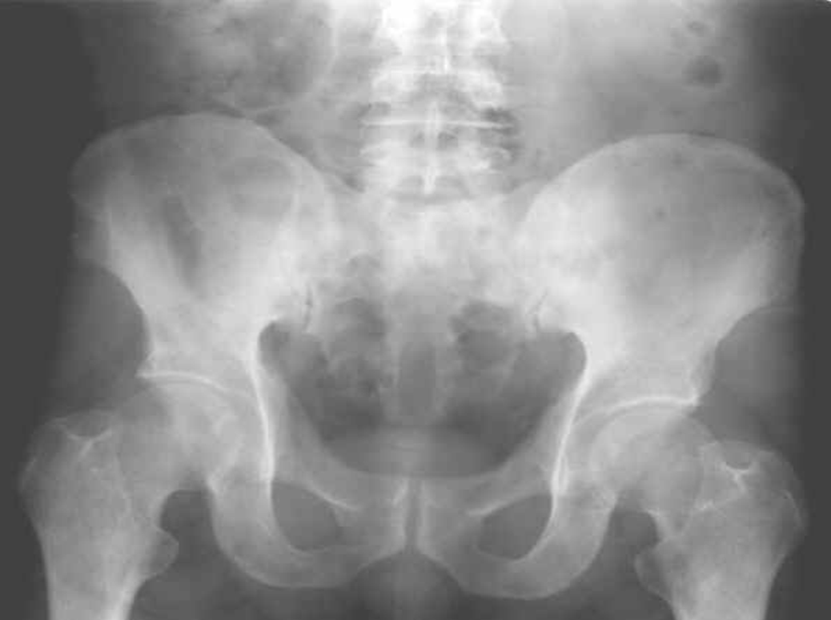
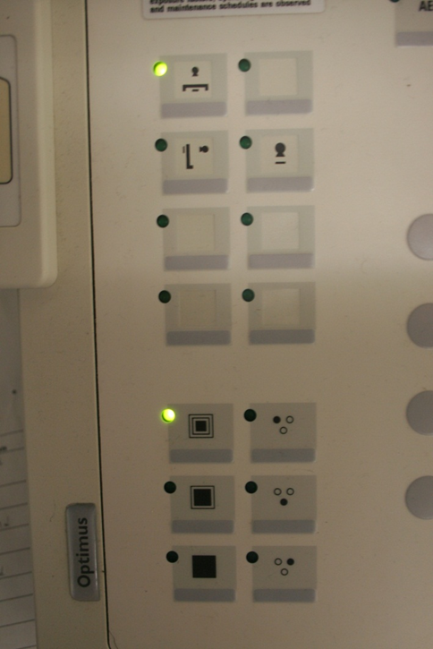


Slide 32
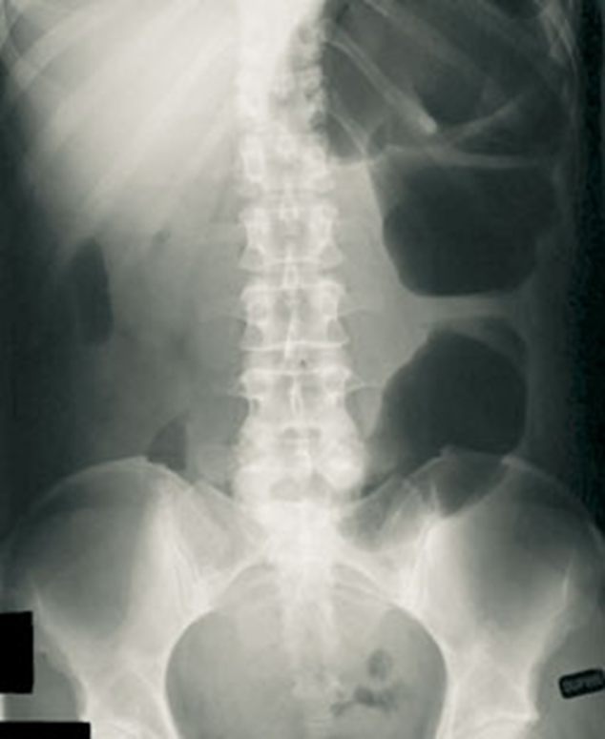


Slide 33
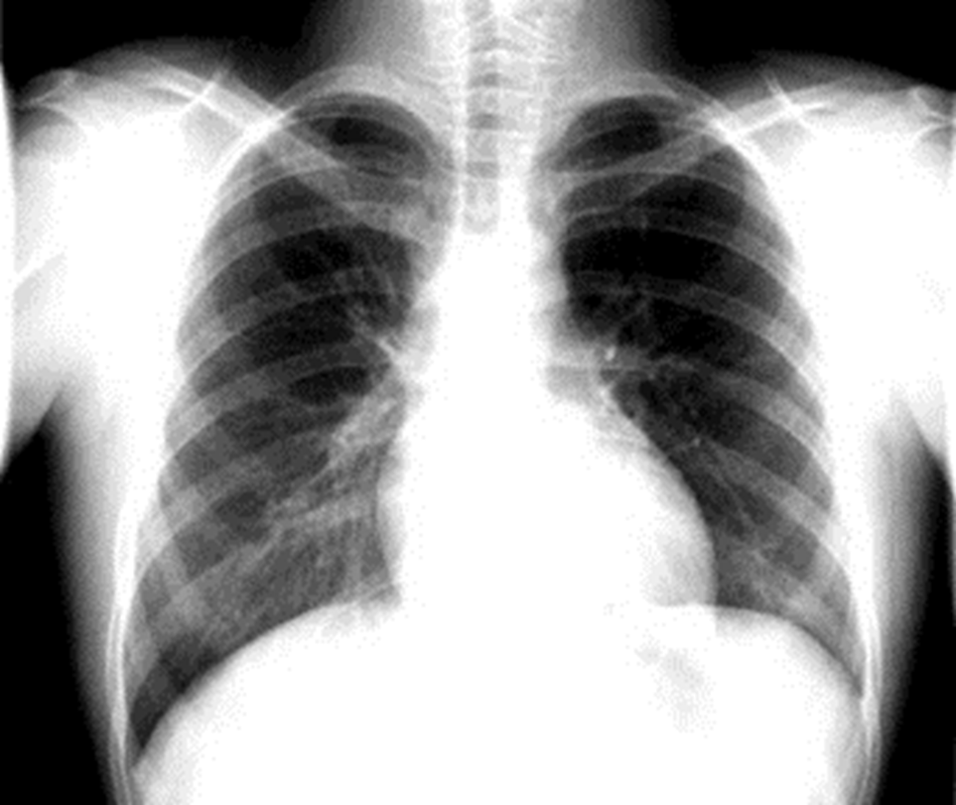


Slide 34
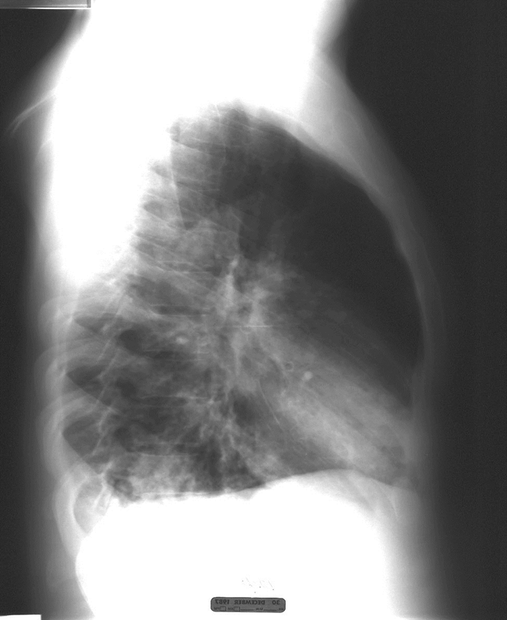
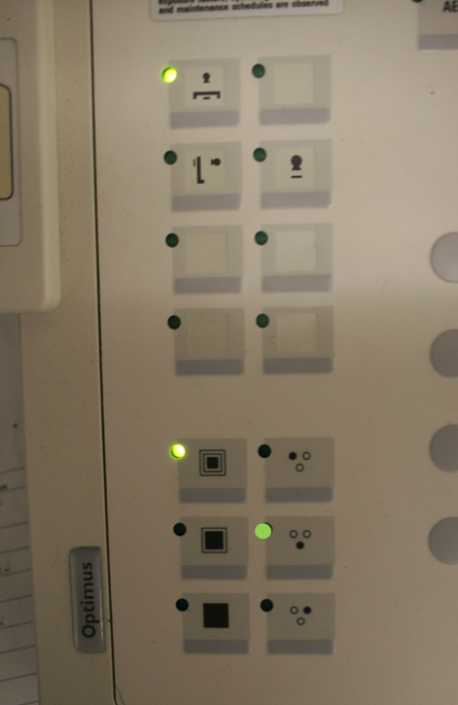


Slide 35
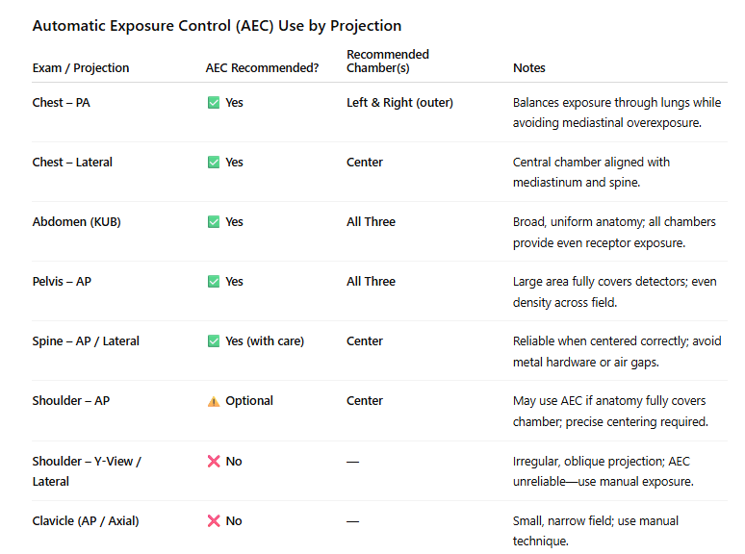

Slide 36
