Slide 1
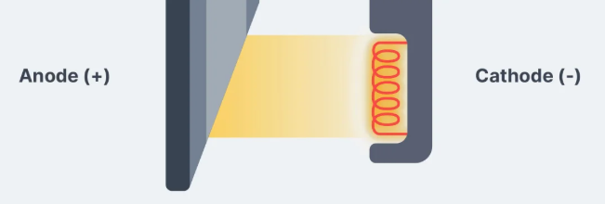
kVp
Prof. Jarek Stelmark
Hostos Community College – The City University of New York

Slide 2
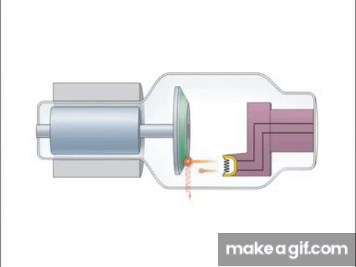
Kilovoltage
When the kVp is increased at the control panel, a larger potential difference occurs in the x-ray tube, giving more electrons the kinetic energy to produce x-rays and increasing the kinetic energy overall. The result is more photons (quantity) and higher energy photons (quality).

Slide 3
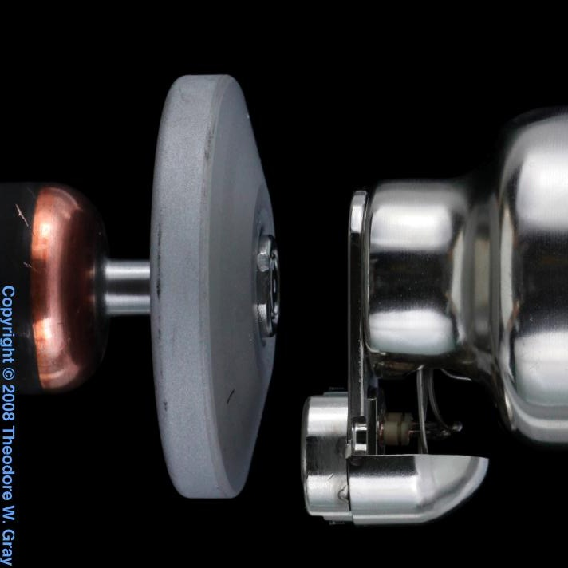
30 – 150 kVp
kV

Slide 4
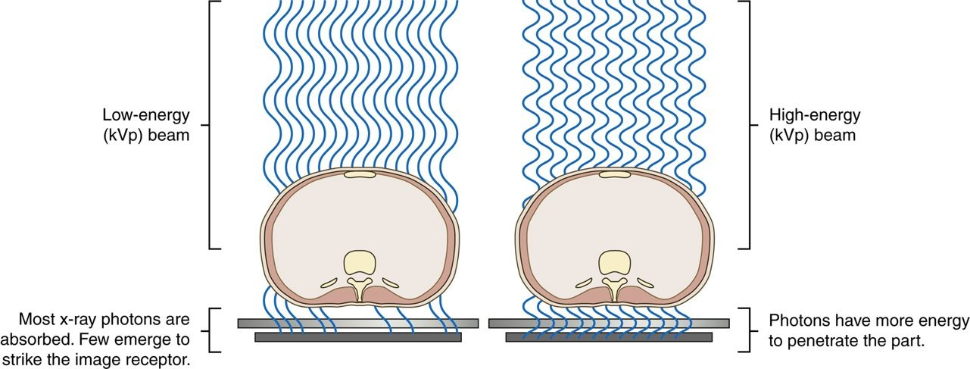
The kVp affects the exposure to the IR because it alters the amount and penetrating ability of the x-ray beam.
Altering the penetrating power of the x-ray beam affects its absorption and transmission through the anatomic tissue being radiographed. Higher kVp increases the penetrating power of the x-ray beam and results in less absorption and more transmission in the anatomic tissues

Slide 5
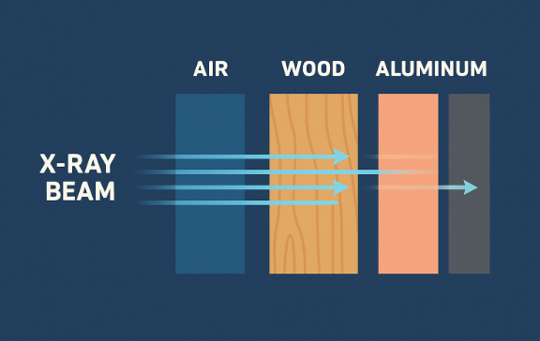
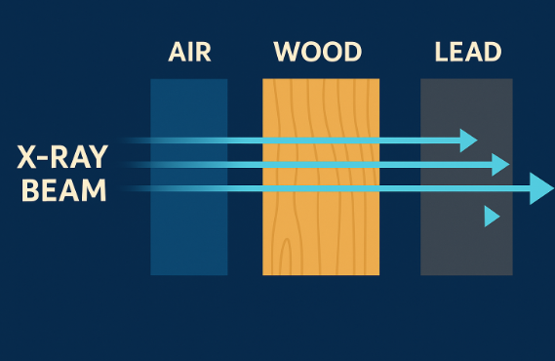
Low kVp
High kVp

Slide 6
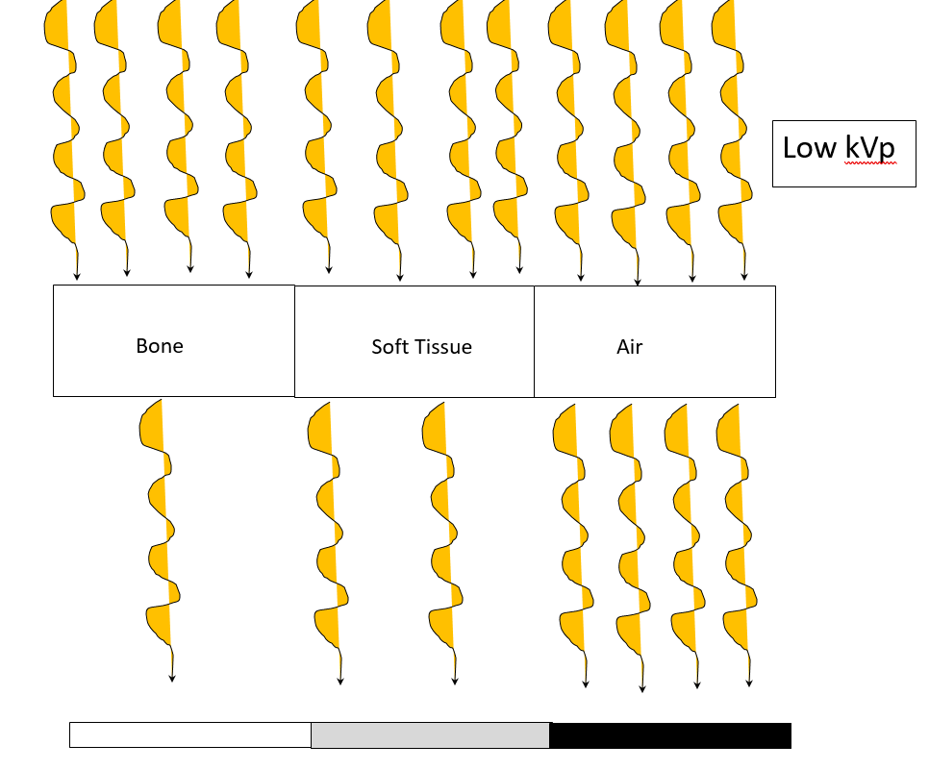

Slide 7
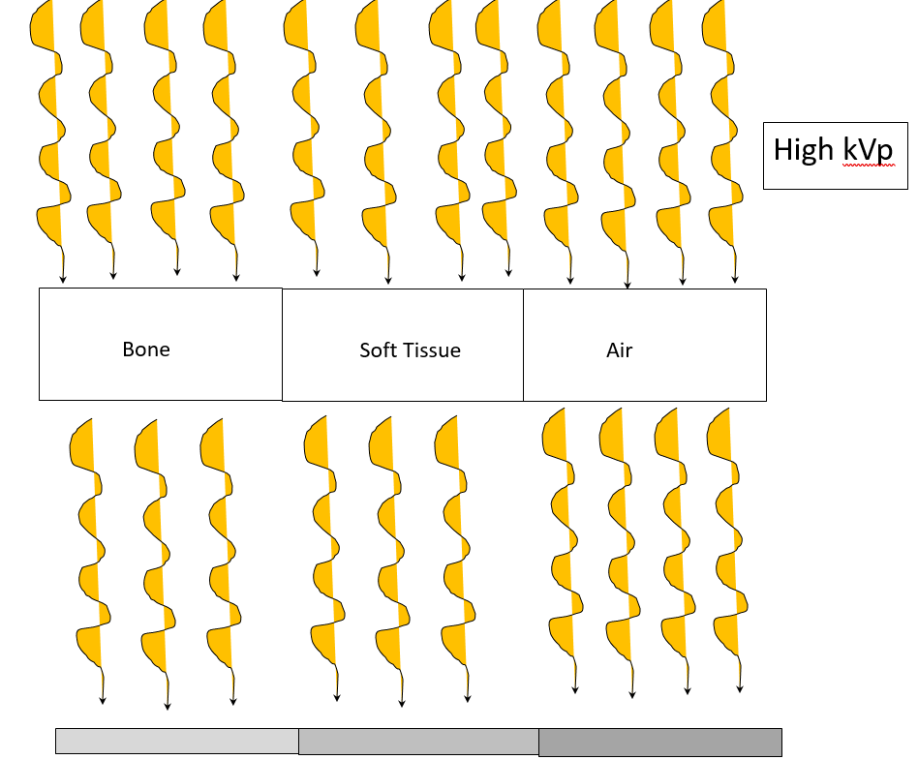

Slide 8
kVp (kilovoltage peak) indeed controls both the quality and quantity of the X-ray beam:
Quality (Beam Energy and Penetrability): Increasing kVp raises the energy of the X-ray photons, which enhances their ability to penetrate tissues.
Quantity (Number of X-rays Produced): Although mAs is the primary factor controlling the quantity of X-rays, kVp also affects it. As kVp increases, the efficiency of X-ray production improves, generating more photons. This is why even a modest increase in kVp can significantly increase exposure to the image receptor.
kVp adjustments have a compounded effect: they change the penetrating power of the beam (quality) and the number of photons generated (quantity), impacting both image contrast and patient dose

Slide 9
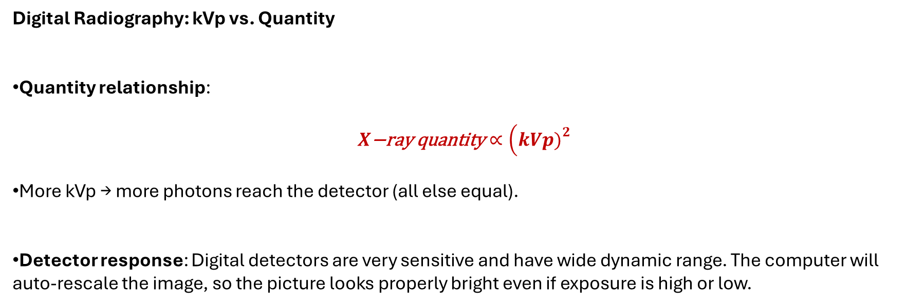
Digital Radiography: kVp vs. Quantity
Quantity relationship:
$$X\text{−}\text{ray} \text{quantity}∝\left(kVp{\left.)\right.}^{2}\right.$$
More kVp → more photons reach the detector (all else equal).
Detector response: Digital detectors are very sensitive and have wide dynamic range. The computer will auto-rescale the image, so the picture looks properly bright even if exposure is high or low.

Slide 10
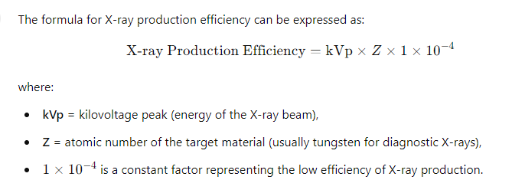
80 kVp x 74 x 10⁻⁴ = 0.592% x rays produced
100 kVp x 74 x 10⁻⁴ = 0.74% x rays produced
150 kVp x 74 x 10⁻⁴ = 1.11% x rays produced

Slide 11
Kilovoltage
The area of interest must be adequately penetrated before the mAs can be adjusted to produce a quality radiographic image. When adequate penetration is achieved, further increasing the kVp results in more radiation reaching the IR. Unlike mAs, the kVp affects the amount of radiation exposure to the IR and radiographic contrast.
Determine the correct kVp
Minimum kVp ( single phase) = [part thickness (cm) x 2] + 30 kVp
Minimum kVp ( Triple phase) = [part thickness (cm) x 2] + 25 kVp
kVp is the controlling factor of radiographic contrast but WW is the main controlling factor

Slide 12

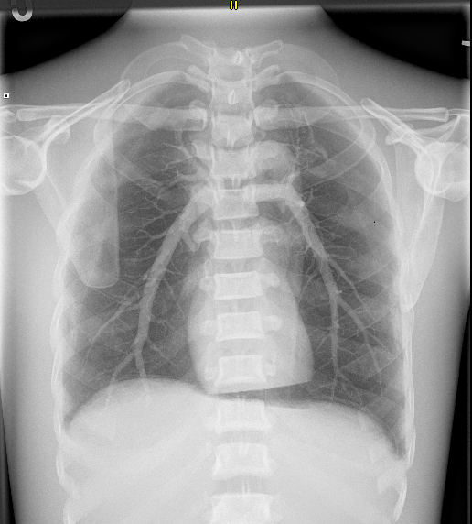
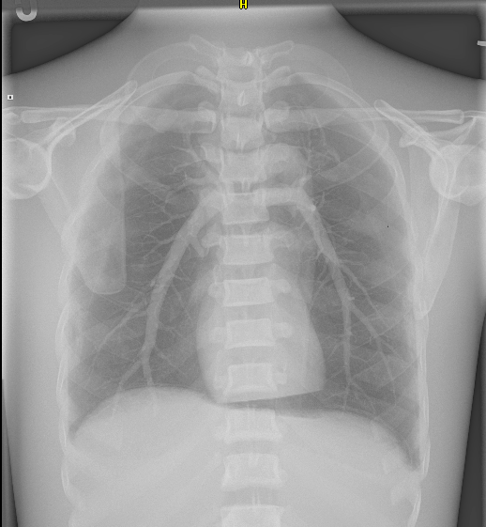
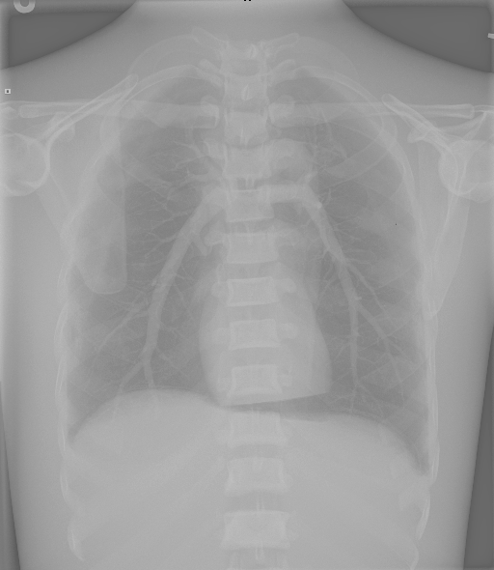
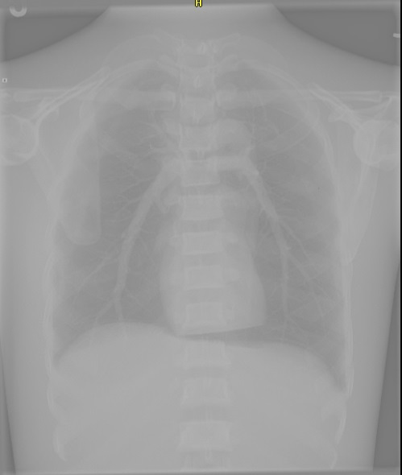
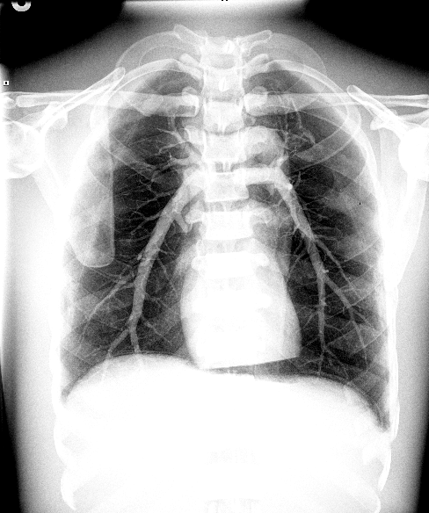
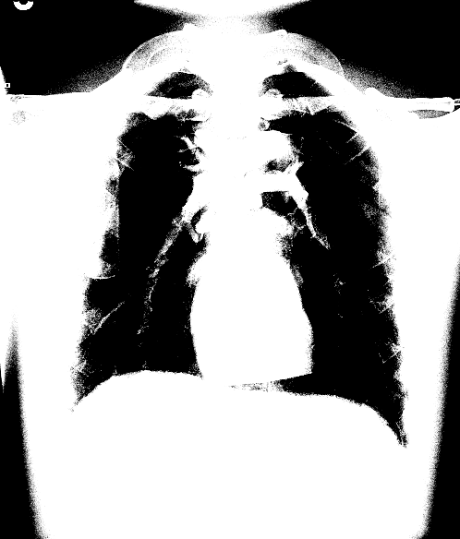
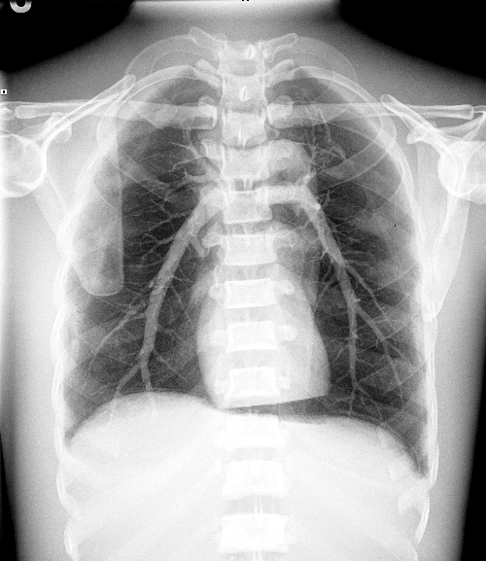
WW 40
WW 60
WW 80
WW 100
WW 40
WW 30
WW 20
WW 10

Slide 14
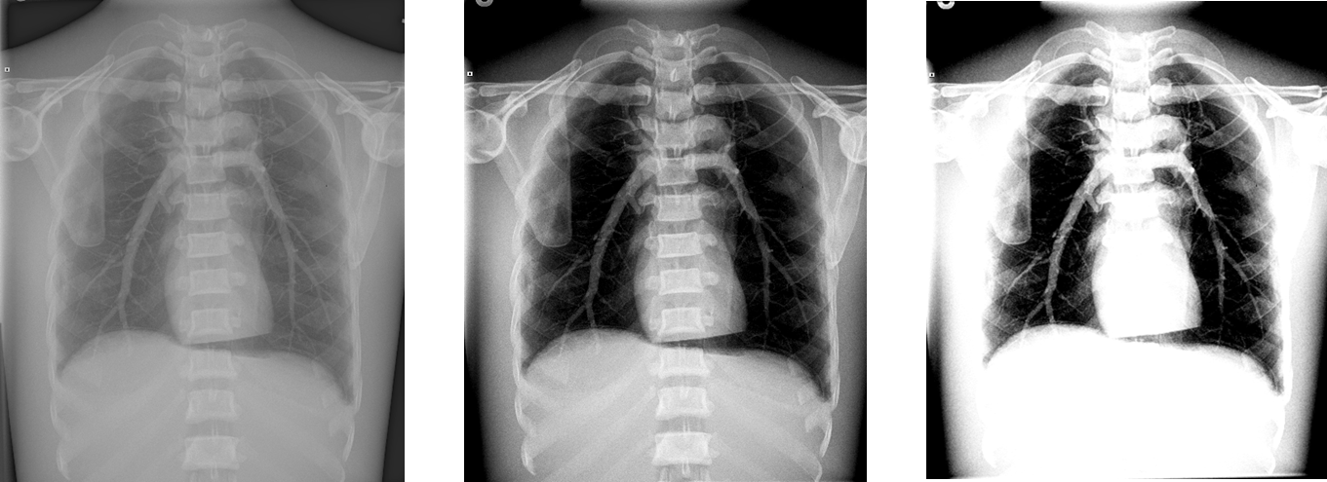
A high kVp results in less absorption and more transmission in the anatomic tissues, which results in less variation in the x-ray intensities exiting the patient (remnant), producing a low-contrast (long-scale) image. A low kVp results in more absorption and less transmission in the anatomic tissues, but with more variation in the x-ray intensities exiting the patient, resulting in a high-contrast (short-scale) image.

Slide 15
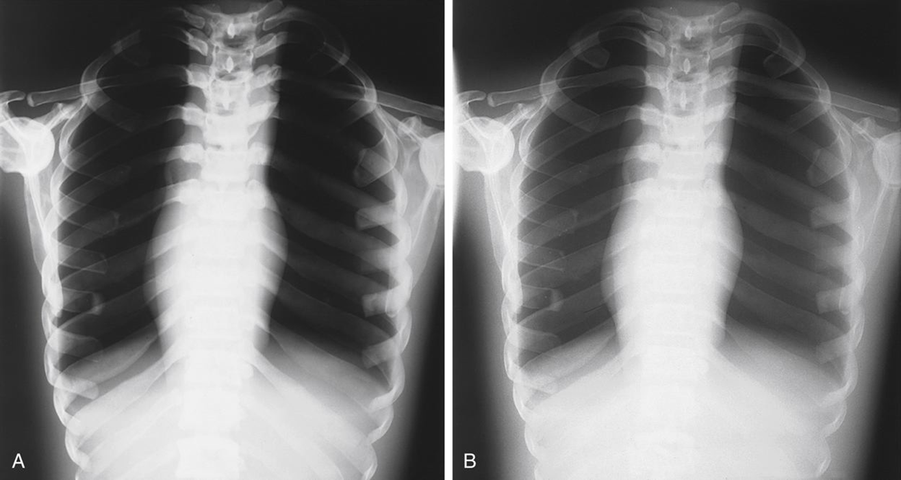
Low kVp
High kVp
High Contrast
Low Contrast

Slide 16
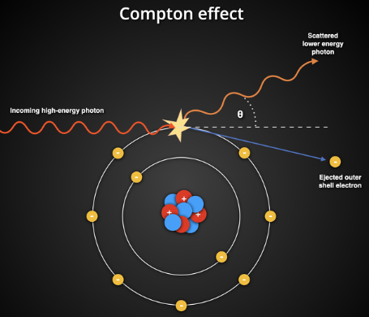
The Compton interaction, or Compton scattering, is a process in radiology and physics where an incoming X-ray photon collides with an outer shell electron in an atom, causing the photon to lose energy and change direction. When this happens, the electron is ejected from the atom (now called a recoil electron), and the scattered photon continues in a new direction with reduced energy.

Slide 17
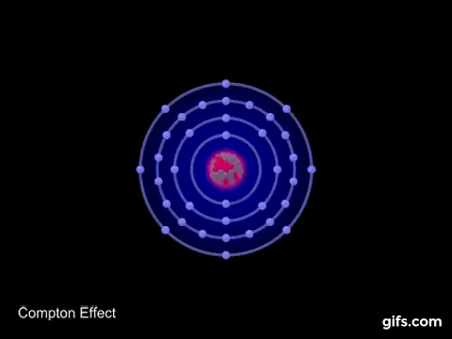

Slide 18
This interaction is significant in medical imaging because:
Image Quality: Compton scattering produces scatter radiation, which can degrade image contrast and visibility of detail.
Radiation Dose: It contributes to the OCUPATIONAL radiation dose.
Safety Concerns: Scatter radiation poses potential exposure risks to radiology staff.
Compton interactions are more common at higher photon energies, making them particularly relevant in X-ray and CT imaging, where managing scatter is essential for clear images and safety.

Slide 19
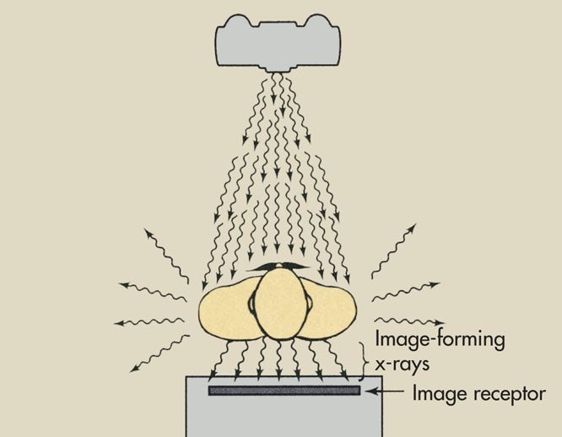
Even under the most favorable conditions, most remnant x-rays are scattered.
If the radiographs were taken with only scatter radiation and no transmitted x-rays reached the image receptor, the image would be dull gray. The radiographic contrast would be very low.

Slide 20
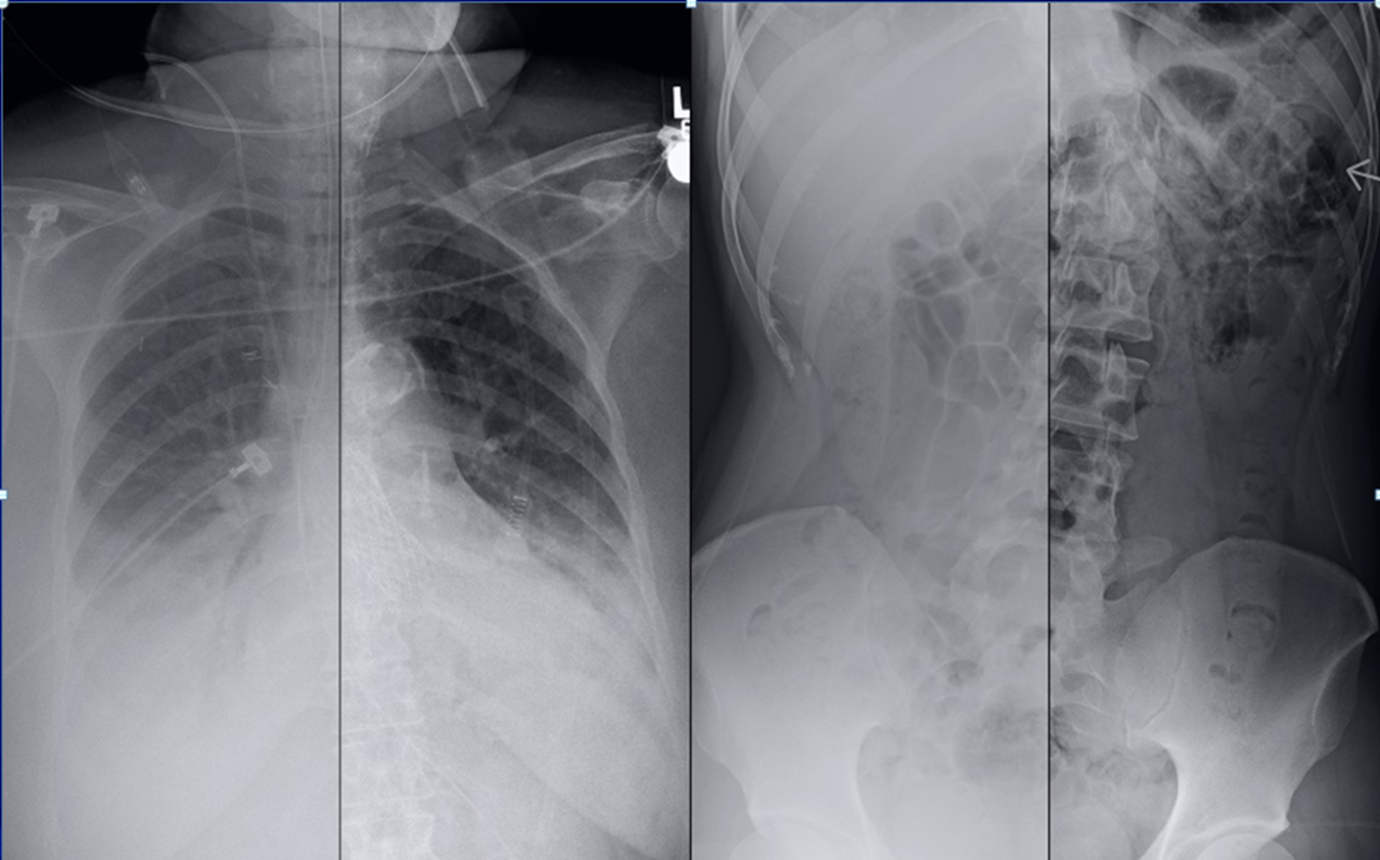
1
2
3
4

Slide 21
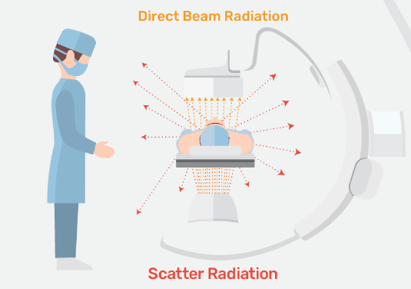

Slide 22
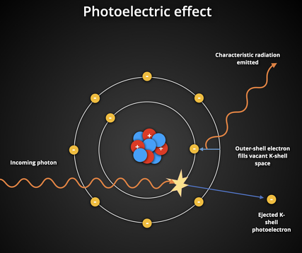
The photoelectric interaction, or photoelectric effect, is a type of interaction that occurs when an X-ray photon collides with an inner shell electron (typically K or L shell) in an atom. In this process, the photon is fully absorbed, and its energy is transferred to the electron, which is then ejected from the atom. This ejected electron is called a photoelectron.

Slide 23
Here’s a breakdown of what happens:
Absorption and Ejection: The incoming photon’s energy must be equal to or greater than the binding energy of the inner shell electron. If it meets this threshold, the photon is fully absorbed, and the electron is ejected from its shell, creating an ionized atom.
Characteristic Radiation: To fill the vacancy left by the ejected electron, an electron from an outer shell drops into the inner shell. As it does, the energy difference is released, often as secondary (characteristic) X-ray photons, which can be absorbed nearby, adding to the patient's dose.
Dose Contribution: Because the photon is fully absorbed during this interaction, the photoelectric effect is the primary contributor to patient dose. It’s especially significant in imaging tissues with high atomic numbers (like bones or contrast media), where more absorption occurs, leading to clearer images and better contrast.

Slide 24
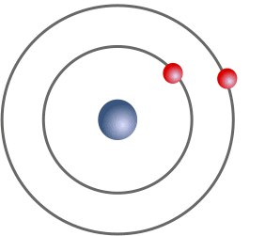

Slide 25
