Slide 1
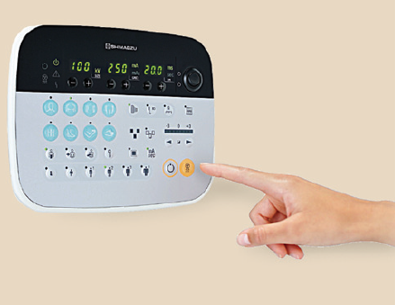
Understanding Exposure Timing: Collimation ,SID, and Patient Size
Prof. Jarek Stelmark
Hostos Community College – The City University of New York

Slide 2
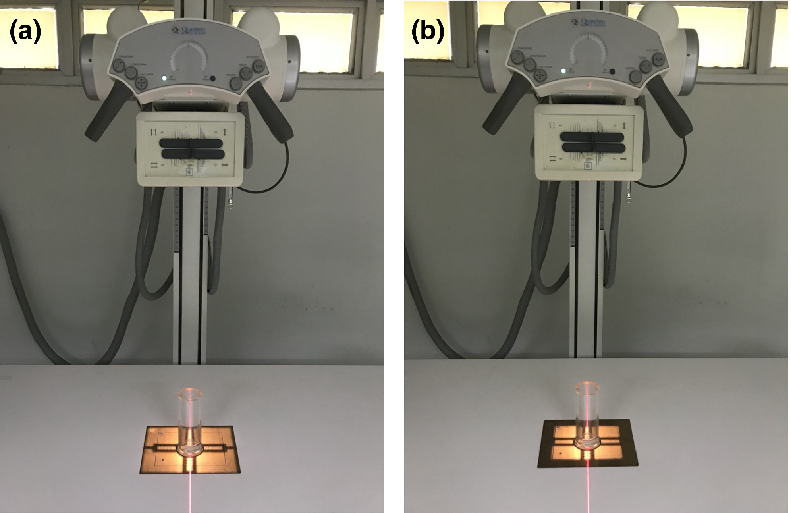
FINAL EFFECTS OF COLLIMATION (AEC)
More collimation
AEC chamber gets less scatter.
Not enough radiation reached the detector.
It keeps the exposure on longer.
EI stays the same because AEC will reach the correct level.
SNR stays the same because EI is unchanged.
Contrast goes up because scatter is reduced.
Patient dose goes down because the exposed area is smaller.
Less collimation
AEC chamber gets more scatter.
The detector received more radiation.
It stops the exposure earlier.
EI stays the same.
SNR stays the same.
Contrast goes down due to more scatter.
Patient dose increases because a larger area is irradiated.

Slide 3
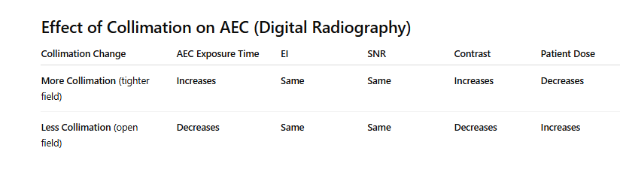

Slide 4
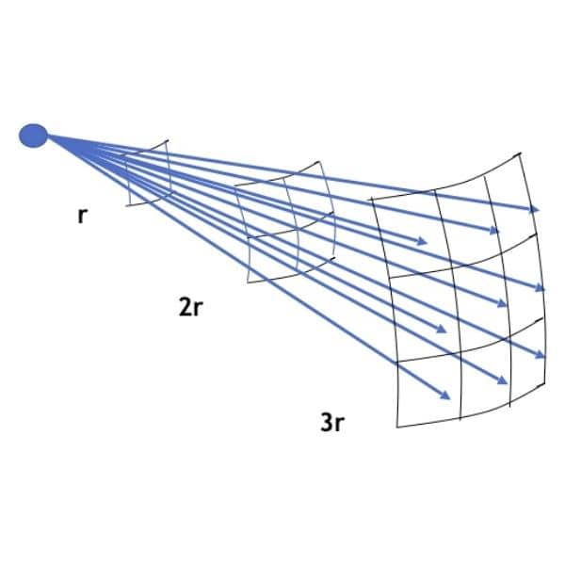
Source to Image Receptor Distance (SID)
SID is the distance from the x-ray tube to the image receptor.
Changing the SID changes the beam intensity at the receptor due to the inverse-square law.
1. Longer SID
Beam intensity at the receptor drops
AEC must increase the exposure time to maintain the same receptor exposure
EI stays the same because AEC compensates
Patient skin dose is lower
2. Shorter SID
Beam intensity at the receptor rises
Less mAs is needed
Exposure time decreases
EI stays the same (AEC compensates)
PT dose slightly higher

Slide 5
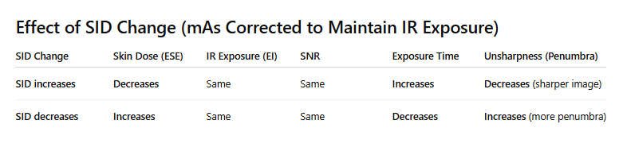

Slide 6
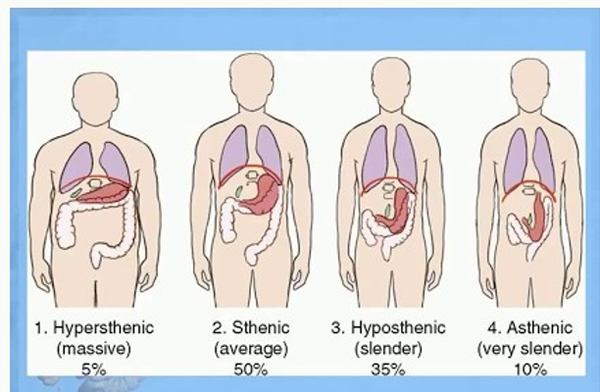
Patient Size and AEC in Radiography
Automatic exposure control adjusts exposure time based on how much the patient attenuates the beam. Larger patients absorb more radiation, so AEC chambers take longer to reach the programmed exposure level. Smaller patients attenuate less, so the AEC terminates the exposure quickly. Although image brightness remains constant, changes in patient size affect exposure time, scatter production, and patient dose.

Slide 7
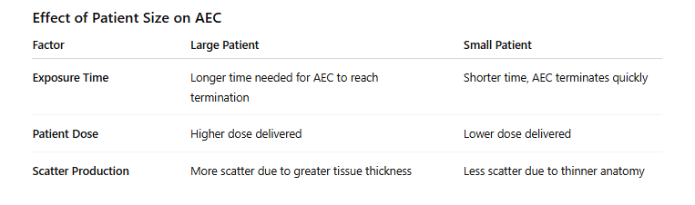

Slide 8
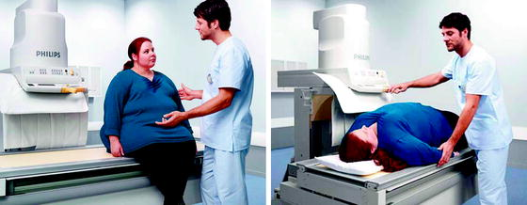
In bariatric patients, use slightly higher kVp with AEC to improve penetration and shorten exposure time, while controlling scatter with tight collimation and a grid.

Slide 9
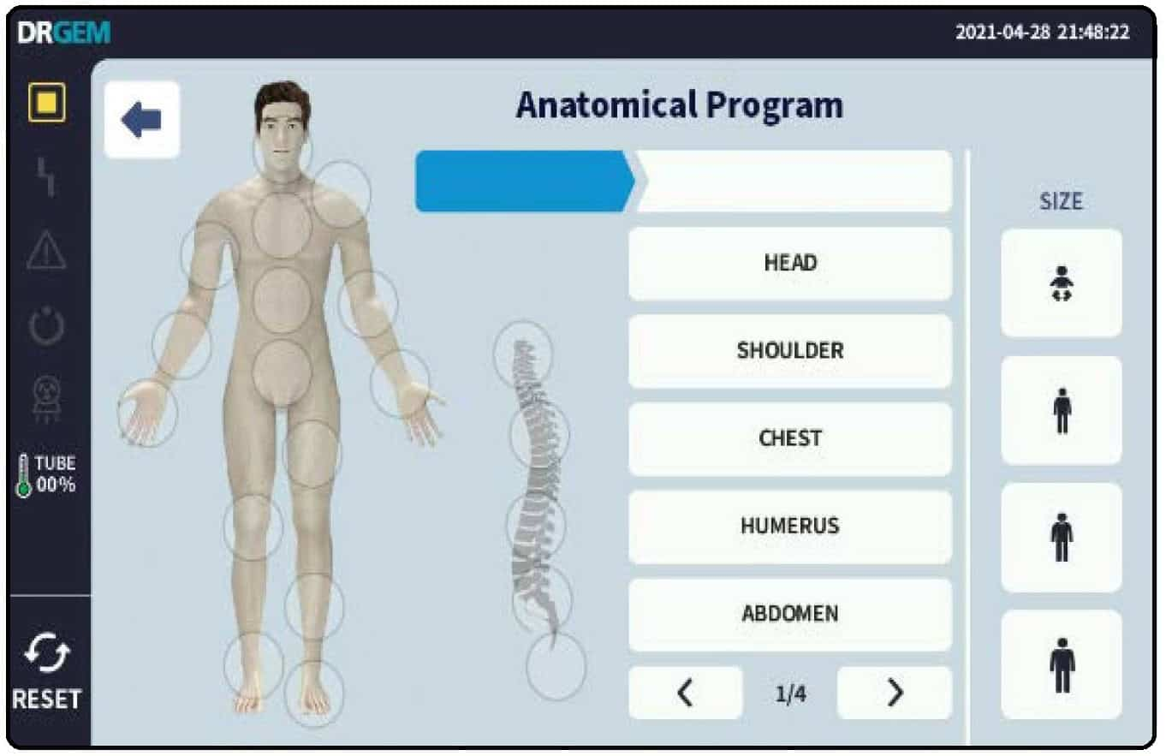
What Is Anatomical Programming?
Anatomical programming (APR) is a built-in feature on the X-ray console that lets you choose the body part you are imaging. Once you select it, the system loads a preset technique for that view. It is meant to make the exam faster and more consistent.

Slide 10
What APR Gives You
When you pick an anatomy button, APR automatically suggests:
kVp
mA
AEC chamber selection
SID recommendations
Table or wall bucky choice

Slide 12
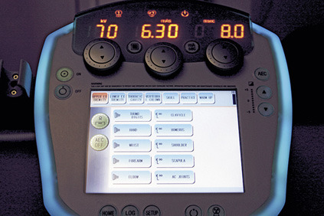
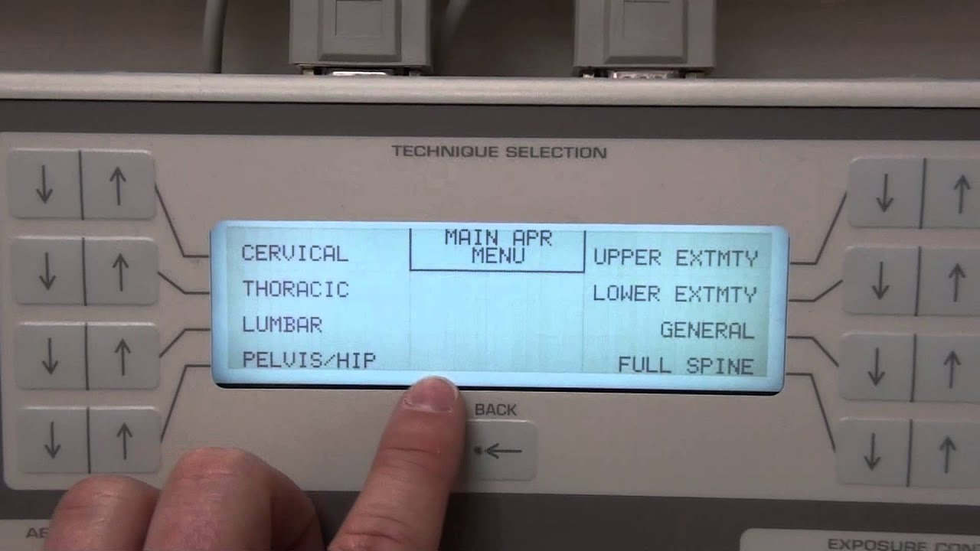
APR saves time, reduces guesswork, and helps keep technique choices consistent between technologists. It is especially useful for routine exams and for newer techs learning how to select techniques.

Slide 13
Your Role as the Technologist
Even with APR, you still decide the final technique.
You must adjust for:
Patient size
Pathology
Motion concerns
Presence of hardware
Pediatric cases
APR gives the baseline. You personalize it.

Slide 14
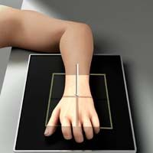
When not to use AEC
Small Body Parts
AEC should not be used when the anatomy is too small to cover the AEC cell fully. Fingers, toes, hands, wrists, ankles, and clavicles allow too much of the primary beam to reach the chamber directly. The cell fills quickly and stops the exposure too soon, producing an underexposed, noisy image. Manual technique is the correct choice.
Hands and Tabletop Work
Hands and similar thin anatomy are always done tabletop without a grid. The AEC chambers are located inside the Bucky, so they are not active during tabletop imaging. Because the anatomy is thin and the AEC is not in the beam path, hands must be manually exposed at all times.

Slide 15
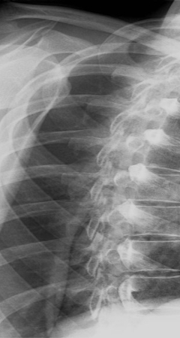
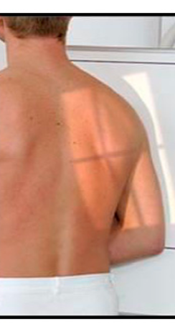
Narrow or Off-Center Anatomy
Some projections, such as the Y-view of the shoulder or a thin clavicle, place only a small amount of tissue over the AEC chamber. Because the cell is not fully covered, it fills too fast and terminates the exposure prematurely. Even perfect positioning may not solve the problem. Manual exposure is preferred.

Slide 16
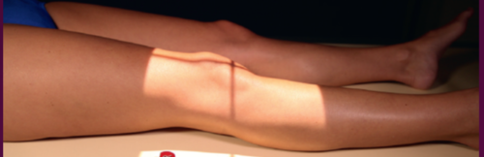
Larger Extremities That Can Use AEC
Some extremities, such as the knee AP or shoulder AP, can safely use AEC if the anatomy completely covers the selected chamber. When the body part is broad, thick, and centered, the AEC receives a stable signal and terminates the exposure correctly.

Slide 17
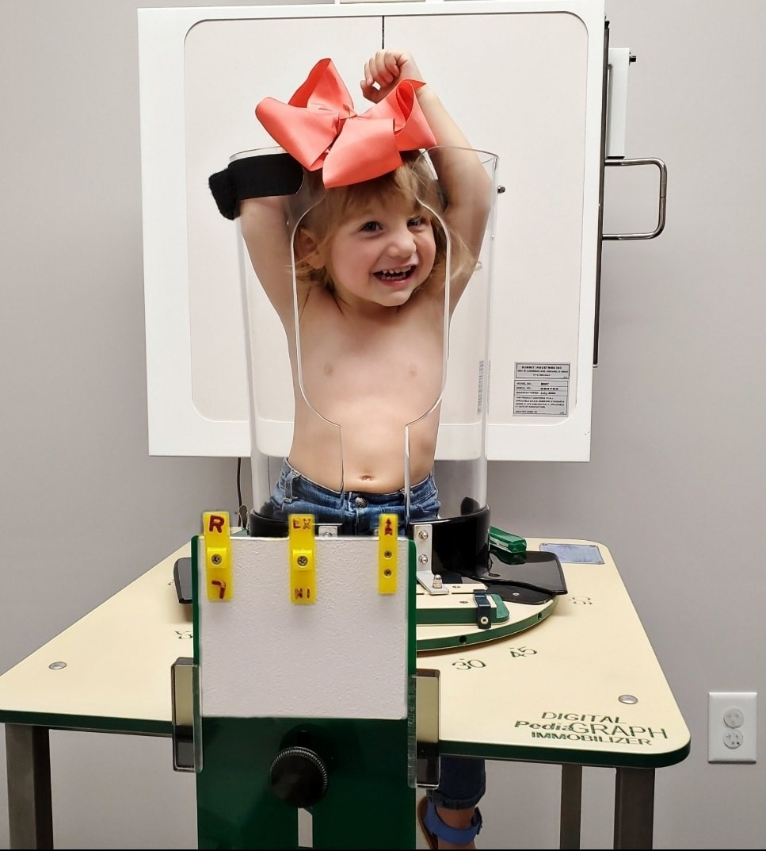

Pediatric Patients
Children often cannot cover the AEC chamber due to their smaller body size. Too little tissue lies over the cell, so radiation reaches it immediately, and the exposure ends too early. This results in a noisy image. Manual technique is safer and more consistent for pediatric imaging.

Slide 18
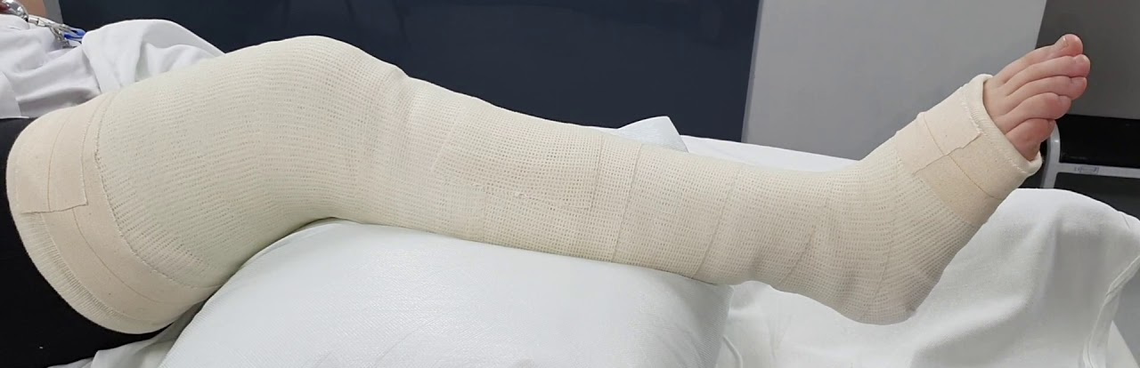
Casts and Splints
Thick fiberglass or plaster casts can make AEC performance unreliable. The extra material may cause the system to extend exposure time, increasing the patient dose. Using manual technique avoids unexpected or excessive exposure times when imaging casted extremities.

Slide 19
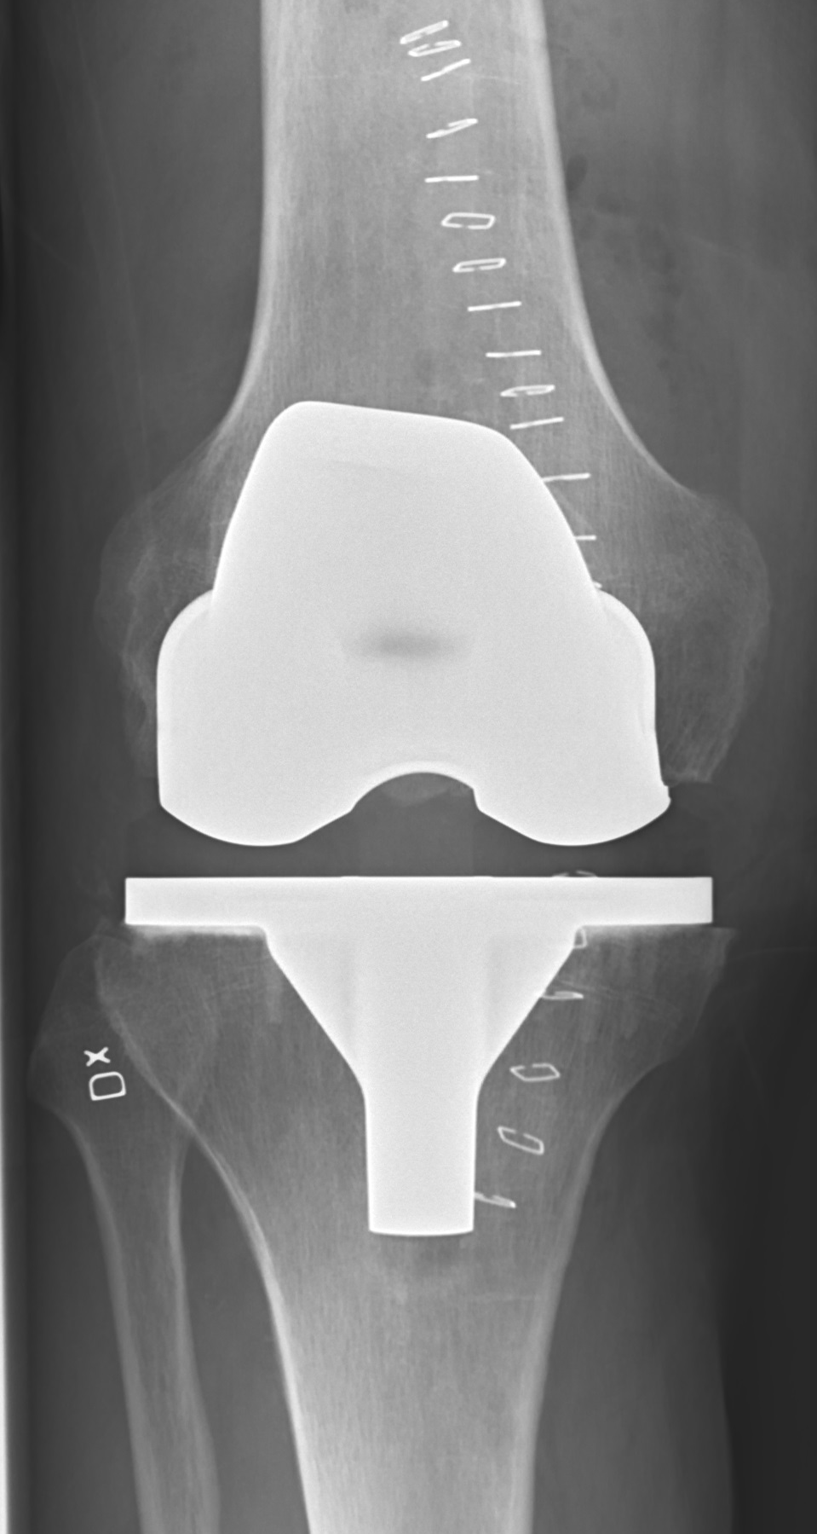
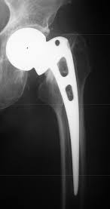
Prosthetic Hardware
Metal hardware changes how the beam reaches the AEC chamber. Sometimes the chamber receives too little radiation because the metal blocks the beam, leading to very long exposure times. Other times the chamber may receive too much due to scatter. Because the response is unpredictable, manual technique gives better control.

Slide 20
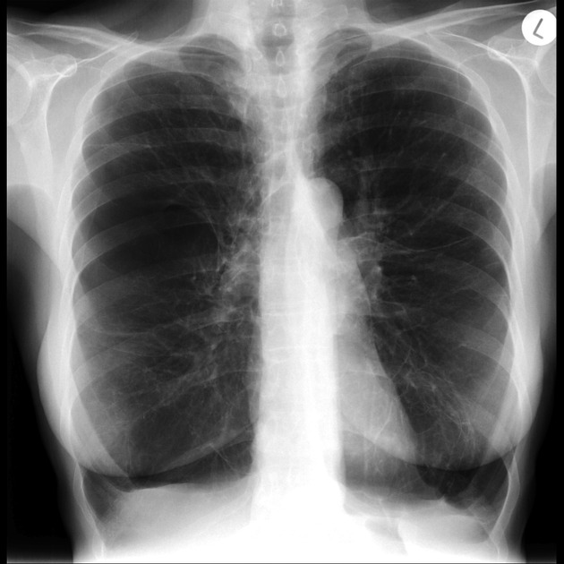
Emphysema
In emphysema, there is increased air and decreased soft tissue. Air attenuates almost nothing, so the AEC chamber receives radiation very quickly. This can cause early termination and produce an underexposed, noisy image.

Slide 21
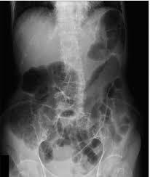
Excess Gas in the Abdomen
An air-filled bowel allows the beam to pass through with minimal attenuation. The AEC chamber fills rapidly, ending the exposure sooner than intended. This leads to an underexposed abdomen with visible noise. Manual technique adjustment is more reliable when there is significant abdominal gas.

Slide 22
AEC works correctly only when the patient fully covers the selected chamber and provides sufficient tissue to attenuate the beam. If the anatomy is too small, too thin, off-center, or contains too much air or metal, the exposure may terminate too early or too late. In those situations, manual technique provides safer and more consistent image quality.

